Slide 1
Architectural Convergence of Big Data and Extreme-Scale Computing: Marriage of Convenience or Conviction
Ron Brightwell, R&D Manager
Scalable System Software Department

Slide 2
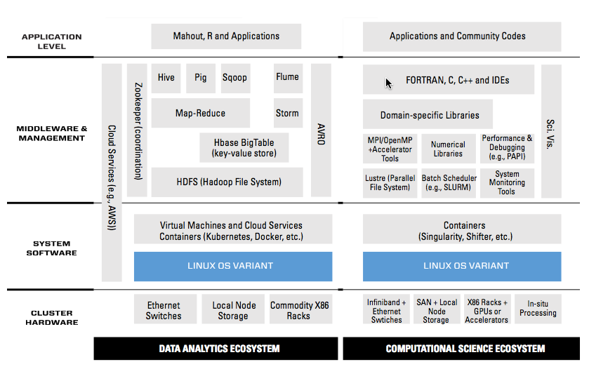

How Do We Bring the Two Worlds of HPC and Big Data Together?

Slide 3
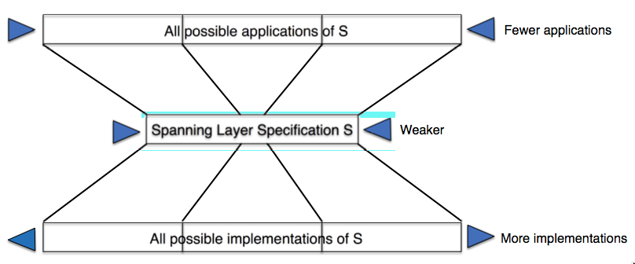
Leverage the Hourglass Model

Slide 4
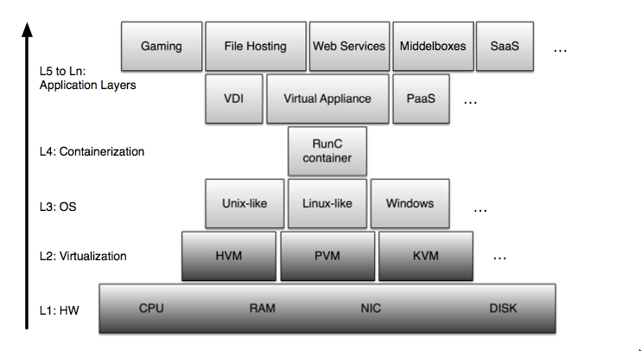
Use Containers

Slide 5
Wait, What Happened?
Added a layer of software
Shifted the Spanning Layer up
Kept all of the original Spanning Layers underneath
  Including the virtualization layer

Slide 6
Motivation for Containers
Linux containers (cgroups)
  Virtualization of the operating system
  Lighter weight approach to hardware virtualization
    Smaller memory footprint
    Allows for deploying more apps per server
  Namespace isolation
  Overcomes lack of application encapsulation in Unix
  Based on FreeBSD Jails and Solaris Zones (circa 2000)
Docker containers
  Application packaging and deployment infrastructure
  Supports application-specific software environment
    User defines software environment, not the system
  Helps overcome lack of a standard Linux environment
  Manages shared library dependency nightmare
  Portability across a variety of platforms
  Solves Cray’s ESM/CCM problem

Slide 7
HPC Systems Are Converging to Reduce Data Movement
External parallel file system is being subsumed
  Near-term capability systems using NVRAM-based burst buffer
  Future extreme-scale systems will continue to exploit persistent memory technologies
In-situ and in-transit approaches for visualization and analysis
  Can’t afford to move data to separate systems for processing
  GPUs and many-core processors are ideal for visualization and some analysis functions
Exascale System
Analytics Cluster
Visualization Cluster
Capacity Cluster
Capability System
Parallel File System
Notes:
An exascale system will likely assume the role that several machines currently play today, mostly due to data movement concerns.
The parallel file system is already being subsumed. There will be an external file system, but it won’t be accessed directly by applications.
In-situ and in-transit analysis and visualization strategies are being pursued to be able to leave simulation data as close as possible to where it is generated.
The line between commodity hardware and specialized HPC hardware is getting more blurry as accelerators, high-speed memory, and network interfaces become integrated.

Slide 8
So, How Do We Bring the Two Worlds Together?

Slide 9
We Don’t

Slide 10
Embrace Divergence
Functional partitioning based on software stack will continue
  Service nodes, I/O nodes, network nodes, compute nodes, etc.
  Nodes are becoming too big to be smallest unit of allocation
Provide infrastructure to manage diverse software stacks
  Node-level partitioning of resources with different stacks
  Support for improved resource isolation
  Mechanisms that provide sharing to reduce data movement
Enable applications and workflows to define their own software environment
Maintain (or eliminate) layers of software

Slide 11
Hobbes Co-Kernel Architecture
Multi-stack architecture tools
  Host boots Linux
  Cores and memory can be taken from
  Linux, forming one or more containers
  Kitten LWK can be launched in each container
  Each Kitten LWK instance operates cooperatively with Linux as a co-kernel
  Each co-kernel can run a different application
    Or guest OS via Palacios VMM
  Containers can be dynamically resized without rebooting
    Number of cores and size of memory can grow and shrink
  Shared memory communication between any OS using XEMEM
Ported to Cray Linux Environment
Multi-enclave launch working on XK7 testbed at Sandia
http://xstack.sandia.gov/hobbes
Notes:
Our current development environment lets you boot linux, hot unplug cores and memore, and then boot Kitten on those freed up resources.
Kitten can then run applications natively or use the Palacios virtual machine to boot whatever software stack is needed.
For a production exascale system, we would boot Kitten natively and then use virtualization to support whatever Linux stack you want.

Slide 12
Convenience or Conviction?
Economics
Hardware
  Component and system vendors are (always) targeting non-HPC markets
  HPC has to (continue to) find overlap with other markets or adapt
Applications and software
  Big Data emphasis on usability and productivity is challenging the HPC environment
  Reducing application development time is a significant cost savings
  Generating data is not the most expensive activity, understanding the data is

Slide 13


Architectural Convergence of Big Data and Extreme-Scale Computing:
Marriage of Convenience or Conviction?
Laxmikant (Sanjay) Kale
http://charm.cs.illinois.edu
Parallel Programming Laboratory
Department of Computer Science
University of Illinois at Urbana Champaign

Slide 14
Disclaimers
If you are going to show any quotes from my talk, you have to show the entire talk
I am trying to make the panel interesting and colorful by arguing one side

Slide 15
What is ”marriage of convenience” here?
Data Analytics, Big Data, Machine learning is very fashionable
We, the poor HPC people interested in CSE applications, are conditioned to ride commodity architectures
  And beg the communities that have volume to add features and carry us along
We have to liberate the HPC/CSE community from this servile mentality!
Revolution!!!
Notes:
Where is convergence? It’s a marriage of convenience

Slide 16
Do we want convergence within HPC/CSE?
I have often argued the following:
Applications fall into categories based on:
  Memory capacity per FLOP
    NAMD runs a large number of time-steps on a relatively small set of atoms
    CFD is opposite
  Injection Bandwidth per FLOP
    So: fat nodes or not-so-fat nodes (thin is out of question these days)
  Bisection Bandwidth need (i.e. near neighbor vs all-to-all communication)
  I/O
I think we need multiple classes of machines even within HPC
So, does architectural convergence with BigData look like a marriage of conviction?

Slide 17
Post-Moore’s-Law landscape
Once we reach 5 nm (or whatever we limit we stop at)
Innovation will shift to FPGAs, specialized ASICs
  Especially if the number of application classes reduce to only a handful at extreme scale
  Already.. Tensor core
In this era of hyper-specialization, do we want to push convergence?

Slide 18
Well.. To balance it
There is actually a case for convergence
Which is based on cost, for a limited time
  Maybe for the next 5 years
Also, as data analytics starts broadening into more complex computations
  Beyond the patterns of simple map-reduce
  Maybe one of the categories of HPC machines can be useful for data analytics

