Slide 1




OpenAtom:
First Principles GW method for electronic excitation
Minjung Kim, Subhasish Mandal, and Sohrab Ismail-Beigi
Yale University
Eric Mikida, Kavitha Chandrasekar, Eric Bohm, Nikhil Jain, and Laxmikant Kale
University of Illinois at Urbana-Champaign
Qi Li and Glenn Martyna
IBM T.J. Watson Research Center

Slide 2


Density Functional Theory (DFT)
Energy functional E[n] of electron density n(r)
Minimizing over n(r) gives exact
Ground-state energy E₀
Ground-state density n(r)
Minimum condition
equivalent to Kohn-Sham equations
LDA/GGA for E_{xc} : good geometries and total energies
Bad band gaps and excitations
Hohenberg & Kohn, Phys. Rev. (1964); Kohn and Sham, Phys. Rev. (1965).

Slide 3
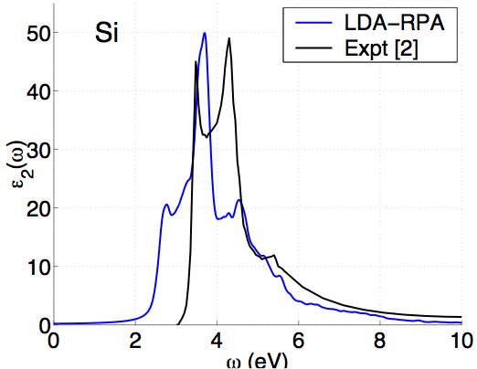
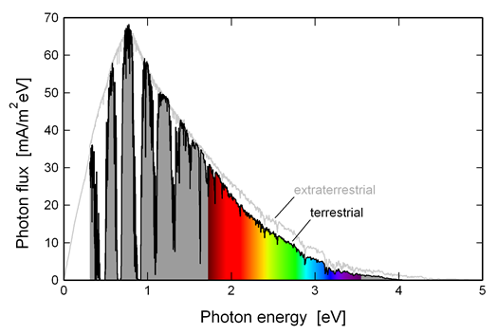
DFT: problems with excitations
Energy gaps (eV)
Material | LDA | Expt. [1]
Diamond | 3.9 | 5.48
Si | 0.5 | 1.17
LiCl | 6.0 | 9.4
SrTiO₃ | 2.0 | 3.25
[1] Landolt-Bornstien, vol. III; Baldini & Bosacchi, Phys. Stat. Solidi (1970).
Solar spectrum

Slide 4
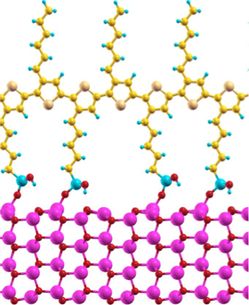
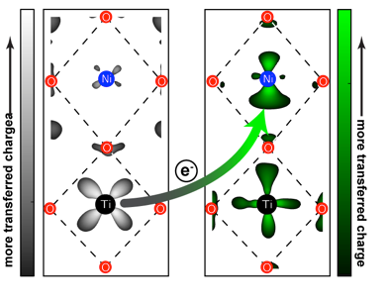
DFT: problems with energy alignment
Interfacial systems:
Electrons can transfer across
Depends on energy level alignment across interface
DFT has errors in band energies
Is any of it real?
e⁻

Slide 5
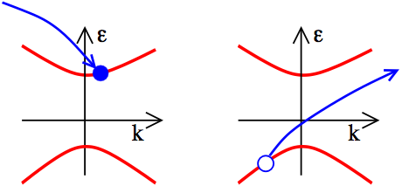
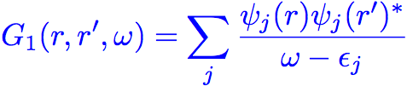

One particle Green’s function
(r’,0)
(r,t)
Dyson Equation:
DFT:

Slide 6
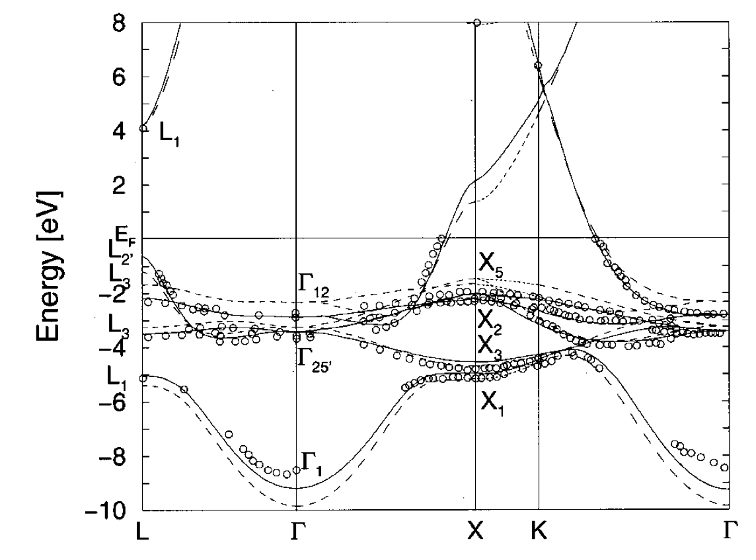
Green’s function successes
Quasiparticle gaps (eV)
Material | LDA | GW | Expt.
Diamond | 3.9 | 5.6* | 5.48
Si | 0.5 | 1.3* | 1.17
LiCl | 6.0 | 9.1* | 9.4
SrTiO₃ | 2.0 | 3.4-3.8 | 3.25
* Hybertsen & Louie, Phys. Rev. B (1986)
Band structure of Cu
Strokov et al., PRL/PRB (1998/2001)

Slide 7
What is a big system for GW?
P3HT polymer
Band alignment for this potential
photovoltaic system?
100s of atoms/unit cell
Not possible routinely (with current software)
Zinc oxide nanowire

Slide 8
GW is expensive
Scaling with number of atoms N
DFT: | N³
GW: | N⁴ | (gives better bands)
BSE: | N⁶ | (gives optical excitations)
But in practice the GW is the killer
a nanoscale system with 50-75 atoms (GaN)
DFT: | 1 | cpu x hours
GW: | 91 | cpu x hours
BSE: | 2 | cpu x hours
∴ Focus on GW

Slide 9
Steps for typical G₀W₀ calculation
Stage 1 : Run DFT calc. on structure → output : ε_{i} and 𝜓_{i}(r)
Stage 2.1 : compute Polarizability matrix
Stage 2.2 : double FFT rows and columns → P(G,G’)
Stage 3 : compute and invert dielectric screening function
Stage 4 : “plasmon-pole” method → dynamic screening
Stage 5 : put together ε_{i} , 𝜓_{i}(r) and → self-energy 𝛴(𝜔)

Slide 10
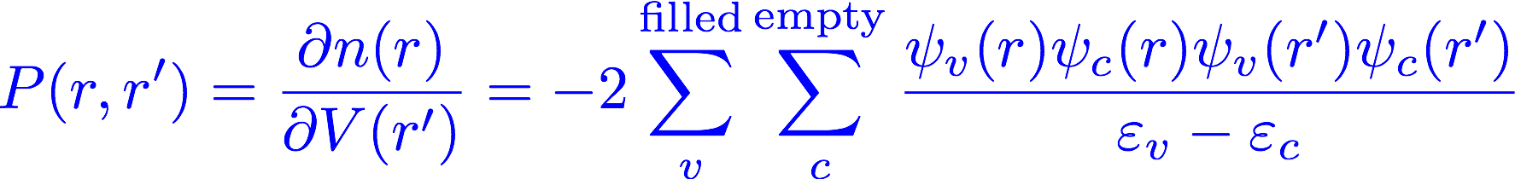
What is so expensive in GW?
One key element : response of electrons to perturbation
P(r,r’) = Response of electron density n(r) at position r
to change of potential V(r’) at position r’

Slide 11
What is so expensive in GW?
One key element : response of electrons to perturbation
Standard perturbation theory expression
Problems:
Must generate “all” empty states (sum over c )
Lots of FFTs to get 𝜓_{i}(r) functions
Enormous outer produce to form P
Dense r grid : P huge in memory

Slide 12
Computing P in Charm++
f_{lm} = ψ_{l} × ψ_{m}* for all l, m
P += f_{lm} f_{lm}† for all f
Basic Computation:
Memory is a primary constraint
Formation of P is the most costly step
Memory:
1MB per state
10,000 total states
100GB to store all state
1TB to store P
90,000,000 f vectors (90TB total)

Slide 13
Computing P in Charm++
f_{lm} = ψ_{l} × ψ_{m}* for all l, m
P += f_{lm} f_{lm}† for all f
Basic Computation:
Parallel decomposition:
Ψ Vectors
1D Chare Array
L occupied
…
M unoccupied
R
P Matrix
2D Tiles
2D Chare Array
R
R

Slide 14
Computing P in Charm++
Duplicate occupied states on each node
ψ
ψ
ψ
Psi Cache
Psi Cache

Slide 15
Computing P in Charm++
Duplicate occupied states on each node
Broadcast an unoccupied state to compute f vectors
ψ
ψ
ψ
ψ
F Cache
F Cache
Psi Cache
Psi Cache

Slide 16
Computing P in Charm++
Duplicate occupied states on each node
Broadcast an unoccupied state to compute f vectors
Locally update each matrix tile
P
P
P
P
P
P
P
P
P
F Cache
F Cache
Psi Cache
Psi Cache

Slide 17
Computing P in Charm++
Duplicate occupied states on each node
Broadcast an unoccupied state to compute f vectors
Locally update each matrix tile
Repeat step 2 for next unoccupied state
F Cache
F Cache
Psi Cache
Psi Cache

Slide 18
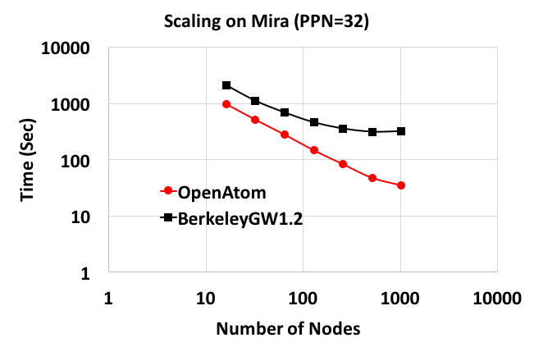
Parallel performance: P calculation
108 atom bulk Si
216 occupied
1832 unoccupied
1 k point
32 processors per node
FFT grids: same accuracy
OA 42x42x22
BGW 111x55x55
Supercomputer : Mira (ANL) : BQ BlueGene/Q

Slide 19
Parallel performance: P calculation
108 atom bulk Si
216 occupied
1832 unoccupied
1 k point
32 processors per node
FFT grids: same accuracy
OA 42x42x22
BGW 111x55x55
Supercomputer : Blue Waters (NCSA) : Cray XE6

Slide 20
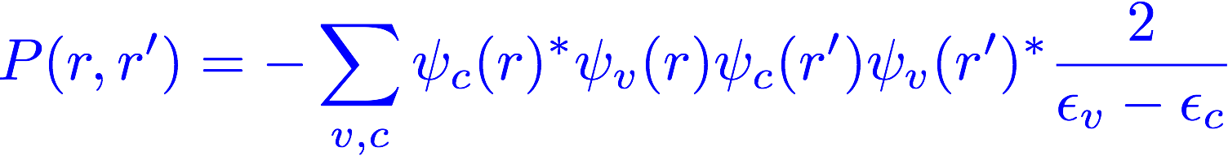
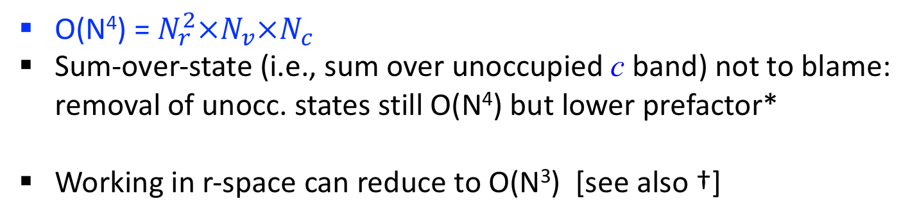
Reducing the scaling: quartic to cubic
O(N⁴) = $N_{r}^{2}×N_{v}×N_{c}$
Sum-over-state (i.e., sum over unoccupied c band) not to blame:
removal of unocc. states still O(N⁴) but lower prefactor*
Working in r-space can reduce to O(N³) [see also †]
* Bruneval and Gonze, PRB 78 (2008); Berger, Reining, Sottile, PRB 82 (2010)
* Umari, Stenuit, Baroni, PRB 81, (2010)
* Giustino, Cohen, Louie, PRB 81, (2010)
* Wilson, Gygi, Galli, PRB 78, (2008); Govoni, Galli, J. Chem. Th. Comp., 11 (2015)
* Gao, Xia, Gao, Zhang, Sci. Rep. 6 (2016)
† Foerster, Koval, Sanchez-Portal, JCP 135 (2011)
† Liu, Kaltak, Klimes and Kresse, PRB 94, (2016)

Slide 21

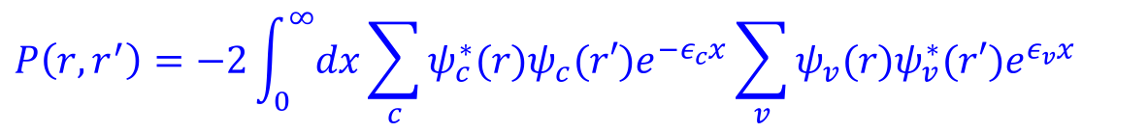
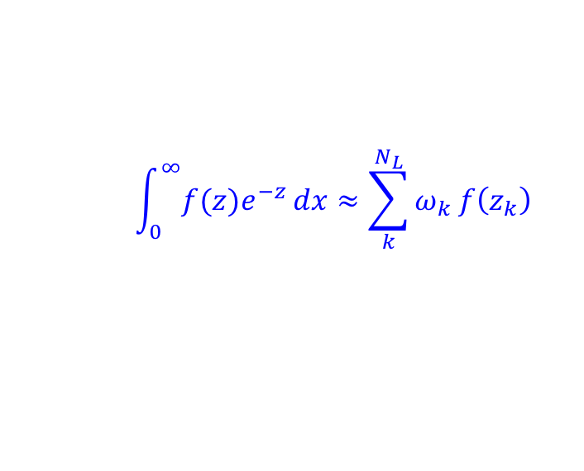
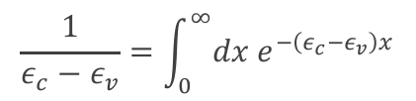
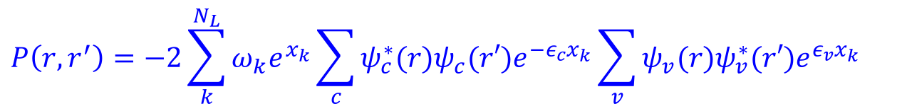
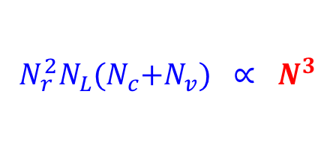
What’s special about r-space?
P is separable in r-space
$$\frac{1}{ε_{c}−ε_{v}}=\int_{0}^{∞}{{dx e}^{−\left(ε_{c}−ε_{v}\right)x}}$$
$$P\left(r,r^{′}\right)=−2\int_{0}^{∞}{dx}\sum_{c}{ψ_{c}^{∗}(r)ψ_{c}(r′)e^{−ε_{c}x}\sum_{v}{ψ_{v}(r)ψ_{v}^{∗}(r′)e^{ε_{v}x}}}$$
separable
$$\int_{0}^{∞}{{f(z)e}^{−z}}dx≈\sum_{k}^{N_{L}}{ω_{k}}f\left(z_{k}\right)$$
Gauss-Laguerre quadrature:
$$P\left(r,r^{′}\right)=−2\sum_{k}^{N_{L}}{ω_{k}e^{x_{k}}}\sum_{c}{ψ_{c}^{∗}(r)ψ_{c}(r′)e^{−ε_{c}x_{k}}\sum_{v}{ψ_{v}(r)ψ_{v}^{∗}(r′)e^{ε_{v}x_{k}}}}$$
$$N_{r}^{2}N_{L}{(N}_{c}+N_{v}) ∝ N^{3}$$
Notes:
Add description what Nz and Nint are

Slide 22
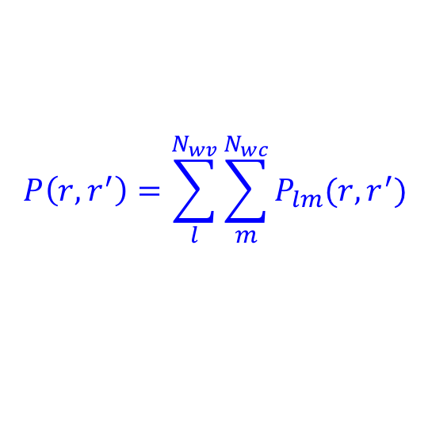

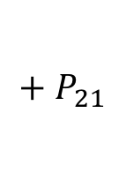
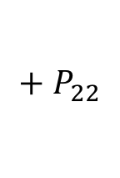
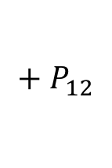


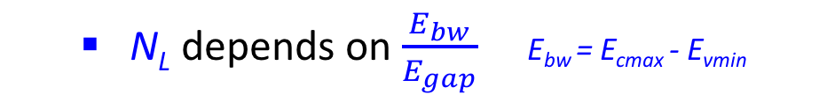
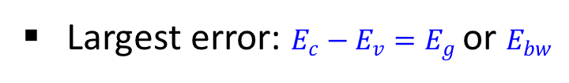
Windowed cubic Laplace method
  N_{L} depends on $\frac{E_{bw}}{E_{gap}}$ E_{bw} = E_{cmax} - E_{vmin}
Largest error: $E_{c}−E_{v}=E_{g}$ or $E_{bw}$
  Example: 2 by 2 windows
$$P=$$
$$P_{11}$$
$$+ P_{21}$$
$$+ P_{12}$$
$$+ P_{22}$$
$$P_{21}$$
{E_{v}}₁
{E_{v}}₂
{E_{c}}₁
{E_{c}}₂
E
E_{v,min}
E_{v,max}
E_{c,min}
E_{c,max}
$$P\left(r,r^{′}\right)=\sum_{l}^{N_{wv}}{\sum_{m}^{N_{wc}}{P_{lm}(r,r^{′})}}$$
N_{wv} : # windows for E_{v}
N_{wc} : # of windows for E_{c}
Save computation: small N_{L} for each window pair
Especially for materials with small band gaps

Slide 23


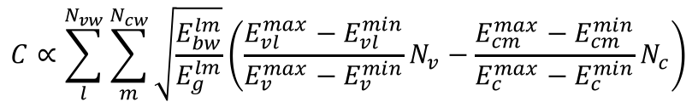
Estimate the computational costs
Computation cost can be estimated with E_{bw} and E_{g}:
$$C∝\sum_{l}^{N_{vw}}{\sum_{m}^{N_{cw}}{\sqrt{\frac{E_{bw}^{lm}}{E_{g}^{lm}}}\left(\frac{E_{vl}^{max}−E_{vl}^{min}}{E_{v}^{max}−E_{v}^{min}}N_{v}−\frac{E_{cm}^{max}−E_{cm}^{min}}{E_{c}^{max}−E_{c}^{min}}N_{c}\right)}}$$
Example: 2x2 window
Real computational costs
Estimated computational costs
$$E_{v,ratio}=\frac{E_{v}^{∗}−E_{v,min}}{E_{v,max}−E_{v}^{∗}}$$
$$E_{c,ratio}=\frac{E_{c}^{∗}−E_{c,min}}{E_{c,max}−E_{c}^{∗}}$$

Slide 24
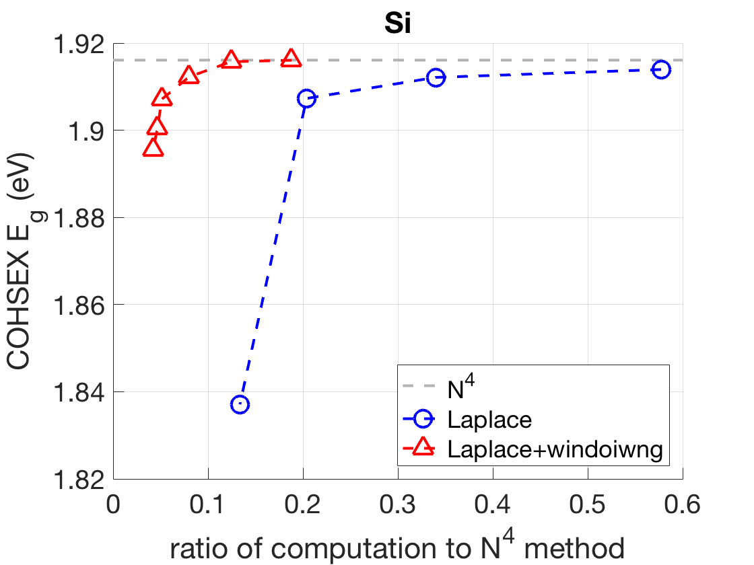
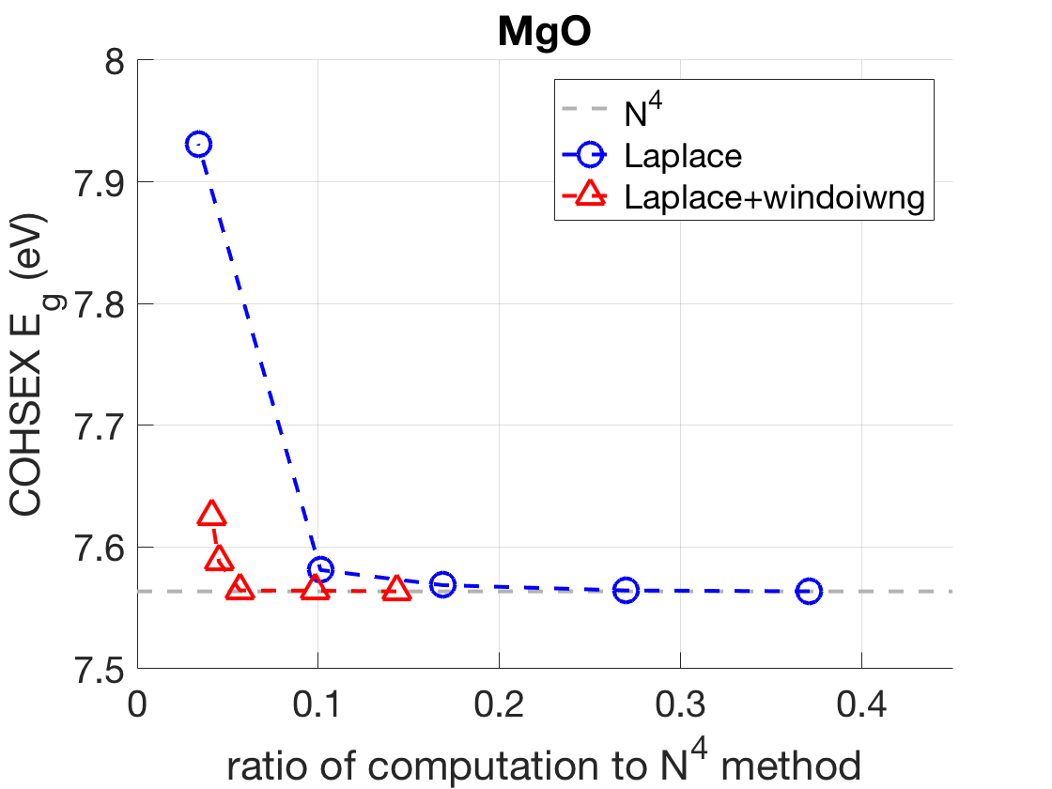
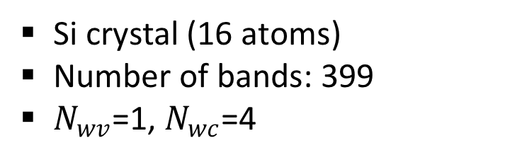
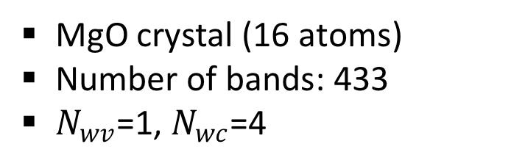
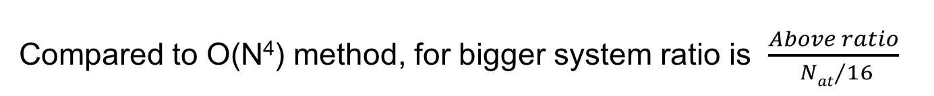
Windowed Laplace: example
Si crystal (16 atoms)
Number of bands: 399
$N_{wv}$=1, $N_{wc}$=4
MgO crystal (16 atoms)
Number of bands: 433
$N_{wv}$=1, $N_{wc}$=4
Compared to O(N⁴) method, for bigger system ratio is $\frac{Above ratio}{ {Nat}/{16}}$

Slide 25
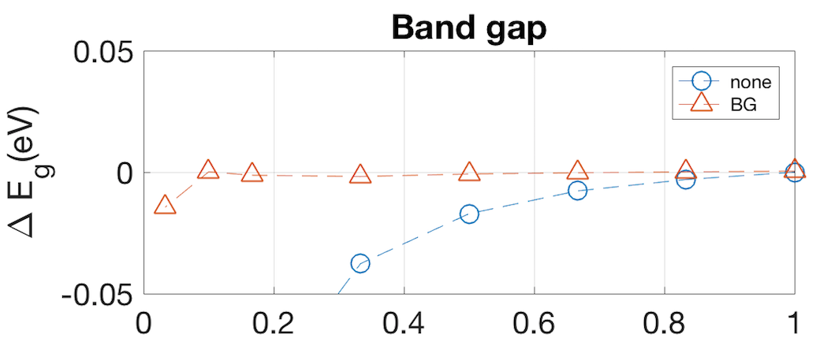
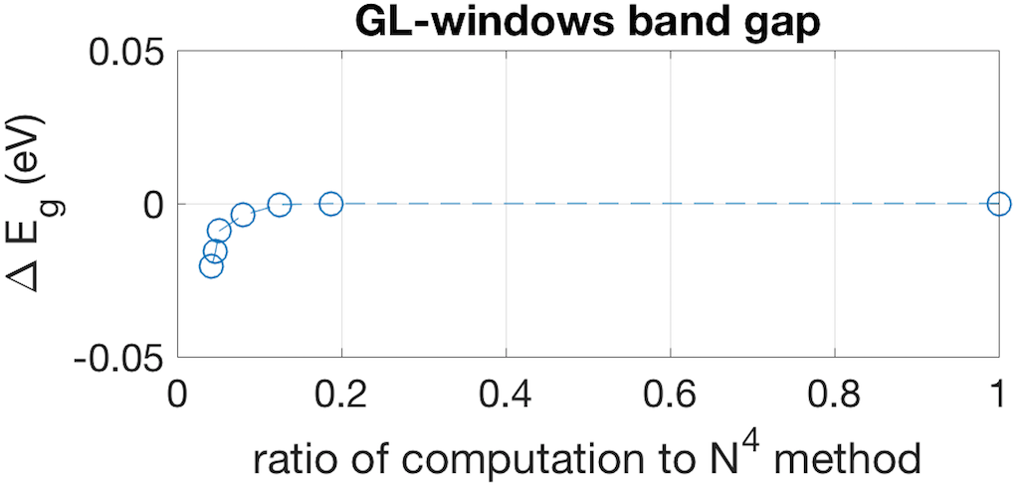
Do I care in practice?
Correct practical comparison:
Our N³ method vs. available N⁴ method with acceleration
Crossover is at very few atoms: N³ method already competitive for small systems
2 atoms Si , 8 k-points
Yambo N⁴ GW software
BG* acceleration
* Bruneval & Gonze, PRB 78 (2008)

Slide 26
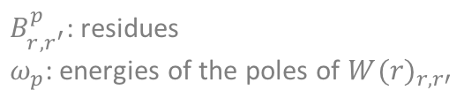
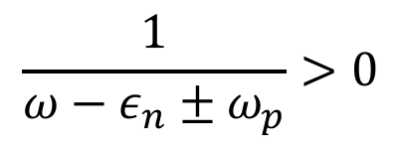
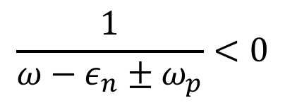
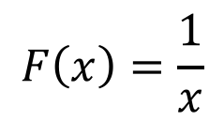
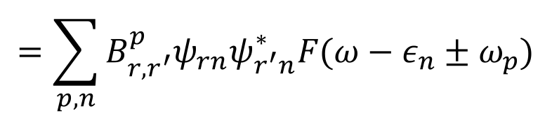

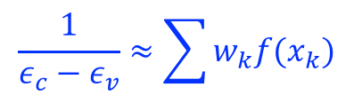
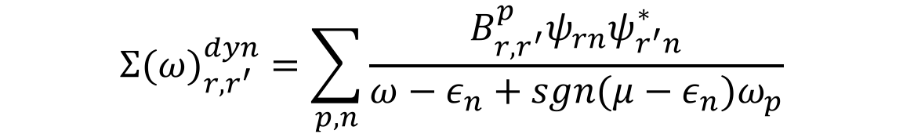
Windowed Laplace method for self-energy
Dynamic GW self-energy:
$${Σ(ω)}_{r,r^{′}}^{dyn}=\sum_{p,n}{\frac{B_{r,r^{′}}^{p}ψ_{rn}ψ_{r^{′}n}^{∗}}{ω−ε_{n}+sgn(μ−ε_{n})ω_{p}}}$$
$B_{r,r^{′}}^{p}$: residues
$ω_{p}$: energies of the poles of ${W(r)}_{r,r′}$
$$=\sum_{p,n}{B_{r,r^{′}}^{p}ψ_{rn}ψ_{r^{′}n}^{∗}F(ω−ε_{n}±ω_{p})}$$
$$F\left(x\right)=\frac{1}{x}$$
$$\frac{1}{ε_{c}−ε_{v}}≈\sum{w_{k}f(x_{k})}$$
Gauss-Laguerre quadrature not appropriate
$$\frac{1}{ω−ε_{n}±ω_{p}}>0$$
$$\frac{1}{ω−ε_{n}±ω_{p}}<0$$
OR
For small $ω−ε_{n}±ω_{p}$: little contribution

Slide 27
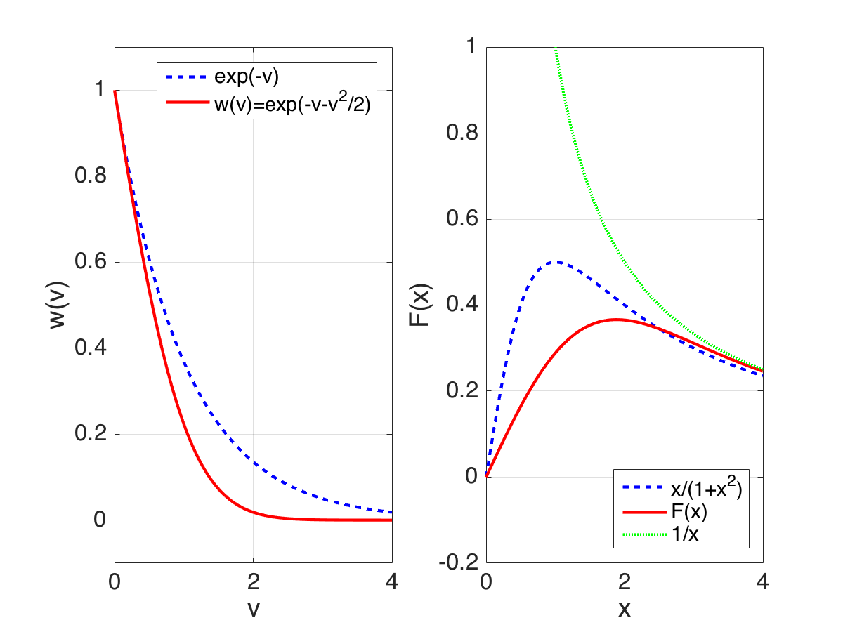
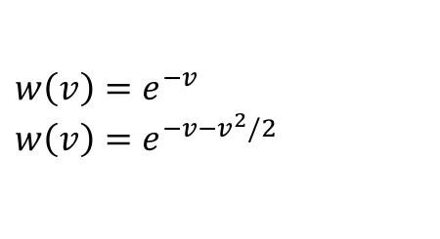

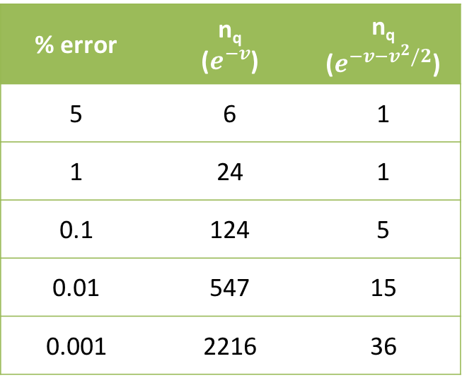
New quadrature for overlapping windows
New quadrature
Size of quadrature grid
% error | n_{q} ($e^{−v}$) | n_{q} ($e^{−v−v^{2}/2}$)
5 | 6 | 1
1 | 24 | 1
0.1 | 124 | 5
0.01 | 547 | 15
0.001 | 2216 | 36
$$F\left(x\right)=Im\int_{0}^{∞}{w\left(v\right)e^{ivx}dv}$$
$$w\left(v\right)=e^{−v}$$
$$w\left(v\right)=e^{−v−v^{2}/2}$$

Slide 28
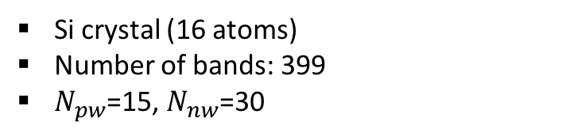
Results - G₀W₀ gap
Si crystal (16 atoms)
Number of bands: 399
$N_{pw}$=15, $N_{nw}$=30

Slide 29
Where we are with OpenAtom GW
Phase |  | Serial | Parallel
1 | Compute P in RSpace | Complete | Complete
2 | FFT P to GSpace | Complete | Complete
3 | Invert epsilon | Complete | Complete
4 | Plasmon pole | Complete | In Progress
5 | COHSEX self-energy | Complete | Complete
6 | Dynamic self-energy | Complete | In Progress
7 | Coulomb Truncation | Future | Future
Aim to release parallel COHSEX version late spring 2018

Slide 30
Summary
OpenAtom framework
r-space has many advantages for GW
Charm++ run time library
  Reduces parallelization/porting/refactoring headaches
  Good performance, very good scaling
r-space separability leads to N³ scaling GW
  Straightforward change to sum-over-states methods
  Crossover with N⁴ for N_{atoms}~ 5-10

Slide 31
Back up slides

Slide 32
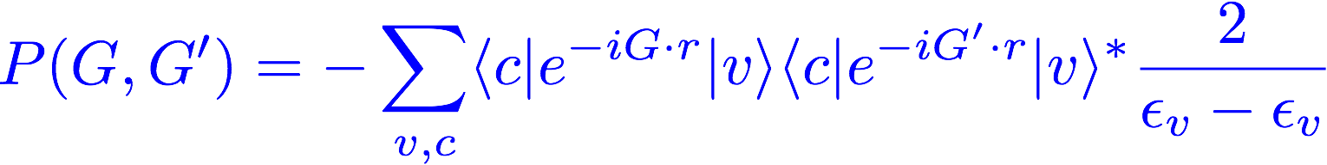




G vs. R space P calculation
G-space:
R-space:
Big multiply: N_{v} N_{c} N_{r}² = O(N⁴)
Directly compute P in G space
Many FFTs : N_{v} N_{c}
Big multiply: N_{v} N_{c} N_{G}² = O(N⁴)
FFT N_{r} rows
FFT N_{r} columns
N_{v} : # occupied states
N_{c} : # unoccupied states
N_{G} : # of G vectors
N_{r}: # r grid
N_{r} ≈ 4N_{c}
N_{v}N_{c} FFTs needed
Big O(N⁴) matrix multiply
N_{v}+N_{c} + 8N_{c} FFTs needed
Big O(N⁴) matrix multiply

Slide 33
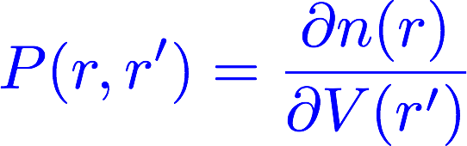
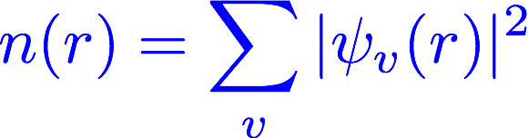
Quasi-philosophical: all basis good in quantum mechanics, why is r-space special?
Observable is diagonal in the best basis

Slide 34
“Physicist” programming
Consider two key steps
Many FFTs → 𝜓_{i}(r)
Outer product → P
Typical MPI / OpenMP: working explicitly with # of processors
Divide 𝜓_{i}(r) among procs
Do pile of FFTs on each proc
Divide (r,r’ ) among procs (e.g. ScaLAPACK)
Do outer product
Problems
N_{i} > N_{proc} and N_{i} < N_{proc} need different parallelizations:
explicitly different coding
Typical programmer does 1. & 2. then 3. & 4. ; hard to interleave
Machines/fashion change: need to recode parallelization…
(GPUs, SMPs, few cores, multicores, etc.)

Slide 35

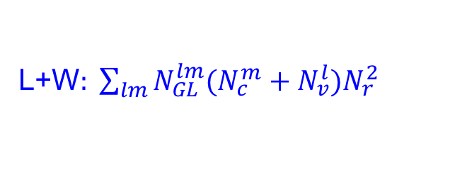
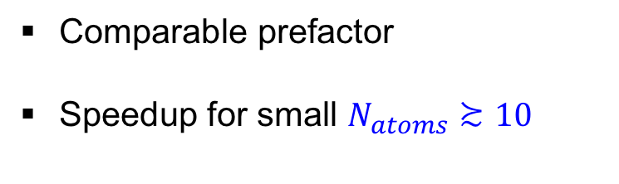
Where is crossover in scaling?
Si 16 atom calculation
Number of computations
$$N^{4}: N_{v}N_{c}N_{r}^{2}$$
L+W$: \sum_{lm}{N_{GL}^{lm}(N_{c}^{m}+N_{v}^{l})N_{r}^{2}}$
Comparable prefactor
Speedup for small $N_{atoms}≿10$

