Slide 1
DARMA
Janine C. Bennett, Jonathan Lifflander, David S. Hollman, Jeremiah Wilke, Hemanth Kolla, Aram Markosyan, Nicole Slattengren, Robert L. Clay (PM)
Charm++ Workshop 2017
April 17th, 2017
Unclassified SAND2017-1430 C

Slide 2
What is DARMA?
DARMA is a C++ abstraction layer for asynchronous many-task (AMT) runtimes.
It provides a set of abstractions to facilitate the expression of tasking that map to a variety of underlying AMT runtime system technologies.
Sandia’s ATDM program is using DARMA to inform its technical roadmap for next generation codes.

Slide 3
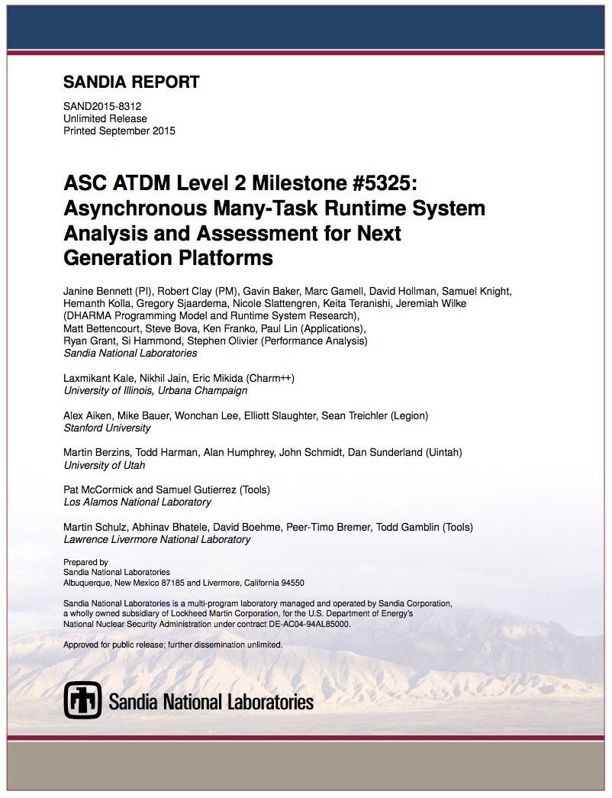
2015 study to assess leading AMT runtimes led to DARMA
Aim: inform Sandia’s technical roadmap for next generation codes
Broad survey of many AMT runtime systems
Deep dive on Charm++, Legion, Uintah
Programmability: Does this runtime enable efficient expression of ATDM workloads?
Performance: How performant is this runtime for our workloads on current platforms and how well suited is this runtime to address future architecture challenges?
Mutability: What is the ease of adopting this runtime and modifying it to suit our code needs?

Slide 4
2015 study to assess leading AMT runtimes led to DARMA
Aim: inform Sandia’s technical roadmap for next generation codes
Conclusions
  AMT systems show great promise
  Gaps in requirements for Sandia applications
  No common user-level APIs
  Need for best practices and standards
Survey recommendations led to DARMA
  C++ abstraction layer for AMT runtimes
  Requirements driven by Sandia ATDM applications
  A single user-level API
  Support multiple AMT runtimes to begin identification of best practices

Slide 5
Sandia ATDM applications drive requirements and developers play active role in informing front end API
Application feature requests
  Sequential semantics
  MPI interoperability
  Node-level performance portability layer interoperability (Kokkos)
  Collectives
  Runtime-enabled load-balancing schemes
Abstractions that facilitate the expression of tasking

Slide 6
Mapping to a variety of AMT runtime system technologies

Slide 7
DARMA provides a unified API to application developers for expressing tasks
Mapping to a variety of AMT runtime system technologies

Slide 8
Application code is translated into a series of backend API calls to an AMT runtime
Mapping to a variety of AMT runtime system technologies

Slide 9
Application code is translated into a series of backend API calls to an AMT runtime
Mapping to a variety of AMT runtime system technologies

Slide 10
Considerations when developing a backend API that maps to a variety of runtimes
AMT runtimes often operate with a directed acyclic graph (DAG)
  Captures relationships between application data and inter-dependent tasks
Mapping to a variety of AMT runtime system technologies

Slide 11
Considerations when developing a backend API that maps to a variety of runtimes
AMT runtimes often operate with a directed acyclic graph (DAG)
  Captures relationships between application data and inter-dependent tasks
DAGs can be annotated to capture additional information
  Tasks’ read/write usage of data
  Task needs a subset of data
Mapping to a variety of AMT runtime system technologies

Slide 12
Considerations when developing a backend API that maps to a variety of runtimes
AMT runtimes often operate with a directed acyclic graph (DAG)
  Captures relationships between application data and inter-dependent tasks
DAGs can be annotated to capture additional information
  Tasks’ read/write usage of data
  Task needs a subset of data
Additional information enables runtime to reason more completely about
  When and where to execute a task
  Whether to load balance
Existing runtimes leverage DAGs with varying degrees of annotation
Mapping to a variety of AMT runtime system technologies

Slide 13
DARMA captures data-task dependency information and the runtime builds and executes the DAG
Mapping to a variety of AMT runtime system technologies

Slide 14
Abstractions that facilitate the expression of tasking

Slide 15
DARMA front end abstractions for data and tasks are co-designed with Sandia ATDM application scientists
Abstractions that facilitate the expression of tasking

Slide 16
DARMA Data Model
  How are data collections/data structures described?
  Asynchronous smart pointers wrap application data
    Encapsulate data effect information used to build and annotate the DAG
      Permissions information (type of access, Read, Modify, Reduce, etc.)
    Enable extraction of parallelism in a data-race-free manner
  How are data partitioning and distribution expressed?
  There is an explicit, hierarchical, logical decomposition of data
    AccessHandle<T>
      Does not span multiple memory spaces
      Must be serialized to be transferred between memory spaces
    AccessHandleCollection<T, R>
      Expresses a collection of data
      Can be mapped across memory spaces in a scalable manner
  Distribution of data is up to individual backend runtime
Abstractions that facilitate the expression of tasking

Slide 17
DARMA Control Model
  How is parallelism achieved?
  create_work
    A task that doesn’t span multiple execution spaces
    Sequential semantics: the order and manner (e.g., read, write) in which data (AccessHandle) is used determines what tasks may be run in parallel
  create_concurrent_work
    Scalable abstraction to launch across distributed systems
    A collection of tasks that make simultaneous forward progress
    Sequential semantics supported across different task collections based on order and manner of AccessHandleCollection usage
  How is synchronization expressed?
  DARMA does not provide explicit temporal synchronization abstractions
  DARMA does provide data coordination abstractions
    Sequential semantic coordination between participants in a task collection
    Asynchronous collectives between participants in a task collection
Abstractions that facilitate the expression of tasking

Slide 18
Using DARMA to inform Sandia’s technical roadmap

Slide 19
Currently there are three backends in various stages of development
Using DARMA to inform Sandia’s ATDM technical roadmap

Slide 20
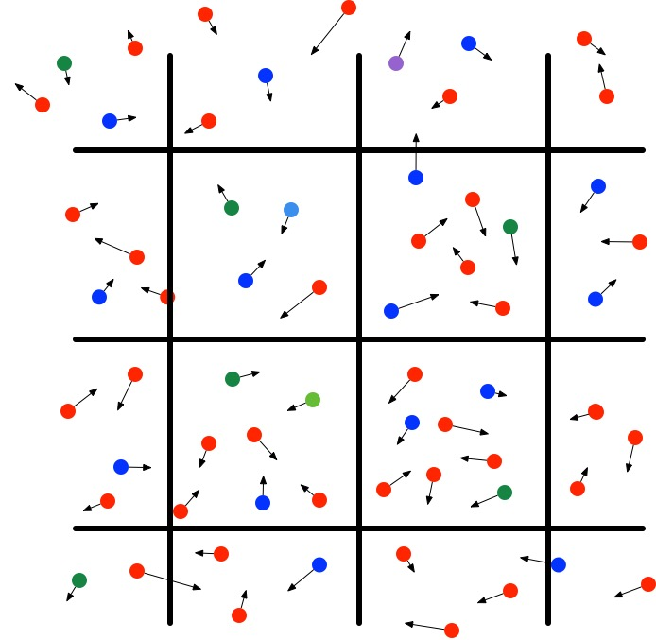
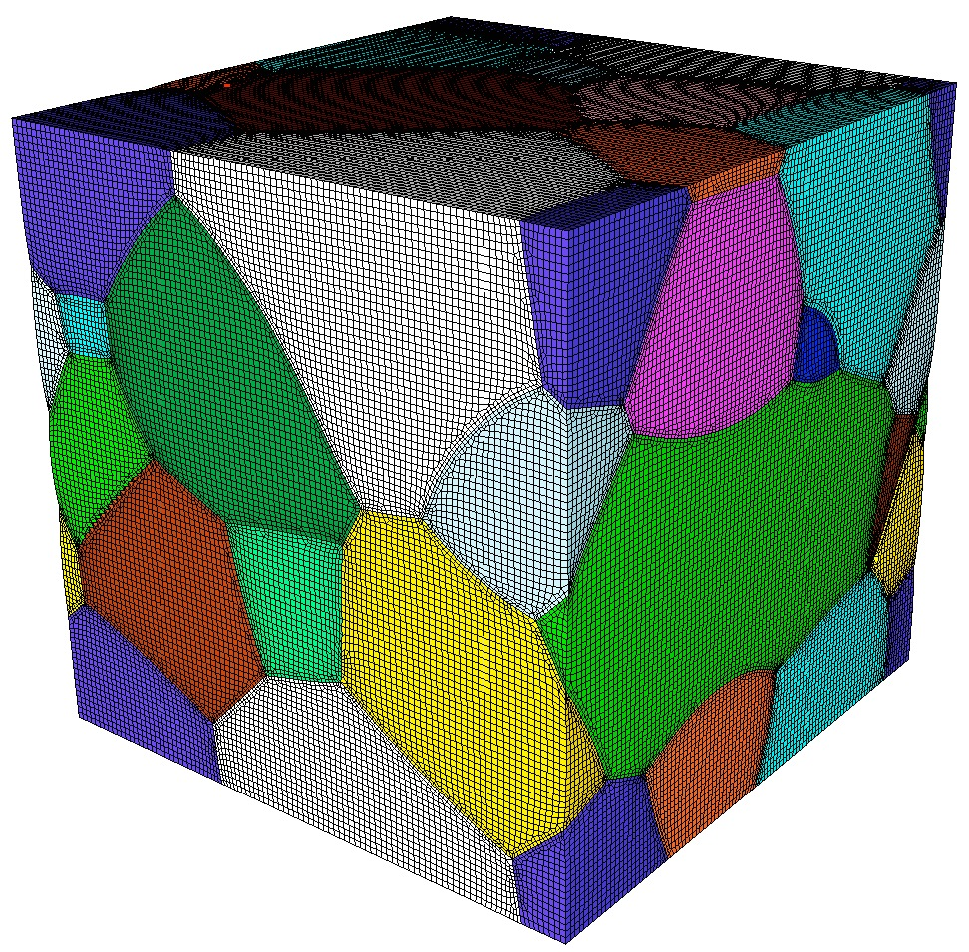
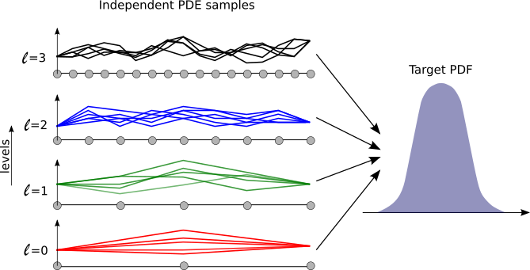
2017 study: Explore programmability and performance of the DARMA approach in the context of ATDM codes
Electromagnetic
Plasma Particle-in-cell Kernels
Multiscale Proxy
Multi Level Monte Carlo Uncertainty Quantification Proxy
Using DARMA to inform Sandia’s ATDM technical roadmap

Slide 21
2017 study: Explore programmability and performance of the DARMA approach in the context of ATDM codes
Kernels and proxies
  Form basis for programmability assessments
  Will be used to explore performance characteristics of the DARMA-Charm++ backend
Simple benchmarks enable studies on
  Task granularity
  Overlap of communication and computation
  Runtime-managed load balancing
These early results are being used to identify and address bottlenecks in DARMA-Charm++ backend in preparation for studies with kernels/proxies
Using DARMA to inform Sandia’s ATDM technical roadmap

Slide 22
DARMA’s Concurrency Abstractions

Slide 23
Asynchronous smart pointers enable extraction of parallelism in a data-race-free manner
  darma::AccessHandle<T> enforces sequential semantics: it uses the order in which data is accessed in your program and how it is accessed (read/write/etc.) to automatically extract parallelism
Abstractions that facilitate the expression of tasking

Slide 24
Tasks are annotated in the code via a lambda or functor interface
Tasks can be recursively nested within each other to generate more subtasks
Abstractions that facilitate the expression of tasking

Slide 25
Example: Putting tasks and data together
Abstractions that facilitate the expression of tasking

Slide 26
Smart pointer collections can be mapped across memory spaces in a scalable manner
AccessHandleCollection<T, R> is an extension to AccessHandle<T> that expresses a collection of data
Abstractions that facilitate the expression of tasking

Slide 27
Tasks can be grouped into collections that make concurrent forward progress together
Task collections are a scalable abstraction to efficiently launch communicating tasks across large-scale distributed systems
Abstractions that facilitate the expression of tasking

Slide 28
Putting task collections and data collections together
Abstractions that facilitate the expression of tasking

Slide 29
Tasks in different execution streams can communicate via publish/fetch semantics
Abstractions that facilitate the expression of tasking

Slide 30
Tasks in different execution streams can communicate via publish/fetch semantics
Abstractions that facilitate the expression of tasking

Slide 31
Tasks in different execution streams can communicate via publish/fetch semantics
Abstractions that facilitate the expression of tasking

Slide 32
A mapping between data and task collections determines access permissions between tasks and data
Abstractions that facilitate the expression of tasking

Slide 33
The Charm++ Backend
About 13k lines of code
Maps a task-based system to an object-oriented one
Much of the code is dealing with lookahead and data versioning (or generations)
  Scalable effect management and refinement
Each create_concurrent_work maps to a chare array in the “present” or future
  Lookahead allows the system to determine where the next task collection will execute and pipeline work
  The set of data inputs to the create_concurrent_work dictate which chare array instance is used (of if a new one is created)
  By reusing a chare arrays that have the same data inputs from the past, persistence is retained
  An AccessHandleCollection may span multiple chare arrays, element by element depending on the versioning

Slide 34
DARMA’s programming model enables runtime-managed, measurement-based load balancing
2D Newtonian particle simulation that starts highly imbalanced.
Initial strong scaling results with DARMA-Charm++ backend are promising
Using DARMA to inform Sandia’s ATDM technical roadmap
Notes:
DARMA’s flexible programming model enables backends to automatically per- form load balancing (LB). Below this, we show the strong scalabil- ity of a 2D Newtonian particle simula- tion that starts highly imbalanced. The LB incrementally runs as particles mi- grate and the work distribution changes.

Slide 35
A latency-intolerant benchmark highlights overheads as grain size decreases
This benchmark has tight synchronization every iteration.
At this scale, each iteration is less than 5ms long.
Using DARMA to inform Sandia’s ATDM technical roadmap
Notes:
Tight synchronization in DARMA limits scalability (our collectives are not yet highly tuned)
For the first case study, we implemented a 2D Jacobi stencil in MPI, Charm++, and DARMA. A traditional stencil is a very regular code with tight synchronization every iteration (tolerates little latency). Thus, any overhead in the system will be apparent, especially as the code is strong- scaled or the block size (task granularity) is reduced.

Slide 36
Increased asynchrony in the application enables the runtime to overlap communication and computation
Scalability improves with asynchronous iterations. Requires only minor changes to application code.
Using DARMA to inform Sandia’s ATDM technical roadmap
Notes:
To study the impact of of increasing communication-computation overlap (thus, increasing latency tolerance), we modified the 2D Jacobi to asyn- chronously perform iterations, only starting an allreduce every 10 itera- tions. In the DARMA code, this only required modifying a several lines of code! Complex problems that arise in MPI, such as buffering messages that may arrive out of iteration order, are handled automatically.

Slide 37
DARMA’s programming model enables runtime-managed, measurement-based load balancing
Load balancing does not require changes to the application code.
Using DARMA to inform Sandia’s ATDM technical roadmap
Notes:
DARMA’s flexible programming model enables backends to automatically per- form load balancing (LB). On the RHS, we implemented a synthetic LB bench- mark that has a known perfect distribu- tion to test the performance of LB.

Slide 38
Stencil benchmark is not latency tolerant and highlights runtime overheads when task-granularity is small
At this scale, each iteration is less than 5ms long.
Using DARMA to inform Sandia’s ATDM technical roadmap
Notes:
Tight synchronization in DARMA limits scalability (our collectives are not yet highly tuned)
For the first case study, we implemented a 2D Jacobi stencil in MPI, Charm++, and DARMA. A traditional stencil is a very regular code with tight synchronization every iteration (tolerates little latency). Thus, any overhead in the system will be apparent, especially as the code is strong- scaled or the block size (task granularity) is reduced.

Slide 39
Increased asynchrony in application enables runtime to overlap communication and computation
Scalability improves with asynchronous iterations. Requires only minor changes to DARMA code.
Using DARMA to inform Sandia’s ATDM technical roadmap
Notes:
To study the impact of of increasing communication-computation overlap (thus, increasing latency tolerance), we modified the 2D Jacobi to asyn- chronously perform iterations, only starting an allreduce every 10 itera- tions. In the DARMA code, this only required modifying a several lines of code! Complex problems that arise in MPI, such as buffering messages that may arrive out of iteration order, are handled automatically.

Slide 40
Summary: DARMA seeks to accelerate discovery of best practices
Application developers
  Use a unified interface to explore a variety of different runtime system technologies
  Directly inform DARMA’s user-level API via co-design requirements/feedback
System software developers
  Acquire a synthesized set of requirements via the backend specification
  Directly inform backend specification via co-design feedback
  Can experiment with proxy applications written in DARMA
Sandia ATDM is using DARMA to inform its technology roadmap in the context of AMT runtime systems

Slide 41
DARMA’s programming model enables runtime-managed, measurement-based load balancing
The Charm++ load balancer incrementally runs as particles migrate and the work distribution changes.
Using DARMA to inform Sandia’s ATDM technical roadmap
Notes:
DARMA’s flexible programming model enables backends to automatically per- form load balancing (LB). Below this, we show the strong scalabil- ity of a 2D Newtonian particle simula- tion that starts highly imbalanced. The LB incrementally runs as particles mi- grate and the work distribution changes.

