Slide 1
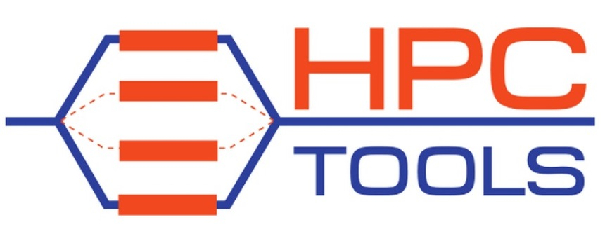
Directive-Based Parallel Programming at Scale?
Barbara Chapman
Stony Brook University
Brookhaven National Laboratory
Charm++ Workshop, April 19 2016
http://www.cs.uh.edu/~hpctools

Slide 2
Agenda
Directives: A little (pre)history
Evolving the standard
Today’s challenges
Where to next?
Notes:
I believe in productive computing
History: importance of directives. What they can do for us, what things have influenced their adoption.
Require a lot of buy-in from many parties, so also significant effort.
We are here because that effort has been made and sustained, so be proud of where we are and think about where we can go next

Slide 3
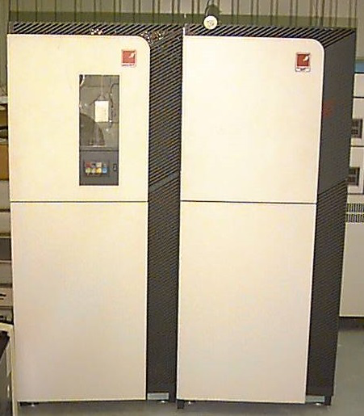

Symmetric Multiprocessors
1980s saw attempts to build parallel computers with shared memory
  Alliant
  Sequent
  Encore, …
Programmed using Fortran
  Vendor extensions, mainly to parallelize loops
Attempt to develop standard API
  PCF features for loop parallelism in Fortran code
  Fortran standards subcommittee formed
BBN Butterfly
Every CPU able to access memory associated with other CPUs
Big penalty for non-local access
15 times slower than local memory access
Notes:
BBN Butterfly quite large – up to 512 processors

Slide 4
PCF Example
PARALLEL SECTIONS
SECTION
PARALLEL DO I= i , N
A(I) = B(I) * C(I)
END DO
SECTION
PARALLEL DO J = i, M
D(J) = F(J) / E(J)
END DO
END PARALLEL SECTIONS
Proposed as Fortran extensions
Team of threads execute parallel
construct
Parallel loops
Parallel sections
Critical, locks and post / wait
Ordered execution
Loop iterations distributed among threads by implementation; must be iteration-order independent
Sections of code must be data independent
Shared and private variables
Loop variable undefined outside parallel loop construct
Nested parallelism
Notes:
Granularity pretty small. Did it match systems of the day?

Slide 5
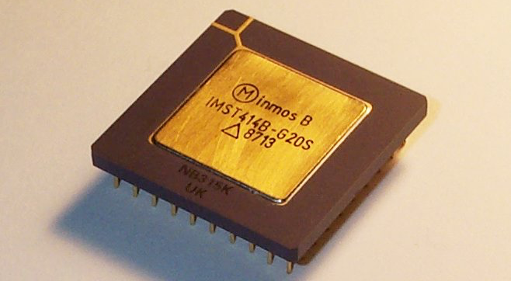
A New Kind of Architecture, Late ‘80s
Notes:
The transputer (the name deriving from transistor and computer^{[2]}) was the first general purpose microprocessor designed specifically to be used in parallel computing systems. The goal was to produce a family of chips ranging in power and cost that could be wired together to form a complete parallel computer. The name was selected to indicate the role the individual transputers would play: numbers of them would be used as basic building blocks, just as transistors had earlier.
Originally the plan was to make the transputer cost only a few dollars per unit. Inmos saw them being used for practically everything, from operating as the main CPU for a computer to acting as a channel controller for disk drives. in the same machine. Spare cyces on any of these transputers could be used for other tasks, greatly increasing the overall performance of the machines.

Slide 6
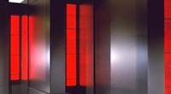
CM-5 TOP500 #1 June 1993

Slide 7
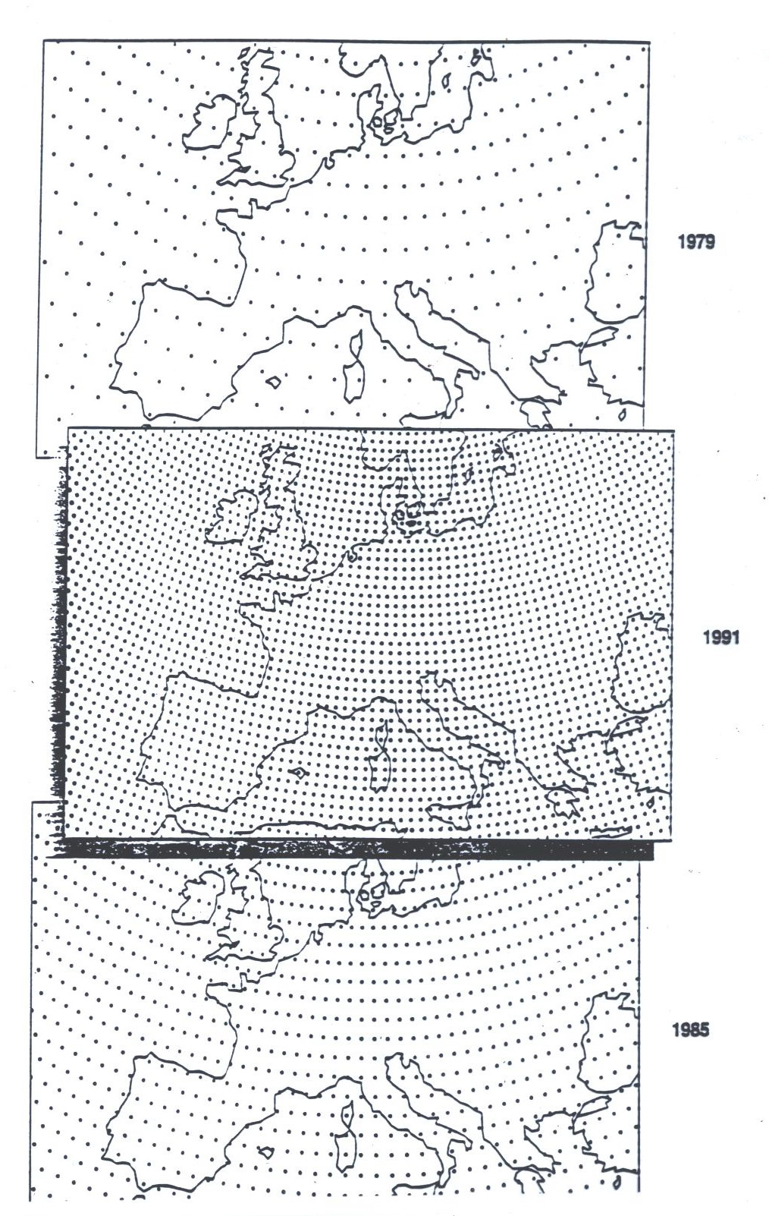
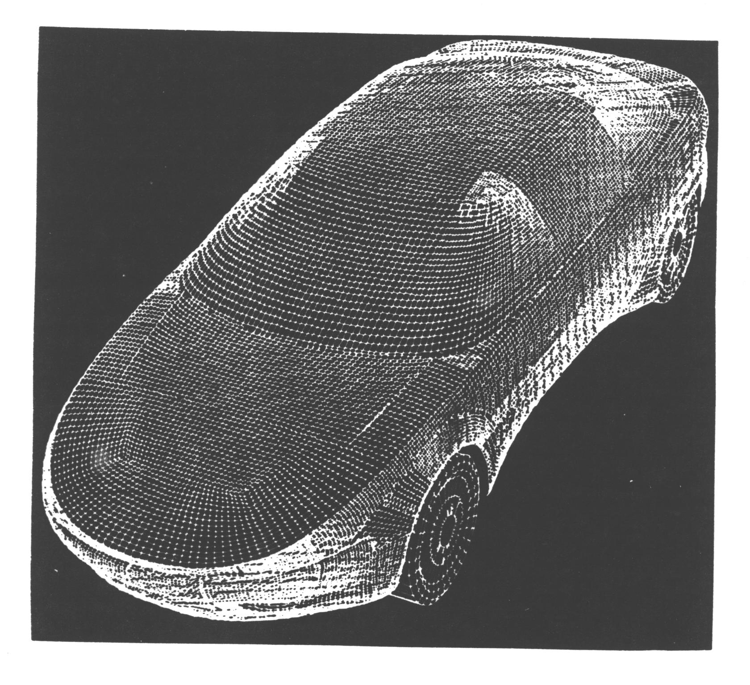
Using The Compute Power
Notes:
Structured…

Slide 8
High Performance Fortran (HPF)
Directives extend Fortran for distributed memory parallel programming
  First definition early 1993, revision 1997
  Japanese created additional features in JA-HPF
Main features are directives for data mapping and parallel loops
  Work performed where the data is stored
  Some library routines
Broad participation in standards effort

Slide 9
HPF Example
Parallel Do
Forall
Independent
!HPF$ DISTRIBUTE W ( BLOCK )
!HPF$ INDEPENDENT, NEW ( X ), REDUCTION ( SUM )
DO I = 1, N
X = W(I) * (I - 0.5)
SUM = SUM + F ( X )
END DO
* Team of processes execute
entire program
* Loop iterations are
distributed among processes
based on data distribution
* Communication at end of loop
to obtain global value SUM
* Each process has local segment of W
* Each process has its own copy of variable X
* Each process computes local value of SUM
* SUM updated at end of loop, result replicated

Slide 10
What Happened to HPF?
Compilers slow to arrive, and supported different styles of HPF programming
  Based upon Fortran 90, also slow to mature
Considered suitable for structured (regular) grids only
MPI flexible and established by the time HPF compilers matured
  Codified experience with early comms libraries
Japanese vendors continued to add features and provide compilers after others gave up
Notes:
Did not meet user needs. Implementations too slow. Too hard overall. Uses did not understand potential of staying (and fundamentally flawed, since compilers could not do good job on many codes)
Hardware characteristics likely would have prevented this from working well.

Slide 11
HPF User Experience
HPF application development was hard
  Required global modifications
  incremental development not possible
Users had little insight into execution behavior
  Creation of good HPF code required insight into compilation process
  But this was rare
  Performance degradation could be severe
Benefits of directive approach neither experienced nor understood by many
Not surprisingly, few tools available (HPF version of Totalview was created)

Slide 12
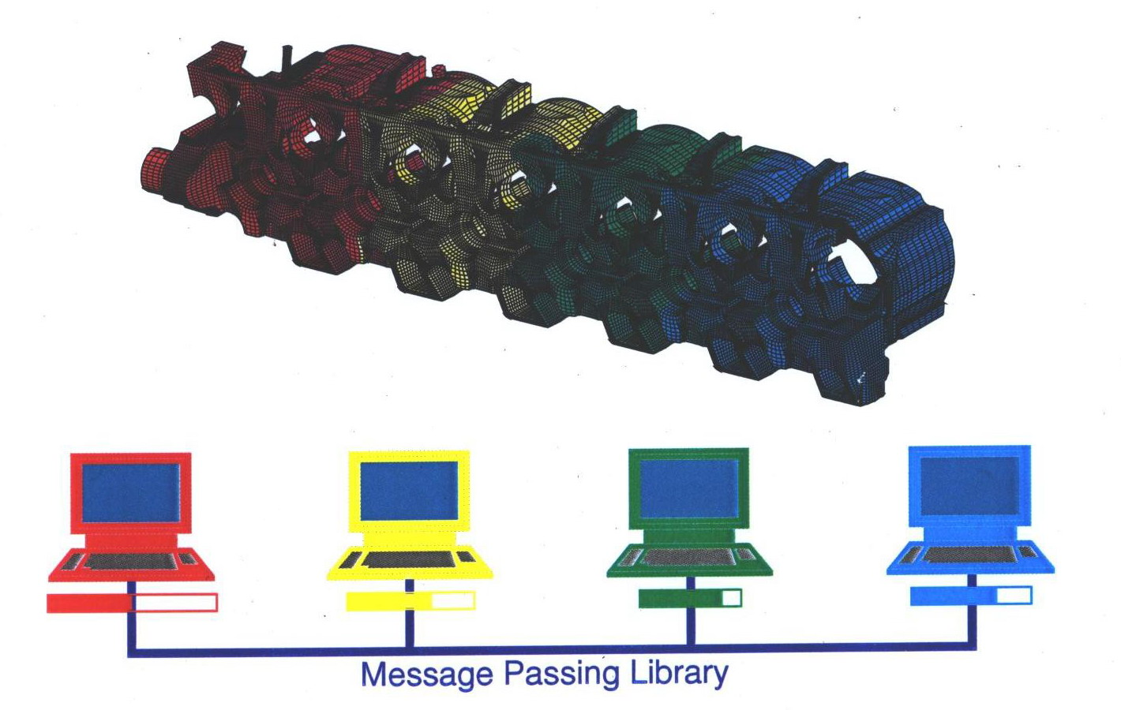
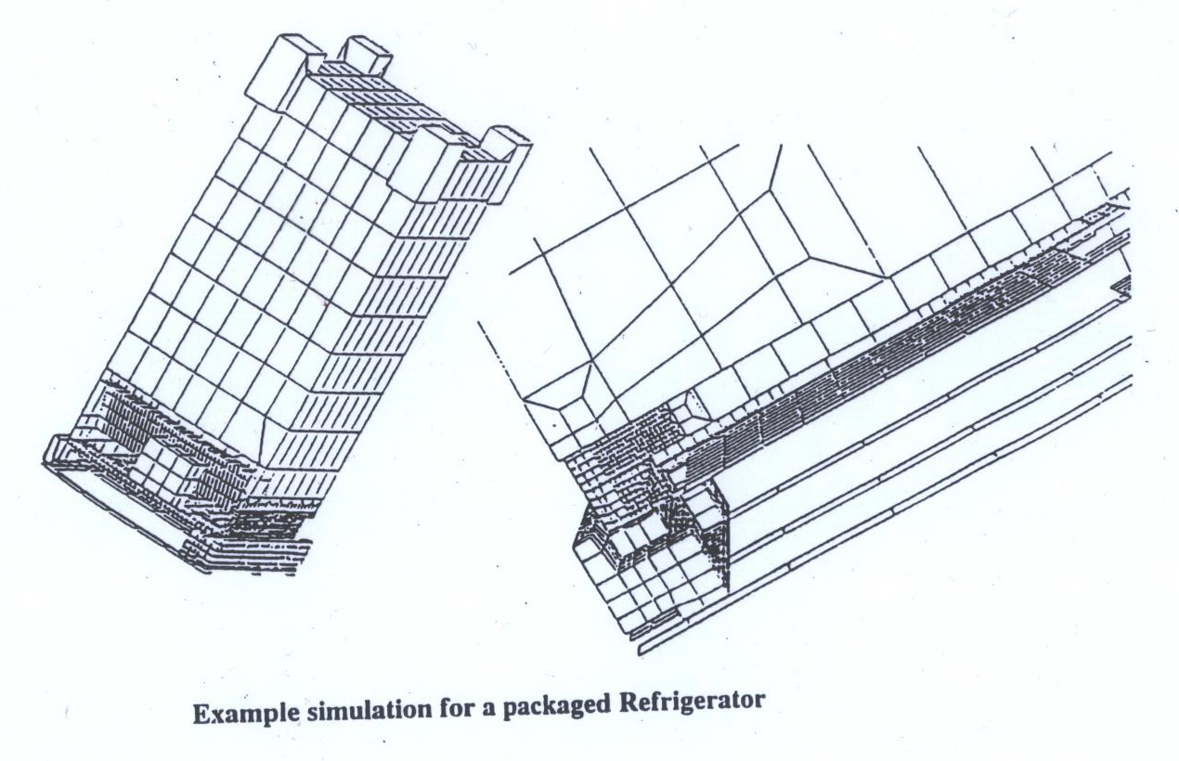
MPI Becomes Widely Used
User distributes the data and computation explicitly to system processing nodes.

Slide 13
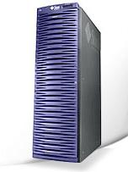

Return of Shared Memory
SMPs on desktop, late 1990s (HP, Sun, Intel, IBM, …)
  Mainstream market, general-purpose applications
  Mostly 2 – 4 cache coherent CPUs
  A few bigger systems e.g. Sun’s 6400 (144 CPUS)
Large-scale distributed shared memory (DSMs)
Memory is distributed, but globally addressed
  E.g. HP Exemplar, SGI Origin and Altix series
  Looks like shared memory system to user
  Hardware supports cache coherency
  Origin: non-local data twice as slow
Sun Fire 6800 Server, 24 CPUs

Slide 14
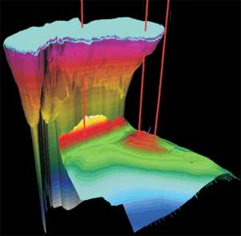
OpenMP Example
!$OMP PARALLEL DO PRIVATE ( X ) , SHARED ( W )
!$OMP& REDUCTION ( +: SUM )
DO I = 1, N
X = W(I) * (I - 0.5)
SUM = SUM + F ( X )
END DO
!$OMP END PARALLEL
* Team of threads execute
parallel region
* Loop iterations are
distributed among threads
* Implicit synchronization
at end of region
* All threads access same W
* Each executing thread has its own
copy of variable X
* Each thread creates and initializes a
private copy of shared variable SUM.
* SUM is updated at next
synchronization point

Slide 15
Agenda
Directives: A little (pre)history
Evolving the standard
Today’s challenges
Where to next?
Notes:
I believe in productive computing
History: importance of directives. What they can do for us, what things have influenced their adoption.
Require a lot of buy-in from many parties, so also significant effort.
We are here because that effort has been made and sustained, so be proud of where we are and think about where we can go next

Slide 16
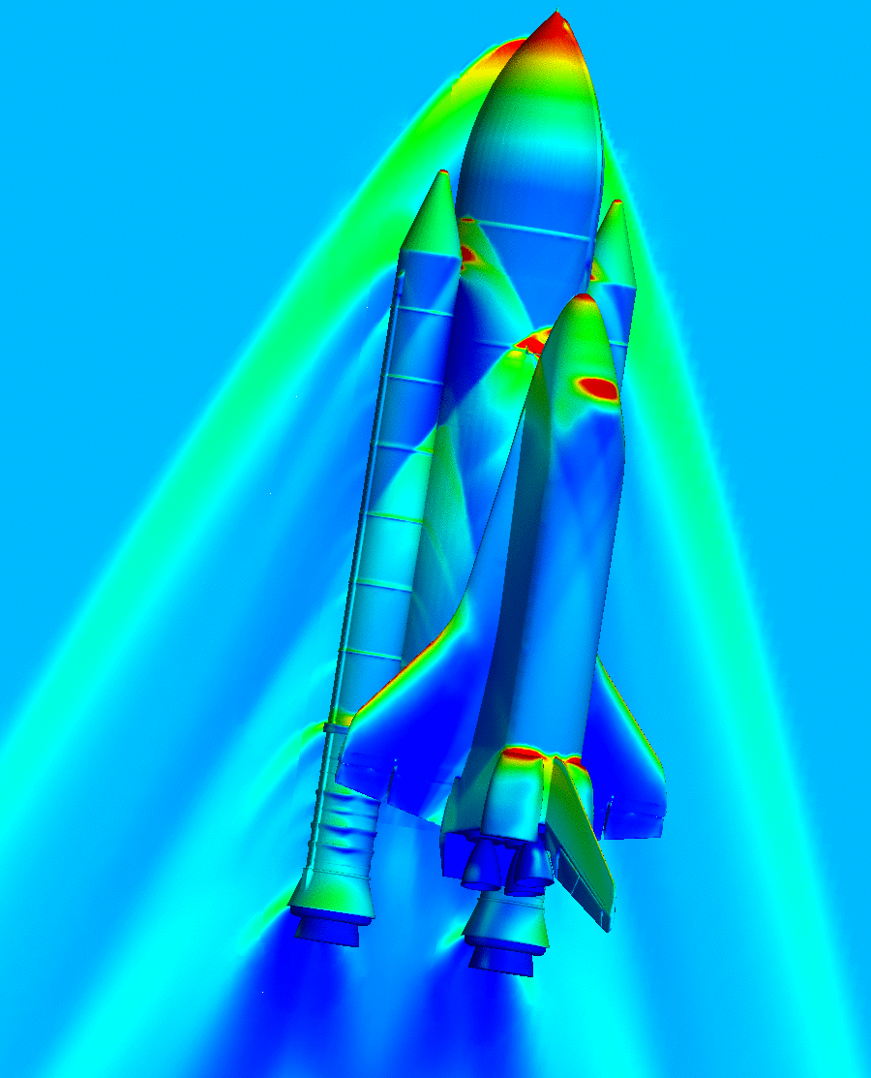
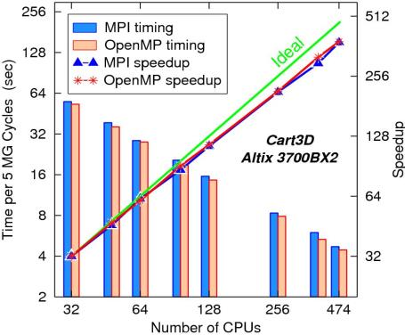

Cart3D OpenMP Scaling, ca. 2005
4.7 M cell mesh Space Shuttle Launch Vehicle example
M∞ = 2.6
α = 2.09º
β = 0.8º
OpenMP version uses same domain decomposition strategy as MPI for data locality, avoiding false sharing and fine-grained remote data access
OpenMP version slightly outperforms MPI version on SGI Altix 3700BX2, both close to linear scaling.
Notes:
Time of version 2.5

Slide 17
Data Mapping and Affinity
Proposed OpenMP Extensions, 1999
SGI page-based data distribution extensions
  Allocates pages to memory across system nodes
  Preserves illusion of true shared memory
HPF-style data mappings
  Didn’t do well on page-based system
  SGI, Compaq
!$SGI DISTRIBUTE array ( CYCLIC (1) )
!$OMP PARALLEL DO PRIVATE ( i , active)
!$OMP& SHARED ( level )
!$SGI+ AFFINITY (i) = DATA ( array ( i ) )
DO i = 1, max
IF ( array ( i ) >= 1) then
active = ….
CALL solve ( active, level, …)
END IF
END DO
“first-touch” default mapping works pretty well (if developer is aware of it)
Notes:
Assigning work to locus of data! Mapping within node? Compaq also (whole enchilada of HPF)

Slide 18
Omni Compiler: Cluster-enabled OpenMP, 2002
OpenMP for a cluster (distributed memory system)
  message passing library (MPI, PVM) provides high performance, but difficult and cumbersome.
Use software distributed shared memory system SCASH as underlying runtime system on cluster
  Page-based DSM
  Related Work: OpenMP compiler for TreadMarks by Rice (later clOMP)
“shmem” memory model
  All variables declared statically in global scope are private.
  The shared address space must be allocated by a library function at runtime.
  Example: SCASH, Unix “shmem” system call
OpenMP
  All variables are shared as defaults.
  No explicit shared memory allocation
Omni OpenMP Compiler
Notes:
Nowadays we have ScaleMP, Numascale
Seamless solution. What about XMP today? OpenMP with data distributions

Slide 19
OpenMP 3.0 Introduces Tasks, 2008
Tasks explicitly created and processed
#pragma omp parallel
{
#pragma omp single
{
p = listhead ;
while (p) {
#pragma omp task
process (p)
p=next (p) ;
}
}
}
  Each encountering thread packages a new instance of a task (code and data)
  Some thread in the team executes the task
Notes:
Already had C and C++ bindings

Slide 20
Asynchronous Task Dependence
Increase power of tasks, reduce barrier synchronization
Task synchronization constructs
  taskwait, and barrier construct
int fib(int n) {
int x, y;
if (n < 2) return n;
else {
#pragma omp task shared(x)
x = fib(n-1);
#pragma omp task shared(y)
y = fib(n-2);
#pragma omp taskwait
return x + y;
}
}
#pragma omp task depend (out: t1, t2, …) depend (in: t4, t5)
Avoid the use of global locks
Work with workstealing
Decentralized dependency setup and resolution

Slide 21
Eliminating Global Barriers in
Smith-Waterman
Global barrier
A Prototype Implementation of OpenMP Task Dependency Support; Priyanka Ghosh, Yonghong Yan, Deepak Eachempati and Barbara Chapman; International Workshop on OpenMP (IWOMP) 2013

Slide 22
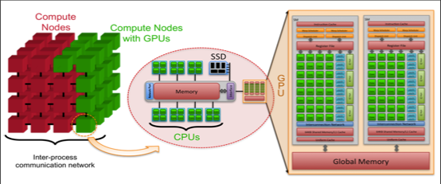
Core Heterogeneity in HPC Systems
Each node has multiple CPU cores, and some of the nodes are equipped with additional computational accelerators, such as GPUs.
www.olcf.ornl.gov/wp-content/uploads/.../Exascale-ASCR-Analysis.pdf

Slide 23
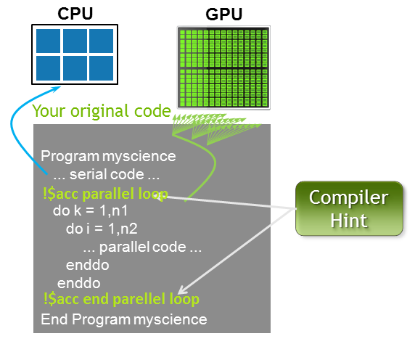
OpenACC
Directive-based programming for offloading code to accelerators
  For Fortran, C, C++
  Loop-based computations
Compute directives
  parallel: control to the user
  kernels: freedom to the compiler
Three levels of parallelism: gang, worker and vector
Open-source and proprietary implementations
OpenACC Validation Suite
  C and Fortran validation for OpenACC 2.0
SPEC Accelerator Benchmarks
http://www.openacc-standard.org/
Notes:
Members:
Industry: Allinea, AMD, Cray, Mentor Embedded, NVIDIA, PathScale, PGI, Rogue Wave, Total
Universities: George Tech, University of Houston, Indiana University, Louisiana State University, TU Dresden, Tokyo Institute of Technology
Centers/Labs: EPCC, NOAA, ORNL, SNL, CSCS
relationship to OpenMP
largely influenced by discussions for accelerator directives within OpenMP language committee
supporting for accelerators in OpenMP came in 4.0, providing similar features to OpenACC 1.0 a year later
OpenACC has been more focused on GPU target; OpenMP 4.0 went with a more general approach for targeting non-GPU accelerators,
OpenMP 4.1 draft released at SC’14, providing some similar features to OpenACC 2.0
OpenACC supports a more descriptive means of expressing parallelism with the kernels construct, giving the compiler more flexibility in how it chooses to generate code

Slide 24
Agenda
Directives: A little (pre)history
Evolving the standard
Today’s challenges
Where to next?
Notes:
I believe in productive computing
History: importance of directives. What they can do for us, what things have influenced their adoption.
Require a lot of buy-in from many parties, so also significant effort.
We are here because that effort has been made and sustained, so be proud of where we are and think about where we can go next

Slide 25
OpenACC Compiler Translation
Need to achieve coalesced memory access on GPUs
Compiling a High-level Directive-Based Programming Model for GPGPUs; Xiaonan Tian, Rengan Xu, Yonghong Yan, Zhifeng Yun, Sunita Chandrasekaran, and Barbara Chapman; 26th International Workshop on Languages and Compilers for Parallel Computing (LCPC2013)
Notes:
Total says they get performance portability; sometimes better performance than CUDA. Interchange loops, collapse may be needed
But non-trivial differences between vendors in how they handle this.
Kernel implemented differently by different compilers.
Want loop transformations. Alternative: Jeff Vetter’s group OpenARC provide abstraction of hardware and then can map abstraction to real hardware as alternative to loop interchange in code
Drawback is that version with interchanged loops is good on all accelerators but not on CPU. ORNL addressing portability between x86 and GPU: reduce duplication of code, get pertabiity across CPU and GPU
Lots to learn about translation; flexibility ultimately positive. Both need to evolve; can use together; Our next step is to explore using APUs; need to integrate
Two pieces of code using OpenMP and OpenACC….--- shows how easy it is to transform OpenMP to OpenACC…
IMO may be you could also say that the ease at which code transformation from OpenMP to OpenACC can take place varies from one application to another.
The tutorial slides I gave is from http://www2.cs.uh.edu/~hpctools/slides/OpenACC_CScADS_2012.pptx

Slide 26
OpenMP for Accelerators
#pragma omp target data device (gpu0) map(to:n, m, omega, ax, ay, b, \
f[0:n][0:m]) map(tofrom:u[0:n][0:m]) map(alloc:uold[0:n][0:m])
while ((k<=mits)&&(error>tol))
{
// a loop copying u[][] to uold[][] is omitted here
…
#pragma omp parallel for private(resid,j,i) reduction(+:error)
for (i=1;i<(n-1);i++)
for (j=1;j<(m-1);j++)
{
resid = (ax*(uold[i-1][j] + uold[i+1][j])\
+ ay*(uold[i][j-1] + uold[i][j+1])+ b * uold[i][j] - f[i][j])/b;
u[i][j] = uold[i][j] - omega * resid;
error = error + resid*resid ;
} // rest of the code omitted ...
}
#pragma omp target device(gpu0)
Early Experiences With The OpenMP Accelerator Model; Chunhua Liao, Yonghong Yan, Bronis R. de Supinski, Daniel J. Quinlan and Barbara Chapman; International Workshop on OpenMP (IWOMP) 2013, September 2013
Notes:
OpenMP 4.0 and now 4.5
CODE LOOKS DIFFERENT ON CPU AND DEVICE
Language level
target, device(), map(), …
num_device, device_type(), no-middle-sync, …
Compiler level
Pragma parsing
Parser building blocks
AST extensions
CUDA-specific IR nodes
AST translation: SageBuilder and SageInterface functions
Loop normalization, multi-dimensional array linearization
Outliner: CUDA kernel generation
Runtime level
Device feature probe: threads per block, block number…
Memory management: allocation, copy, data tracking/reuse, etc.
Loop scheduling: within and across thread blocks
Reduction: a first two-level algorithm

Slide 27
Dynamic Program Adaptation
OpenMP fairly amenable to dynamic adaptation
  Adjustment of thread count, schedule
  Adaptive barriers, reduction routines
  Runtime decisions
  Tasks, mergeable
Use of performance interface to inform dynamic tools
  Can help adjust data layout, find memory performance problems
Potential useful for variety of runtime techniques
OpenMP Program
(object code)
OpenMP Runtime Library
Collector API
executable (./a.out)
request
events
Performance Tool
Notes:
Need to add new PMI. But name???

Slide 28
False Sharing: Monitoring Results
Cache line invalidation measurements
Program name | 1-thread | 2-threads | 4-threads | 8-threads
histogram | 13 | 7,820,000 | 16,532,800 | 5,959,190
kmeans | 383 | 28,590 | 47,541 | 54,345
linear_regression | 9 | 417,225,000 | 254,442,000 | 154,970,000
matrix_multiply | 31,139 | 31,152 | 84,227 | 101,094
pca | 44,517 | 46,757 | 80,373 | 122,288
reverse_index | 4,284 | 89,466 | 217,884 | 590,013
string_match | 82 | 82,503,000 | 73,178,800 | 221,882,000
word_count | 4,877 | 6,531,793 | 18,071,086 | 68,801,742
Notes:
Found five applications with large amount of cache line invalidation
Codes from Phoenix suite used, ported Pthreads versions to OpenMP. No artificial injection of false sharing.
5 of 8 apps showed symptoms of false sharing (they are displayed). In case of reverse_index its contribution to performance was NOT significant
Adjusted data allocation using aligned
Overheads of detection significant only in “reverse_index” code, which has many dynamic data allocations (stack frame traversal, note could have multiple allocations for same variable if list or tree)

Slide 29
False Sharing: Data Analysis Results
Determining the variables that cause misses
Program Name | Global/static data | Dynamic data
histogram | - | main_221
linear_regression | - | main_155
reverse_index | use_len | main_519
string_match | key2_final | string_match_map_266
word_count | length, use_len, words | -
Notes:
The analysis result on those applications
We were able to find the problematic data structure on each application. One of these had high overheads due to dyn data allocation. In others can use symtab info to help identify

Slide 30
Runtime False Sharing Detection
Original Version
Optimized Version
histogram
string_match
word_count
histogram
string_match
word_count
reverse_index
reverse_index
linear_regression
linear_regression
B. Wicaksono, M. Tolubaeva and B. Chapman. “Detecting false sharing in OpenMP applications using the DARWIN framework”, LCPC 2011
Notes:
Codes from Phoenix suite used, ported Pthreads versions to OpenMP. No artificial injection of false sharing.
Speedup over sequential code on 4 node Alitix, 2 cores per node. Used dplace to enforce affinity
5 of 8 apps showed symptoms of false sharing (they are displayed). In case of reverse_index its contribution to performance was NOT significant
Adjusted data allocation using aligned
Overheads of detection significant only in “reverse_index” code, which has many dynamic data allocations (stack frame traversal, note could have multiple allocations for same variable if list or tree)

Slide 31
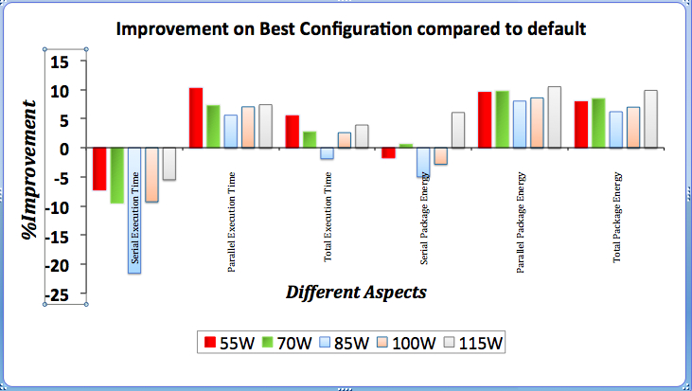
Energy Management Tools
OpenMP runtime settings can be adjusted statically and dynamically for best performance
  Number of threads, scheduling policy and chunk size, wait policy, binding policy, may all affect performance
Selections are not independent of power cap
Modeling may help select settings to optimize both energy and execution performance
%-age improvement in Co-MD application under different power capping
Notes:
OpenMP ICVs which include scheduling, number of threads, chunk size, size of stack, wait policy and binding policy
For this work we are just considering computational intensive applications. The reason, we do not have support to find DRAM energy in the crill framework. The previous work in this area shows that in the computational intensive kernels, DRAM energy consumptions remains constant. So our results are valid with out DRAM energy information.

Slide 32
Agenda
Directives: A little (pre)history
Evolving the standard
Today’s challenges
Where to next?
Notes:
I believe in productive computing
History: importance of directives. What they can do for us, what things have influenced their adoption.
Require a lot of buy-in from many parties, so also significant effort.
We are here because that effort has been made and sustained, so be proud of where we are and think about where we can go next

Slide 33
Memory Will Change
Disk
Pool
NVM
DDR
NVM
DDR
O(1)
IPM
Machines + Disk arrays
Chassis w/ large DDR+NVM per Exa-machine
O(1,000)
LL$
LLS
O(10)
Boards w/ limited DDR+NVM per Chassis
NVM/Flash
NVM/Flash
L2$
L2S
O(1)
Sockets w/ IPM per Board
NVM/Flash
NVM/Flash
L1$
L1S
NVM/Flash
NVM/Flash
O(1)
Dies w/ shared LL$/SPAD per socket
O(100)
RF
Blocks w/ shared L2 per die
DRAM
DRAM
O(10)
Cores per block
DRAM
DRAM
ALU
DRAM
DRAM
Low Power CPU
Optical SW & Launch Pad
Low Power CPU
TSV Interposer
PCB

Slide 34

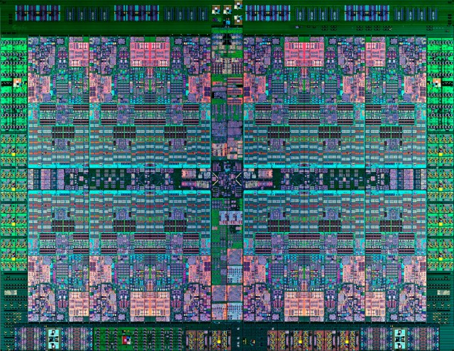

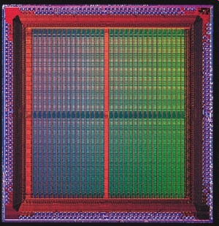

So Will Integration of Accelerators
  HCA, CAPI, GPU interconnect
  Programmability
  Diversity
Coherence Bus
CAPP
POWER CPU
Power8
CPU
GPU
NVLink
PSL
CPU L2
HW
Coherence
GPU L2
PCIe
X86, ARM64, POWER CPU
Global Memory
Notes:
Huge from user point of view BBN: SGI 16:1 to 2:1 made tremendous difference to user. Programmability is key!!
AND DIVERSITY

Slide 35

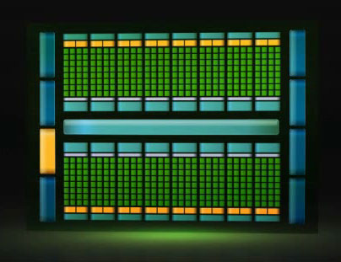
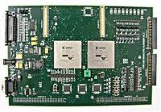
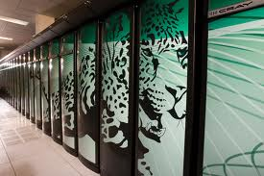
A Layered Programming Approach
…
Computational Chemistry
Climate Research
Astrophysics
Applications
New kinds of info
DSLs, other means for application scientists to provide information
Adapted versions of today’s portable parallel programming APIs (MPI, OpenMP, PGAS, Charm++)
Familiar
Maybe some non-portable low-level APIs (threads, CUDA, Verilog)
Custom
Very low-level
Machine code, device-level interoperability stds, powerful runtime
Heterogeneous Hardware
Notes:
Would really like to get full “languages” at highest level and translate back to lower level. But which ones and how to make this viable option? I don’t think we have the time to do that if basic are to be in place by 2015
And all the autotuners etc. that make life easier and support the highest layer, where you would like to go long-term
No need for domain specialist to know all about the hardware
No assumptions

Slide 36
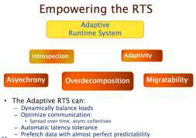
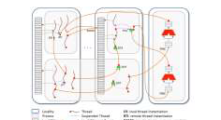
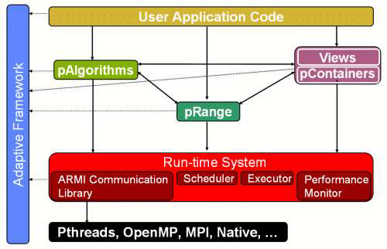

More Dynamic Execution?
What will the runtime (RT) environment look like? How dynamic will it be?
Role of runtime system? Relationship between RT and OS, programming models? How is information exchanged?
  Performance less predictable in dynamic execution environment
Notes:
Including: do we really need a dynamic runtime system for exasdcale?

Slide 37
OpenMP in an Exascale World
OpenX: prototype software stack for Exascale systems
  HPX is runtime system
  Lightweight threads
  Thread migration for load balancing, throughput.
Translating OpenMP -> HPX
  Maps OpenMP task and data parallelism onto HPX
  Exploit data flow execution capabilities at scale
  Big increase in throughput for fine-grained tasks
Migration path for OpenMP applications
XPRESS Migration Stack
MPI/OpenMP Application
MPI
OpenMP compiler
OpenMP Thin Runtime Glue
Legacy stack
HPX
OpenX

Slide 38
OpenMP over HPX (on-going work)
Execution model: dynamic adaptive resource management; message-driven computation; efficient synchronization; global name space; task scheduling
OpenMP translation:
  No direct interface to OS threads
  No tied tasks
  Threadprivate tricky, slow
  Doesn’t support places
  OpenMP task dependencies via futures
  HPX locks faster than OS locks
Notes:
Run on 20 core / 40 thread IvyBridge
Task granularity of benchmarks is a problem: HPX requires > 30microsec to amortize overheads in this implementation, but they are usually smaller…
Can run any binaries that use clang/intel, or openUH OpenMP.
Performance within expected range of existing runtimes for XPRESS project.
MPI is

Slide 39
Synchronization in OpenMP Execution
C5
C6
C1
C2
C3
C4
C1
C2
C3
C4
C9
C10
C7
C8
C5
C6
C7
C8
C13
C14
C11
C12
C9
C10
C11
C12
C17
C15
C21
C16
C18
C19
C20
C13
C14
C15
C16
C22
C23
C24
C25
T.-H. Weng, B. Chapman: Implementing OpenMP Using Dataflow Execution Model for Data Locality and Efficient Parallel Execution. Proc. HIPS-7, 2002
Notes:
Has to be executed before relationship –LHS how it is implied by OMP barrier semantics. How it is really needed in routine of POP code
Errors in representation here – LHS missing links; rhs missing some or one too many

Slide 40
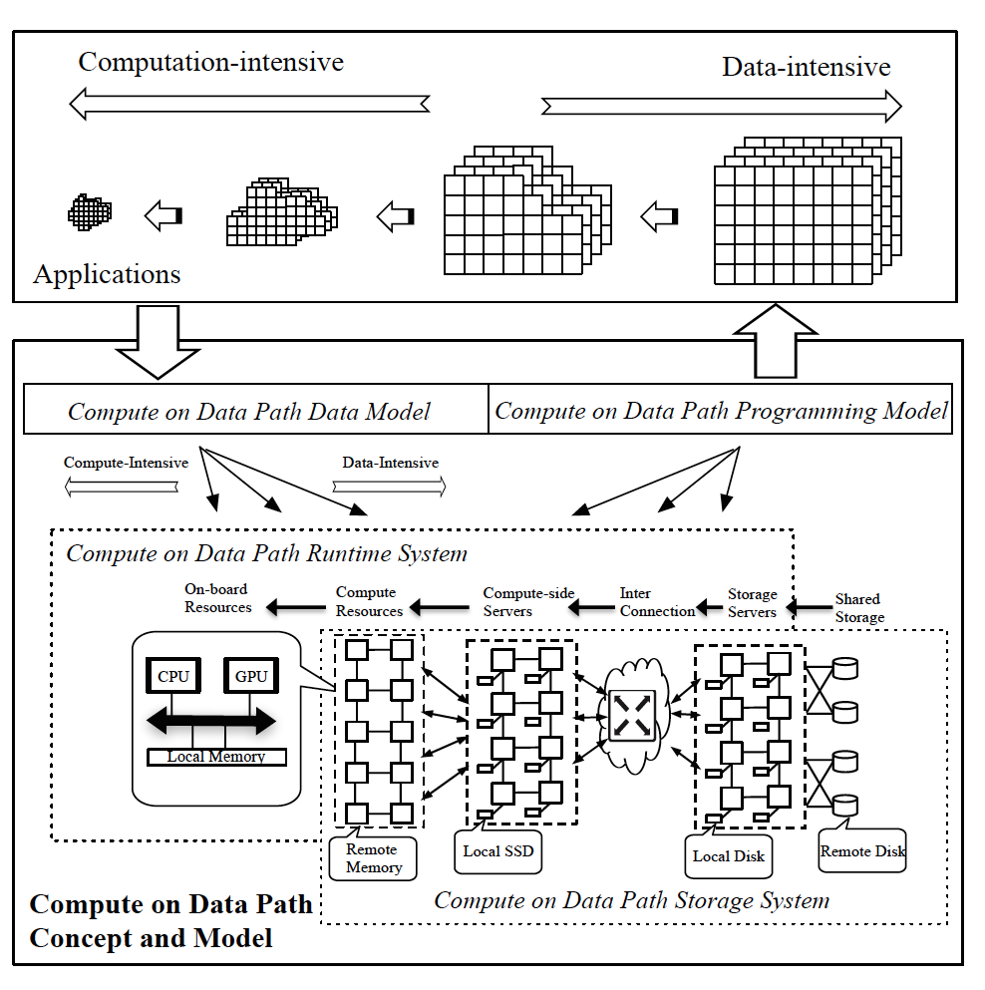
A Data-Centric Era
Continuum of needs from computation-heavy to data heavy
Potentially within a single application or workflow
Need to address data movement in its entirety
  Data Layout
  New kinds of memory
What role does user play?
TTU
UH
UH
NW
Notes:
Many uses of GPUs really important. Need to learn how to exploit them in continuum of hardware and memory hierarchy

Slide 41
Where are Directives Headed?
OpenMP has shown significant staying power despite some big changes in hardware characteristics
  Broad user base; yet strong HPC representation
  Paying more attention to data locality, affinity, tasking
Need to continue to evolve directives and implementation
  Data and memory challenges remain
  Less synchronization, more tasks, is good
  Performance; validation, power/energy savings,..
  Runtime: resources, more dynamic execution
What about level of abstraction?
  Performance portability is a major challenge
  OpenMP codes often hardwire in system-specific details
Notes:
Pioneering spirit!!
As always optimizations reduce the clarity of the model

Slide 42
Wrap-Up
Programmers need portable, productive programming interfaces
  Directives help deliver new concepts
  Hardware changes require us to continue to adapt
  Importance of accelerator devices likely to grow
  Many new challenges posed by diversity, large data sets, memory and new application trends
Directives pretty successful
Not all the answers are in the programming interface
  New or adapted algorithms
  Novel compiler translations; modeling for smart decisions
  Innovative implementations and runtime adaptations
  Tools to facilitate development and tuning
Notes:
Did not mention error handling and resilience here but also major factor of course

