Slide 1
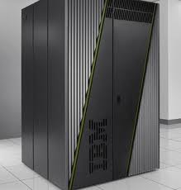




Using Charm++ to Improve Extreme Parallel Discrete-Event
Simulation (XPDES) Performance and Capability
Chris Carothers, Elsa Gonsiorowski, & Justin LaPre
Center for Computational Innovations/RPI
Nikhil Jain, Laxmikant Kale & Eric Mikida
Charm++ Group/UIUC
Peter Barnes & David Jefferson
LLNL/CASC

Slide 2
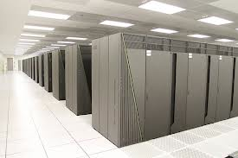
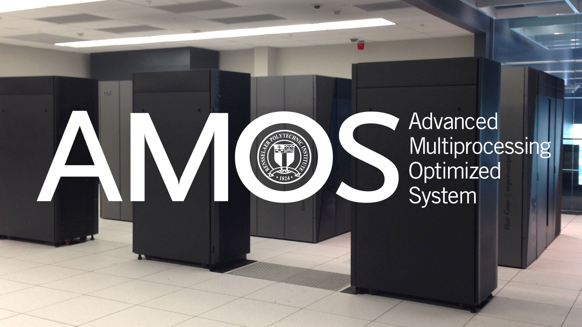
Outline
The Big Push…
Blue Gene/Q
ROSS Implementation
PHOLD Scaling Results
Overview of LLNL Project
PDES Miniapp Results
Impacts and Synergies

Slide 3
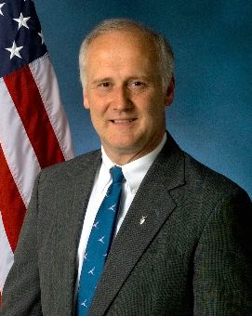
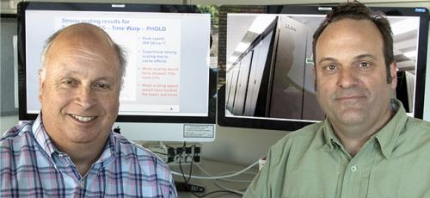
The Big Push…
David Jefferson, Peter Barnes (left) and Richard Linderman (right) contacted Chris to see about doing a repeat of the 2009 ROSS/PHOLD performance study using the “Sequoia” Blue Gene/Q supercomputer
AFRL’s purpose was to use the scaling study as a basis for obtaining a Blue Gene/Q system as part of HPCMO systems
Goal: (i) to push the scaling limits of massively parallel OPTIMISTIC discrete-event simulation and (ii) determine if the new Blue Gene/Q could continue the scaling performance obtained on BG/L and BG/P.
  We thought it would be easy and straight forward …

Slide 4
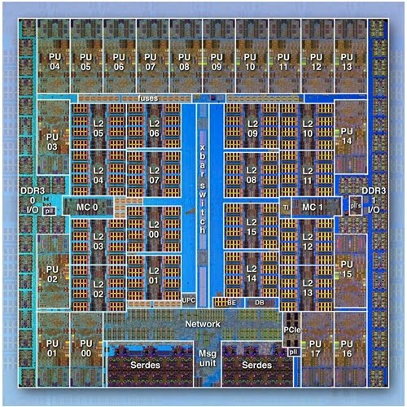
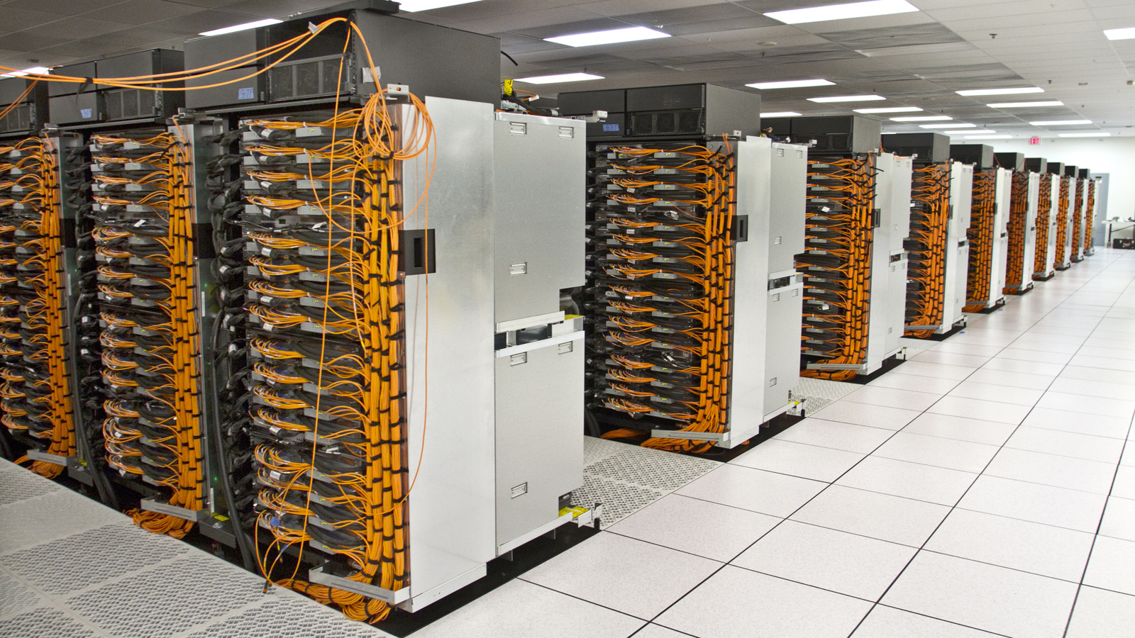
IBM Blue Gene/Q Architecture
1.6 GHz IBM A2 processor
16 cores (4-way threaded) + 17th core for OS to avoid jitter and an 18th to improve yield
204.8 GFLOPS (peak)
16 GB DDR3 per node
42.6 GB/s bandwidth
32 MB L2 cache @ 563 GB/s
55 watts of power
5D Torus @ 2 GB/s per link for all P2P and collective comms
1 Rack =
1024 Nodes, or
16,384 Cores, or
Up to 65,536 threads or MPI tasks
1.6 GHz IBM A2 processor
16 cores (4-way threaded)
16 GB DDR3 per node
  42.6 GB/s bandwidth
32 MB L2 cache
204.8 GFLOPS (peak)
55 watts of power
5D Torus @ 2 GB/s network
1 Node
1 Rack =
1024 Nodes, or
16,384 Cores, or
Up to 65,536 threads or MPI tasks

Slide 5
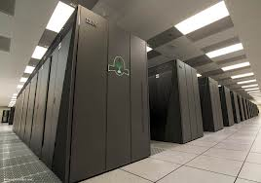
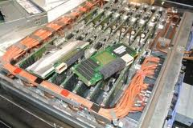
LLNL’s “Sequoia” Blue Gene/Q
Sequoia: 96 racks of IBM Blue Gene/Q
  1,572,864 A2 cores @ 1.6 GHz
  1.6 petabytes of RAM
  16.32 petaflops for LINPACK/Top500
  20.1 petaflops peak
  5-D Torus: 16x16x16x12x2
  Bisection bandwidth ➔ ~49 TB/sec
  Used exclusively by DOE/NNSA
Power ➔ ~7.9 Mwatts
“Super Sequoia” @ 120 racks
  24 racks from “Vulcan” added to the existing 96 racks
  Increased to 1,966,080 A2 cores
  5-D Torus: 20x16x16x12x2
  Bisection bandwidth did not increase

Slide 6
ROSS: Local Control Implementation
ROSS written in ANSI C & executes on BGs, Cray XT3/4/5, SGI and Linux clusters
GIT-HUB URL: ross.cs.rpi.edu
Reverse computation used to implement event “undo”.
RNG is 2^121 CLCG
MPI_Isend/MPI_Irecv used to send/recv off core events.
Event & Network memory is managed directly.
  Pool is allocated @ startup
  AVL tree used to match anti-msgs w/ events across processors
Event list keep sorted using a Splay Tree (logN).
LP-2-Core mapping tables are computed and not stored to avoid the need for large global LP maps.
V
i
r
t
u
a
l
T
i
m
e
Local Control Mechanism:
error detection and rollback
(1) undo
state Δ’s
(2) cancel
“sent” events
LP 1
LP 2
LP 3

Slide 7
ROSS: Global Control Implementation
GVT (kicks off when memory is low):
  Each core counts #sent, #recv
  Recv all pending MPI msgs.
  MPI_Allreduce Sum on (#sent - #recv)
  If #sent - #recv != 0 goto 2
  Compute local core’s lower bound time-stamp (LVT).
  GVT = MPI_Allreduce Min on LVTs
Algorithms needs efficient MPI collective
LC/GC can be very sensitive to OS jitter
(17th core should avoid this)
V
i
r
t
u
a
l
T
i
m
e
Global Control Mechanism:
compute Global Virtual Time (GVT)
collect versions
of state / events
& perform I/O
operations
that are < GVT
GVT
LP 1
LP 2
LP 3
So, how does this translate into Time Warp performance on BG/Q

Slide 8
PHOLD Configuration
PHOLD
  Synthetic “pathelogical” benchmark workload model
  40 LPs for each MPI tasks, ~251 million LPs total
    Originally designed for 96 racks running 6,291,456 MPI tasks
  At 120 racks and 7.8M MPI ranks, yields 32 LPs per MPI task.
  Each LP has 16 initial events
  Remote LP events occur 10% of the time and scheduled for random LP
  Time stamps are exponentially distributed with a mean of 0.9 + fixed time of 0.10 (i.e., lookahead is 0.10).
ROSS parameters
  GVT_Interval (512) ➔ number of times thru “scheduler” loop before computing GVT.
  Batch(8) ➔ number of local events to process before “check” network for new events.
    Batch X GVT_Interval events processed per GVT epoch
  KPs (16 per MPI task) ➔ kernel processes that hold the aggregated processed event lists for LPs to lower search overheads for fossil collection of “old” events.
  RNGs: each LP has own seed set that are ~2^70 calls apart

Slide 9
PHOLD Implementation
void phold_event_handler(phold_state * s, tw_bf * bf,
phold_message * m, tw_lp * lp)
{
tw_lpid dest;
if(tw_rand_unif(lp->rng) <= percent_remote) {
bf->c1 = 1;
dest = tw_rand_integer(lp->rng, 0, ttl_lps - 1);
} else {
bf->c1 = 0;
dest = lp->gid;
}
if(dest < 0 || dest >= (g_tw_nlp * tw_nnodes()))
tw_error(TW_LOC, "bad dest");
tw_event_send( tw_event_new(dest,
tw_rand_exponential(lp->rng, mean) + LA, lp) );
}

Slide 10
CCI/LLNL Performance Runs
CCI Blue Gene/Q runs
  Used to help tune performance by “simulating” the workload at 96 racks
  2 rack runs (128K MPI tasks) configured with 40 LPs per MPI task.
  Total LPs: 5.2M
Sequoia Blue Gene/Q runs
  Many, many pre-runs and failed attempts
  Two sets of experiments runs
  Late Jan./ Early Feb, 2013: 1 to 48 racks
  Mid March, 2013: 2 to 120 racks
  Sequoia went down for “CLASSIFIED” service on March ~14th, 2013
All runs where fully deterministic across all core counts

Slide 11
Impact of Multiple MPI Tasks per Core
Each line starts at 1 MPI tasks per core and move to 2 MPI tasks per core and finally 4 MPI tasks per core
At 2048 nodes, observed a ~260% performance increase from 1 to 4 tasks/core
Predicts we should obtain ~384 billion ev/sec at 96 racks

Slide 12
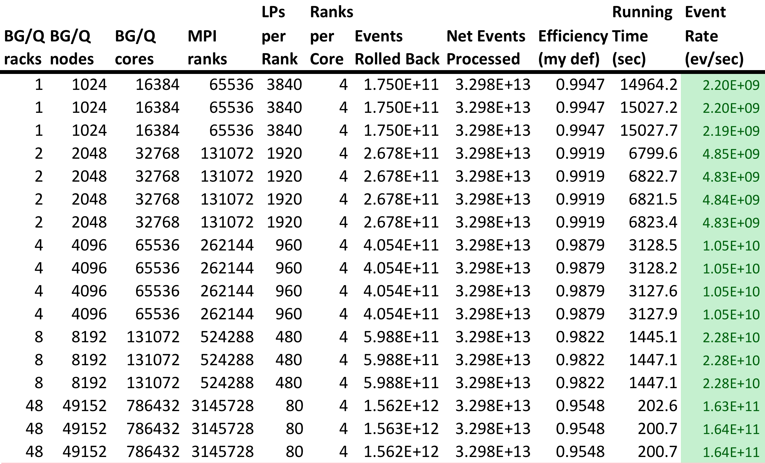
Detailed Sequoia Results: Jan 24 - Feb 5, 2013
75x speedup in scaling from 1 to 48 racks w/ peak event rate of 164 billion!!

Slide 13


Excitement, Warp Speed & Frustration
At 786,432 cores and 3.1M MPI tasks, we where extremely encouraged by ROSS’ performance
From this, we defined “Warp Speed” to be:
  Log10(event rate) – 9.0
  Due to 5000x increase, plotting historic speeds no longer makes sense on a linear scale.
  Metric scales 10 billion events per second as a Warp 1.0
However…we where unable to obtain a full machine run!!!!
  Was it a ROSS bug??
  How to debug at O(1M) cores??
  Fortunately NOT a problem w/i ROSS!
  The PAMI low-level message passing system would not allow jobs larger than 48 racks to run.
  Solution: wait for IBM Efix, but time was short..

Slide 14
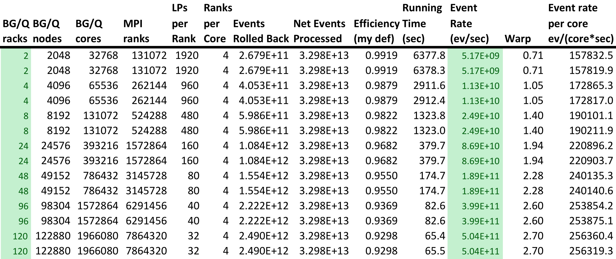
Detailed Sequoia Results: March 8 – 11, 2013
With Efix #15 coupled with some magic env settings:
  2 rack performance was nearly 10% faster
  48 rack performance improved by 10B ev/sec
  96 rack performance exceeds prediction by 15B ev/sec
  120 racks/1.9M cores ➔ 504 billion ev/sec w/ ~93% efficiency

Slide 15
ROSS/PHOLD Strong Scaling Performance
97x speedup for 60x more hardware
Why?
Believe it is due to much improved cache performance at scale
E.g, at 120 racks each node only requires ~65MB, thus most data is fitting within the 32 MB L2 cache

Slide 16
PHOLD Performance History
“Jagged” phenomena attributed to different PHOLD config
2005: first time a large supercomputer reports PHOLD performance
2007: Blue Gene/L PHOLD performance
2009: Blue Gene/P PHOLD performance
2011: CrayXT5 PHOLD performance
2013: Blue Gene/Q

Slide 17

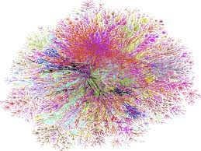
LLNL/LDRD: Planetary Scale Simulation Project
Summary: Demonstrated highest PHOLD performance to date
  504 billion ev/sec on 1,966,080 cores ➔ Warp 2.7
  PHOLD has 250x more LPs and yields 40x improvement over previous BG/P performance (2009)
  Enabler for thinking about billion object simulations
LLNL/LDRD 3 year project: “Planetary Scale Simulation”
  App1: DDoS attack on big networks
  App2: Pandemic spread of flu virus
  Opportunities to Improve ROSS capabilities:
  Shift from MPI to Charm++

Slide 18
Shifting ROSS from MPI to Charm++
Why shift?
  Potential for 25% to 50% performance improvement over all-MPI code base
  BG/Q single node performance: ~4M ev/sec MPI vs. ~7M ev/sec using all threads
Gains:
  Uses of threads and shared memory internal to a nodes
  lower latency P2P messages via direct access to PAMI
  Asynchronous GVT
  Scalable, near seamless dynamic load balancing via Charm++ RTS.
Initial results: PDES miniapp in Charm++
  Quickly gain real knowledge about how best leverage Charm++ for PDES
  Uses YAWNS windowing conservative protocol
  Groups of LPs implemented as Chares
  Charm messages used to transmit events
  TACC Stampede cluster used in first experiments to 4K cores
  TRAM used to “aggregate” messages to lower comm overheads

Slide 19
PDES Miniapp: LP Density

Slide 20
PDES Miniapp: Event Density

Slide 21
Impact on Research Activities With ROSS
DOE CODES Project Continues
  New focus on design trade-offs for Virtual Data Facilities
  PI: Rob Ross @ ANL
LLNL: Massively Parallel KMC
  PI: Tomas Oppelstrup @ LLNL
IBM/DOE Design Forward
  Co-Design of Exascale networks
  ROSS as core simulation engine for Venus models
  PI: Phil Heidelberger @ IBM
Use of Charm++ can improve all these activities
Notes:
Virtual Data Facility is a COORDINATED, MULTI-SITE FACILITY whose purpose is to address the SHARED DATA INFRASTRUCTURE NEEDS of the Office of Science.
ESNet == Energy Sciences Network!!

Slide 22

Thank You!

