Slide 1
Scaling Agent-based Simulation of Contagion Diffusion over Dynamic Networks on Petascale Machines
Keith Bisset
Jae-Seung Yeom, Ashwin Aji
kbisset@vbi.vt.edu
ndssl.vbi.vt.edu
Network Dynamics and Simulation Science Lab
Virginia Bioinformatics Institute
Virginia Tech

Slide 2
Contagion Diffusion
The problem we are trying to solve
  Contagion propagation across large interaction networks
  ~300 million nodes, ~1.5/70 billion edges
Examples
  Infectious Disease
  Norms and Fads (e.g., Smoking, Obesity)
  Digital viruses (e.g., computer viruses, cell phone worms)
  Human immune system modeling
Notes:
Numbers for bipartite person-location graph, interaction graph much more dense
Interaction based computing
Agent based
General purpose diffusion simulator
2 use cases: Epi, Immunology

Slide 3
EpiSimdemics
Episimdemics is an individual-based modeling environment
  Each individual is represented based on synthetic population of US
  Each interaction between two co-located individuals is represented
Uses a people-location bipartite graph as the underlying network.
Planned: Add people-people graph for direct interactions
Features
  Time dependent and location dependent interactions
  A scripting language to specify complex interventions
  PTTS representation of disease and behavior
Notes:
Highly parallel agent based system
Interactor states described via automata
Scenario (agent behavior, interventions)
Bio 10^6, plam 10^8-10^10
Epi entire US (300 million)
Supports complex contagion

Slide 4
Example Person-Person Graph
Image courtesy SDSC

Slide 5
EpiSimdemics Algorithm
For each timestep (e.g., a day)
  In parallel, each person
    Determines where they will go
    Send a message to each location they will visit
  In parallel, each location
    Converts each message into an event pair
    Calculates probability of infection between each co-located pair of infectious, susceptible people
    Sends message to each newly infected person
  In parallel, each infected person updates state
  Global simulation state is updated

Slide 6
Charm Implementation
main
P
PM1
LM1
L
PE0
P
PM2
LM2
L
PE1
visit
P
PMn
LMn
L
person data
visit data
Location data
Person
Manager
Location
Manager
Processing steps of an iteration
main
main
PM1
LM1
done()
LM1
PM1
LM1
PM1
LM1
PM1
done()
PM1
PM2
LM2
done()
LM2
PM2
LM2
PM2
LM2
PM2
done()
PM2
PM2
LM3
done()
LM3
PM2
LM3
PM2
LM3
PM2
done()
PM2
sendInteractors()
Sync. by Charm’s CD
computeInfection()
computeInfection()
Sync. by Charm’s CD
endOfDay()
Notes:
sendInteractors() Each person sends a lightweight copy to each location it will visit
sync – ensure each location has all interactors
computeInfections() Sequential DES, compute interactions between each pair of colocated people. Send message to each infected person
sync – ensure each infected person has received notification
endOfDay – each infected person updates state, update global simulation state variables (e.g., number of infected)

Slide 7
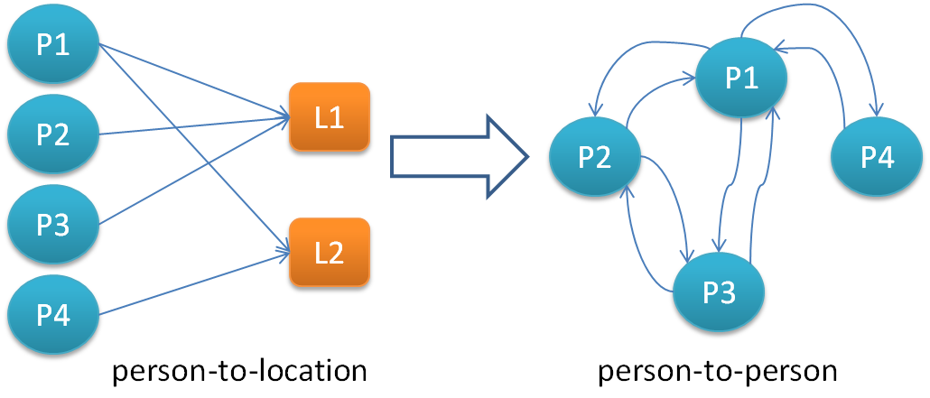
Data organization
P-L graph explicit, defines communication
P-P graph implicit, defines computation, 50x more edges
Both graphs evolve over time
US Population
  270 million people, 70 million locations
  1.5 billion edges P-L graph
  ~75 billion edges P-P graph (potential interactions/step)

Slide 8
Complex, Layered Interventions
Intervention | Population | Compliance | When
Vaccination | Adult Children Crit Workers | 25% 60% 100% | Day 0
School | Closure Reopen | 60% | 1.0% Children diagnosed (by county)
Quarantine | Crit Workers | 100% | 1.0% adults diagnosed
Self Isolate | All | 20% | 2.5% adults diagnosed
# stay home when symptomatic.
intervention symptomatic
set num_symptomatic++
apply diagnose with prob=0.60
schedule stayhome 3
trigger disease.symptom >= 2
apply symptomatic
# vaccinate 25% of adults
intervention vaccinate_adult
treat vaccine
set num_vac_adult++
trigger person.age > 18
apply vaccinate_adult with prob=0.25
Notes:
Prevent 30% of treated individuals from becoming infected.
Children stay home during school hours (with adult if under 13). Compliant children stay home outside of school hours.
Critical workers removed from general population and isolated in small groups.
Eliminate all activities outside of the home.

Slide 9
Effects of Interventions

Slide 10
BlueWaters Setup
Charm++ SMP mode
Gemini network layer
4 processes/node
3 compute 1 comm threads per process
Application based message coalescence
Notes:
nodes not cores in plot
22,528 out of 22,640 XE compute nodes (99.5%)

Slide 11
Weak Scaling
Notes:
Person per PE constant
Last point US population (270 million agents, 1.5 billion edges, ~75 billion potential interactions per day)

Slide 12
Location Granularity
Location load depends on number of visits
Location size follows power law
Not apparent until running at scale
Notes:
log-log plots

Slide 13
Scaling for US Population
Notes:
either memory/network effects
effciency compares well to Kalyan S. Perumalla and Sudip K. Seal (~15%, 64k cores XT5)

Slide 14
Static Partitioning
Round Robin
  Random distribution
  Low overhead
  Works well for small geographic areas (metro area)
Graph Partitioner
  Metis based partitioning
  Multi-constraint (two phases separated by sync)
  Higher Overhead
  Helps as geographic area increases (state, national)
Notes:
geographic region highly clustered
location assignment gravity model with 60 mile radius

Slide 15
Static Partitioning - Results
SendInteractor(). Person computation to generate visit messages
AddVisitMessage(). Location side message receive handling.
ComputeInfections(). Location computation of interaction among visitors
Notes:
replace with scaled
MI with 256 nodes (3072 cores)

Slide 16
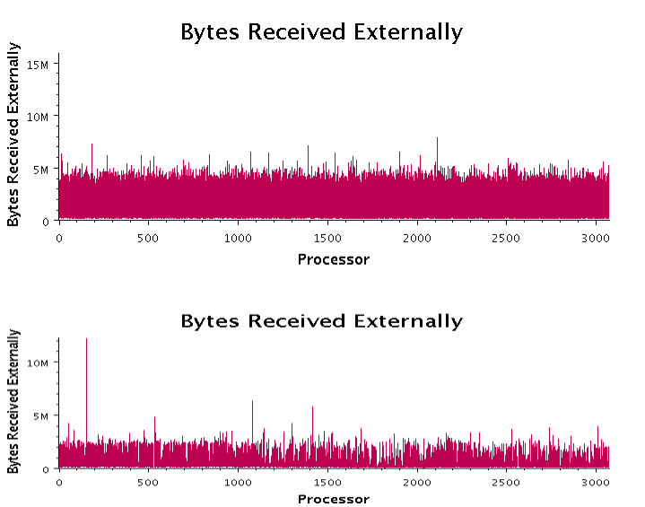
Message Volume
Round Robin
Graph Partitioner
256 nodes, 10 million people

Slide 17
Graph Sparsification
Goal: Improve runtime of Graph Partitioning
Procedure
Randomly remove edges from high degree nodes
Partition sparse graph
Use full graph for execution

Slide 18
Impact of GPU Acceleration on Execution Profile
70.9%
7.7x
Assume 1CPU cores per GPU devices, in practice, CPU > GPU
Notes:
This slide presents the potential benefits of GPU acceleration. The “Infect” phase gets accelerated by 7.7x and the overall application performance improves by 70.9%. The numbers are for WA (5.8M), experimental platform is HokieSpeed @ VT, and 8 nodes and 2 CPUs per node are used. There are 2 GPUs per node as well. This means that each CPU core gets exclusive access to a full GPU. This is to motivate the potential benefits of GPU acceleration. Of course, in reality, each CPU does not get exclusive access to a GPU, i.e. there will be many more CPUs per node than GPUs per node. So, GPUs are basically shared by different CPUs. This ties in to why we want to use the load balancing strategy of Charm++ in conjunction with GPUCharmSimdemics.

Slide 19
GPU-CharmSimdemics Scenarios
GPU
Scenario 1 – All chares from all CPU processes offload simultaneously to GPU
  GPUs (Kepler) maintain tasks queue from different processes
  Inefficient: CPUs will be idle waiting for GPU execution to complete
Scenario 2 – Chares from only some select CPU processes offload to GPU
  1:1 ratio can be maintained between “GPU” processes and GPUs
  But, “GPU” chares will finish sooner than “CPU” chares, i.e. load imbalance
  Use LB methods of Charm++ to rebalance chares
GPU
Node
GPU
GPU
Node

Slide 20
Future Work
Dynamic Load Balancing with semantic information
  Prediction model based on past runs
  Information from simulation state variables
  Use dynamic interventions – more variable load
Try Charm++ Meta Load Balancer
Further improvements to initial partitioning
  Minimize message imbalance as well as edge-cut
Message reduction
Sequential replicates to amortize data load time
Scale to global population - 10 billion people

Slide 21
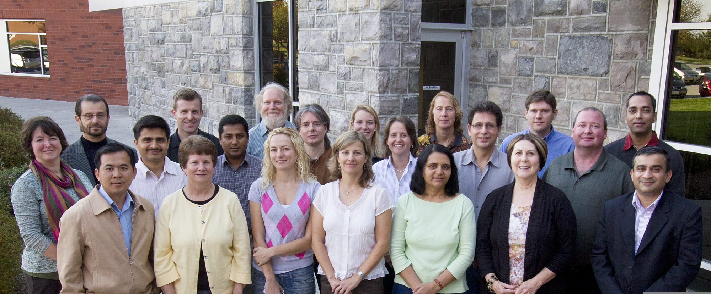


Acknowledgements
NDSSL Faculty, Staff and Students
UIUC Parallel Programming Lab
NSF HSD Grant SES-0729441, NSF PetaApps Grant OCI-0904844, NSF NETS Grant CNS-0831633, NSF CAREER Grant CNS-0845700, NSF NetSE Grant CNS-1011769, NSF SDCI Grant OCI-1032677, DTRA R&D Grant HDTRA1-09-1-0017, DTRA Grant HDTRA1-11-1-0016, DTRA CNIMS Contract HDTRA1-11-D-0016-0001, DOE Grant DE-SC0003957, PSU/DOE 4345-VT-DOE-4261, US Naval Surface Warfare Center Grant N00178-09-D-3017 DEL ORDER 13, NIH MIDAS Grant 2U01GM070694-09, NIH MIDAS Grant 3U01FM070694-09S1, LLNL Fellowship SubB596713 DOI Contract D12PC00337

