Slide 1

Architecture-Aware Algorithms and Software for Peta and Exascale Computing
Jack Dongarra
University of Tennessee
Oak Ridge National Laboratory
University of Manchester
Notes:
E =c*v^2*f
C=capacity; f proposal to v
Its on a single chip
multiple distinct processing engines
multi independent threads of control or program counters
Bw discrete chips (on bus) 2GB/s multicore 40 GB/s
Latency 60 ns to 3 ns
Energy 500 pJ 5 pJ
Freq pro v
Power proposional to v^2F or v^3

Slide 2

H. Meuer, H. Simon, E. Strohmaier, & JD
- Listing of the 500 most powerful
Computers in the World
- Yardstick: Rmax from LINPACK MPP
Ax=b, dense problem
- Updated twice a year
SC‘xy in the States in November
Meeting in Germany in June
- All data available from www.top500.org
TPP performance
Rate
Size

Slide 3
Performance Development
100 Pflop/s
44.16 PFlop/s
10 Pflop/s
2.56 PFlop/s
1 Pflop/s
100 Tflop/s
SUM
31 TFlop/s
10 Tflop/s
N=1
1 Tflop/s
1.17 TFlop/s
6-8 years
100 Gflop/s
N=500
59.7 GFlop/s
10 Gflop/s
My Laptop
1 Gflop/s
400 MFlop/s
100 Mflop/s
1993
1995
1997
1999
2001
2003
2005
2007
2009
My iPhone (40 Mflop/s)
2010

Slide 4
36rd List: The TOP10
Rank | Site | Computer | Country | Cores | Rmax [Pflops] | % of Peak | Power [MW] | Flops/Watt
1 | Nat. SuperComputer Center in Tianjin | Tianhe-1A, NUDT Intel + Nvidia GPU + custom | China | 186,368 | 2.57 | 55 | 4.04 | 636
2 | DOE / OS Oak Ridge Nat Lab | Jaguar, Cray AMD + custom | USA | 224,162 | 1.76 | 75 | 7.0 | 251
3 | Nat. Supercomputer Center in Shenzhen | Nebulea, Dawning Intel + Nvidia GPU + IB | China | 120,640 | 1.27 | 43 | 2.58 | 493
4 | GSIC Center, Tokyo Institute of Technology | Tusbame 2.0, HP Intel + Nvidia GPU + IB | Japan | 73,278 | 1.19 | 52 | 1.40 | 850
5 | DOE / OS Lawrence Berkeley Nat Lab | Hopper, Cray AMD + custom | USA | 153,408 | 1.054 | 82 | 2.91 | 362
6 | Commissariat a l'Energie Atomique (CEA) | Tera-10, Bull Intel + IB | France | 138,368 | 1.050 | 84 | 4.59 | 229
7 | DOE / NNSA Los Alamos Nat Lab | Roadrunner, IBM AMD + Cell GPU + IB | USA | 122,400 | 1.04 | 76 | 2.35 | 446
8 | NSF / NICS U of Tennessee | Kraken, Cray AMD + custom | USA | 98,928 | .831 | 81 | 3.09 | 269
9 | Forschungszentrum Juelich (FZJ) | Jugene, IBM Blue Gene + custom | Germany | 294,912 | .825 | 82 | 2.26 | 365
10 | DOE / NNSA LANL & SNL | Cielo, Cray AMD + custom | USA | 107,152 | .817 | 79 | 2.95 | 277

Slide 5
36rd List: The TOP10
Rank | Site | Computer | Country | Cores | Rmax [Pflops] | % of Peak | Power [MW] | GFlops/Watt
1 | Nat. SuperComputer Center in Tianjin | Tianhe-1A, NUDT Intel + Nvidia GPU + custom | China | 186,368 | 2.57 | 55 | 4.04 | 636
2 | DOE / OS Oak Ridge Nat Lab | Jaguar, Cray AMD + custom | USA | 224,162 | 1.76 | 75 | 7.0 | 251
3 | Nat. Supercomputer Center in Shenzhen | Nebulea, Dawning Intel + Nvidia GPU + IB | China | 120,640 | 1.27 | 43 | 2.58 | 493
4 | GSIC Center, Tokyo Institute of Technology | Tusbame 2.0, HP Intel + Nvidia GPU + IB | Japan | 73,278 | 1.19 | 52 | 1.40 | 850
5 | DOE / OS Lawrence Berkeley Nat Lab | Hopper, Cray AMD + custom | USA | 153,408 | 1.054 | 82 | 2.91 | 362
6 | Commissariat a l'Energie Atomique (CEA) | Tera-10, Bull Intel + IB | France | 138,368 | 1.050 | 84 | 4.59 | 229
7 | DOE / NNSA Los Alamos Nat Lab | Roadrunner, IBM AMD + Cell GPU + IB | USA | 122,400 | 1.04 | 76 | 2.35 | 446
8 | NSF / NICS U of Tennessee | Kraken, Cray AMD + custom | USA | 98,928 | .831 | 81 | 3.09 | 269
9 | Forschungszentrum Juelich (FZJ) | Jugene, IBM Blue Gene + custom | Germany | 294,912 | .825 | 82 | 2.26 | 365
10 | DOE / NNSA LANL & SNL | Cielo, Cray AMD + custom | USA | 107,152 | .817 | 79 | 2.95 | 277
500 Computacenter LTD HP Cluster, Intel + GigE UK 5,856 .031 53

Slide 6
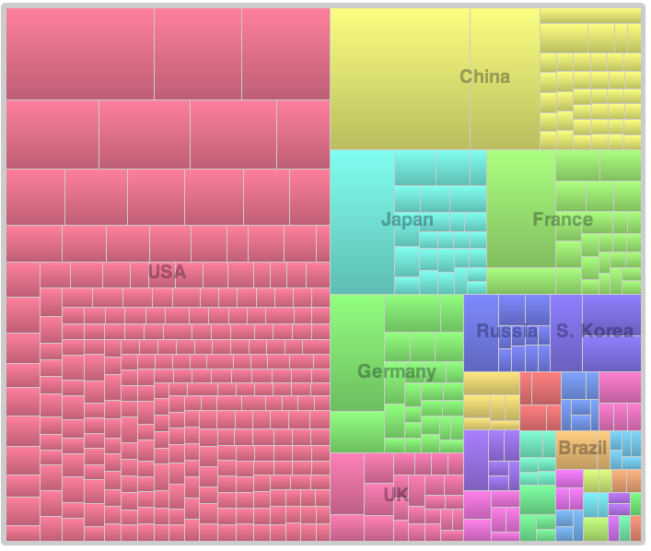
Countries Share
Absolute Counts
US: 274
China: 41
Germany: 26
Japan: 26
France: 26
UK: 25

Slide 7
Performance Development in Top500
100 Pflop/s
10 Pflop/s
N=1
1 Pflop/s
Gordon
Bell
Winners
100 Tflop/s
10 Tflop/s
1 Tflop/s
N=500
100 Gflop/s
10 Gflop/s
1 Gflop/s
100 Mflop/s

Slide 8
Potential System Architecture
Systems | 2010 | 2018 | Difference Today & 2018
System peak | 2 Pflop/s | 1 Eflop/s | O(1000)
Power | 6 MW | ~20 MW
System memory | 0.3 PB | 32 - 64 PB | O(100)
Node performance | 125 GF | 1,2 or 15TF | O(10) – O(100)
Node memory BW | 25 GB/s | 2 - 4TB/s | O(100)
Node concurrency | 12 | O(1k) or 10k | O(100) – O(1000)
Total Node Interconnect BW | 3.5 GB/s | 200-400GB/s | O(100)
System size (nodes) | 18,700 | O(100,000) or O(1M) | O(10) – O(100)
Total concurrency | 225,000 | O(billion) | O(10,000)
Storage | 15 PB | 500-1000 PB (>10x system memory is min) | O(10) – O(100)
IO | 0.2 TB | 60 TB/s (how long to drain the machine) | O(100)
MTTI | days | O(1 day) | - O(10)
Notes:
Missing Latencies
Message injection rates
Flops/watt cost money and bytes/flop that costs money
Joule/op in 2009, 2015 and 2018:
2015: 100 pj/op
Capacity doesn’t cost as much power as bandwidth
how many joules to move a bit
2 picojoule/bit
75pj/bit for accessing DRAM
32 Petabytes: with system memory at same fraction of system
Need $ number
Best machine for 20MW and best machine for $200M
Memory op is 64 bit word of memory
75 picojoule bit for (multiply by 64) (DDR 3 spec)
50 pj/ for an entire 64 bit op
Memory technology in 5pj/bit by 2015 if we invest soon
Anything more aggressive than 4pj/bit is close to the limit (will not sign up for 2pj/bit)
2015 10 pj/flop
5pj/flop in 2018
So we are talking 30:1 ratio of memory reference per flop
10pj/operation to bring a byte in
8 terabits * 1pj -> 8 watts
JEDEC is fundamentally broken (DDR4 is the end)
Low swing differential
insertion of known technology
20GB/s per component to 1 order of magnitude more
10-12 Gigabits/second per wire
16-64 using courant limited scaling of hydro codes
Cost per DRAM in that timeframe and how much to spend
# outstanding memory references per cycle-→ bandwidth * latency
above based on memory reference size
memory concurrency
200 cycles from DRAM (2GHz) is 100ns (40ns for memory alone). With queues will be 100ns
O(1000) references per node to memory
O(10k) for 64 byte cache lines?
Need to add system bisection:
2015: whatever local node bandwidth: factor of 4-8 or 2-4 against per-node interconnect bandwidth
2018:
Occupancy vs latency:
zero occupancy (1 slot for message launch)
5ns per
2-4 in 2015
2-4 in 2018
10^4 vs 10^9th

Slide 9
Potential System Architecture with a cap of $200M and 20MW
Systems | 2010 | 2018 | Difference Today & 2018
System peak | 2 Pflop/s | 1 Eflop/s | O(1000)
Power | 6 MW | ~20 MW
System memory | 0.3 PB | 32 - 64 PB | O(100)
Node performance | 125 GF | 1,2 or 15TF | O(10) – O(100)
Node memory BW | 25 GB/s | 2 - 4TB/s | O(100)
Node concurrency | 12 | O(1k) or 10k | O(100) – O(1000)
Total Node Interconnect BW | 3.5 GB/s | 200-400GB/s | O(100)
System size (nodes) | 18,700 | O(100,000) or O(1M) | O(10) – O(100)
Total concurrency | 225,000 | O(billion) | O(10,000)
Storage | 15 PB | 500-1000 PB (>10x system memory is min) | O(10) – O(100)
IO | 0.2 TB | 60 TB/s (how long to drain the machine) | O(100)
MTTI | days | O(1 day) | - O(10)
Notes:
Missing Latencies
Message injection rates
Flops/watt cost money and bytes/flop that costs money
Joule/op in 2009, 2015 and 2018:
2015: 100 pj/op
Capacity doesn’t cost as much power as bandwidth
how many joules to move a bit
2 picojoule/bit
75pj/bit for accessing DRAM
32 Petabytes: with system memory at same fraction of system
Need $ number
Best machine for 20MW and best machine for $200M
Memory op is 64 bit word of memory
75 picojoule bit for (multiply by 64) (DDR 3 spec)
50 pj/ for an entire 64 bit op
Memory technology in 5pj/bit by 2015 if we invest soon
Anything more aggressive than 4pj/bit is close to the limit (will not sign up for 2pj/bit)
2015 10 pj/flop
5pj/flop in 2018
So we are talking 30:1 ratio of memory reference per flop
10pj/operation to bring a byte in
8 terabits * 1pj -> 8 watts
JEDEC is fundamentally broken (DDR4 is the end)
Low swing differential
insertion of known technology
20GB/s per component to 1 order of magnitude more
10-12 Gigabits/second per wire
16-64 using courant limited scaling of hydro codes
Cost per DRAM in that timeframe and how much to spend
# outstanding memory references per cycle-→ bandwidth * latency
above based on memory reference size
memory concurrency
200 cycles from DRAM (2GHz) is 100ns (40ns for memory alone). With queues will be 100ns
O(1000) references per node to memory
O(10k) for 64 byte cache lines?
Need to add system bisection:
2015: whatever local node bandwidth: factor of 4-8 or 2-4 against per-node interconnect bandwidth
2018:
Occupancy vs latency:
zero occupancy (1 slot for message launch)
5ns per
2-4 in 2015
2-4 in 2018
10^4 vs 10^9th

Slide 10
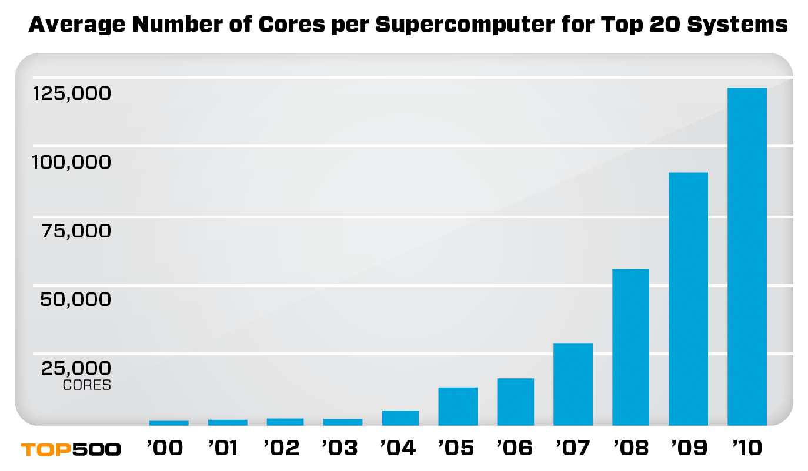
Factors that Necessitate Redesign of Our Software
Steepness of the ascent from terascale to petascale to exascale
Extreme parallelism and hybrid design
  Preparing for million/billion way parallelism
Tightening memory/bandwidth bottleneck
  Limits on power/clock speed implication on multicore
  Reducing communication will become much more intense
  Memory per core changes, byte-to-flop ratio will change
Necessary Fault Tolerance
  MTTF will drop
  Checkpoint/restart has limitations
  shared responsibility
  Software infrastructure does not exist today

Slide 11
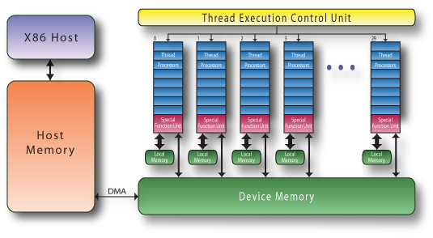
Commodity plus Accelerators
Commodity
Accelerator (GPU)
Intel Xeon
8 cores
3 GHz
8*4 ops/cycle
96 Gflop/s (DP)
Nvidia C2050 “Fermi”
448 “Cuda cores”
1.15 GHz
448 ops/cycle
515 Gflop/s (DP)
Interconnect
PCI-X 16 lane
64 Gb/s
1 GW/s
17 systems on the TOP500 use GPUs as accelerators

Slide 12
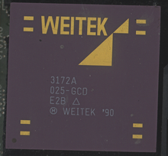
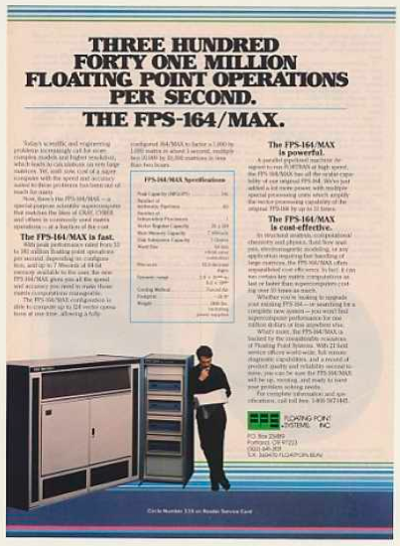
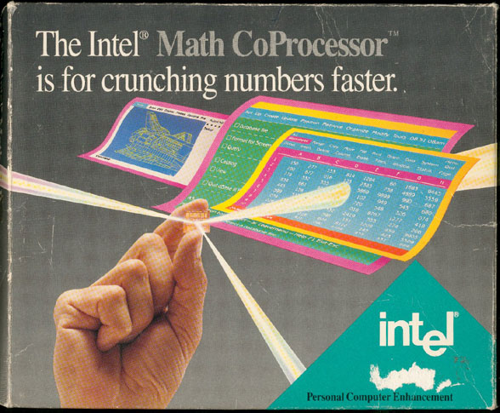
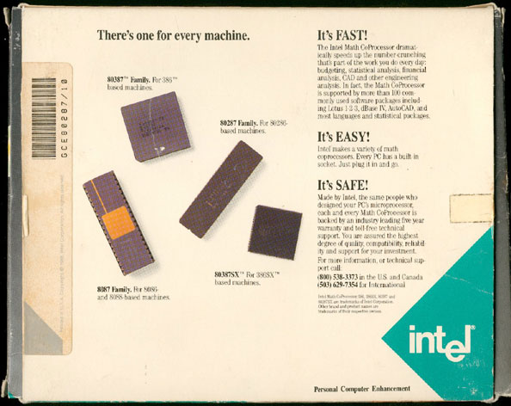
We Have Seen This Before
Floating Point Systems FPS-164/MAX Supercomputer (1976)
Intel Math Co-processor (1980)
Weitek Math Co-processor (1981)
1976
1980

Slide 13
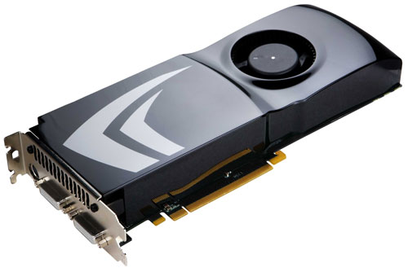
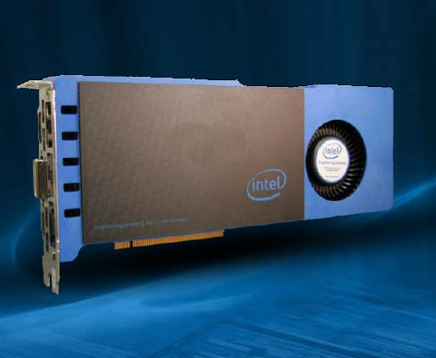


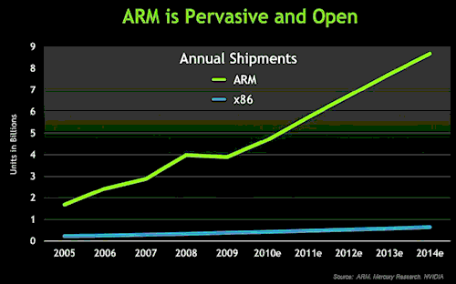
Future Computer Systems
Most likely be a hybrid design
  Think standard multicore chips and accelerator (GPUs)
Today accelerators are attached
Next generation more integrated
Intel’s MIC architecture “Knights Ferry” and “Knights Corner” to come.
  48 x86 cores
AMD’s Fusion in 2012 - 2013
  Multicore with embedded graphics ATI
Nvidia’s Project Denver plans to develop an integrated chip using ARM architecture in 2013.

Slide 14
Major Changes to Software
Must rethink the design of our software
  Another disruptive technology
    Similar to what happened with cluster computing and message passing
  Rethink and rewrite the applications, algorithms, and software

Slide 15
Exascale algorithms that expose and exploit multiple levels of parallelism
Synchronization-reducing algorithms
  Break Fork-Join model
Communication-reducing algorithms
  Use methods which have lower bound on communication
Mixed precision methods
  2x speed of ops and 2x speed for data movement
Reproducibility of results
  Today we can’t guarantee this
Fault resilient algorithms
  Implement algorithms that can recover from failures

Slide 16
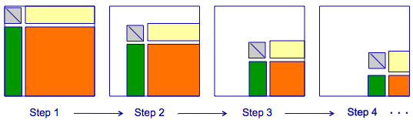
Parallel Tasks in LU/LL^{T}/QR
Break into smaller tasks and remove dependencies
* LU does block pair wise pivoting

Slide 17
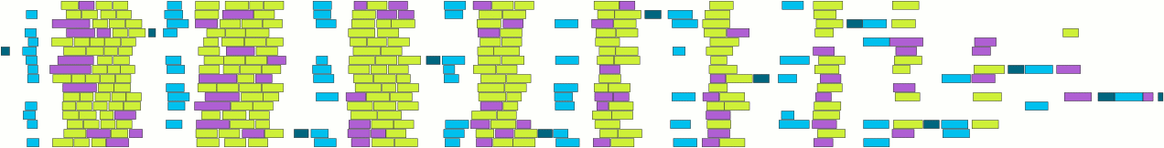
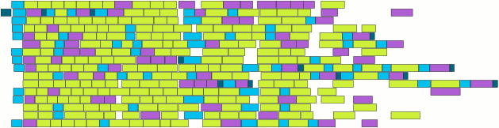
PLASMA: Parallel Linear Algebra s/w for Multicore Architectures
Objectives
  High utilization of each core
  Scaling to large number of cores
  Shared or distributed memory
Methodology
  Dynamic DAG scheduling
  Explicit parallelism
  Implicit communication
  Fine granularity / block data layout
Arbitrary DAG with dynamic scheduling
Cholesky
4 x 4
Fork-join
parallelism
DAG scheduled
parallelism
Time
17

Slide 18
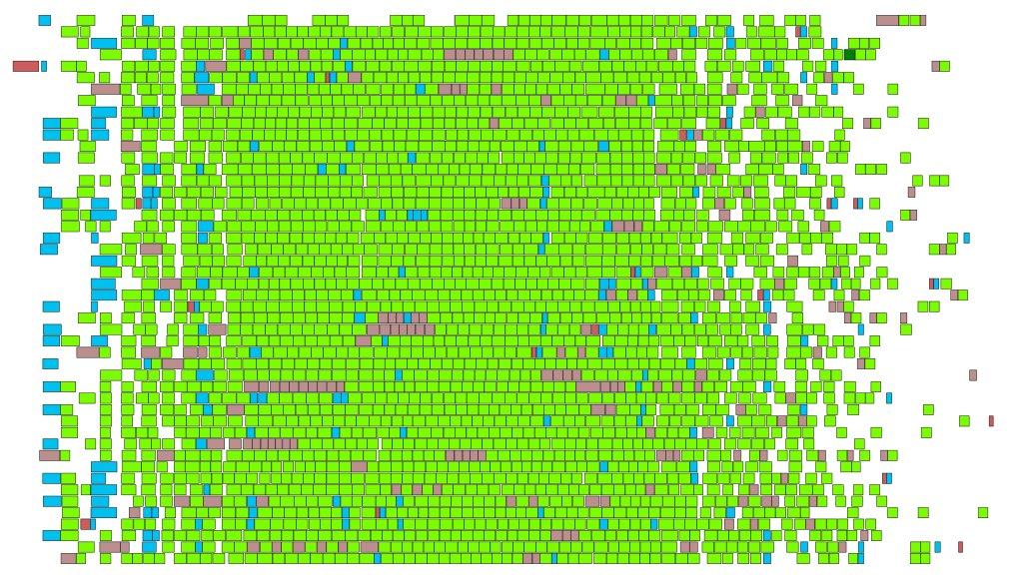
Synchronization Reducing Algorithms
  Regular trace
  Factorization steps pipelined
  Stalling only due to natural load imbalance
  Reduce ideal time
  Dynamic
  Out of order execution
  Fine grain tasks
  Independent block operations
8-socket, 6-core (48 cores total) AMD Istanbul 2.8 GHz

Slide 19
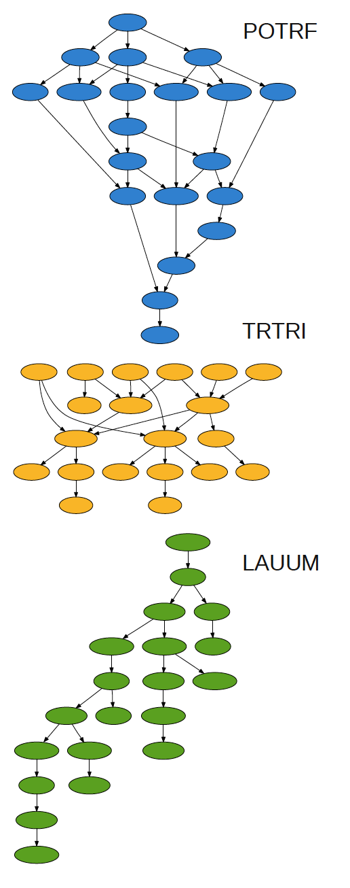
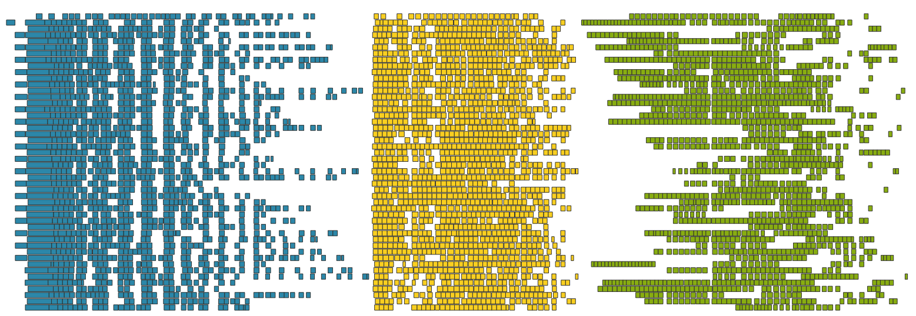
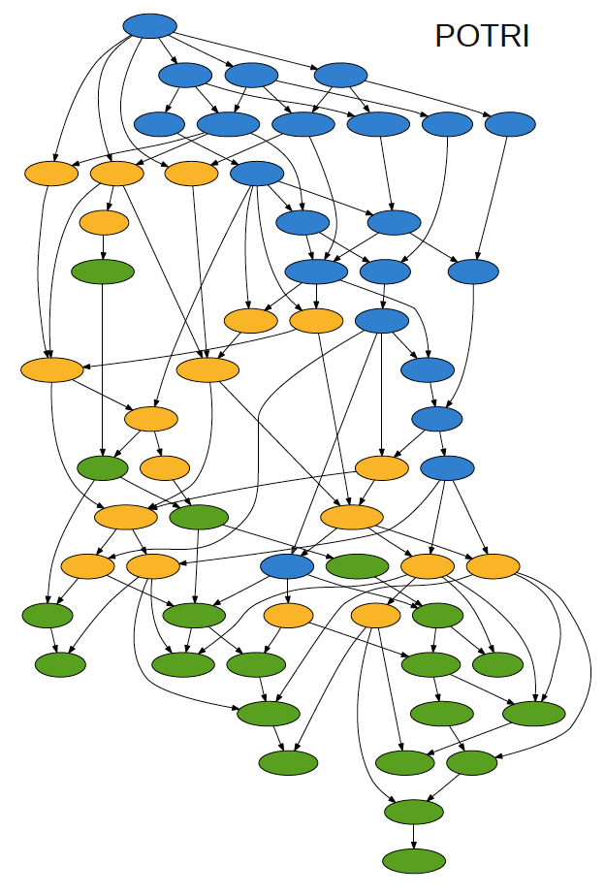
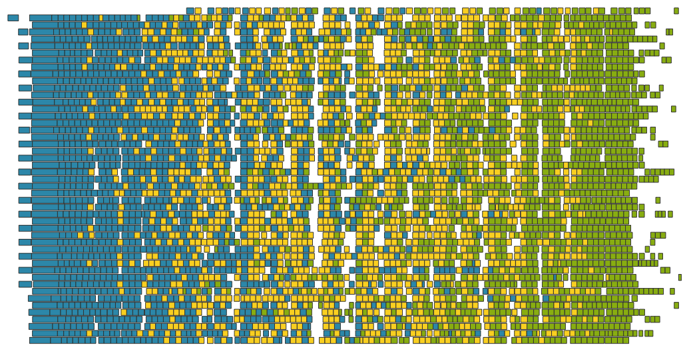
Pipelining: Cholesky Inversion
48 cores
POTRF, TRTRI and LAUUM.
The matrix is 4000 x 4000,tile size is 200 x 200,
POTRF+TRTRI+LAUUM: 25 (7t-3)
Cholesky Factorization alone: 3t-2
Pipelined: 18 (3t+6)

Slide 20
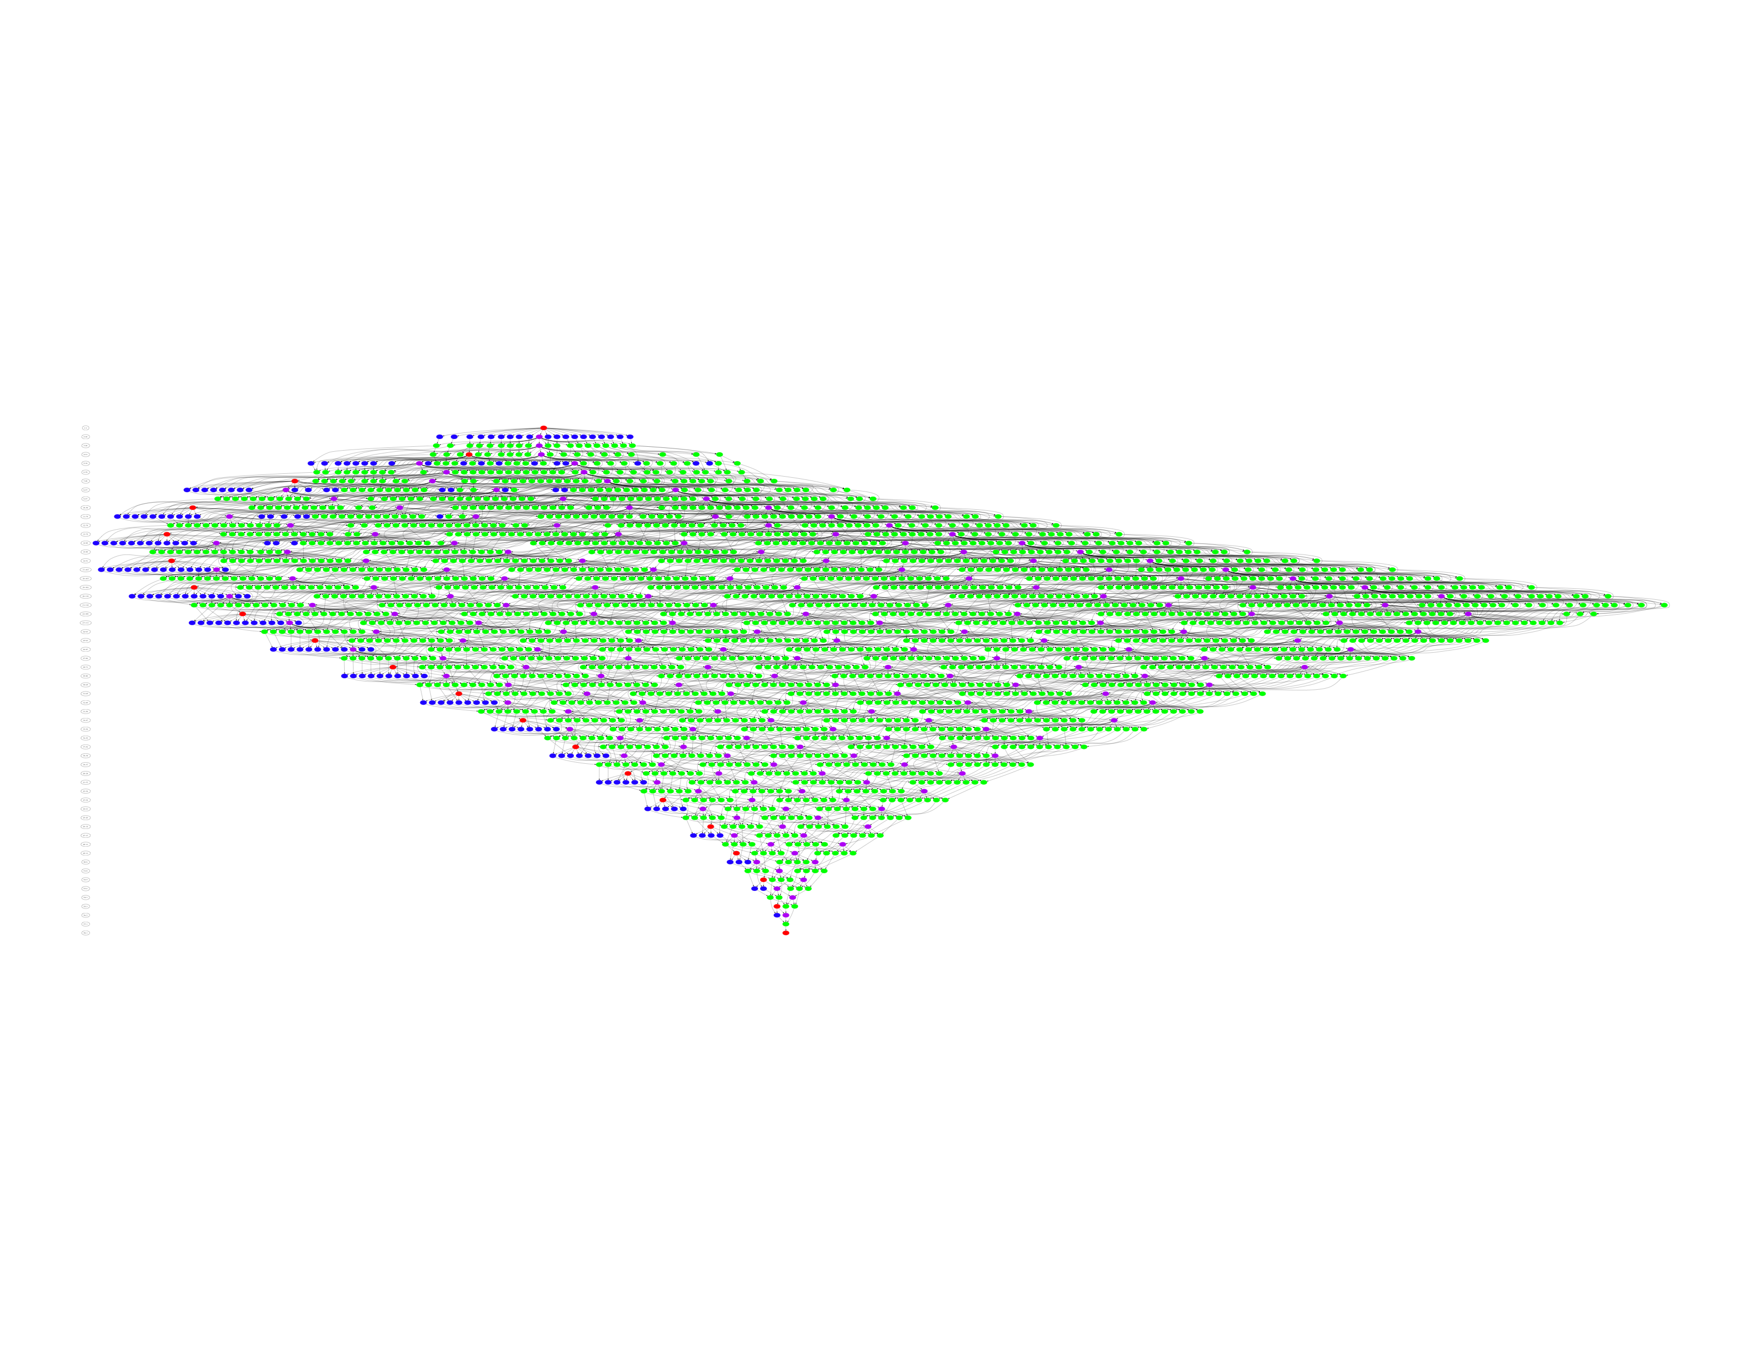
Big DAGs: No Global Critical Path
DAGs get very big, very fast
  So windows of active tasks are used; this means no global critical path
  Matrix of NBxNB tiles; NB³ operation
    NB=100 gives 1 million tasks

Slide 21
PLASMA Scheduling
Dynamic Scheduling: Sliding Window
Tile LU factorization
10 x 10 tiles
300 tasks
100 task window

Slide 22
PLASMA Scheduling
Dynamic Scheduling: Sliding Window
Tile LU factorization
10 x 10 tiles
300 tasks
100 task window

Slide 23
PLASMA Scheduling
Dynamic Scheduling: Sliding Window
Tile LU factorization
10 x 10 tiles
300 tasks
100 task window

Slide 24
PLASMA Scheduling
Dynamic Scheduling: Sliding Window
Tile LU factorization
10 x 10 tiles
300 tasks
100 task window

Slide 25
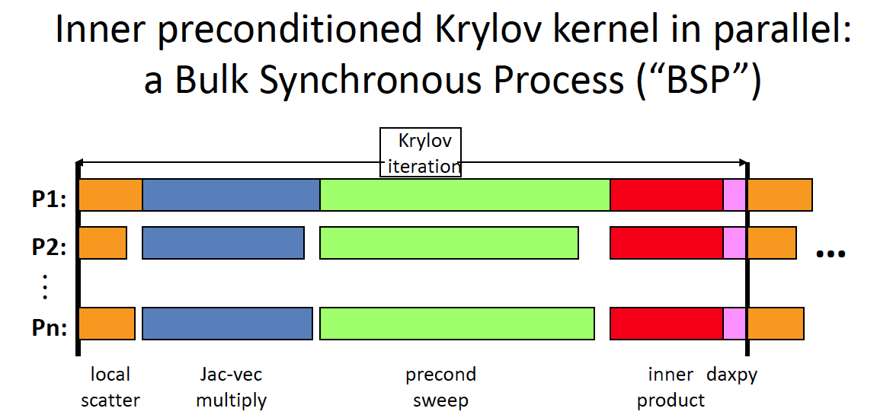

Slide 26
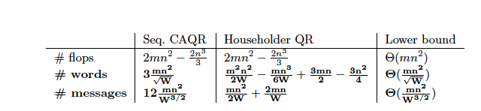
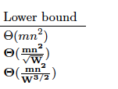
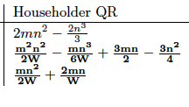
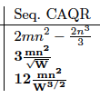
Communication Avoiding Algorithms
Goal: Algorithms that communicate as little as possible
Jim Demmel and company have been working on algorithms that obtain a provable minimum communication.
Direct methods (BLAS, LU, QR, SVD, other decompositions)
  Communication lower bounds for all these problems
  Algorithms that attain them (all dense linear algebra, some sparse)
    Mostly not in LAPACK or ScaLAPACK (yet)
Iterative methods – Krylov subspace methods for Ax=b, Ax=λx
  Communication lower bounds, and algorithms that attain them (depending on sparsity structure)
    Not in any libraries (yet)
For QR Factorization they can show:

Slide 27
Standard QR Block Reduction
We have a m x n matrix A we want to reduce to upper triangular form.

Slide 28
Standard QR Block Reduction
We have a m x n matrix A we want to reduce to upper triangular form.
Q₁^{T}

Slide 29
Standard QR Block Reduction
We have a m x n matrix A we want to reduce to upper triangular form.
R
Q₁^{T}
Q₂^{T}
Q₃^{T}
A = Q₁Q₂Q₃R = QR

Slide 30
Communication Avoiding QR
Example
R₀
R₀
R₀
R
R
D₀
Domain_Tile_QR
D₀
R₁
D₁
Domain_Tile_QR
D₁
R₂
R₂
D₂
Domain_Tile_QR
D₂
R₃
D₃
Domain_Tile_QR
D₃
A. Pothen and P. Raghavan. Distributed orthogonal factorization. In The 3rd
Conference on Hypercube Concurrent Computers and Applications, volume II, Applications,
pages 1610–1620, Pasadena, CA, Jan. 1988. ACM. Penn. State.

Slide 31
Communication Avoiding QR
Example
R₀
R₀
R₀
R
R
D₀
Domain_Tile_QR
D₀
R₁
D₁
Domain_Tile_QR
D₁
R₂
R₂
D₂
Domain_Tile_QR
D₂
R₃
D₃
Domain_Tile_QR
D₃
A. Pothen and P. Raghavan. Distributed orthogonal factorization. In The 3rd
Conference on Hypercube Concurrent Computers and Applications, volume II, Applications,
pages 1610–1620, Pasadena, CA, Jan. 1988. ACM. Penn. State.

Slide 32
Communication Avoiding QR
Example
R₀
R₀
R₀
R
R
D₀
Domain_Tile_QR
D₀
R₁
D₁
Domain_Tile_QR
D₁
R₂
R₂
D₂
Domain_Tile_QR
D₂
R₃
D₃
Domain_Tile_QR
D₃
A. Pothen and P. Raghavan. Distributed orthogonal factorization. In The 3rd
Conference on Hypercube Concurrent Computers and Applications, volume II, Applications,
pages 1610–1620, Pasadena, CA, Jan. 1988. ACM. Penn. State.

Slide 33
Communication Avoiding QR
Example
R₀
R₀
R₀
R
R
D₀
Domain_Tile_QR
D₀
R₁
D₁
Domain_Tile_QR
D₁
R₂
R₂
D₂
Domain_Tile_QR
D₂
R₃
D₃
Domain_Tile_QR
D₃
A. Pothen and P. Raghavan. Distributed orthogonal factorization. In The 3rd
Conference on Hypercube Concurrent Computers and Applications, volume II, Applications,
pages 1610–1620, Pasadena, CA, Jan. 1988. ACM. Penn. State.

Slide 34
Communication Avoiding QR
Example
R₀
R₀
R₀
R
R
D₀
Domain_Tile_QR
D₀
R₁
D₁
Domain_Tile_QR
D₁
R₂
R₂
D₂
Domain_Tile_QR
D₂
R₃
D₃
Domain_Tile_QR
D₃
A. Pothen and P. Raghavan. Distributed orthogonal factorization. In The 3rd
Conference on Hypercube Concurrent Computers and Applications, volume II, Applications,
pages 1610–1620, Pasadena, CA, Jan. 1988. ACM. Penn. State.

Slide 35
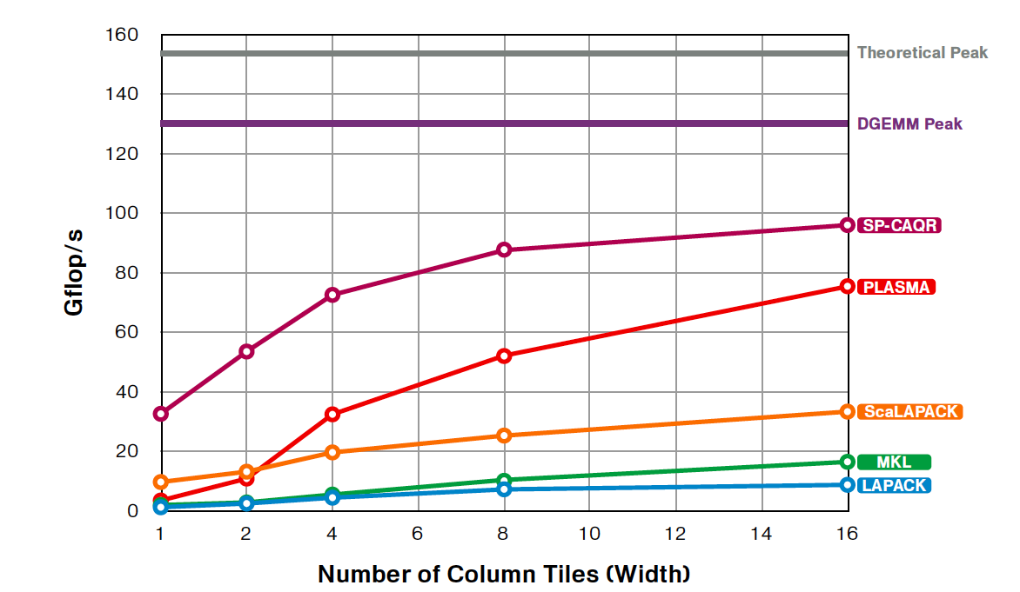
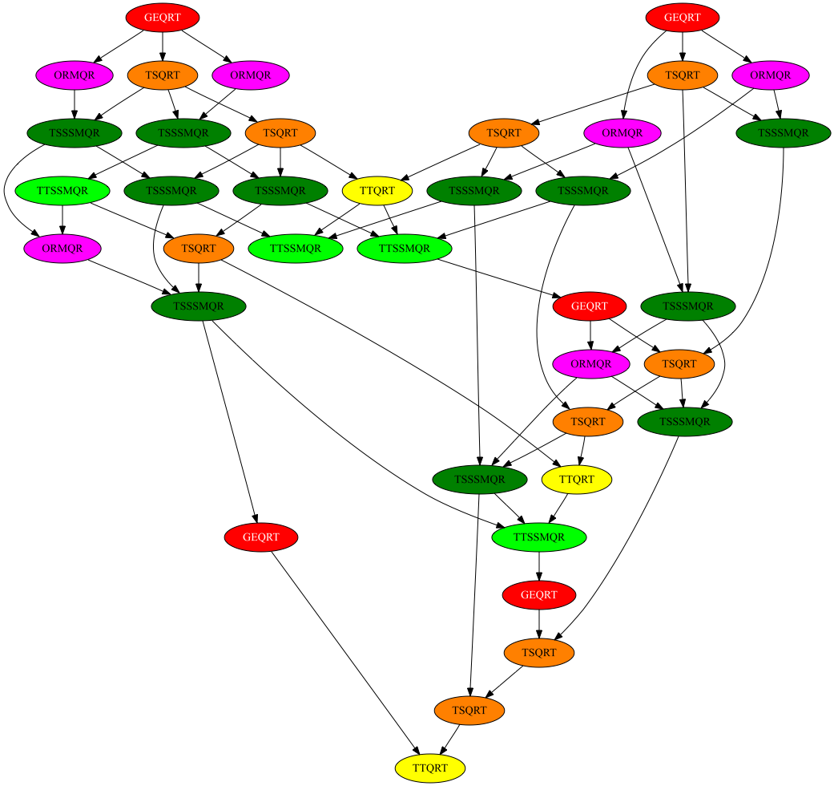
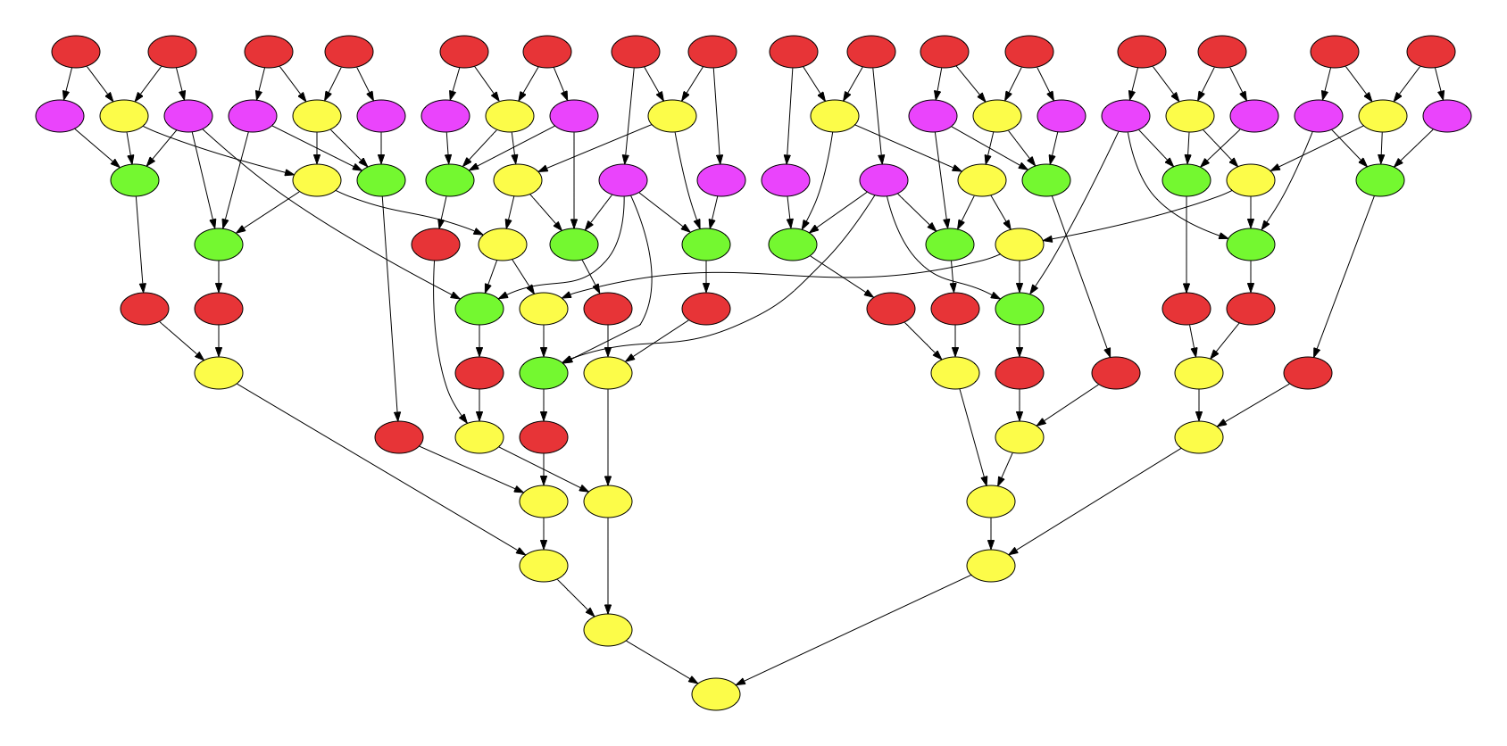
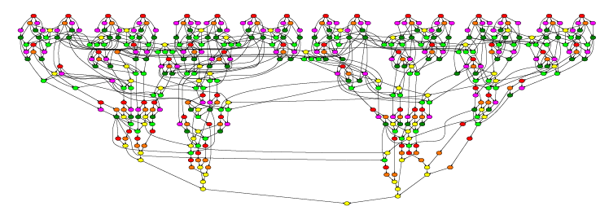
Communication Reducing QR
Factorization
Quad-socket, quad-core machine Intel Xeon EMT64 E7340 at 2.39 GHz.
Theoretical peak is 153.2 Gflop/s with 16 cores.
Matrix size 51200 by 3200

Slide 36
Mixed Precision Methods
Mixed precision, use the lowest precision required to achieve a given accuracy outcome
  Improves runtime, reduce power consumption, lower data movement
  Reformulate to find correction to solution, rather than solution; Δx rather than x.

Slide 37
Idea Goes Something Like This…
Exploit 32 bit floating point as much as possible.
  Especially for the bulk of the computation
Correct or update the solution with selective use of 64 bit floating point to provide a refined results
Intuitively:
  Compute a 32 bit result,
  Calculate a correction to 32 bit result using selected higher precision and,
  Perform the update of the 32 bit results with the correction using high precision.

Slide 38
Mixed-Precision Iterative Refinement
Iterative refinement for dense systems, Ax = b, can work this way.
  Wilkinson, Moler, Stewart, & Higham provide error bound for SP fl pt results when using DP fl pt.
L U = lu(A) SINGLE O(n³)
x = L\(U\b) SINGLE O(n²)
r = b – Ax DOUBLE O(n²)
WHILE || r || not small enough
z = L\(U\r) SINGLE O(n²)
x = x + z DOUBLE O(n¹)
r = b – Ax DOUBLE O(n²)
END

Slide 39
Mixed-Precision Iterative Refinement
Iterative refinement for dense systems, Ax = b, can work this way.
  Wilkinson, Moler, Stewart, & Higham provide error bound for SP fl pt results when using DP fl pt.
  It can be shown that using this approach we can compute the solution to 64-bit floating point precision.
    Requires extra storage, total is 1.5 times normal;
    O(n³) work is done in lower precision
    O(n²) work is done in high precision
    Problems if the matrix is ill-conditioned in sp; O(10⁸)
L U = lu(A) SINGLE O(n³)
x = L\(U\b) SINGLE O(n²)
r = b – Ax DOUBLE O(n²)
WHILE || r || not small enough
z = L\(U\r) SINGLE O(n²)
x = x + z DOUBLE O(n¹)
r = b – Ax DOUBLE O(n²)
END

Slide 40
Ax = b
FERMI Tesla C2050: 448 CUDA cores @ 1.15GHz
SP/DP peak is 1030 / 515 GFlop/s
Single Precision
Gflop/s
Double Precision
Matrix size

Slide 41
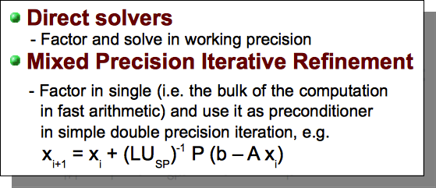
Ax = b
FERMI Tesla C2050: 448 CUDA cores @ 1.15GHz
SP/DP peak is 1030 / 515 GFlop/s
Single Precision
Mixed Precision
Gflop/s
Double Precision
Similar results for Cholesky & QR
Matrix size

Slide 42
Power Profiles
Two dual-core 1.8 GHz AMD Opteron processors
Theoretical peak: 14.4 Gflops per node
DGEMM using 4 threads: 12.94 Gflops
PLASMA 2.3.1, GotoBLAS2
Experiments:
  PLASMA LU solver in double precision
  PLASMA LU solver in mixed precision
PLASMA DP
N = 8400, using 4 cores | PLASMA DP | PLASMA Mixed
Time to Solution (s) | 39.5 | 22.8
GFLOPS | 10.01 | 17.37
Accuracy | 2.0E-02 | 1.3E-01
Iterations |  | 7
System Energy (KJ) | 10852.8 | 6314.8
PLASMA Mixed Precision

Slide 43
Reproducibility
For example when done in parallel can’t guarantee the order of operations.
Lack of reproducibility due to floating point nonassociativity and algorithmic adaptivity (including autotuning) in efficient production mode
Bit-level reproducibility may be unnecessarily expensive most of the time
Force routine adoption of uncertainty quantification
  Given the many unresolvable uncertainties in program inputs, bound the error in the outputs in terms of errors in the inputs

Slide 44

A Call to Action: Exascale is a Global Challenge
Hardware has changed dramatically while software ecosystem has remained stagnant
Community codes unprepared for sea change in architectures
No global evaluation of key missing components
The IESP was Formed in 2008
Goal to engage international computer science community to address common software challenges for Exascale
Focus on open source systems software that would enable multiple platforms
Shared risk and investment
Leverage international talent base
Notes:
PIES

Slide 45

International Exascale Software Program
Improve the world’s simulation and modeling capability by improving the coordination and development of the HPC software environment
Workshops:
Build an international plan for coordinating research for the next generation open source software for scientific high-performance computing
Notes:
When I was asked what are we really doing here construct a doc which has a coordinated research plan and roadmap to be used by agencies to build a program in exasw. Too big an effort to do along.
We seek to create an common, open source software infrastructure for scientific computing that enables leading edge science and engineering groups to develop applications that exploit the full power of the exascale computing platforms that will come on-line in the 2018-2020 timeframe.

Slide 46
Example Organizational Structure:
Incubation Period (today):
IESP provides coordination internationally, while regional groups have well managed R&D plans and milestones
IESP
JP
EU-EESI
US-DOE
US-NSF

Slide 47
Conclusions
For the last decade or more, the research investment strategy has been overwhelmingly biased in favor of hardware.
This strategy needs to be rebalanced - barriers to progress are increasingly on the software side.
Moreover, the return on investment is more favorable to software.
  Hardware has a half-life measured in years, while software has a half-life measured in decades.
High Performance Ecosystem out of balance
  Hardware, OS, Compilers, Software, Algorithms, Applications
    No Moore’s Law for software, algorithms and applications

Slide 48

`
Published in the January 2011 issue of
The International Journal of High Performance Computing Applications
“We can only see a short distance ahead, but we can see plenty there that needs to be done.”
  Alan Turing (1912 —1954)
www.exascale.org

