Slide 1
Large Scale Simulations Enabled by BigSim
Dr. Gengbin Zheng and Ehsan Totoni
Parallel Programming Laboratory
University of Illinois at Urbana-Champaign
April 18, 2011

Slide 2
What is BigSim
A function level simulator for parallel applications on peta-scale machine
An emulator runs applications at full scale
A simulator predicts performance by simulating message passing

Slide 3
What’s New Last Year
Improved simulation framework from these aspects
  Even larger/faster emulation and simulation
  More accurate prediction of sequential performance
Apply BigSim to predict Blue Waters machine

Slide 4
Emulation at Large Scale
Using existing (possibly different) clusters for emulation
Applied memory reduction techniques
For example, we achieved for NAMD:
  Emulate 10M-atom benchmark on 256K cores using only 4K cores of Ranger (2GB/core)
  Emulate 100M-atom benchmark on 1.2M cores using only 48K cores of Jaguar (1.3GB/core)

Slide 5
Accurate Prediction of Sequential Execution Blocks
Predicting parallel applications can be challenging
  Accurate prediction of sequential execution blocks
  Network performance
This paper explores techniques to use statistical models for sequential execution blocks
Gengbin Zheng, Gagan Gupta, Eric Bohm, Isaac Dooley, and Laxmikant V. Kale, "Simulating Large Scale Parallel Applications using Statistical Models for Sequential Execution Blocks", in the Proceedings of the 16th International Conference on Parallel and Distributed Systems (ICPADS 2010)

Slide 6
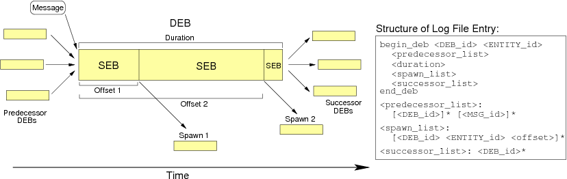
Dependent Execution Blocks and Sequential Execution Blocks (SEB)

Slide 7
Old Ways to Predict SEB time
CPU scaling
  Take execution on one machine to predict another
  not accurate
Hardware simulator
  Cycle accurate timing
  However it is slow
Performance counters
  Very hard, and platform specific
An efficient and accurate prediction method?

Slide 8
Basic Idea – Machine learning
Identify parameters that characterize the execution time of an SEB:
  x₁,x₂, …, x_{n}
With machine learning, build statistical model of the execution time:
  T=f(x₁,x₂,…,x_{n})
Run SEBs in realistic scenario and collect data points
  X₁₁,x₂₁,…,x_{n1} => T1
  X₁₂,x₂₂,…,x_{n2} => T2
  …

Slide 9
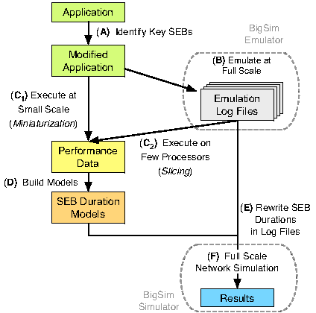
SEB Prediction Scheme (6 steps)

Slide 10
Data Collection at Small Scale
Slicing (C₂)
  Record and replay any processor
  Instrument exact parameters
  Require binary compatible architecture
Miniaturization (C₁)
  Scaled down execution (smaller dataset, smaller number of processors)
  Not all application can scale down

Slide 11
Build Prediction Models (D)
Machine learning techniques
  Linear Regression
  Least median squared linear regression
  SVMreg
Use machine learning software like weka
As an example:
  T(N) = -0.036N² + 0.009N³ + 12.47
Notes:
SVMreg support vector machine for regression

Slide 12
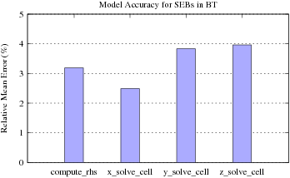
Validation – NAS BT Benchmark
Use Abe to predict Ranger
NAS BT Benchmark BT.D.1024
emulate 64 core Abe, recording 8 target cores
replay on Ranger to predict

Slide 13
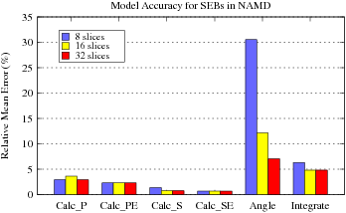
NAMD Prediction
NAMD STMV 1M-atom benchmark
4096 core prediction
Using 512 core of BG/P
Notes:
Chosen for benchmarks on bluewaters

Slide 14
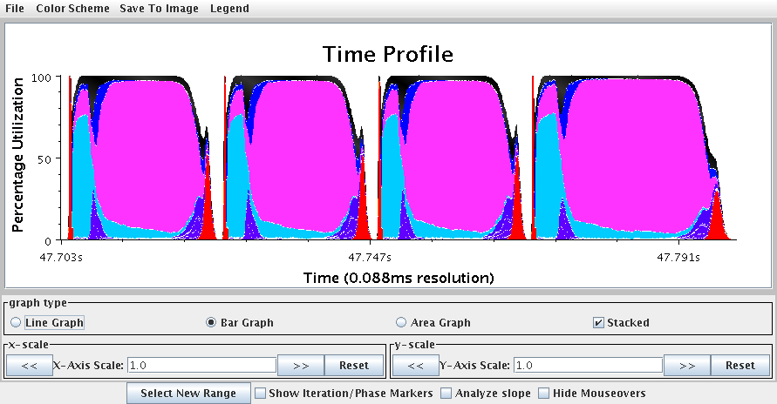
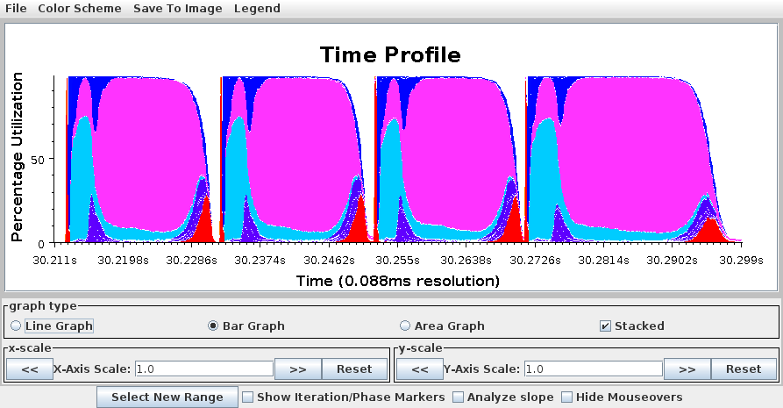
NAMD Prediction (STMV 4096 core)
Native
Prediction
Notes:
Prediction on function level, which make it possible to generate detailed execution traces

Slide 15
Blue Waters
Will be here soon
More than 300K POWER7 Cores
PERCS Network
  Unique network not similar to any other!
  No theory or legacy for it
  Applications and runtimes tuned for other networks
NSF Acceptance: Sustained petaFLOPs for real applications
  Tuning applications typically takes months to years after machines become online

Slide 16
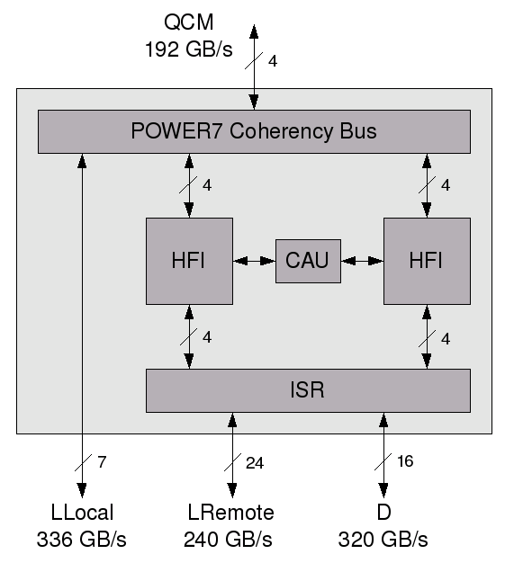
PERCS Network
Two-level fully-connected
Supernodes with 32 nodes
24 GB/s LLocal (LL) link, 5 GB/s LRemote (LR) link, 10 GB/s D link, 192 GB/s to IBM HUB Chip

Slide 17
BigSim for Blue Waters
Detailed packet level network model developed for Blue Waters
Validated against MERCURY and IH-Drawer
  Ping Pong within 1.1% of MERCURY
  Alltoall within 10% of drawer
Optimizations for that scale
Different outputs (link statistics, projections…)
Some example studies: (E. Totoni et al., submitted to SC11)
  Topology-aware mapping
  System noise
  Collective optimization

Slide 18
Topology-Aware Mapping
Apply different mappings in simulation
Evaluate using output tools (Link Utilization…)

Slide 19
Topology-Aware Mapping
Example: Mapping of 3D stencil
  Default mapping: rank ordered mapping of MPI tasks to cores of nodes
  Drawer mapping: 3D cuboids on nodes and drawers
  Supernode mapping: 3D cuboids on supernodes also; 80% communication decrease, 20% overall time

Slide 20
System Noise
BigSim’s noise injection support
  Captured noise of a node with the same architecture
    Replicate on all the target machines nodes with random offsets (not synchronized)
  Artificial periodic noise patterns for each core of a node
    With periodicity, amplitude and offset (phase)
    Replicate on all nodes with random offsets
Increases length of computations appropriately

Slide 21
Noise Studies
Applications:
  NAMD: 10 Million atom system on 256K cores
  MILC: su3_rmd on 4K cores
  K-Neighbor with Allreduce 1 ms sequential computation, 2.4 ms total iteration time
  K-Neighbor without Allreduce
Inspecting with different noise frequencies and amplitudes

Slide 22
Noise Studies
NAMD is tolerant, but jumps around certain frequencies
MILC is sensitive even in small jobs (4K cores), almost as much affected as large jobs

Slide 23
Noise Studies
Simple models are not enough
In high frequencies there is chance that small MPI calls for collectives get affected
  Delaying execution significantly
Combining noise patterns:

Slide 24
MPI_Alltoall Optimization
Optimized Alltoall for large messages in SN
BigSim’s link utilization output gives the idea:
  Outgoing links of a node are not used effectively at all times during Alltoall
  Shifted usage of different links

Slide 25
MPI_Alltoall Optimization
New algorithm: each core send to different node
  Use all 31 outgoing links
  Link utilization now looks better

Slide 26
MPI_Alltoall Optimization
Up to 5 times faster than existing Pairwise-Exchange scheme
Much closer to theoretical peak bandwidth of links

Slide 27
Questions?

