Slide 1
Exscale – when will it happen?
William Kramer
National Center for Supercomputing Applications

Slide 2
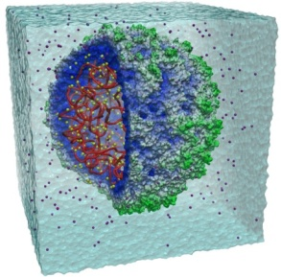
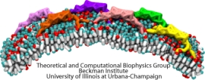
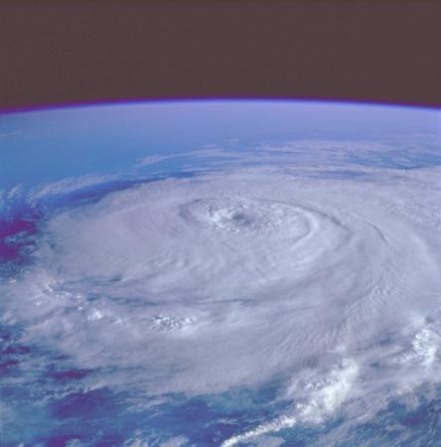
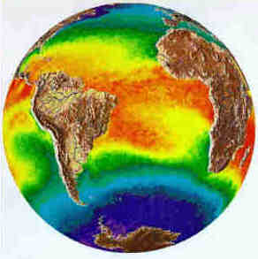
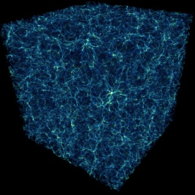
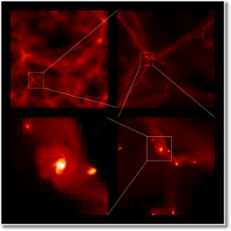
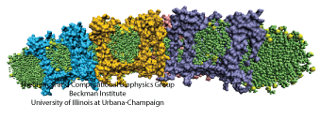
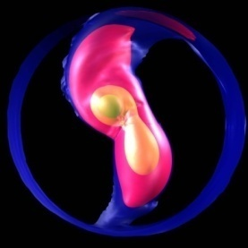
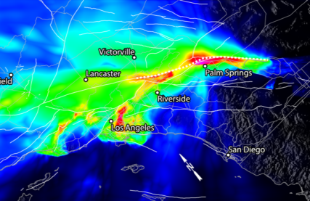
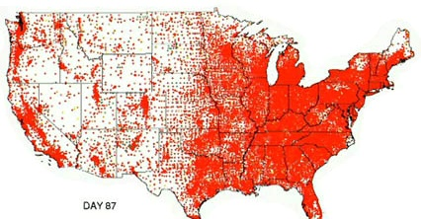
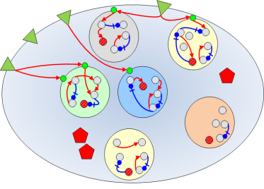
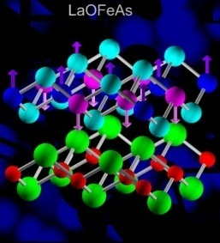
Sustained Petascale computing will enable advances in a broad range of science and engineering disciplines:
Molecular Science
Weather & Climate Forecasting
Astrophysics
Astronomy
Earth Science
Health
Life Science
Materials

Slide 3
Blue Waters Computing System
System Attribute Ranger Blue Waters
Vendor Sun IBM
Processor AMD Barcelona IBM Power7
Peak Performance (PF) 0.579 >10
Sustained Performance (PF) <0.05 >1
Number of Cores/Chip 4 8
Number of Processor Cores 62,976 >300,000
Amount of Memory (TB) 123 >1.2
Interconnect Bisection BW (TB/s) ~4
Amount of Disk Storage (PB) 1.73 18
I/O Aggregate BW (TB/s) ? 1.5
Amount of Archival Storage (PB) 2.5 (20) >500
External Bandwidth (Gbps) 10 100-400
17
>20
2
~3.5
10
>>10
>10
>200
>10

Slide 4
Observations
Real sustained PF is ~2 years after peak PF
Sustained Petascale took O($1B) for the first system
O($1.7B) for the first two systems
In the best case, Peak EF is probably O($2-3B) time frame for the first system
O($4B) for the first two systems
There are very real HW and SW challenges for computer design that have to be solved regardless of Exascale
Scale (HW, System SW, Application SW)
Reliability
Balance
Communications
Middle level SW …..
With a very few notable exceptions such as Charm++ based codes, as system scale increases, the application base and science team able to use the largest systems decreases proportionally

Slide 5
Key Issues for Exascale – beyond the technical
If Exascale is not started soon, development expertise will have to be recreated - adding cost and delay
Is the best value for Exascale in one system? Is the cost of one system worth it
Is Exascale in aggregate worth it (and how big of a building block?, data movement, etc)
Should we provide (~5-10) 100-200 PF systems linked in a data infrastructure to do Exascale science problems?
More familiar and evolutionary
The energy debate needs to be put into context with everything else – use true TCO, rather then one component
It is not clear that people will use an EF system for real science if we build it the way some expect.
Need clear – really meaningful metrics for sustain (aka time to solution) performance based on needed use rather than easiest use
Not Peak Flops nor Linpack Flops
Holistic – ∑{Performance, Effectiveness, Resiliency, Consistency, Usability}/TCO
Most discussions on Exascale and even Petascale talk about the crisis in the data deluge, but that is little discussion in the HPC community. So, why should the community be pushing "Exaflops" rather than "Yottabytes“ in order to improve science productivity and quality?

Slide 6
Conclusion
Essentially whether Exascale can be done in the time frame people are talking about depends how one defines success and on how much money someone spends
If there is a public will - and it appears there is within parts of the administration but not sure about congress - EF can be done.
Not clear there is fundamental motivation for the public needed
Not clear industrial policy is sufficient without critical S&E driver(s)
The schedule (2018), cost (~$3B) and scope (EF for 20MW that is usable by many) is compromised
There will be Exascale systems
In some time period but not in 2018-2020 unless unprecedented public funding occurs immediately

