Slide 1
Parallel Computing Techniques for Aircraft Fleet Management
Gagan Raj Gupta
Laxmikant V. Kale
Udatta Palekar
Department of Business Administration
University of Illinois at Urbana-Champaign
Steve Baker
MITRE Corporation

Slide 2
Outline
Motivation
Problem Description
Model Development
Solution Approach
Parallel Implementation
Techniques for reducing execution time

Slide 3
Stochastic Programming
Take optimal decisions under uncertainty
Useful for a diverse range of applications
Traffic management
Financial Planning
Manufacturing Production Planning
Optimal truss design
Inventory management
Electrical generation capacity planning
Machine Scheduling
Macroeconomic modeling and planning
Asset Liability Management

Slide 4
Problem Summary
Allocate aircrafts to different bases and missions to minimize disruptions
Plan for disruptions
Model different scenarios, probability of occurrence
Handle multiple mission types
Channel, SAAM, JAAT, Contingency
Several aircraft, cargo types
Multiple levels of penalty for incomplete missions
Multiple routes, transshipment routes, allow unutilized aircrafts to be used across missions

Slide 5
Model Formulation
Level of fidelity
Complexity vs. accuracy
Ability to generalize
Should be able to add details later
Facilitate parallelization
Decompose into stages, what goes in various stages?
Integer vs. Linear programs

Slide 6
Solution Approach
Classical Stochastic Programming (SP) Problem
2 stage SP problem with linear recourse
Stage 1 (MIP)
Decides allocation of aircrafts
Training mission assignment
Stage 2 (LP):
Given the allocations, decide how to accomplish missions
Solve Channel, Contingency and SAAM
Obtain Duals, Objective Value
Send Cuts to Stage 1

Slide 7
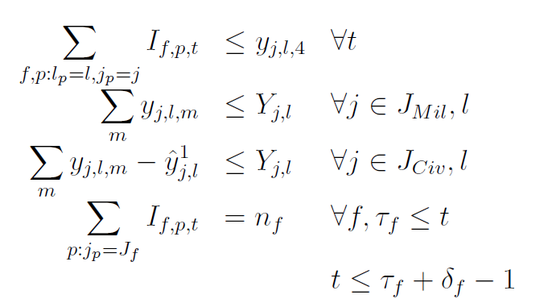
Stage 1
j : Type of aircraft
l : Base Location
m: Mission type
s: scenario
Minimize
Rent of aircraft ‘j’
Number of rented aircrafts
Probability of scenario ‘s’
Stage 2 cost of scenario ‘s’
Subject to:
Schedule for training
Aircrafts of type ‘j’ available at base ‘l’
Allocated for other missions

Slide 8
Stage 2 Cuts
Dual prices for aircraft allocation
Stage 2 objective value for scenario ‘s’ and allocation
We use the multi-cut method to add a cut for each scenario to Stage 1
These cuts are based on the duals from Stage 2 problem

Slide 9
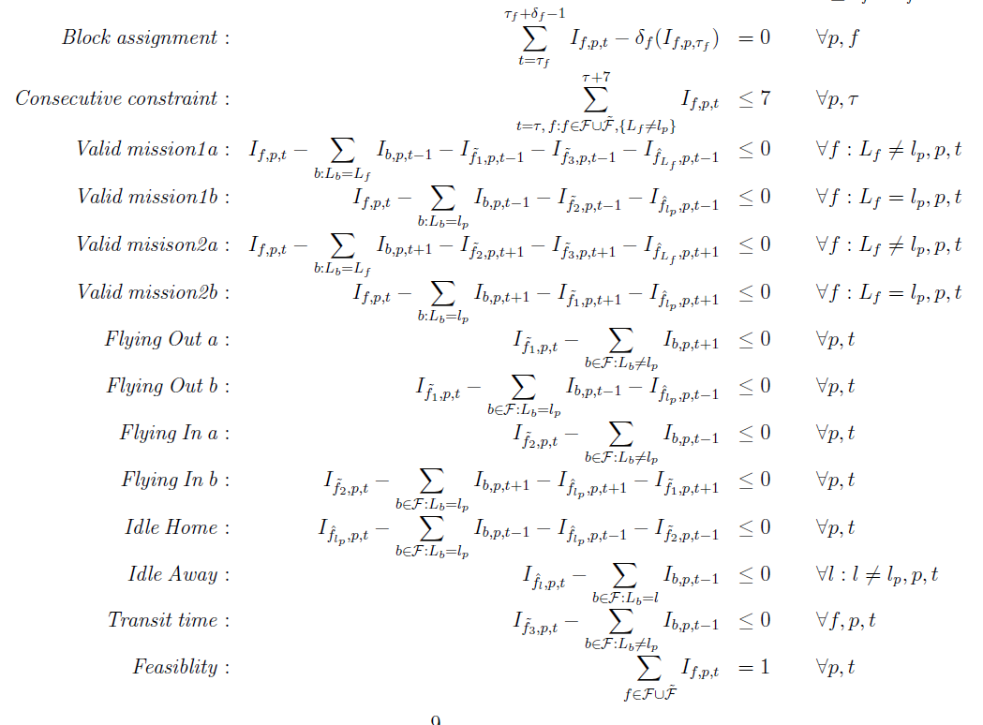
Detailed training model

Slide 10
Stage 2
Short-term Rented aircrafts
Penalty for late delivery
Objective Function
Penalty for very late delivery
Operational costs

Slide 11
Channel Mission

Slide 12
Contingency and SAAM

Slide 13
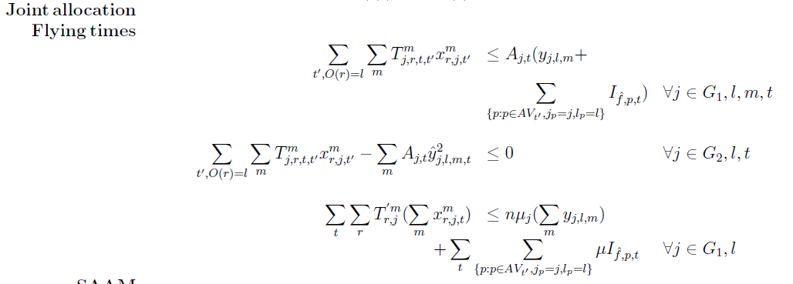
Stage2: Tying them together

Slide 14
Effective Parallel Programming
Divide work into smaller units
2 stage decomposition
Create enough work
Solve multiple scenarios
Reduce synchronization overheads
Multi-cut method
Overlap computation with communication
Use Charm++ runtime system
Efficient use of LP/IP solver
Use Advanced basis when advantageous

Slide 15
Solution Technique
Multi-cut Method
Divide the scenarios into sets
Add cuts for each set
All sets needed for upper-bound computation
Algorithm
While (! Convergence)
Begin New Round: Distribute scenarios among solvers
Collect Cuts, Solve Stage 1
Update Lower and Upper Bound

Slide 16
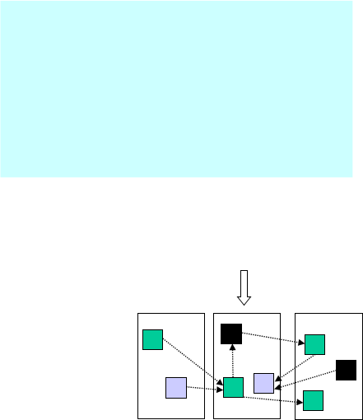
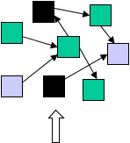
Implementation in Charm++
Programmer: [Over] decomposition of problem into virtual processors
Runtime: Assigns VPs to processors
Enables adaptive runtime strategies
Benefits
Software engineering
Number of virtual processors can be independently controlled
Separate VPs for different modules
Message driven execution
Adaptive overlap of communication
Asynchronous reductions
Dynamic mapping
Heterogeneous clusters
Automatic check-pointing
Change set of processors used
Dynamic load balancing
Communication optimization
System implementation
User View

Slide 17
Details of Parallel Implementation
Entities (Objects)
Hold state
Invoke methods (local and remote)
Main : Solves Stage 1 as Mixed Integer Program
Further Decomposition Possible
Heuristic for Training (Right now, none allocated)
Comm : Manages Communication
One per round (Allocation Vector)
Solver : Solve Stage 2
Placed on each "processor / core"

Slide 18
Decomposition
Send allocation to Comm object
Receive Cuts
Main
Comm
R-1
Comm
R-2
Comm
R-3
Send scenarios to Solvers
Receive Duals
Sol
Sol
Sol
Sol
Sol
Sol
Sol
One instance of Solver per processor running an instance of IP/LP solver

Slide 19
Basic Performance Chart
New allocation received
Comm
Created
Stage 1
Solved
Timeline
Convergence
Odd Round Stage 2
Even Round Stage 2
Message received
White bars – Idle Time Colored bars – Computation
* Exaggerated solve times for clarity

Slide 20
Messaging Structure
Cuts added to Stage 1
Duals sent back to Comm Object
Scenarios sent to Solvers
* Exaggerated solve times for clarity

Slide 21
Test Case
50 Scenarios
Multi-Cut Method.
First 4 rounds are used for cut generation
Begin new round if at least half of the scenarios have been solved
Keep updating the Allocation Vector by solving Stage 1
Subsequent rounds are used for updating the upper and lower bounds.
Run till convergence is reached.
Criterion: |UB-LB|/UB <0.001
1,2,4,8 proc runs

Slide 22
Advanced Basis
Apply OR Theory
Since the RHS alone changes, the solution is dual feasible
Use the current solution and apply dual simplex
May lead to savings in solution times
Advanced Basis (save time for matrix factorization)
Might be close to the solution (on the polytope)

Slide 23
Solution Times (8 proc run)
Odd and Even rounds shown in alternate color
Some of the processors wait for a long time to receive a scenario
Reason: Messages are longer than the typical case
The Processor having Comm objects gets engaged in solving Stage 2 problems
SOLUTION : Use interrupts to deliver the message quickly.
We will call it as No Interrupt Case.

Slide 24
With Network Interrupts
Comm Object becomes responsive
None of the processors wait for the initial scenario
Have to wait for subsequent scenarios because the processor having Comm object is busy solving Stage 2 problems.
SOLUTION: We try two approaches
Buffering: Give multiple problems to each Solver
Reserve a processor to handle communication.

Slide 25
Triple Buffering
Still have to wait for subsequent scenarios because the processor having Comm object is busy solving Stage 2 problems.

Slide 26
Separate Processor for Communication
Alleviates the problem to a large extent
Comes at the cost of wasting one processor
Remaining idle times because of synchronization

Slide 27
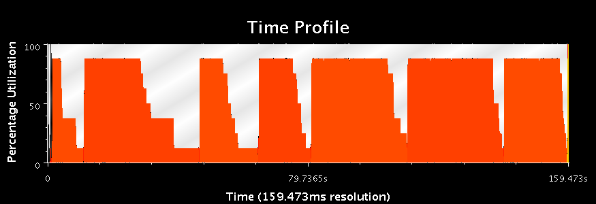
Time Profile Graphs (% Utilization)
Triple Buffering
High load initially but processors starve due to less responsive Comm object
Peak Utilization = 88 %
Having a separate processor for Comm Object allows it to feed the processors with new problems
Even with better utilization, the second case takes longer time to Complete!

Slide 28
Run Times (Advanced Basis)
Experiment | Number of Processors | Run Time
No Interrupt | 1 2 4 8 | 197 sec 209 sec 165 sec 148 sec
Interrupt | 1 2 4 8 | 197 sec 206 sec 162 sec 157 sec
Triple Buffering + Interrupt | 1 2 4 8 | 198 sec 209 sec 149 sec 121 sec
Separate Communication + Interrupt | 2 4 8 | 152 sec 134 sec 158 sec

Slide 29
Comparison (Advanced Basis)

Slide 30
Run times are highly correlated
Surprisingly, the solution times are highly correlated with the state of the solver
Run times are also sensitive to the initial allocation of the aircrafts to the bases (Stage1 decisions)
Even by increasing the utilization of each processor during multiple processor runs to around (75-80%) the solution times reduce only by a small fraction.

Slide 31
Advanced allocation, Advanced Basis + Sep proc for Comm
Initial allocation of 3 aircrafts per base per mission
Reduces run time for 8 processor run to 80.23 sec from the best case of 121 sec in previous experiments
Reduces run time for 1 processor run to 153.9 sec from the usual 197 sec in previous experiments

Slide 32
Run Times (New Basis)
Experiment | Number of Processors | Run Time
No Interrupt | 1 2 4 8 | 203 sec 155 sec 102 sec 84 sec
Interrupt | 1 2 4 8 | 202 sec 133 sec 87 sec (Speed Up: 2.3) 78 sec (Speed Up: 2.6)
Triple Buffering + Interrupt | 2 4 8 | 251 sec 100 sec 94 sec
Turns out that making a fresh start on every solve is better in this experiment.

Slide 33
Run Times (New Basis)

Slide 34
Overlapping the rounds
In this case we expect to create more work and utilize the idle processors
Potentially, the multi-cut method can work even if we keep adding valid cuts from a previous round to the Stage 1
Give the solvers some work to do while a new round is started, thereby removing the time wasted in synchronization
We also experiment with the cases of reserving a processor for communication

Slide 35
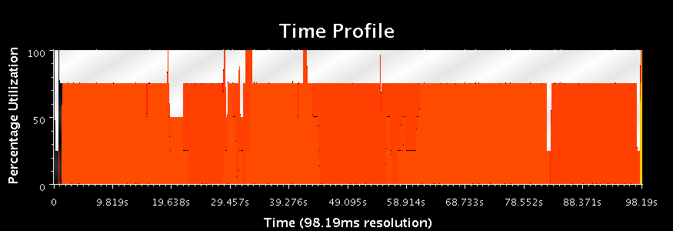
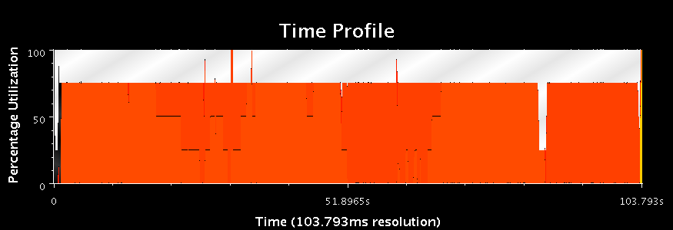
Time Profile Graphs (4 proc)
New Basis
Advanced Basis
We are able to almost completely remove idle times (except for the wasted processor)

Slide 36
Overlap + Hybrid Scheme
Hybrid Scheme:
New basis every round
Advanced basis within the round
Triple Buffering
Interrupts

Slide 37
Run Times (Overlap)
Experiment | Number of Processors | Run Time
Overlap (New Basis) | 4 8 | 102 sec 92 sec
Overlap (Advanced Basis) | 4 8 | 103 sec 120 sec
Overlap (Use all processors + New Basis) | 4 8 | 82 sec 89 sec
Overlap+ Hybrid Scheme | 4 8 | 62.53 ( Speed Up: 3.24) 61.32 ( Speed Up: 3.31)

Slide 38
A final comparison
1 proc
8 proc
Initial runs with Advanced Start and no Interrupts
Speedup = 1.4
8 proc
(Hybrid
+Overlap)
Notice that the white bars have almost disappeared!
Speedup = 3.3

Slide 39
Conclusion
Effective Parallel Programming
Divide work into smaller units (2 stage decomposition)
Create enough work (multiple scenarios)
Reduce synchronization overheads (multi-cut method, overlap rounds)
Peculiarity of this application
Large size messages requiring the use of interrupts
Coarse grained computation
More decomposition
Dependency in solve times
Requires theoretical study and further experimentation

Slide 40
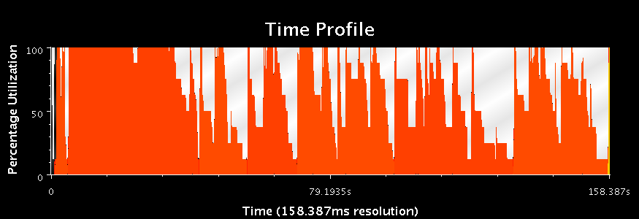
Time Profile Graphs (% Utilization)
8 processors
No Interrupts
8 processors
With Interrupts
Notice the idle times!

Slide 41
New Basis (with Interrupts)
Different scenarios take different amounts of time
Notice that none of them take very long times as in the case of ReSolve
It appears that a few bad cases impact the performance

Slide 42
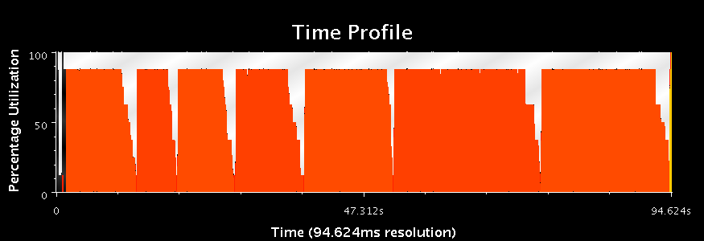
Time Profile Graphs (New basis)
With Network Interrupts
Separate processor for Comm object
Having a separate Comm object ensures steady utilization at the cost of wasting one processor
Towards the end of the round, some processors remain idle
To address this, we allow the rounds to overlap

