Slide 1
Programming an SMP Desktop using Charm++
Laxmikant (Sanjay) Kale
http://charm.cs.uiuc.edu
Parallel Programming Laboratory
Department of Computer Science
University of Illinois at Urbana Champaign
Supported in part by IACAT

Slide 2
Prologue
I will present an abbreviated version of the planed talk
We are running late..
Also, I realized that what I really intended to present, with code examples, will need an hour long talk..
We will write that in a report later (may be put it in charm documentation)

Slide 3
Outline
Charm++ designed for portability between shared and distributed memory
Optimizing multicore charm
K-neighbor and its description and performance
What optimizations were carried out
Abstractions:
Basic: shared object space, Readonly data
Plain global variables: still work.. More on disciplined use of these later
Nodegroups
Passing pointers to shared data structures, including sections of arrays.
Readonly, write-exclusive: permissions by convention or “capability”

Slide 4
Optimizing SMP implementation of Charm++
Changed memory allocator
to avoid acquiring a lock per memory allocation
Reduced the granularity of critical region
Used thread local storage (__thread) to avoid false sharing
Use memory fence instead of lock for pcqueue
Reduce lock contention by using a separate msg queue for every other core on the same node
Simplify the data structure of pcqueue
Assumes queuesize is adequately large

Slide 5
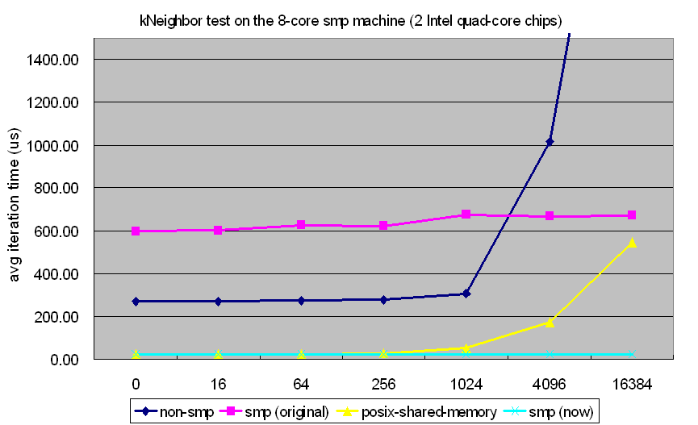
Results on SMP Performance
Improvement on K-Neighbor Test (8 cores, Mar’2009)

Slide 6
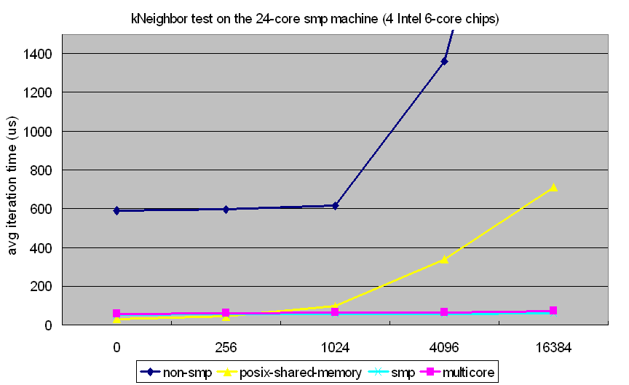
Results on SMP Performance
Improvement on K-Neighbor Test (24 cores, Mar’2009)

Slide 7
Results on SMP Performance
Improvement on K-Neighbor Test (16 cores, Apr’2009)

Slide 8
We evaluated many of our applications to test and demonstrate the efficacy of the optimized SMP runtime

Slide 9
Jacobi 2D stencil computation on Power 5 (8000x8000 matrix size)

Slide 10
ChaNGa:
Barnes-Hut based production astronomy code

Slide 11
ChaNGa:
Barnes-Hut based production astronomy code

Slide 12
NAMD Scaling with Optimization
NAMD apoa1 running on upcrc

Slide 13
Summary of constructs that use shared memory in Charm++

Slide 14
Basic Mechanisms
Chares and Chare array constitute a “shared object space”
Analogous to shared address space
Readonly globals
Initialized in main::main or any method called from it synchronously
Shared global variables

Slide 15
More powerful mechanisms
Node groups
Passing pointers to shared data structures, including sections of arrays.
Readonly, write-permission

Slide 16
Node Groups
Node Groups - a collection of objects (chares)
Exactly one representative on each node
Ideally suited for system libraries on SMP
Similar to arrays:
Broadcasts, reductions, indexing
But not completely like arrays:
Non-migratable; one per node
Notes:
Special chare array

Slide 17
Conditional packing
Pass data structure between chares
Pass pointer (dest. within the node)‏
PUP the entire structure (dest. outside the node)‏
Who owns the data and frees it?
Data structure must inherit from CkConditional
Reference counted
A data structure can contain info about an array section
Useful in cases like in-place sorting (e.g. quicksort)‏

Slide 18
Sharing Data and Conditional packing
Pointers can be sent in “messages”, but they are packed to underlying data structures when going across nodes
(feature in chare kernel since 1989 or so!)
Data structure being shared should be encapsulated, with a read or write “capability”
If I give you write access, I promise not to modify it, read it, or grant access to someone else
If I give you a read access, I promise not to change it until you are done

Slide 19
Disciplined Sharing
My pet idea: shared arrays with restricted modes
Readonly, write-exclusive, accumulate, and “owner-computes”
Modes can change at well-defined global synch points
Captures a large fraction of uses of shared arrays

