Slide 1
Optimizing Molecular Dynamics and Stencil mini-applications for Intel’s Knights Landing
IXPUG, SC’16 Lightning Talk
Kavitha Chandrasekar*, Laxmikant V. Kale
University of Illinois at Urbana Champaign

Slide 2
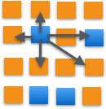
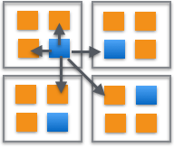
Charm++ Runtime System
Supports an asynchronous message-driven execution model
Overdecomposition of work units (or chares) on PEs (Processing Elements)
Migratability of work units
Load balancing framework
Support for several applications
NAMD
OpenAtom
ChaNGa
Over-decomposition of work into Charm++ objects
Mapping of Charm++ objects to processors
Charm++ RTS view of over-decomposition

Slide 3
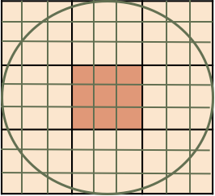
LeanMD – Molecular Dynamics Mini-application
Molecular Dynamics simulation application
Atoms in the simulation are divided spatially into k-cells roughly the size of the cutoff distance
3-away strategy
Uses PINY MD physics engine for its molecular dynamics calculations
Computation bound
Computation of interacting forces
Communication involved
Exchange of atoms based on calculated position
Load imbalance from exchange of atoms
Cutoff radius
LeanMD work units

Slide 4
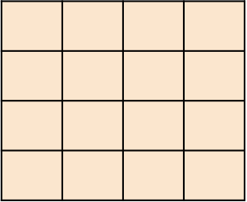
Stencil3D Application
Stencil application is representative of communication pattern with neighboring chares in 2D or 3D grid
Example is MIMD Lattice computation
3D chare array of doubles
Regular communication pattern with 7 neighbor chares
Computation performed on received data
Temperatures are updated on receiving boundary data from neighbors
Communication/Memory bound
No load imbalance
(x,y-1)
(x-1,y)
(x,y)
(x+1,y)
(x,y+1)
Five point communication for 2D stencil

Slide 5
Experimental Setup
Charm++ in SMP mode
Reduces message copy
Ability to map workers to cores
Single KNL node (Stampede 1.5)
Quadrant mode
Cache Mode (except for comparison of Cache and Flat mode)
256 cores were used out of 272 cores for mapping work units to PEs
Performance Tools
IPC, MCDRAM and DDR4 accesses – perf stat
Energy numbers – RAPL counters

Slide 6
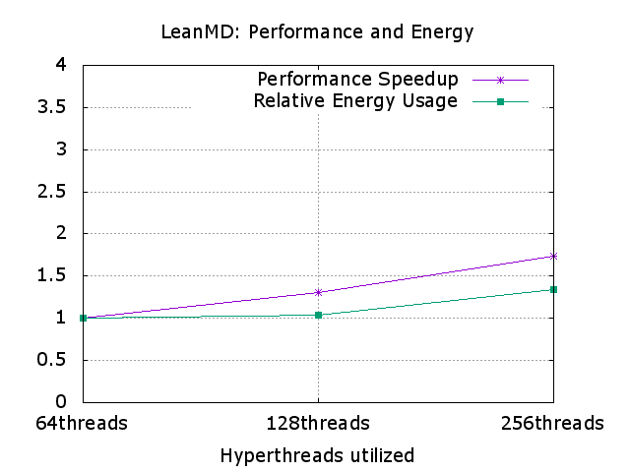
LeanMD – Performance Analysis
Load balancing using Greedy heuristics
Speedup (Higher the better)
Energy Usage (Lower the better)
Input size:
Cell and Compute Dimensions
16 X 16 X 16 cells
CPU Pinning: No significant degradation was observed without CPU pinning

Slide 7
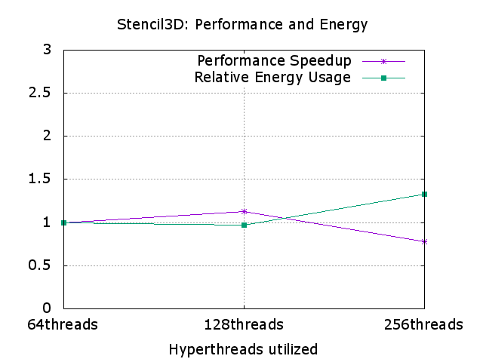
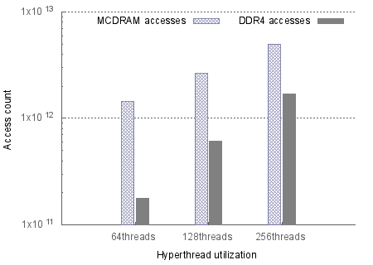
Stencil3D - Performance analysis
Large: Stencil3d
2048 X 2048 X 1024
Block dimensions: 256 X 128 X 128
Optimal configuration for smaller working set sizes was also observed to be 128 threads (2 hyperthreads per core)
Factors for lack of performance improvement
Working set size
Potentially causes increased eviction from MCDRAM
Higher memory streams in parallel
Overhead from higher number of worker threads
Scope for energy efficient execution with 2 hyperthreads per core
CPU-pinning: 10%-30% performance degradation without CPU-pinning
Lack of benefits from L2 locality, context switches, thread migrations
Load imbalance due to variation in core frequencies

Slide 8
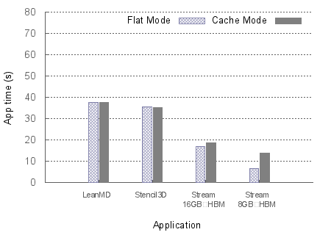
Flat mode vs. Cache mode
LeanMD and Stencil3D do not show any significant performance difference when run on Cache mode vs Flat mode
Input data size fits in MCDRAM in both cases
Stream is the only benchmark that benefits from Flat mode for input data size half the size of MCDRAM

Slide 9
Conclusion and Future work
HPC applications like LeanMD and Stencil3D can benefit in terms of performance and energy when tuned appropriately on Knights Landing
Depending on working set size there might be thrashing of HBM in Cache mode
Memory bound applications might not benefit from using all 4 hyperthreads
Overdecomposition factor is a key influencer in performance depending on the number of worker PEs
Variation in core frequencies can lead to load imbalance making CPU pinning or similar techniques necessary
Automation of tuning for application characteristics within the Charm++ framework by adjusting knobs like
Hyperthreading
CPU affinity
Scheduling on nodes with preferred HBM usage mode

