Slide 1


Charm++
Overview and suggestions for collaborations
I am looking for Research Programmers and PostDocs as well as
PhD students (deadline Dec 15th)
With strong software skills
Laxmikant (Sanjay) Kale
http://charm.cs.illinois.edu
Parallel Programming Laboratory
Department of Computer Science
University of Illinois at Urbana Champaign

Slide 2
A couple of forks
Overdecomposition +
Migratability
MPI + x
“Task Models”
  Asynchrony
Overdecomposition and migratability:
  Most adaptivity
MPI+X
Task
Models

Slide 3
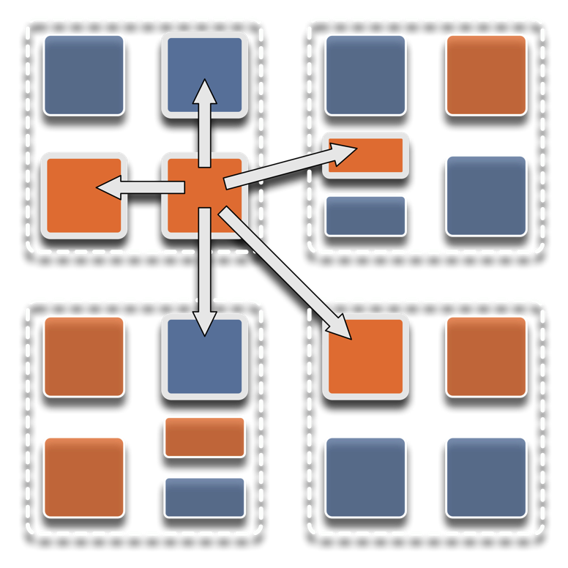
Overdecomposition
Decompose the work units & data units into many more pieces than execution units
  Cores/Nodes/..
Not so hard: we do decomposition anyway

Slide 4
Migratability
Allow these work and data units to be migratable at runtime
  i.e. the programmer or runtime, can move them
Consequences for the app-developer
  Communication must now be addressed to logical units with global names, not to physical processors
  But this is a good thing
Consequences for RTS
  Must keep track of where each unit is
  Naming and location management

Slide 5
Asynchrony:
Message-Driven Execution
You have multiple units on each processor
They address each other via logical names
Message-driven execution:
  Let the work-unit that happens to have data (“message”) available for it execute next
  Let the RTS select among ready work units
  Programmer should not specify what executes next, but can influence it via priorities

Slide 6
Charm++: Object-based overdecomposition
Multiple “indexed collections” of C++ objects
Indices can be multi-dimensional and/or sparse
Programmer expresses communication between objects
  with no reference to processors : A[i].foo(…)
System implementation
User View

Slide 7
Message-driven Execution
A[23].foo(…)

Slide 8
Empowering the RTS
Adaptive
Runtime System
Introspection
Adaptivity
Asynchrony
Overdecomposition
Migratability
The Adaptive RTS can:
  Dynamically balance loads
  Optimize communication:
    Spread over time, async collectives
  Automatic latency tolerance
  Prefetch data with almost perfect predictability
Notes:
You can have asynchrony without overdecomposition or vice versa, you can have migratability without asynchrony, but you need all three to empower the RTS.You need to add introspection and adaptivity to make a powerful Adaptive Runtime System

Slide 9
Benefits in Charm++
Over-decomposition
Scalable Tools
Automatic overlap of Communication and Computation
message-driven execution
Perfect prefetch
compositionality
Emulation for Performance Prediction
Migratability
Fault Tolerance
Introspective and adaptive runtime system
Dynamic load balancing (topology-aware, scalable)
Temperature/Power/Energy Optimizations

Slide 10
Adaptive Runtime Systems
Decomposing program into a large number of Objects empowers the RTS, which can:
  Migrate Objects at will
  Schedule tasks (Dependent Execution Blocks) at will
  Instrument computation and communication at the level of these logical units
    Object A communicates y bytes to B every iteration
    Sequential Block S has a high cache miss ratio
  Maintain historical data to track changes in application behavior
    Historical => previous iterations
    E.g., to trigger load balancing

Slide 11
Utility for Multi-cores, Many-cores, Accelerators:
Objects connote and promote locality
Message-driven execution
  A strong principle of prediction for data and code use
  Much stronger than principle of locality
    Can use to scale memory wall:
    Prefetching of needed data:
      into scratch pad memories, for example
Processor 1
Scheduler
Message Queue
Notes:
Replace figure with a new drawing

Slide 12
Impact on communication
Current use of communication network:
  Compute-communicate cycles in typical MPI apps
  So, the network is used for a fraction of time,
  and is on the critical path
So, current communication networks are over-engineered for by necessity
P1
P2
BSP based application

Slide 13
Impact on communication
With overdecomposition
  Communication is spread over an iteration
  Also, adaptive overlap of communication and computation
P1
P2
Overdecomposition enables overlap

Slide 14
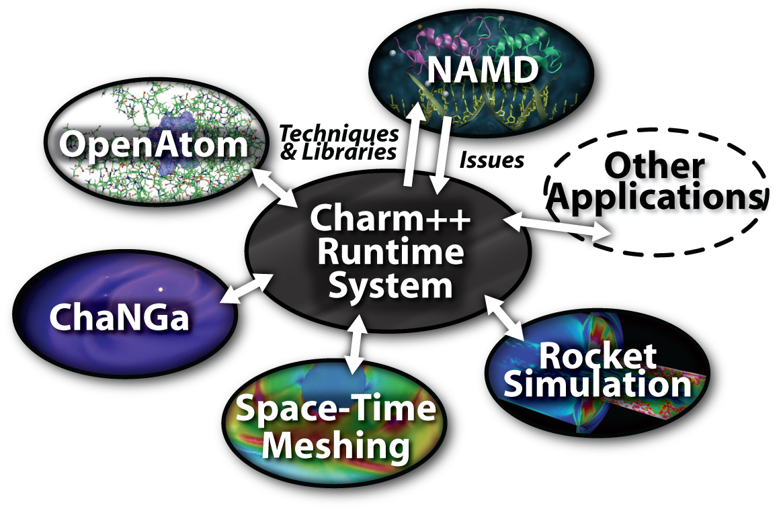
Charm++ and CSE Applications
Well-known Biophysics molecular simulations App
Gordon Bell Award, 2002
Nano-Materials..
Synergy
Enabling CS technology of parallel objects and intelligent runtime systems has led to several CSE collaborative applications
_{EpiSimdemics}
Computational Astronomy
_{Stochastic}
_{Optimization}

Slide 15
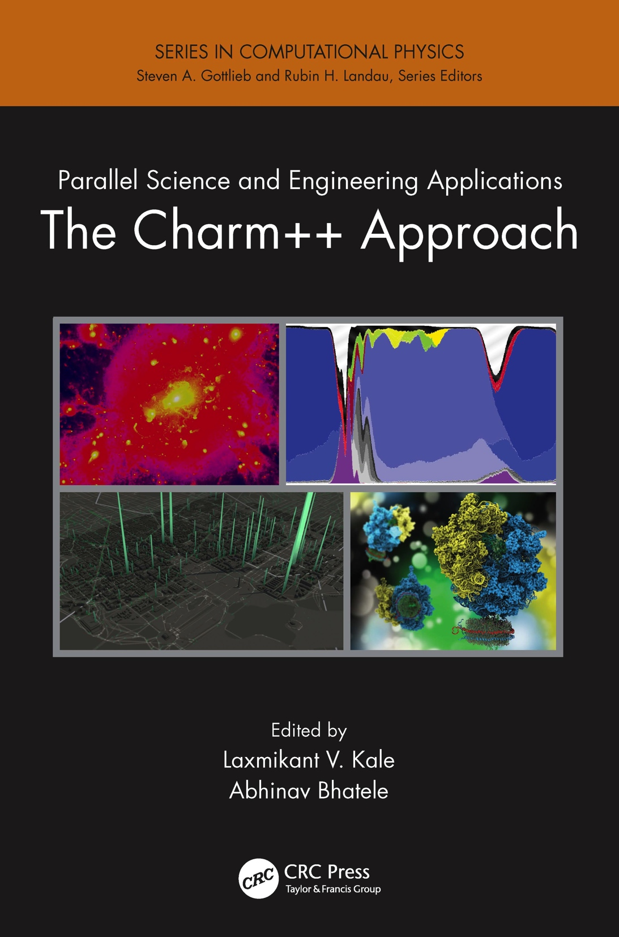
A recently published book
surveys seven major applications developed using Charm++
More info on Charm++:
http://charm.cs.illinois.edu
Including the miniApps

Slide 16
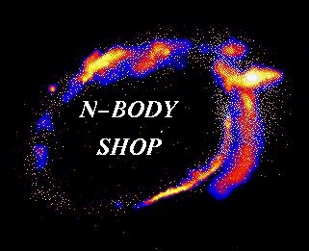
ChaNGa
  Thomas Quinn, University of Washington
  Laxmikant Kale, University of Illinois
  Orion Lawlor
  Filippo Gioachin
  Pritish Jetley
  Celso Mendes
  Amit Sharma
  Lukasz Wesolowski
  Gengbin Zheng
  Edgar Solomonik
  Harshitha Menon
  Graeme Lufkin
  Joachim Stadel
  James Wadsley
  Greg Stinson
  Michael Tremmel
  Alex Fry
  Lauren Anderson

Slide 17
ChaNGa
Simulation of galaxy formation
  N-body problem: using Barnes-Hut tree, evolved from PKDGRAV
Why Charm++?
  Tree structure can be naturally expressed as objects
  Dynamic nature of the simulation
Features
  Dynamic load balancing with choice of strategies
  Latency tolerant compared to Gasoline/Pkdgrav
  SMP aware
  Checkpointing (via migration to disk)
  Visualization (LiveViz Framework)
Notes:
E.g., on Gigabit, Gasoline can not scale beyond one node

Slide 18
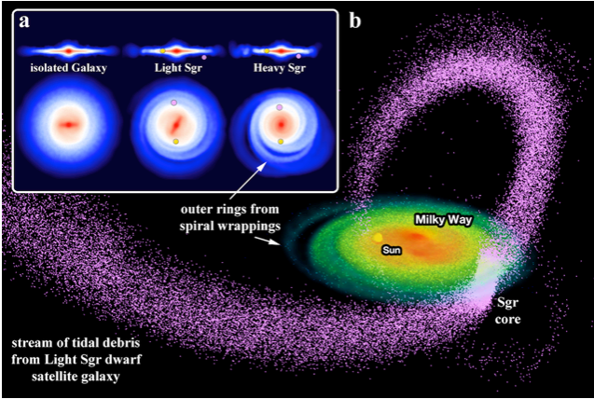
Science Results
Collisions of dwarf galaxies with the Milky Way disk (Purcell et al, Nature 2011)
Evolution of X­ray and radio properties of galaxy clusters (Ruan et al 2013)
Reliability of galaxy formation modeling (Kim et al, 2014)
Sinking of Super Massive Black Holes into the centers of galaxies. (Tremmel et al 2015)
Constrains on Dark Matter properties (Fry et al 2015, Governato et al 2015)
Understanding the shapes of disk galaxies (Herpich et al., 2015)
Spin and the shape of Dark Matter Halos (Lentz, et al, in prep)
Formation of planets around low mass stars (Backus et al, in prep)
Planetary disks around binary stars: “Tatooine”s (Fleming et al, in prep)

Slide 19
ChaNGa scaling to half a million cores

Slide 20
Multiple Time-Stepping: 3 fold improvement

Slide 21
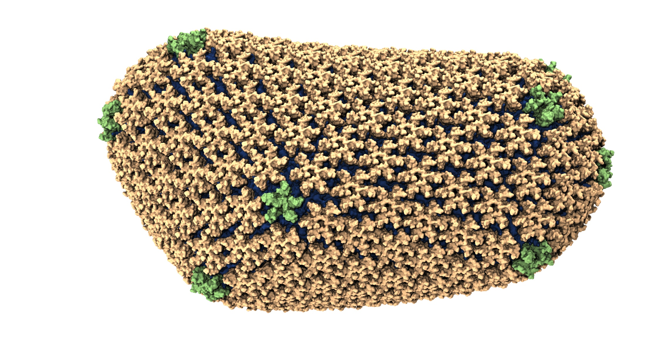
NAMD: Biomolecular simulations
Collaboration with K. Schulten
With over 70,000 registered users
Scaled to most top US supercomputers
In production use on supercomputers and clusters and desktops
Gordon Bell award in 2002
Recent success: Determination of the structure of HIV capsid by researchers including Prof Schulten

Slide 22
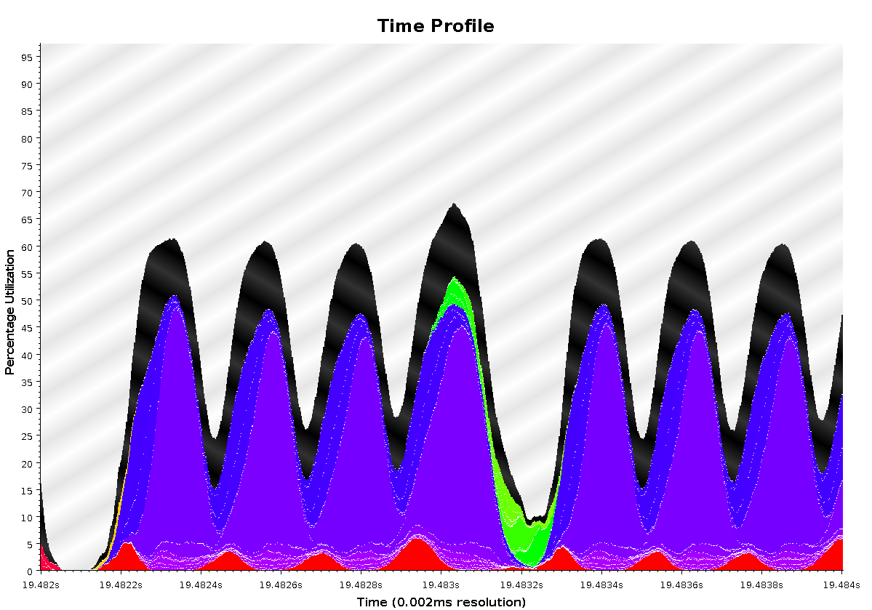
Time Profile of ApoA1 on Power7 PERCS
92,000 atom system, on 500+ nodes (16k cores)
2ms total
A snapshot of optimization in progress.. Not the final result
Overlapped steps, as a result of asynchrony

Slide 23
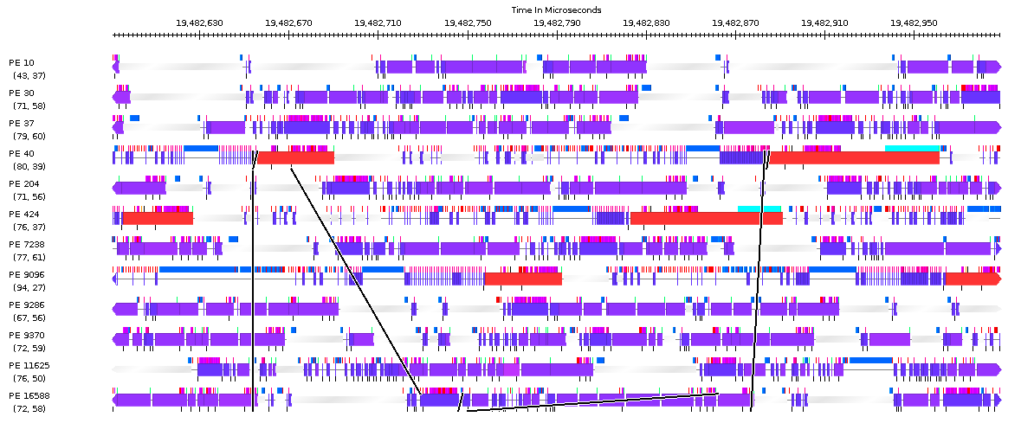
Timeline of ApoA1 on Power7 PERCS
230us

Slide 24
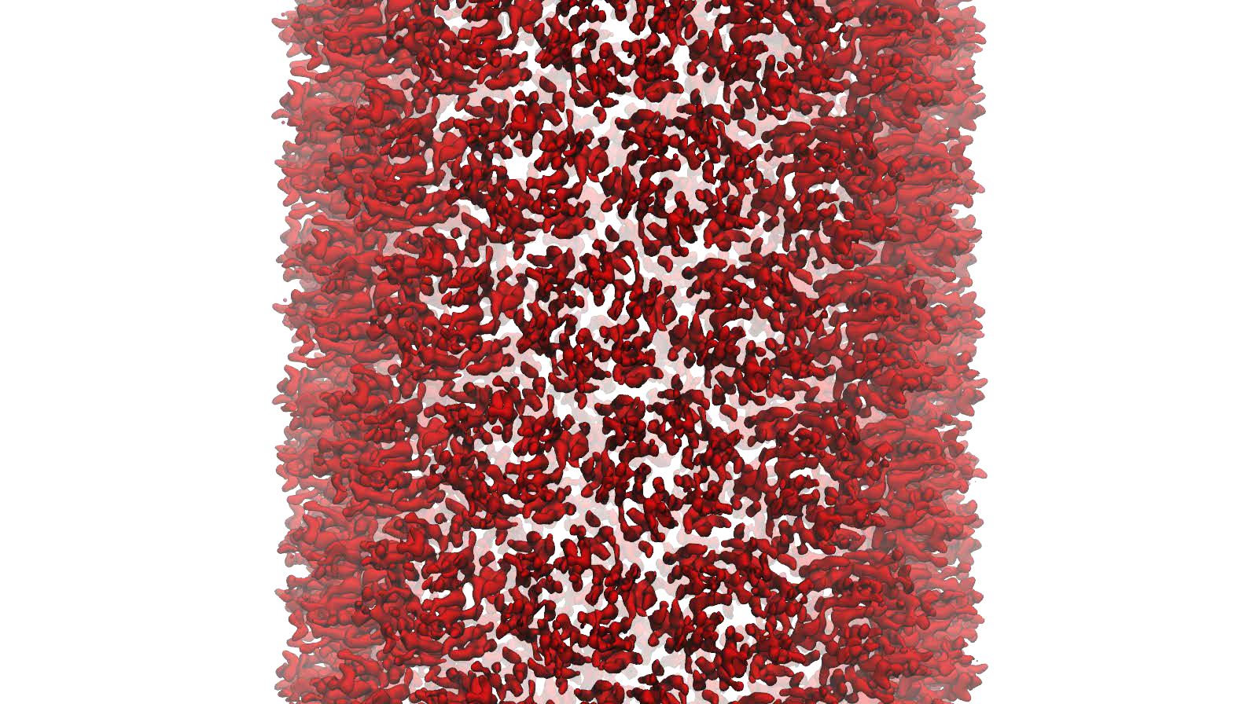
NAMD: Strong Scaling
HIV Capsid was a 64 million atom simulation, including explicit water atoms
Most biophysics systems of interests are 10M atoms or less… maybe 100M
Strong scaling desired to billions of steps

Slide 25
OpenAtom, a CPAIMD code
Electronic interactions between the nuclei and electrons
  Quantum mechanical kinetic energy, Hartree energy, Exchange-correlation energy, External energy
In short, many phases with heavy communication
  Multiple concurrent 3D-FFTs to generate the states in real space
  Reduction of states to the density
  Multicast of the KS potential computed from the density to the states
  Applying the orthogonality constraint
  Topology aware mapping
Conventional Strategy:
  Discretization size is based on the number of processors
  Communication is determined by the number of processors
  Parallel scaling limited to number of processors = Coarse grained parameter (say number of electronic states)
Recent NSF-funded SSI-SI2 project (Martyna, Ismail-Beigi, Kale)
  Extend openAtom features/performance
  Add GW-BSE capabilities

Slide 26
AMPI: Adaptive MPI
Each MPI process is implemented as a user-level thread
Threads are light-weight and migratable!
  <1 microsecond context switch time, potentially >100k threads per core
Each thread is embedded in a Charm++ object (chare)
MPI processes
Virtual Processors (user-level migratable threads)
Real Processors

Slide 27
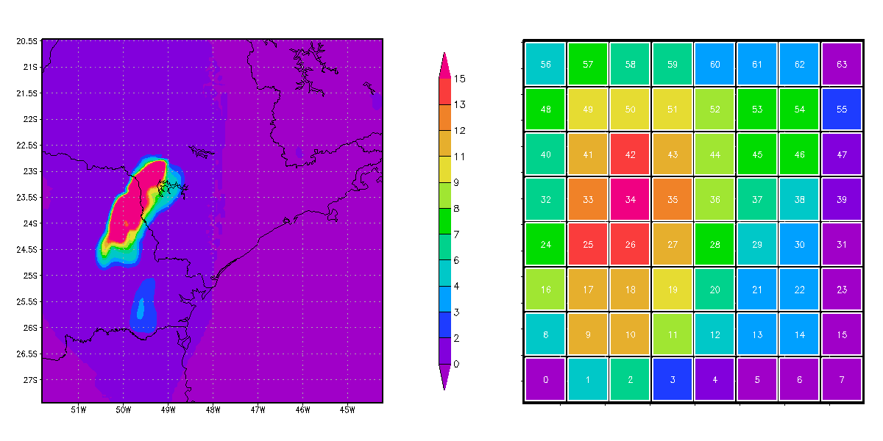
A quick Example:
Weather Forecasting in BRAMS
Brams: Brazillian weather code (based on RAMS)
AMPI version (Eduardo Rodrigues, with Mendes and J. Panetta)

Slide 28
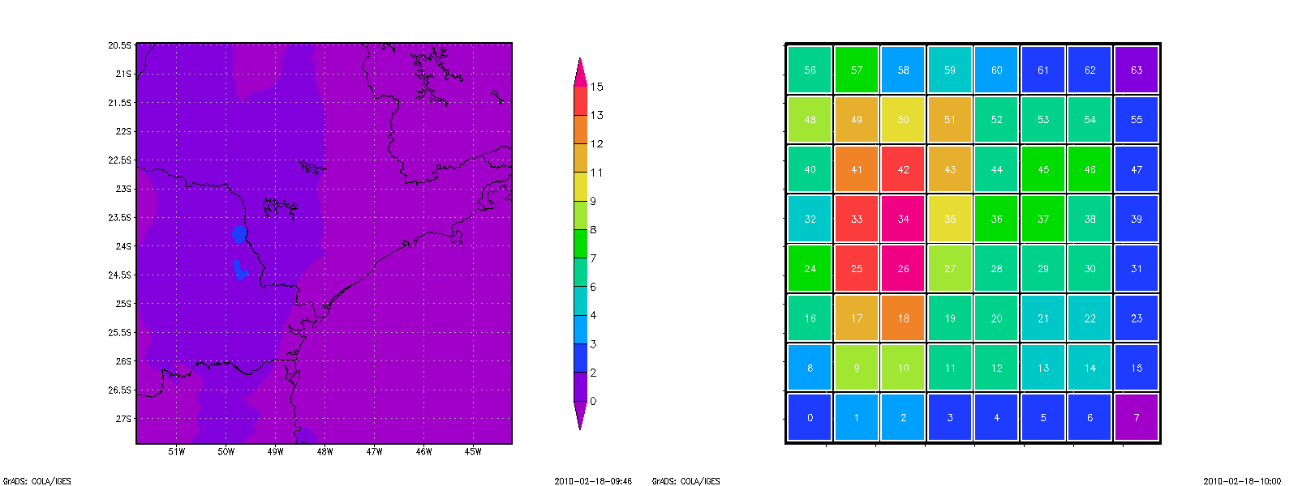


Slide 29
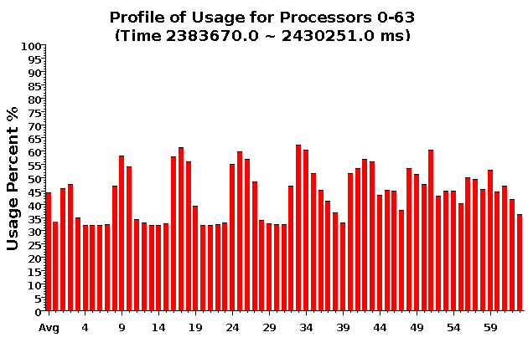
Baseline: 64 objects on 64 processors

Slide 30
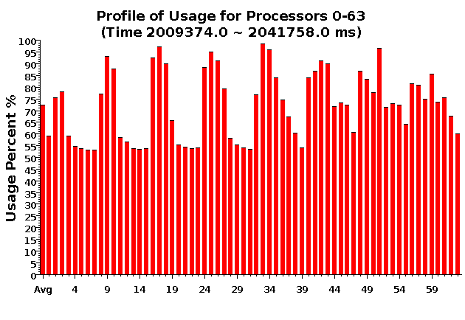
Over-decomposition: 1024 objects on 64 processors:
Benefits from communication/computation overlap

Slide 31
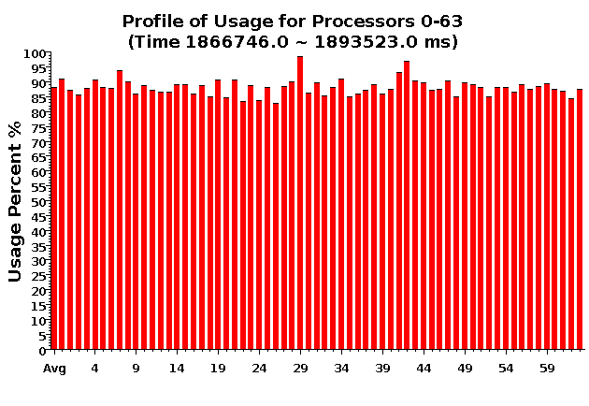
With Load Balancing:
1024 objects on 64 processors
No overdecomp (64 threads) | 4988 sec
Overdecomp into 1024 threads | 3713 sec
Load balancing (1024 threads) | 3367 sec

Slide 32
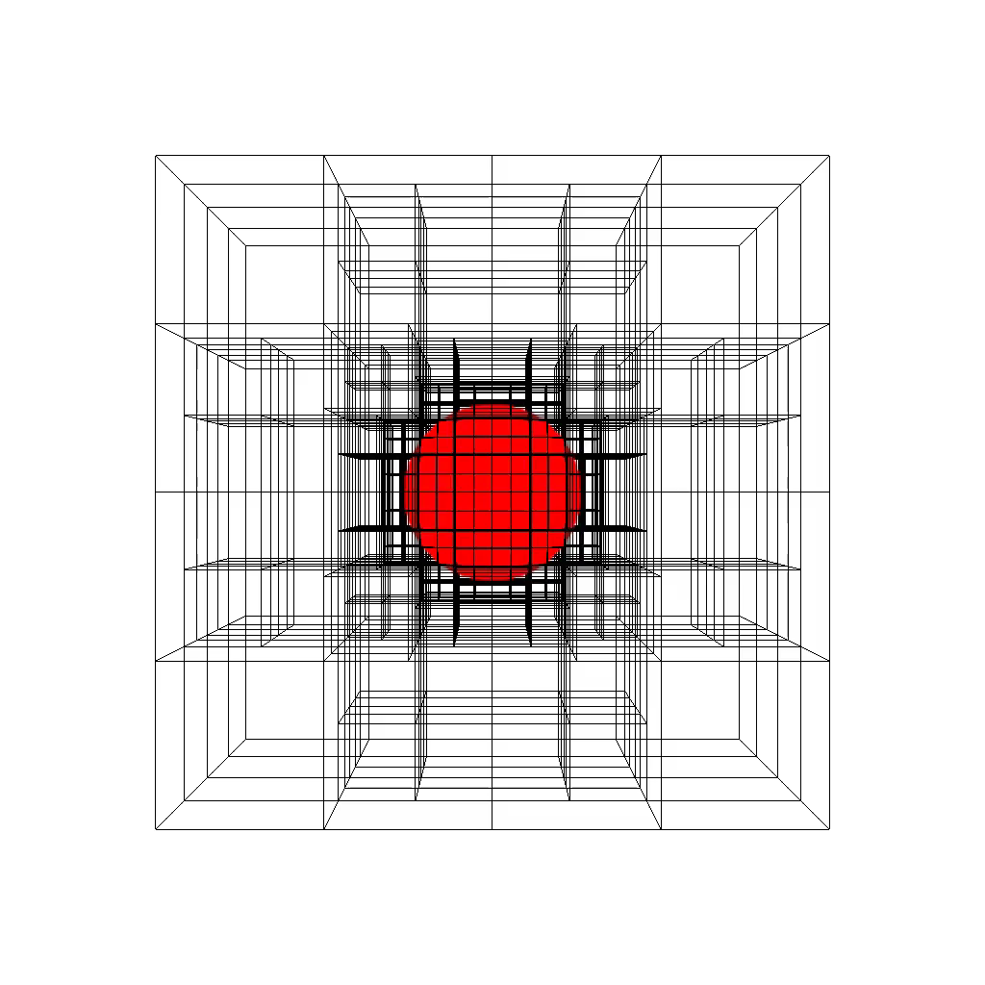
Structured AMR
Structured AMR miniApp
Notes:
Points: how overecomposition was leveraged, logical naming, with location management, Dynamic load balancing, Most importantly, highly asynchronous re-meshing

Slide 33
Structured AMR: State Machine

Slide 34
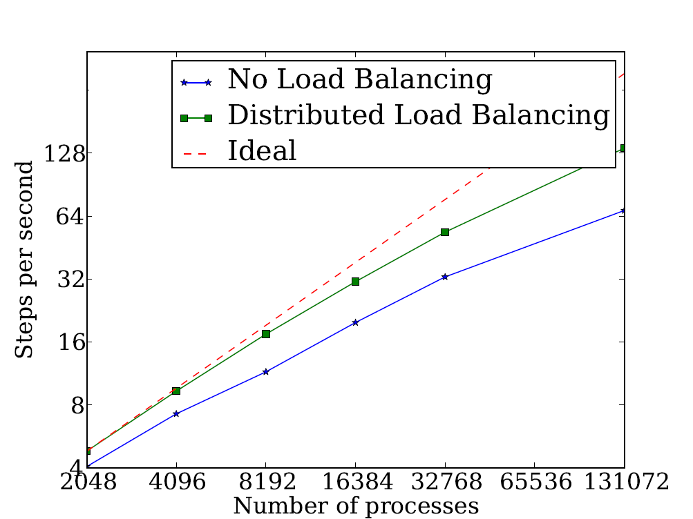
Structured AMR: Performance
Advection Benchmark
First order method in 3d-space
Testbed: IBM BG/Q Mira
Cray XK/6 Titan
Number of Cores

Slide 35
Many other Applications
Some collaborative and some independent
Collaborative:
  Cloth simulation:
    Disney Research Rasmus Tamstorf and Xiang Ni
  Episimdemics (Marathe, Bisset, et al)
  Stochastic Optimization (Palekar, ..)
  ..
Independent:
  Cello/Enzo-P
  Spectre (numerical relativity: Eric Schnetter, Scott Field, ..)
  …

Slide 36
Costs of Overdecomposition?
We examined the “Pro”s so far
Cons and remedies:
Scheduling overhead?
  Not much at all
  In fact get benefits due to blocking
Memory in ghost layer increases
  Fuse local regions with compiler support
  Fetch one ghost layer at a time
  Hybridize (pthreads/openMP inside objects/DEBs)
Less control over scheduling?
  i.e. too much asynchrony?
  But can be controlled in various ways by an observant RTS/programmer
For domain-decomposition based solvers, may increase number of iterations
  You can lift it to node-level overdecomposition (use openMP inside)
  Also, other ideas:
Too radical and new?
  Well, its working well for the past 10-15 years in multiple applications, via Charm++ and AMPI

Slide 37
Interoperation of Charm++ and MPI
Implement a library in the language that suits it the most, and use them together!

Slide 38
Is Interoperation Feasible in Production Applications?
Application | Library | Productivity | Performance
CHARM in MPI (on Chombo) | HistSort in Charm++ | 195 lines removed | 48x speed up in Sorting
EpiSimdemics | MPI IO | Write to single file | 256x faster input
NAMD | FFTW | 280 lines less | Similar performance
Charm++’s Load Balancing | ParMETIS | Parallel graph partitioning | Faster applications

Slide 39
Increasing Interest within DoE etc
DoE has some of the largest applications and is the lead agency for HPC in US
Recognizing the need for newer programming models, several new efforts have started
Janine Bennett, Robert Clay et al (Sandia) led a year long project to evaluate new models, and produced a Sandia Report (Charm++, Legion, Uintah)
Los Alamos led team, part of ExMatex, used/evaluated Charm++ for their miniApps
Livermore: Lulesh, Kripke miniApps, and interest in using it for apps
Intel: Matteson et al evaluated Charm++

Slide 40
Charm++ Ecosystem
Tools:
  Projections: Performance analysis and visualization
  CharmDebug: A powerful visual debugger
Libraries: sorting, collision detection, I/O, …
Online manuals: https://charm.cs.illinois.edu/help
Draft of a Tutorial Introduction book is available
An active mailing list: charm@cs.illinois.edu
A collection of miniApps:
  http://charmplusplus.org/benchmarks/
  Exemplar applications that demonstrate range of Charm++ applicability

Slide 41
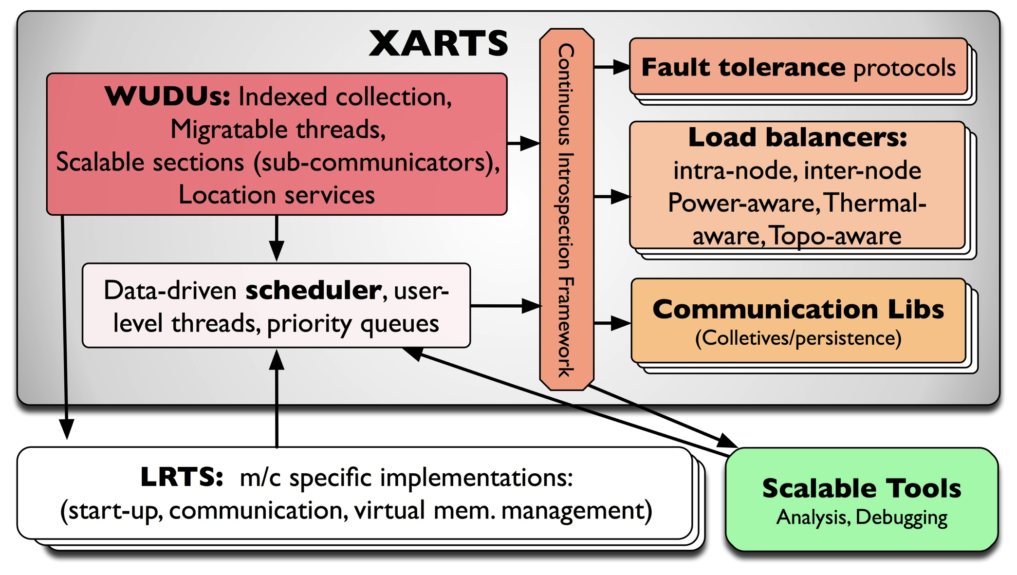
Charm++ RTS

Slide 42
Fault Tolerance in Charm++/AMPI
Four approaches available:
  Disk-based checkpoint/restart
  In-memory double checkpoint w auto. restart
  Proactive object migration
  Message-logging: scalable fault tolerance
Common Features:
  Easy checkpoint: migrate-to-disk
  Based on dynamic runtime capabilities
  Use of object-migration
  Can be used in concert with load-balancing schemes
Notes:
42

Slide 43
Extensions to fault recovery
Based on the same over-decomposition ideas
  Use NVRAM instead of DRAM for checkpoints
    Non-blocking variants
    [Cluster 2012] Xiang Ni et al.
  Replica-based soft-and-hard-error handling
    As a “gold-standard” to optimize against
    [SC 13] Xiang Ni, E. Meneses, N. Jain, et al.

Slide 44
Saving Cooling Energy
Easy: increase A/C setting
  But: some cores may get too hot
So, reduce frequency if temperature is high (DVFS)
  Independently for each chip
But, this creates a load imbalance!
No problem, we can handle that:
  Migrate objects away from the slowed-down processors
  Balance load using an existing strategy
  Strategies take speed of processors into account
Implemented in experimental version
  SC 2011 paper, IEEE TC paper
Several new power/energy-related strategies
  https://charm.cs.illinois.edu/research/energy
  PASA ‘12: Exploiting differential sensitivities of code segments to frequency change

Slide 45
Whole Machine Optimizations
Leverage ability to shrink and expand the sets of nodes used by a job in Charm++
Job Scheduling
  Power-aware resource management
  Overprovisioned data centers
  Use of Linear Programming (LP/IP solvers)

Slide 46
Parallel Discrete Event Simulation
A new (renewed) project
  Funded by LLNL, in collaboration with Chris Carothers (RPI)
  Optimistic concurrency control: allow causality violations and rollback: improved parallelism
  Converted ROSS simulator to use Charm++ instead of MPI
    Better match. Reduced size of code significantly
  PHOLD runs up to 40% faster after the port
  Capability to perform load balancing : observed up to 30% performance improvement
  New asynchronous GVT and load balancing algorithms being developed

Slide 47
Challenge:
How to tune performance when
you don’t have access to
the machine at scale
See: BigSim project papers at http://charm.cs.illinois.edu/research/bigsim
BigSim leverages object-based virtualization to support such tuning

Slide 48
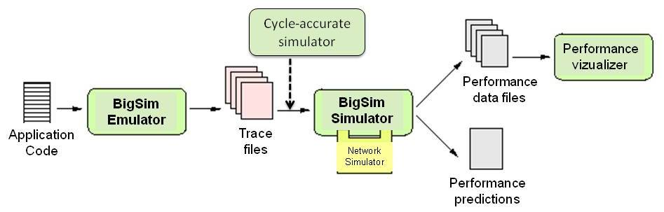
BigSim - Tracer
BigSim Simulation System - Overall Structure:
Next Generation Project: TRACER
Strong emphasis on detailed modeling of network contention

Slide 49
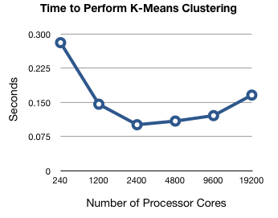
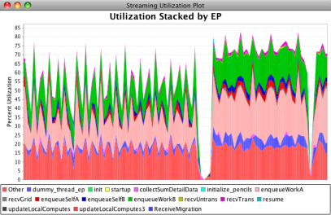
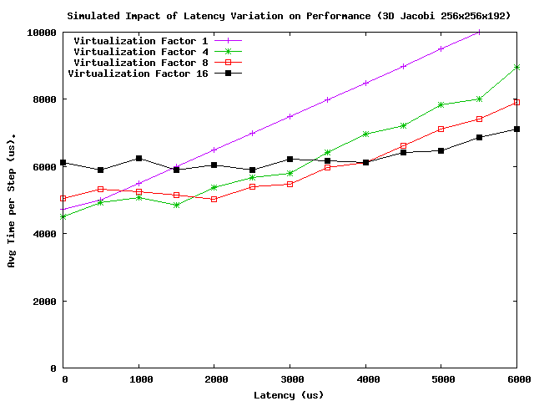
Scalable Performance Analysis
Scalable performance analysis idioms
  And tool support for them
Parallel performance analysis
  Use end-of-run when machine is available to you
  E.g. parallel k-means clustering
Live streaming of performance data
  stream live performance data out-of-band in user-space to enable powerful analysis idioms
What-if analysis using BigSim
  Emulate once, use traces to play with tuning strategies, sensitivity analysis, future machines
See: Chee Wai Lee et al, HIPS 2008, (and Chee Wai’s PhD thesis)
At http://charm.cs.illinois.edu./research/parallel_perf/

Slide 50
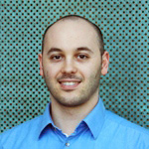
Challenge:
Scalable Debugging
See: Papers by Filippo Gioachin,
(and his Ph.D. thesis)
At http://charm.cs.illinois.edu/research/parallel_debug/

Slide 51
Load Balancing for MPI applications
NCSA/NSF funded project
Modularize and separate load balancing capabilities so they can be used by MPI applications
Multiple methods of use
  More to less intrusive
  Connects with the same back-end of Charm++ load balancing libraries
  Requires some multi-block decomposition by the programmer
Heterogeneous Load balancing:
  Deal with load imbalance issues created by use of GPGPUs for Charm++ , AMPI application

Slide 52
Topology aware mapping
Also NCSA/NSF project
Identify when communication contention becomes an important performance issue
Solve it by changing rank-to-physical node mapping
  Within the context of given allocation
  Suggest application to use the appropriate queue
Applies mainly to MPI programs
  But also to Charm++ programs such as NAMD, and ChanGA
    Using a variation of mapping strategy, as a part of the load balancer

Slide 53
Metabalancer and Control Points
Idea: the RTS itself can be dynamically tuned via introspection
Example: Metabalancer
  How often to trigger load balancing
  Which load balancing strategy to use
Broader Framework
  Recent work by Yanhua Sun (PICS), and Isaac Dooley
  Application can provide “control points”, which are knobs that the RTS can turn based on the analyzed needs

Slide 54
Collaboration Potential
Modular architecture of the runtime system
  Mostly…
  Makes it easy to add a load balancing strategy, or resilience protocol, for example
Ready made set of mini-applications and real applications to demonstrate your techniques on
  See http://charmplusplus.org/benchmarks
Tools eco-system
  You can develop your own tools modularly
    E.g. Kate Isaacs’ novel logical-time views

Slide 55
Additional Collaboration Ideas
Load balancing strategies
Resilience protocols
  Especially Message logging
  Also, SDC (Silent data corruption)
Higher level languages
  using Charm++ as a back-end
  Compiler supported or libraries
  Domain-Specific Languages
Mini-Application Development
Algorithms and Libraries
Within-node runtime and abstractions
  E.g. recent joint work with Barcelona / OMPSS
Energy related optimizations
Job scheduling: malleability
  shrinking/expanding the sets of processors used by a job

Slide 56
Summary
Charm++ embodies an adaptive, introspective runtime system
Many applications have been developed using it
  NAMD, ChaNGa, Episimdemics, OpenAtom, …
  Many miniApps, and third-party apps
Adaptivity developed for apps is useful for addressing exascale challenges
  Resilience, power/temperature optimizations, ..
I am looking for Research Programmers and PostDocs as well as
PhD students (deadline Dec 15th)
With strong software skills
More info on Charm++:
http://charm.cs.illinois.edu
Including the miniApps
Overdecomposition
Asynchrony
Migratability

Slide 57
Existing and older collaborations
Scotch (Pelegrini)
TreeMatch load balancer
NUMA-aware memory allocation
BigDFT
OMPss

