Slide 1


Analyzing Energy-Time Tradeoff in Power Overprovisioned HPC Data Centers
Akhil Langer, Harshit Dokania, Laxmikant Kale, Udatta Palekar*
Parallel Programming Laboratory
Department of Computer Science
University of Illinois at Urbana-Champaign
*Department of Business Administration
University of Illinois at Urbana-Champaign
http://charm.cs.uiuc.edu/research/energy
29th May 2015
The Eleventh Workshop on High-Performance, Power-Aware Computing (HPPAC)
Hyderabad, India
Notes:
Good Morning Everyone. I am going to talk about our work on Power-aware Job scheduling, in which we are trying to maximize the performance of a data center under a strict power budget.

Slide 2
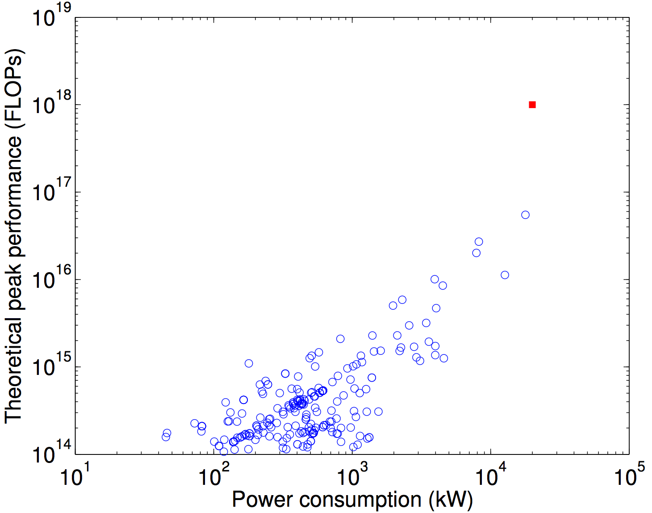
Major Challenge to Achieve Exascale
Power consumption for Top500
Exascale in 20MW!
Notes:
In order to achieve this, we need to make sure that we are efficiently utilizing every watt of power.

Slide 3
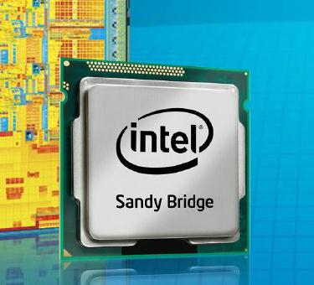



Data Center Power
How is power demand of data center calculated?
  Using Thermal Design Power (TDP)!
However, TDP is hardly reached!!
Constraining CPU/Memory power
Intel Sandy Bridge
Running Average Power Limit (RAPL) library
  measure and set CPU/memory power
Notes:
So let us see how the power requirement fo a data center is calculated. The total power is computed as the sum of the TDP that is the maximum power draw by the subsustem.
Owever, this is excessive as it is seldom reached. Nonetheless, we need to allocate this much so that the circuit does not trip
In the occasion that the power does reach TDP.
However, recent advnaces in architectures allow the user to constraint the power consumption of cpu. So we can constraints power
Consumption, while remaining under the same power budget.
So let us see how is the power requirement of a data center calculated. Computer subsystems such as CPU and memory have a vendor-specified Thermal Design Power (TDP) that corresponds to the maximal power draw by the subsystem. Currently, maximum power consumption of the data center is computed by taking into account the TDP of its subsystems.
However, this is wasteful as these subsystems seldom run at their TDP limit. Nonetheless TDP amount of power has to be kept aside so that the circuit breaker do not trip in the rare case when the power consumption reaches TDP. Recent advances in processor and hardware memory design have made it possible for the user to control the power consumption of CPU and memory through software. This ability to constrain maximum power consumption to below TDP values ensures that the total power consumptin never exceeeds the over budget. Such a system is called an overprovisioned system.
Assuming overprovisioning is a practical requirement because as we move to larger machines, power consumption overtakes hardware as the limiting factor and HPC researchers are forced to think power as the limiting factor.

Slide 4
Constraining CPU/Memory power
Intel Sandy Bridge
Running Average Power Limit (RAPL) library
  measure and set CPU/memory power
Achieved using combination of P-states and Clock throttling
Performance states (or P-states) corresponding to processor’s voltage and frequency
e.g. P0 – 3GHz, P1- 2.66 GHz, P2-2.33GHz, P3-2GHz
Clock throttling – processor is forced to be idle
Notes:
So let us see how is the power requirement of a data center calculated. Computer subsystems such as CPU and memory have a vendor-specified Thermal Design Power (TDP) that corresponds to the maximal power draw by the subsystem. Currently, maximum power consumption of the data center is computed by taking into account the TDP of its subsystems.
However, this is wasteful as these subsystems seldom run at their TDP limit. Nonetheless TDP amount of power has to be kept aside so that the circuit breaker do not trip in the rare case when the power consumption reaches TDP. Recent advances in processor and hardware memory design have made it possible for the user to control the power consumption of CPU and memory through software. This ability to constrain maximum power consumption to below TDP values ensures that the total power consumptin never exceeeds the over budget. Such a system is called an overprovisioned system.
Assuming overprovisioning is a practical requirement because as we move to larger machines, power consumption overtakes hardware as the limiting factor and HPC researchers are forced to think power as the limiting factor.
Modern processors have different performance states, also called as P-states. A P-state corresponds to the processor’s frequency and voltage. For example, Intel Xeon 5160 processor has four P-states - P0, P1, P2, and P3 corresponding to
core frequency of 3.0, 2.66, 2.33, 2 GHz, respectively. P0 is the highest performance state with maximum frequency but also higher power consumption. Higher P-state numbers represent lower frequency and lower power consumption. P- state of the processor can be changed to lower its power consumption. Clock throttling is another method for lowering power consumption of processor. In clock throttling, processor is forced to be idle a fixed number of cycles per second.

Slide 5
Constraining CPU/Memory power
Intel Sandy Bridge
Running Average Power Limit (RAPL) library
  measure and set CPU/memory power
Solution to Data Center Power
Constrain power consumption of nodes
Overprovisioning - Use more nodes than conventional data center for same power budget
Notes:
So let us see how is the power requirement of a data center calculated. Computer subsystems such as CPU and memory have a vendor-specified Thermal Design Power (TDP) that corresponds to the maximal power draw by the subsystem. Currently, maximum power consumption of the data center is computed by taking into account the TDP of its subsystems.
However, this is wasteful as these subsystems seldom run at their TDP limit. Nonetheless TDP amount of power has to be kept aside so that the circuit breaker do not trip in the rare case when the power consumption reaches TDP. Recent advances in processor and hardware memory design have made it possible for the user to control the power consumption of CPU and memory through software. This ability to constrain maximum power consumption to below TDP values ensures that the total power consumptin never exceeeds the over budget. Such a system is called an overprovisioned system.
Assuming overprovisioning is a practical requirement because as we move to larger machines, power consumption overtakes hardware as the limiting factor and HPC researchers are forced to think power as the limiting factor.

Slide 6
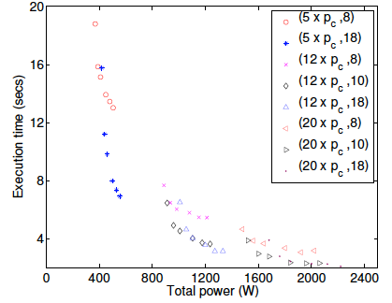
Application Performance with Power
Application performance does not improve proportionately with increase in power cap
Run on larger number of nodes each capped at lower power level
p_{c}: CPU power cap
p_{m}: Memory power cap
Configuration
(n x pc, pm )
(12x44,18)
(20x32,10)
Performance of LULESH at different configurations
[CLUSTER 13]. Optimizing Power Allocation to CPU and Memory Subsystems in Overprovisioned HPC Systems. Sarood et al. pdf
Notes:
Let us see how an application performs at different power caps and what is the optimal configuration of an application.
Increase in power allowed to a node does not lead to proportionate increase in the performance of an application. Therefore, for a give power budget it will be better to run an application at a larger number of nodes each with a lower power cap as compared to running them with nodes running at their TDP. The optimal resource configuration can be decided by profiling an applications performance for different resource configurations i.e. cpu power, number of nodes, etc.
With TDP as the power consumption, only 8 nodes can be powered with 1200W, However, the optimal configuration is to run on 12 nodes with 44 as the CPU power cap.

Slide 7
PARM: Power Aware Resource Manager
Maximizing Data Center Performance Under Strict Power Budget
Data center capabilities
Power capping ability
Overprovisioning
Notes:
Given this context, we state our problem as to maximize the performance of a data center under a strict power budget. We assume that the data center has the capability to constrain CPU power consumption and it is an overprovisioned data center.

Slide 8
PARM POWER-AWARE RESOURCE MANAGER
Profiler
Scheduler
Execution framework
Strong Scaling Power Aware Model
Schedule Jobs (LP)
Launch Jobs/ Shrink-Expand
Job Characteristics Database
Update Queue
Ensure Power Cap
`
Job Ends/Terminates
Triggers
Job Arrives
Notes:
PARM consits of three components: Profiler (to model power characteristics of the job), Scheduler (that selects the job and the amount of resources, that is, nodes and power cap to be allocated to the selected jobs), and the execution framework that launches the jobs and ensure power cap.

Slide 9
PARM: Power Aware Resource Manager
Performance Results
Lulesh, AMR, LeanMD, Jacobi and Wave2D
  38-node Intel Sandy Bridge Cluster, 3000W budget
Description
noMM: without Malleability and Moldability
noSE: with Moldability but no Malleability
wSE: with Moldability and Malleability
1.7X improvement in throughput
[SC 14]. Maximizing Throughput of Overprovisioned Data Center Under a Strict Power Budget. Sarood et al. pdf
Notes:
We compare three versions of PARM with SLURM which is used on many of the top supercomputers of the world.
noMM version of the PARM corresponds to one in which jobs are neither mallable not moldable.

Slide 10
Energy Consumption Analysis
Although power is a critical constraint, high energy consumption can lead to excessing electricity costs
  20MW power @ $0.07/KWh = USD 1M/month
In Future, users may be charged in terms of energy units instead of core hours!
Selecting right configuration is important for desirable energy-vs-time tradeoff

Slide 11
Computational Testbed
38-node Dell PowerEdge R620 cluster
Each node is an Intel Xeon E5-2620 Sandy Bridge server with 6 physical cores running at 2GHz, 2-way SMT with 16GB of RAM
Use RAPL for power capping/measurement
CPU power caps - [31, 34, 37, 40, 43, 46, 49, 52, 55]W
  What happens when CPU power cap is below 30 W?
TDP value of a node = 168 W
Notes:
When the CPU is power capped below 30W, execution time for the applications increases significantly even with small reduction in power cap. his is because at these low power caps, the power management has exhausted the P-states and starts using CPU throttling to reduce the power consumption. Power caps less than 30W will therefore not be used for most practical purposes.

Slide 12
Applications
Wave
  Finite Difference Scheme over a 2D mesh
Lulesh
  Shock hydrodynamics application
Adaptive Mesh Refinement (AMR)
  Oct-tree based structured adaptive mesh refinement
LeanMD
  Molecular Dynamic Simulation Based based on Lennard-Jones potential

Slide 13
Impact of Power Capping on
Performance and CPU frequency
Notes:
Performance of LeanMD is affected the least as power cap is decreased, while the performance of Wave is affected the most. Correlation between CPU frequencies and application sensitivity to power capping is not direct (Figure 1b). LeanMD is least affected by power capping and has the highest frequency of all the applications. AMR, which is the next application that is affected the least by power capping, has very low frequency. Wave and Lulesh, which have similar sensitivity to power capping, have very different frequencies. This implies that power is a complex interplay of power consumption by the cores and by other on- chip activity like cache accesses, memory controller, etc.

Slide 14
Terminology
Configuration
  (n, p), where n is number of nodes, and p is CPU power cap
  n ∈ [4, 8, 12, 16] ,
  p ∈ [31, 34, 37, 40, 43, 46, 49, 52, 55]W
Different operation settings
  Conventional Data Center (CDC)
    Nodes allocated TDP power
  Performance Optimized Overprovisioned Data Center (pODC)
  Energy and time optimized Overprovisioned Data Center (iODC)
Notes:
In a Conventional Data Center (CDC), TDP amount of
power is allocated to each node so that the circuit breakers do
not trip on the occasion that the power consumption reaches
TDP. Given a power budget of P Watts, a CDC will be able to
use P nodes, where 168W is the maximum possible power 168
draw of a compute node (Section IV-A). An Overprovisioned Data Center (ODC) uses power capping and has more nodes than a CDC while remaining within the same power budget. An ODC with a configuration that maximizes the performance (pODC) will have very high energy consumption (Figure 2), and hence it is not very desirable. As can be observed in Figure 2, energy consumption can be minimized by running at a configuration with least number of nodes (four, in this case). However, such configurations have very large execution time and are therefore also not desirable. We examine various scenarios and show how careful selection of configuration (let us call it iODC) can lead to significant energy savings as compared to pODC with minimal impact on execution time

Slide 15
Results
Power Budget =1450W and AMR
Only 8 nodes can be powered in CDC
pODC with configuration
(16, 43) gives 30% improved performance but also 22% increased energy
ODC with configuration
(12, 55) gives 29% improved performance with just 4% increased energy consumption
Notes:
Execution time and energy consumption for different configurations plotted against the power budget for four different applications. Solid lines (——) correspond to execution time, while the dotted lines (. . . . . .) correspond to energy consumption. Different colors correspond to the number of nodes in the configuration. Legend for colors is shown at the top of the figure. Markers on each line correspond to the CPU power caps in the set [31, 34, 37, 40, 43, 46, 49, 52, 55]W. To determine the best performing configuration for a given power budget draw a vertical line at the power budget and chose the configuration to the left that has the minimum execution time.
• Given a total power budget of P = 1450W and AMR application, in pODC, configuration (16, 43) gives the best execution time of 90.5 seconds. This is 30% improvement in execution time with 22% increase in energy consumption over a CDC which can enable only 8 nodes for the given power budget. However, energy consumption of the ODC can be reduced by 14.9% by using the configuration (12, 55) with mere 0.001% increase in execution time as compared to the configuration (16, 43) with the best execution time. In other words, in iODC, by intelligent selection of
the configuration, a 30% improvement in execution time can be achieved with only 4% increase in energy consumption as compared to a CDC setting.
• Given P = 1200W and LeanMD, configuration (12, 55) gives the best execution time. However, by run- ning with configuration (12, 46), we can obtain 7.7% savings in energy while having only 1.4% penalty in execution time.
• Given P = 1500W and Lulesh, configuration (16, 43) yields the best execution time, while the configuration (12, 52) gives savings of 15.3% in energy with only 2.8% increase in the execution time.
• Given P = 1550W and Wave, configuration (16, 46) gives the best execution time, but a 12% savings in energy consumption can be obtained with 6% increase in execution time by using the configuration (12, 55).

Slide 16
Results
Power Budget = 1200W and LeanMD
pODC at (12,55)
iODC at (12, 46) leads to 7.7% savings in energy with only 1.4% penalty in execution time
Notes:
Execution time and energy consumption for different configurations plotted against the power budget for four different applications. Solid lines (——) correspond to execution time, while the dotted lines (. . . . . .) correspond to energy consumption. Different colors correspond to the number of nodes in the configuration. Legend for colors is shown at the top of the figure. Markers on each line correspond to the CPU power caps in the set [31, 34, 37, 40, 43, 46, 49, 52, 55]W. To determine the best performing configuration for a given power budget draw a vertical line at the power budget and chose the configuration to the left that has the minimum execution time.
• Given a total power budget of P = 1450W and AMR application, in pODC, configuration (16, 43) gives the best execution time of 90.5 seconds. This is 30% improvement in execution time with 22% increase in energy consumption over a CDC which can enable only 8 nodes for the given power budget. However, energy consumption of the ODC can be reduced by 14.9% by using the configuration (12, 55) with mere 0.001% increase in execution time as compared to the configuration (16, 43) with the best execution time. In other words, in iODC, by intelligent selection of
the configuration, a 30% improvement in execution time can be achieved with only 4% increase in energy consumption as compared to a CDC setting.
• Given P = 1200W and LeanMD, configuration (12, 55) gives the best execution time. However, by run- ning with configuration (12, 46), we can obtain 7.7% savings in energy while having only 1.4% penalty in execution time.
• Given P = 1500W and Lulesh, configuration (16, 43) yields the best execution time, while the configuration (12, 52) gives savings of 15.3% in energy with only 2.8% increase in the execution time.
• Given P = 1550W and Wave, configuration (16, 46) gives the best execution time, but a 12% savings in energy consumption can be obtained with 6% increase in execution time by using the configuration (12, 55).

Slide 17
Results
Power Budget = 1500W and Lulesh
pODC at (16, 43)
iODC at (12, 52) leads to 15.3% savings in energy with only 2.8% penalty in execution time

Slide 18
Results
Power Budget = 1550W and Wave
pODC at (16, 46)
iODC at (12, 55) leads to 12% savings in energy with only 6% increase in execution time

Slide 19
Results
Note: Configuration choice currently limited by profiled samples, better configurations can be obtained by performance modeling that can predict performance and energy for any configuration
Notes:
Although overprovisioned data centers have promise for maximizing power efficiency for a given power budget, it also has the disadvantage of excessive energy consumption. In this work, we analyzed the energy-vs-time trade-off for power overprovisioned HPC data centers. We showed that careful selection of configurations can lead to significant savings in energy consumption with little impact on the execution time. For some applications, running at fewer nodes and a higher power cap can lead to 15.3% savings in energy with only 2.8% increase in execution time as compared to a configuration that yields the best execution time.

Slide 20
Future Work
Automate the selection of configurations for iODC using performance modeling and energy-vs-time tradeoff metrics
Incorporate CPU temperature and data center cooling energy consumption into the analysis

Slide 21
Takeaways
Overprovisioned Data Centers can lead to significant performance improvements under a strict power budget
However, energy consumption can be excessive in a purely performance optimized overprovisioned data center
Intelligent selection of configuration can lead to significant energy savings with minimal impact on performance

Slide 22
Publications
http://charm.cs.uiuc.edu/research/energy
[PMAM 15]. Energy-efficient Computing for HPC Workloads on Heterogeneous Many-core Chips. Langer et al. pdf
[SC 14]. Maximizing Throughput of Overprovisioned Data Center Under a Strict Power Budget. Sarood et al. pdf
[TOPC 14]. Power Management of Extreme-scale Networks with On/Off Links in Runtime Systems. Ehsan et al. pdf
[SC 14]. Using an Adaptive Runtime System to Reconfigure the Cache Hierarchy. Ehsan et al. pdf
[SC 13]. A Cool Way of Improving the Reliability of HPC Machines. Sarood et al. pdf
[CLUSTER 13]. Optimizing Power Allocation to CPU and Memory Subsystems in Overprovisioned HPC Systems. Sarood et al. pdf
[CLUSTER 13]. Thermal Aware Automated Load Balancing for HPC Applications. Harshitha et al. pdf
[IEEE TC 12]. Cool Load Balancing for High Performance Computing Data Centers. Sarood et al. pdf
[SC 12]. A Cool Load Balancer for Parallel Applications. Sarood et al. pdf
[CLUSTER 12]. Meta-Balancer: Automated Load Balancing Invocation Based on Application Characteristics. Harshitha et al. pdf

Slide 23
Thank you!
Analyzing Energy-Time Tradeoff in Power Overprovisioned HPC Data Centers
Akhil Langer, Harshit Dokania, Laxmikant Kale, Udatta Palekar*
Parallel Programming Laboratory
Department of Computer Science
University of Illinois at Urbana-Champaign
*Department of Business Administration
University of Illinois at Urbana-Champaign
http://charm.cs.uiuc.edu/research/energy
29th May 2015
The Eleventh Workshop on High-Performance, Power-Aware Computing (HPPAC)
Hyderabad, India
Notes:
Good Morning Everyone. I am going to talk about our work on Power-aware Job scheduling, in which we are trying to maximize the performance of a data center under a strict power budget.

