Slide 1


The Need for Well-Factored Dynamic Parallel Programming Systems, and Why Charm++ is a Good Choice
Phil Miller

Slide 2
(Over)Decomposition
Decompose the work units & data units into many more pieces than execution units
  Cores/Nodes/..
Not so hard: we do (over) decomposition anyway
  Multi-block and AMR on structured meshes
  Unstructured mesh partitions
  N-body tree code ‘leaves’
  Blocked linear algebra

Slide 3
Task/Object Placement
Those pieces have to go somewhere
Naïve reasons:
  Matching (range of) indices
  Easy to compute ID<->place mapping
Good reasons: (e.g.)
  Load balance
  Communication locality on core/node
  Communication locality over network
  Workload affinity for hardware type

Slide 4
Task/Object Movement
Is the chosen placement the best possible?
Can you change it?
  Without restarting the application?
Why?
  Load not as predicted (or assumed)
  Load changed
  Hardware performance changed(?!)
  Part of hardware failed

Slide 5
Asynchronous Execution
Work shouldn’t have to ‘wait its turn’
Components should be willing to share
I.e., Composition of independent tasks
  Steps of a parallel algorithm
  Multi-module and multi-physics
  Using all hardware resources, all the time

Slide 6
Missing Optimizations
Second-order placement effects
Load balancing frequency
Dynamic critical paths
Energy usage
Productivity
Why do it all by yourself, in every app?

Slide 7
Instantiations of (some of) these ideas
Charm++
  Including Adaptive MPI, Charj, Charisma, MSA, DSLs
KAAPI
HPX
StarPU
OmpSs
ParSEC
CnC
Chapel
X10
Every AMR framework
  Especially Uintah
ProActive
FG-MPI
MPC

Slide 8
Why Charm++
Application experience
  NAMD, EpiSimdemics, ChaNGa
  OpenAtom, Fractography, Stochastic MIP, Cloth Simulation
Interoperation with native MPI code
  Easy, low risk, incremental adoption
Production-ready development
  Portability
  Stability
  Compatibility
Rich, Extensible Ecosystem
Comprehensive feature set

Slide 9
Why Charm++
Application experience
  NAMD, EpiSimdemics, ChaNGa
  OpenAtom, Fractography, Stochastic MIP, Cloth Simulation
Interoperation with native MPI code
  Easy, low risk, incremental adoption
Production-ready development
  Portability
  Stability
  Compatibility
Rich, Extensible Ecosystem
Comprehensive feature set

Slide 10
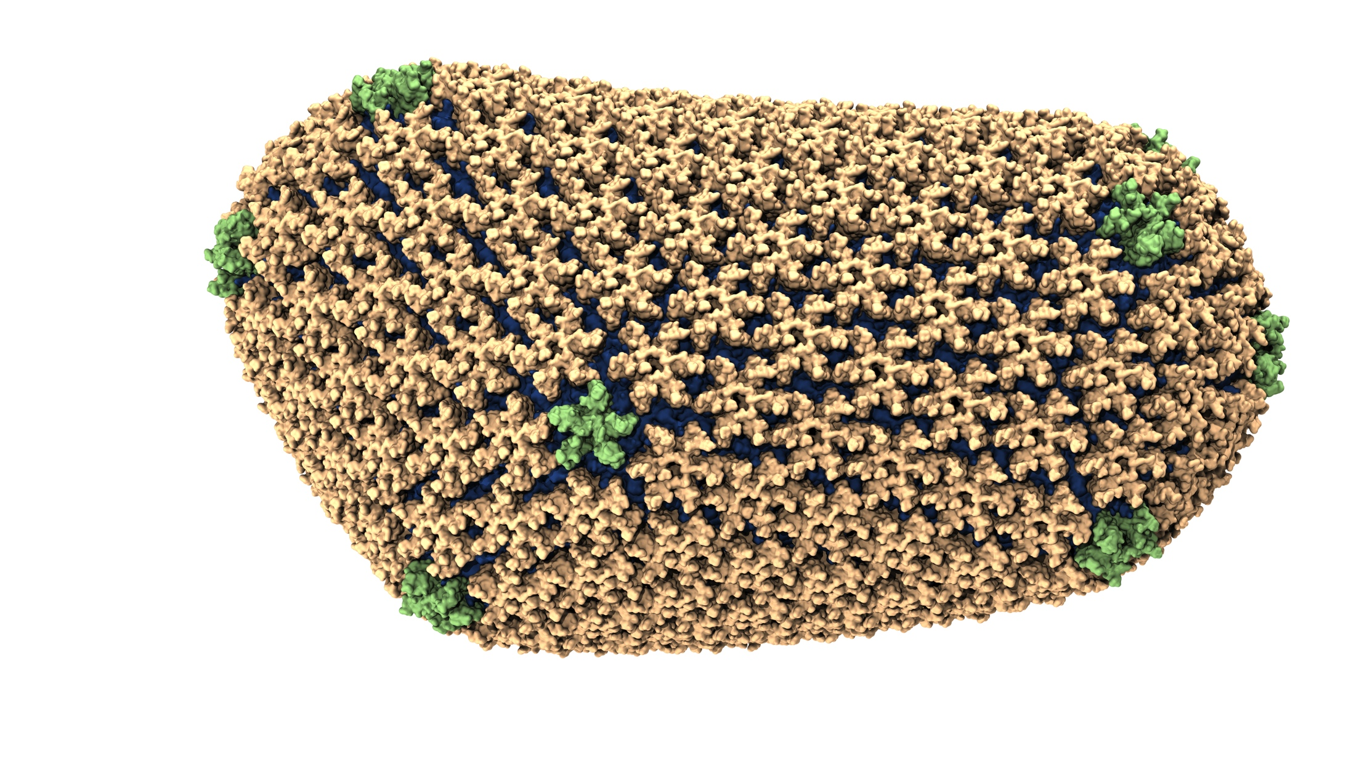
NAMD: Biomolecular Simulations
Long-term collaboration (1994-now) with
K. Schulten
Over 50,000 users
Scaled to top US supercomputers
2002 Gordon Bell award
2012 Fernbach award
Science cover article:
Determination of HIV capsid structure

Slide 11
NAMD strong scaling on Titan Cray XK7, Blue Waters Cray XE6, and Mira IBM Blue Gene/Q for 21M and 224M atom benchmarks

Slide 12
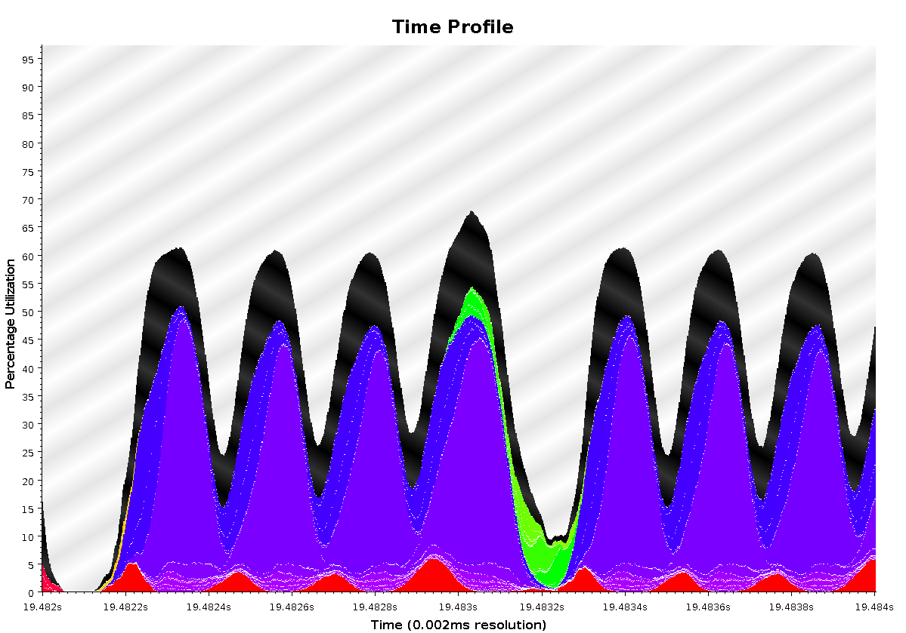
Time Profile of ApoA1 on Power7 PERCS
92,000 atom system, on 500+ nodes (16k cores)
2ms total
A snapshot of optimization in progress.. Not the final result
Overlapped steps, as a result of asynchrony

Slide 13
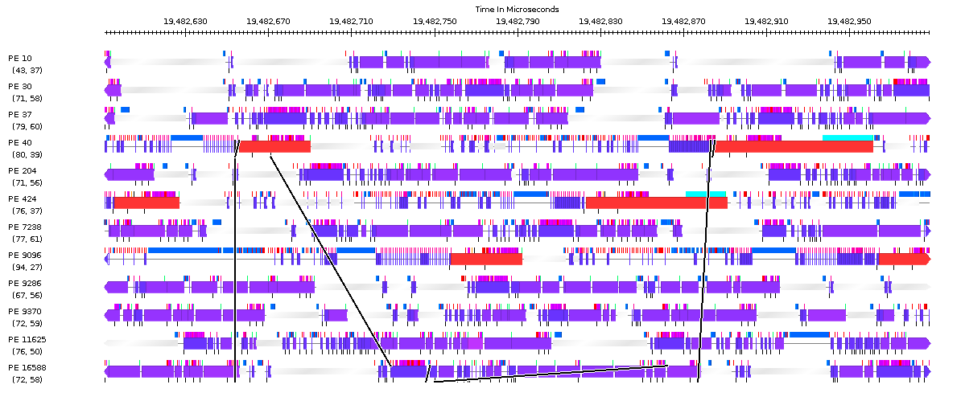
Timeline of ApoA1 on POWER7 PERCS
230us

Slide 14
EpiSimdemics

Slide 15
Conversion to Charm++
Original in MPI, scaling failed at 512 cores
Headline features:
  Asynchronous reductions
  Easy decomposition experiments
  Streaming all-to-all
  Composition - split mid-run for multiple scenarios,
  overlap on full job partition

Slide 18
ChaNGa: Cosmology Simulation
Collaboration with
Tom Quinn at UW
Tree: Represents particle distribution
TreePiece: object/chares containing particles
Notes:
Animation1 - For clustered datasets, TreePieces containing those red nodes receive high volume of request

Slide 19
Multiple time-stepping!
Our scientist collaborators suggest an algorithmic optimization:
  Don’t move slow-moving particles every step
    i.e. don’t calculate forces on them either
  In fact, make many (say 5) categories (rungs) of particles based on their velocities
  Rung sequence (with 5 rungs)
    4 3 4 2 4 3 4 1 4 3 4 2 4 3 4 0
    Rung 0: all particles, Rung 4: fastest-moving particles
  Each tree-piece object now presents a different load when different “rungs” are being calculated

Slide 20
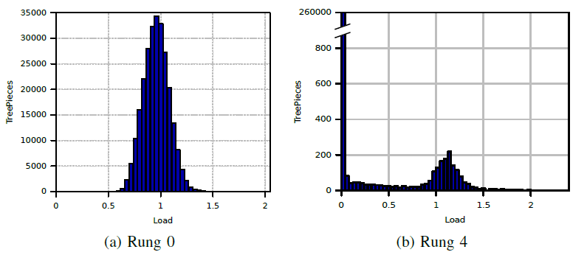
Multiple time-stepping!
Load (for the same object) changes across rungs
  Yet, there is persistence within the same rung!
  So, specialized phase-aware balancers were developed

Slide 21
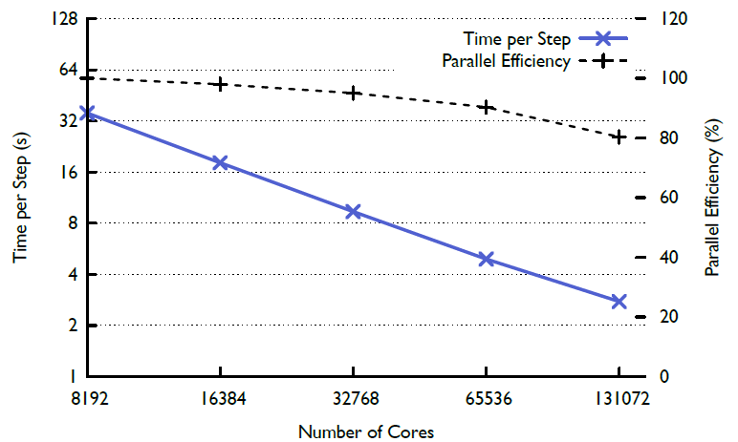
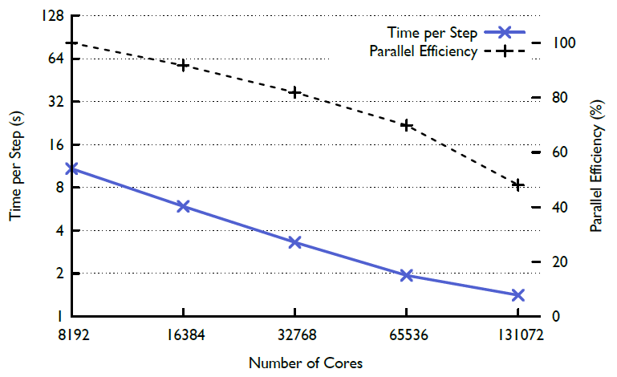
Multi-stepping tradeoff
Parallel efficiency is lower, but performance is improved significantly
Single Stepping
Multi Stepping

Slide 22
Why Charm++
Application experience
  NAMD, EpiSimdemics, ChaNGa
  OpenAtom, Fractography, Stochastic MIP, Cloth Simulation
Interoperation with native MPI code
  Easy, low risk, incremental adoption
Production-ready development
  Portability
  Stability
  Compatibility
Rich, Extensible Ecosystem
Comprehensive feature set

Slide 23
MPI Interoperability
Make calls between MPI and Charm++ code
Implement each parallel kernel in the most suitable model
Code shares process address space
  Can pass plain pointers across interface
Control transfer between Charm++ and MPI analogous to MPI code calling external libraries (e.g. ParMETIS, FFTW, PETSc, Hypre)

Slide 24
MPI Interoperability Modes

Slide 25
MPI Interoperability Code
Include mpi-interoperate.h
Add an interface function callable from the main program

Slide 26
MPI Interoperabilty: Control Flow
Begin execution at user main
Perform MPI initialization and application initialization
Create a communicator for Charm++
Initialize Charm++
for (as many times needed)
  perform MPI based communication and application work
  invoke Charm++ code
Exit Charm++
Exit MPI

Slide 27
MPI Interoperability: Example Code

Slide 28
MPI Interoperability: Use Cases
Demonstrated in HPC Challenge submission with FFT benchmark
Chombo AMR framework using parallel sorting library from
  Highly Scalable Parallel Sorting by Edgar Solomonik and Laxmikant Kale (IPDPS, 2009)
EpiSimdemics using MPI-IO

Slide 29
Why Charm++
Application experience
  NAMD, EpiSimdemics, ChaNGa
  OpenAtom, Fractography, Stochastic MIP, Cloth Simulation
Interoperation with native MPI code
  Easy, low risk, incremental adoption
Production-ready development
  Portability
  Stability
  Compatibility
Rich, Extensible Ecosystem
Comprehensive feature set

Slide 30
Development: Portability
Compilers: GNU, Intel, IBM, Clang, Cray, PGI
  ROSE, Sun, Fujitsu
Network: BlueGene *, Cray *, IB Verbs, TCP/IP
CPU Architectures: x86, POWER, BG *, ARM
OS: Linux, Mac, Windows, BG *

Slide 31
Development: Stability
Nightly cross-platform testing
Summer project to raise coverage to 100%
Continuous Integration against applications
Code Review of every commit
RTS runs clean under Valgrind and ubsan
Recently tried ThreadSanitizer on SMP build
  Fixed 90% of reports, remainder to be fixed soon
  Only harmful case was in just-changed code

Slide 32
Development: Compatibility
Frivolous API changes avoided
NAMD always tested for compatibility, forward and backward

Slide 33
Why Charm++
Application experience
  NAMD, EpiSimdemics, ChaNGa
  OpenAtom, Fractography, Stochastic MIP, Cloth Simulation
Interoperation with native MPI code
  Easy, low risk, incremental adoption
Production-ready development
  Portability
  Stability
  Compatibility
Rich, Extensible Ecosystem
Comprehensive feature set

Slide 34
Features & Ecosystem
Automatic offline & online fault tolerance
  Checkpoint in one line, transparent restart
  Need vendors to support resilient jobs!
Plethora of LB strategies
  Easy to plug in your own
Scalable online tools
  CharmDebug
  LiveViz
Resource Optimizations
  In-job power & energy: need freedom to control DVFS/RAPL
  Job size tuning via shrink/expand: need cooperative scheduler
  Across-job power & energy: scheduling with power constraints

Slide 35
Why Charm++
Application experience
  NAMD, ChaNGa, EpiSimdemics
  OpenAtom, Fractography, Stochastic MIP, Cloth Simulation
Interoperation with native MPI code
  Easy, low risk, incremental adoption
Production-ready development
  Portability
  Stability
  Compatibility
Rich, Extensible Ecosystem
Comprehensive feature set
Questions?

