Slide 1


Charm++ Applications
Laxmikant (Sanjay) Kale
http://charm.cs.illinois.edu
Parallel Programming Laboratory
Department of Computer Science
University of Illinois at Urbana Champaign

Slide 2
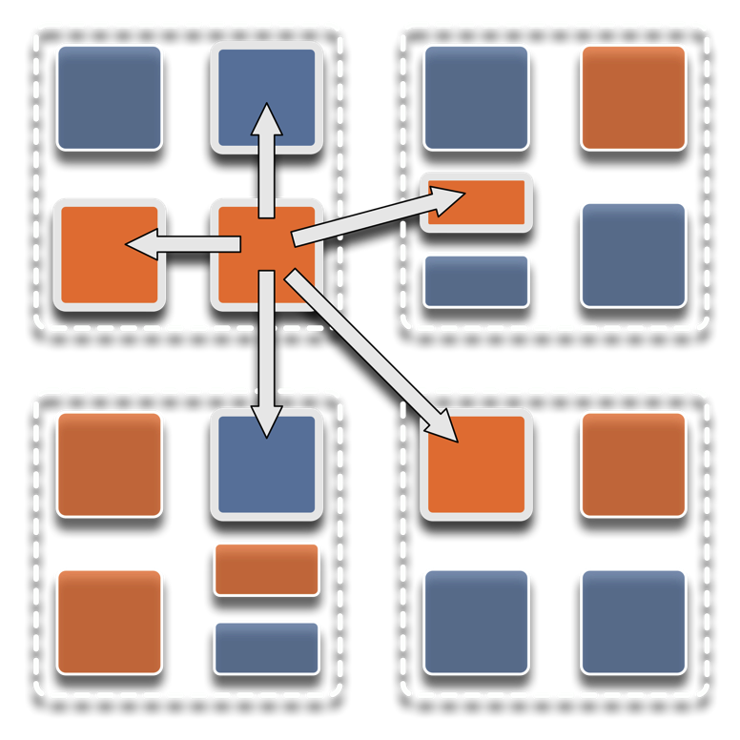
Overdecomposition
Decompose the work units & data units into many more pieces than execution units
  Cores/Nodes/..
Not so hard: we do decomposition anyway

Slide 3
Migratability
Allow these work and data units to be migratable at runtime
  i.e. the programmer or runtime, can move them
Consequences for the app-developer
  Communication must now be addressed to logical units with global names, not to physical processors
  But this is a good thing
Consequences for RTS
  Must keep track of where each unit is
  Naming and location management

Slide 4
Asynchrony:
Message-Driven Execution
You have multiple units on each processor
They address each other via logical names
Message-driven execution:
  Let the work-unit that happens to have data (“message”) available for it execute next
  Let the RTS select among ready work units
  Programmer should not specify what executes next, but can influence it via priorities

Slide 5
Charm++: Object-based overdecomposition
Multiple “indexed collections” of C++ objects
Indices can be multi-dimensional and/or sparse
Programmer expresses communication between objects
  with no reference to processors : A[i].foo(…)
System implementation
User View

Slide 6
Message-driven Execution
A[..].foo(…)

Slide 7
Empowering the RTS
Adaptive
Runtime System
Introspection
Adaptivity
Asynchrony
Overdecomposition
Migratability
The Adaptive RTS can:
  Dynamically balance loads
  Optimize communication:
    Spread over time, async collectives
  Automatic latency tolerance
  Prefetch data with almost perfect predictability
Notes:
You can have asynchrony without overdecomposition or vice versa, you can have migratability without asynchrony, but you need all three to empower the RTS.You need to add introspection and adaptivity to make a powerful Adaptive Runtime System

Slide 8
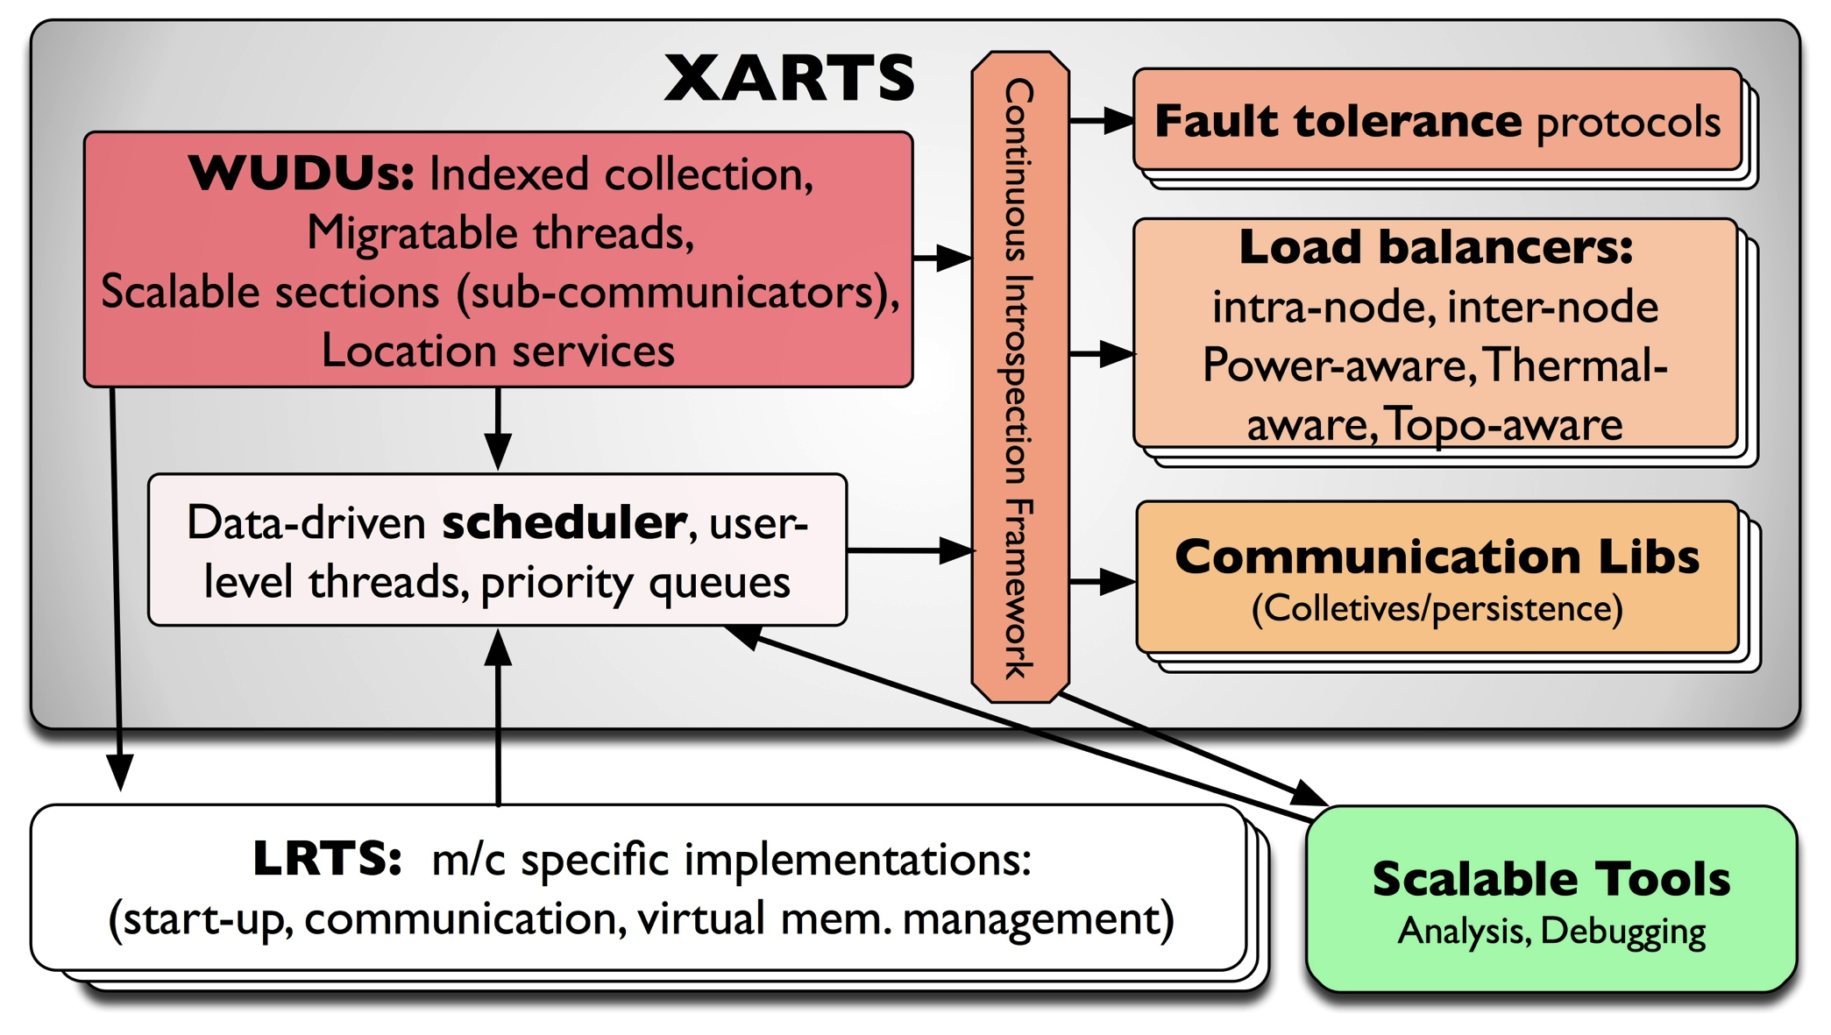
Charm++ RTS

Slide 9
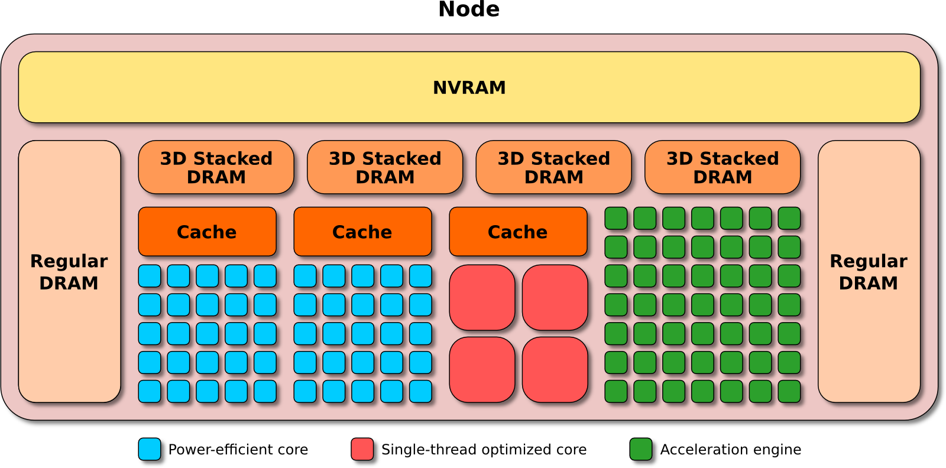
Argo
An Exascale Operating System and Runtime
Key Areas of Innovation:
NodeOS/R
  Core-specialization permits multiple, concurrent kernels
Lightweight Concurrency
  Embed fine-grained tasks and lightweight threads into OS for massive parallelism
Backplane
  Event, Control, and Performance backplanes to support global optimizations
Global View
  “Enclave” abstraction to allow global optimization of power, resilience, perf.
$9.7M ASCR DOE
3 year project, launched Aug 2013
The Crew of the Argo:
Argonne National Laboratory;
Principle Investigator and Chief Architect: Pete Beckman
Chief Scientist: Marc Snir
P. Balaji, R. Gupta, K. Iskra, R. Thakur, K. Yoshii, F. Cappello
Boston University: J. Appavoo, O. Krieger
Lawrence Livermore National Laboratory:
M. Gokhale, E. Leon, B. Rountree, M. Schulz, B. Van Essen
Pacific Northwest National Laboratory: S. Krishnamoorthy, R. Gioiosa
University of Chicago: H. Hoffmann
University of Illinois at UC: L. Kale, E. Bohm, R. Venkataraman
University of Oregon: A. Malony, S. Shende, K. Huck
University of Tennesee Knoxville: J. Dongarra, G. Bosilca

Slide 10
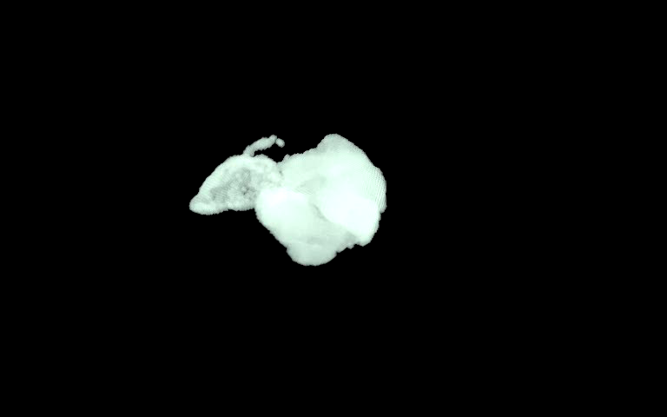
ChaNGa: Parallel Gravity
Evolution of Universe and Galaxy Formation
Collaborative project (NSF)
  with Tom Quinn, Univ. of Washington
Gravity, gas dynamics
Barnes-Hut tree codes
  Oct tree is natural decomp
  Geometry has better aspect ratios, so you “open” up fewer nodes
  But is not used because it leads to bad load balance
  Assumption: one-to-one map between sub-trees and PEs
  Binary trees are considered better load balanced
  With Charm++: Use Oct-Tree, and let Charm++ map subtrees to processors

Slide 11
ChaNGa: Cosmology Simulation
Collaboration with Tom Quinn UW
Tree: Represents particle distribution
TreePiece: object/chares containing particles
Notes:
Animation1 - For clustered datasets, TreePieces containing those red nodes receive high volume of request

Slide 12
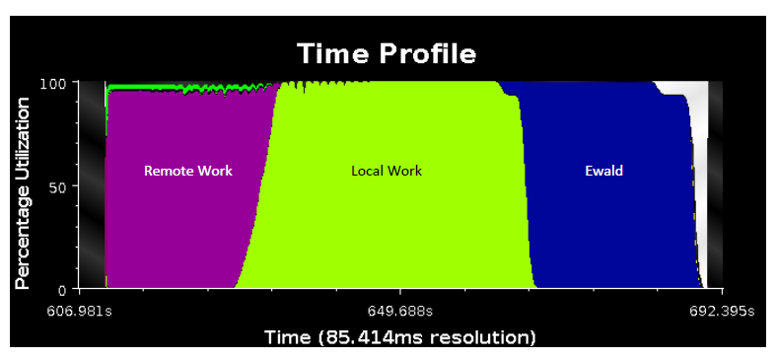
ChaNGa: Optimized Performance
Asynchronous, highly overlapped, phases
Requests for remote data overlapped with local computations

Slide 13
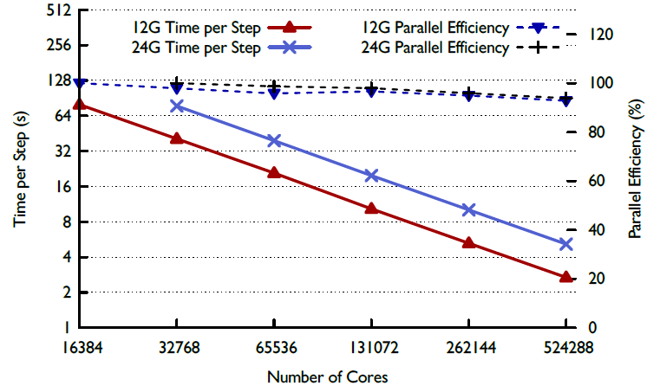
ChaNGa : a recent result

Slide 14
Clustered Dataset - Dwarf
Idle time due to message delays
Also, load imbalances: solved by Hierarchical balancers
Highly clustered
Maximum request per processor: > 30K
Notes:
Animation 1 : Shows volume
Animation 2 : Time profile

Slide 15
Solution: Replication
PE 1
PE 2
PE 3
PE 4
Replicate tree nodes to distribute requests
Requester randomly selects a replica

Slide 16
Replication Impact
Replication distributes requests
Maximum request reduced from 30K to 4.5K
Gravity time reduced from 2.4 s to 1.7 s, on 8k
Notes:
Gravity time reduced from 2.4 s to 1.7 s for 8k cores and from 2.1 s to 0.99 t 16K

Slide 17
Multiple time-stepping!
Our scientist collaborators suggest an algorithmic optimization:
  Don’t move slow-moving particles every step
    i.e. don’t calculate forces on them either
  In fact, make many (say 5) categories (rungs) of particles based on their velocities
  Rung sequence (with 5 rungs)
    4 3 4 2 4 3 4 1 4 3 4 2 4 3 4 0
    Rung 0: all particles, Rung 4: fastest-moving particles
  Each tree-piece object now presents a different load when different “rungs” are being calculated

Slide 18
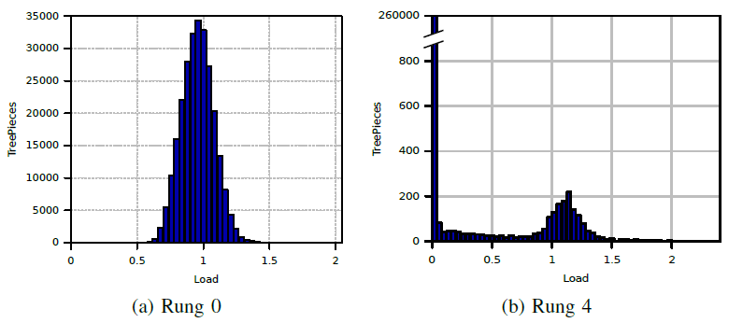
Multiple time-stepping!
Load (for the same object) changes across rungs
  Yet, there is persistence within the same rung!
  So, specialized phase-aware balancers were developed

Slide 19
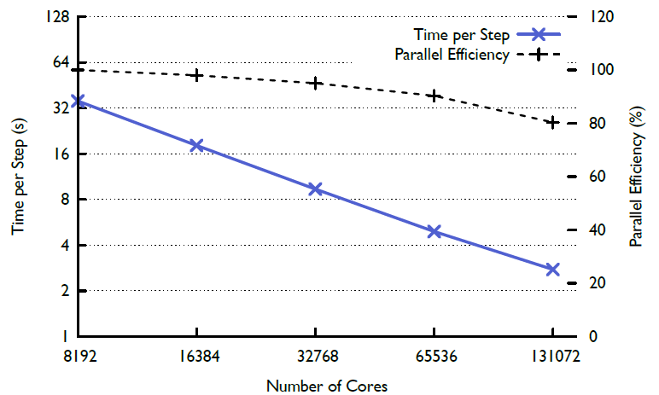
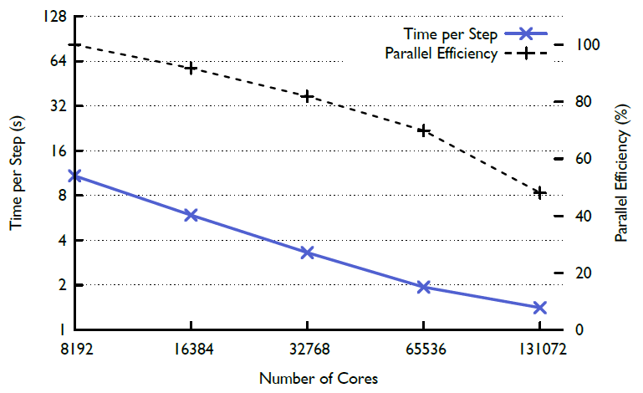
Multi-stepping tradeoff
Parallel efficiency is lower, but performance is improved significantly
Single Stepping
Multi Stepping

Slide 20
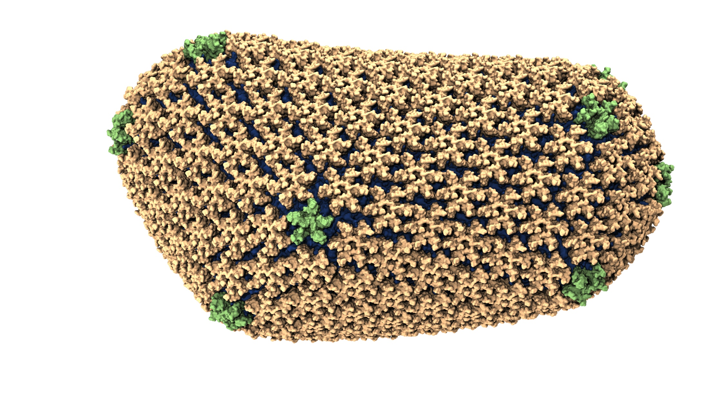
NAMD: Biomolecular Simulations
Collaboration with K. Schulten
With over 50,000 registered users
Scaled to most top US supercomputers
In production use on supercomputers and clusters and desktops
Gordon Bell award in 2002
Recent success: Determination of the structure of HIV capsid by researchers including Prof Schulten

Slide 21
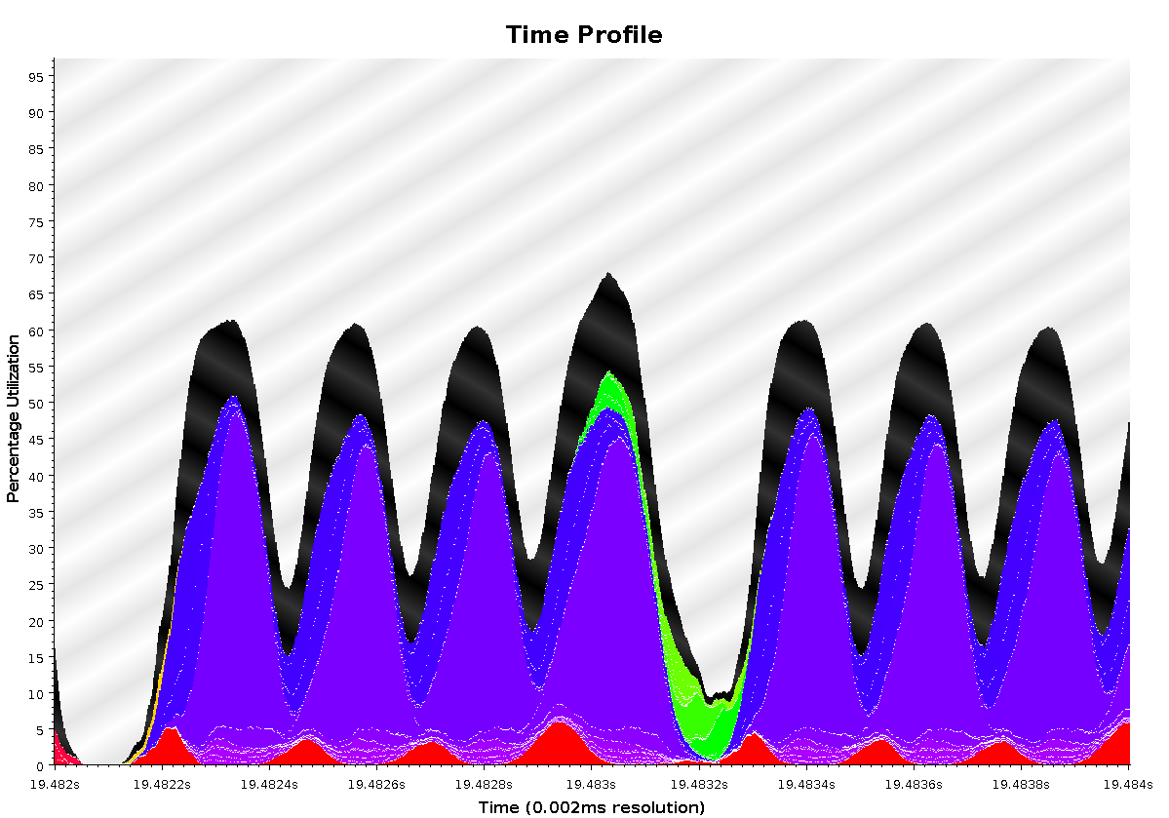
Time Profile of ApoA1 on Power7 PERCS
92,000 atom system, on 500+ nodes (16k cores)
2ms total
A snapshot of optimization in progress.. Not the final result
Overlapped steps, as a result of asynchrony

Slide 22
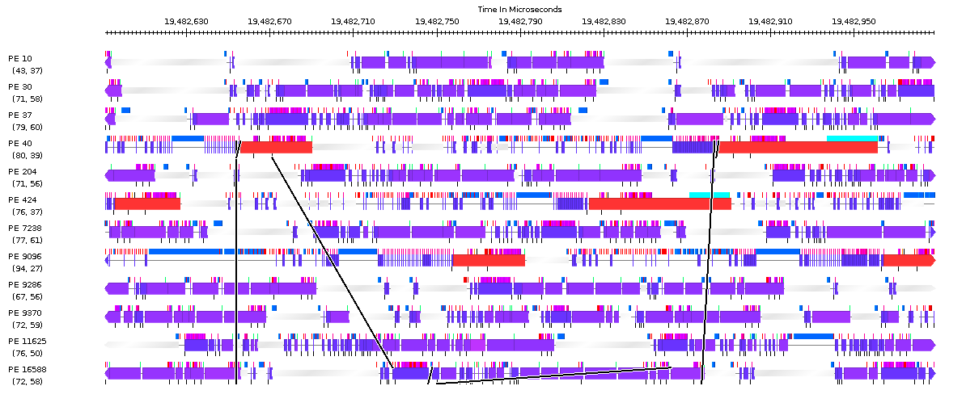
Timeline of ApoA1 on Power7 PERCS
230us

Slide 23
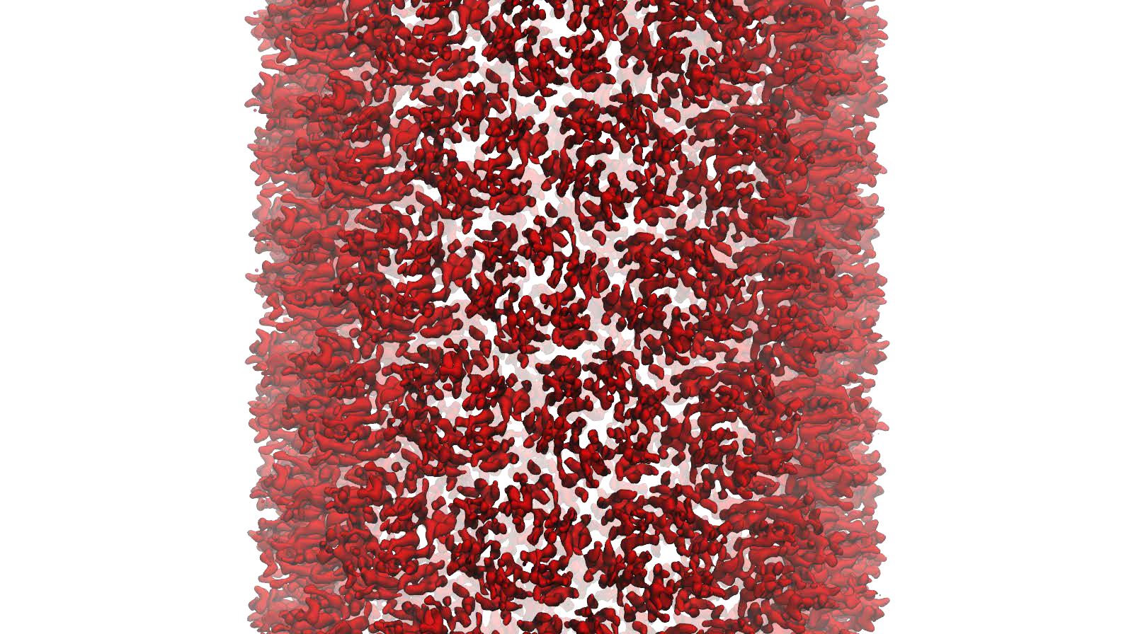
NAMD: Strong Scaling
HIV Capsid was a 64 million atom simulation, including explicit water atoms
Most biophysics systems of interests are 10M atoms or less… maybe 100M
Strong scaling desired to billions of steps

Slide 24
Enhancing Asynchrony in NAMD
Charm++ reductions are non-blocking
  So, you can do other work while reduction is progressing through the system
Synchronization:
  NAMD, when used with a barostat (NPT ensemble), needs pressure from the current step to rescale volume
  So, no other work was performed during reduction
Enhancing asynchrony:
  For strong scaling, the algebra was reworked to use the results of the reduction one step later
  Overlapped reduction with an entire force computation step
  10% performance improvement on 16k nodes on Titan

Slide 25
NAMD strong scaling on Titan Cray XK7, Blue Waters Cray XE6, and Mira IBM Blue Gene/Q for 21M and 224M atom benchmarks

Slide 26
Episimdemics
Simulation of spread of contagion
  Code by Madhav Marathe, Keith Bisset, .. Vtech
  Original was in MPI
Converted to Charm++
  Benefits: asynchronous reductions improved performance considerably

Slide 29
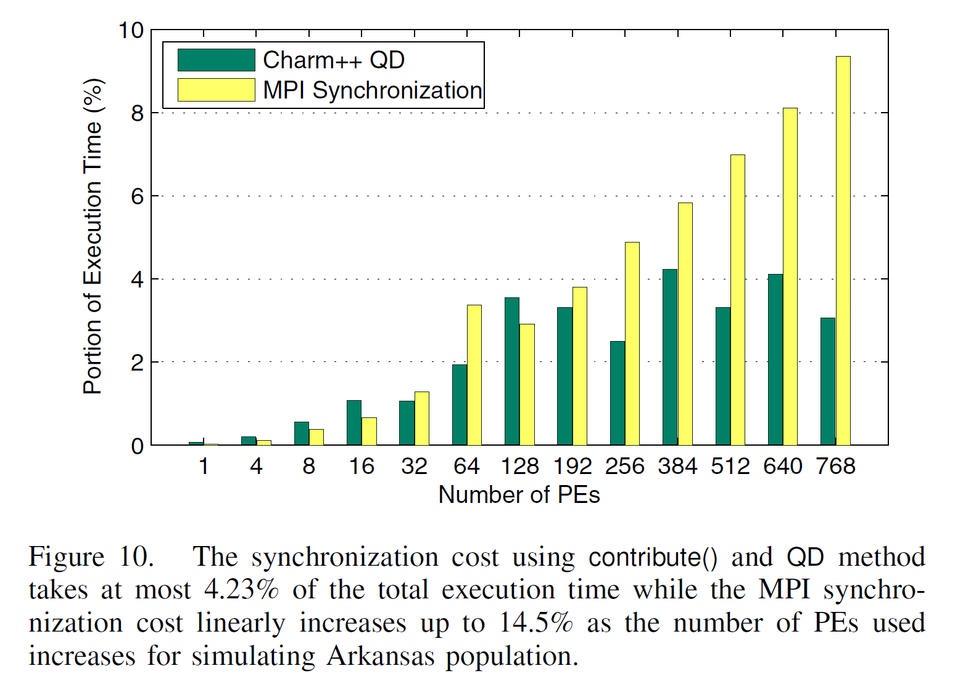

Slide 31
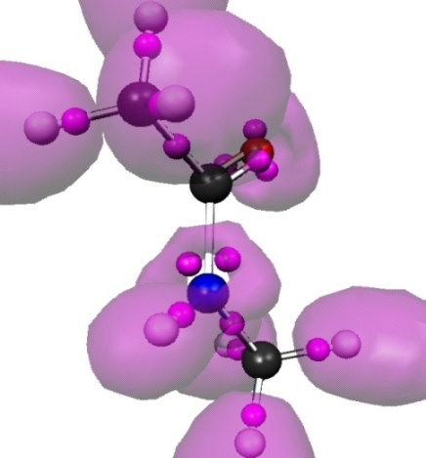
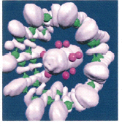
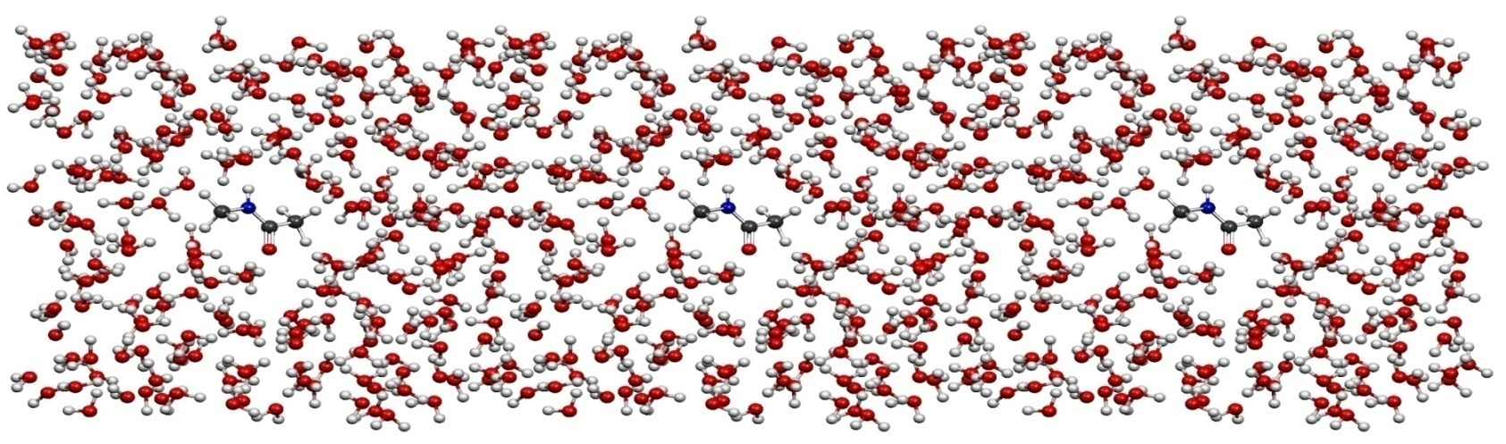
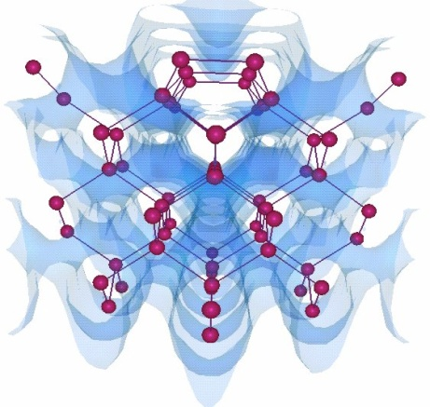
OpenAtom
Car-Parinello Molecular Dynamics
NSF ITR 2001-2007, IBM, DOE,NSF
Molecular Clusters :
Nanowires:
Recent NSF SSI-SI2 grant
With
G. Martyna (IBM)
Sohrab Ismail-Beigi
Semiconductor Surfaces:
3D-Solids/Liquids:
Using Charm++ virtualization, we can efficiently scale small (32 molecule) systems to thousands of processors

Slide 32
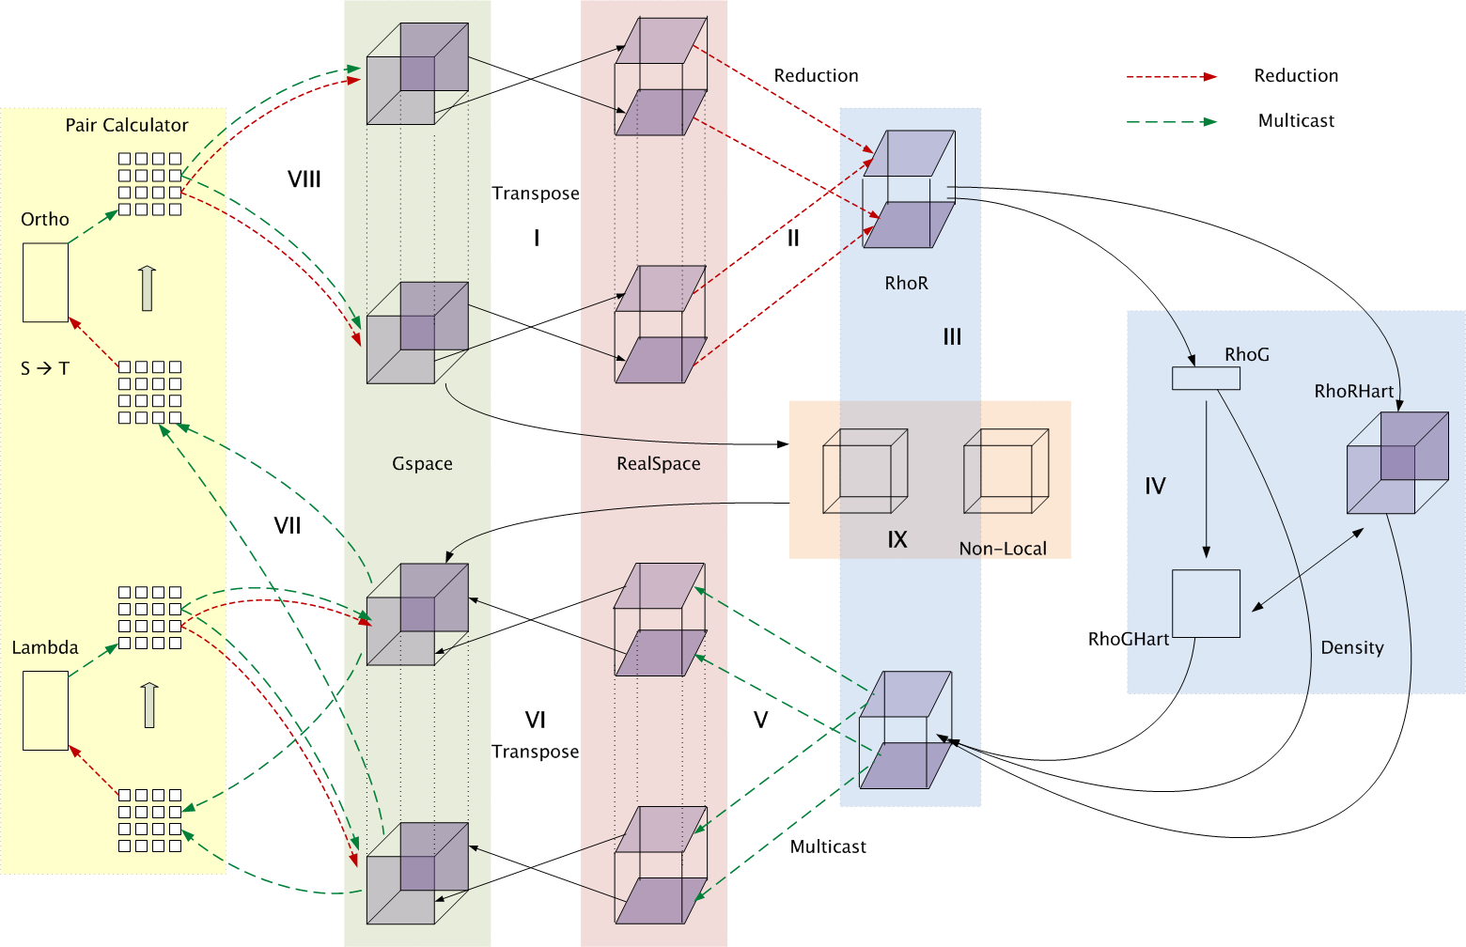
Decomposition and Computation Flow

Slide 33
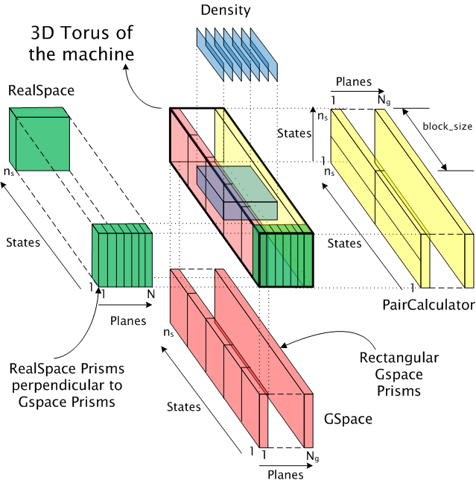
Topology Aware Mapping of Objects

Slide 34
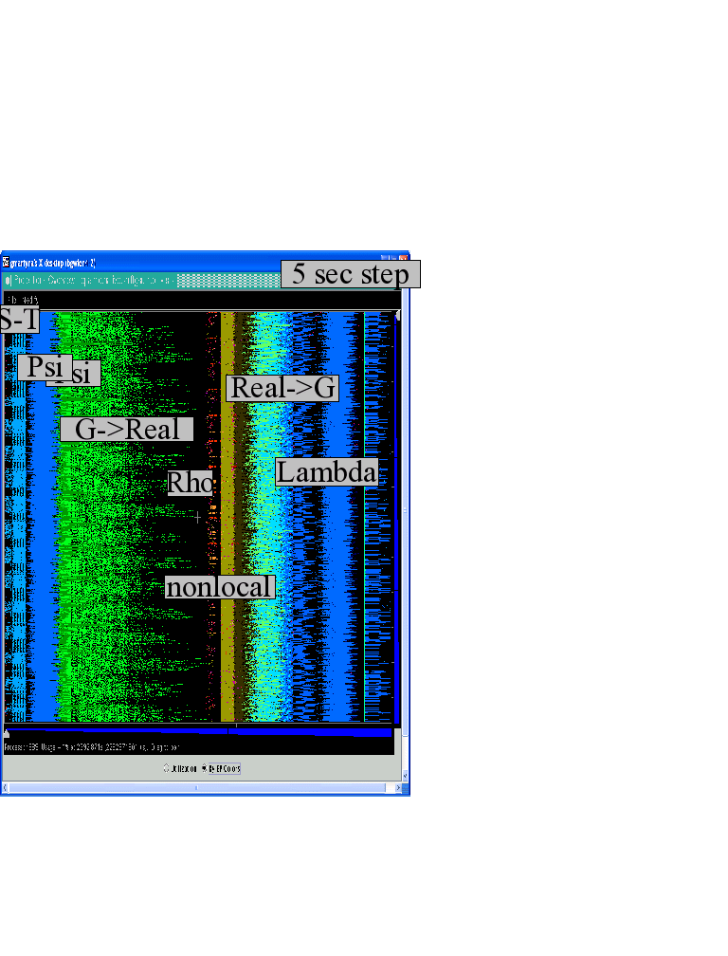
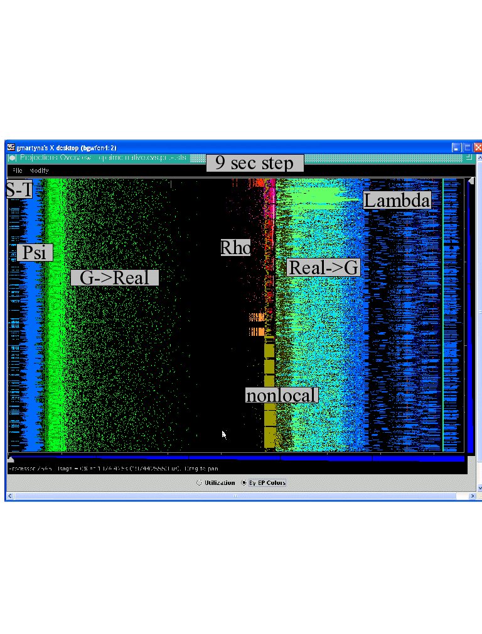

Improvements by topological aware mapping of computation to processors
Punchline: Overdecomposition into Migratable Objects created the degree of freedom needed for flexible mapping
The simulation of the left panel, maps computational work to processors taking the network connectivity into account while the right panel simulation does not. The “black’’ or idle time processors spent waiting for computational work to arrive on processors is significantly reduced at left. (256waters, 70R, on BG/L 4096 cores)

Slide 35
OpenAtom Performance Sampler
Ongoing work on:
K-points

Slide 36
MiniApps
Mini-App | Features | Machine | Max cores
AMR | Overdecomposition, Custom array index, Message priorities, Load Balancing, Checkpoint restart | BG/Q | 131,072
LeanMD | Overdecomposition, Load Balancing, Checkpoint restart, Power awareness | BG/P BG/Q | 131,072 32,768
Barnes-Hut (n-body) | Overdecomposition, Message priorities, Load Balancing | Blue Waters | 16,384
LULESH 2.02 | AMPI, Over-decomposition, Load Balancing | Hopper | 8,000
PDES | Overdecomposition, Message priorities, TRAM | Stampede | 4,096

Slide 37
More MiniApps
Mini-App | Features | Machine | Max cores
1D FFT | Interoperable with MPI | BG/P BG/Q | 65,536 16,384
Random Access | TRAM | BG/P BG/Q | 131,072 16,384
Dense LU | SDAG | XT5 | 8,192
Sparse Triangular Solver | SDAG | BG/P | 512
GTC | SDAG | BG/Q | 1,024
SPH |  | Blue Waters | -

Slide 38
Where are Exascale Issues?
I didn’t bring up exascale at all so far..
  Overdecomposition, migratability, asynchrony were needed on yesterday’s machines too
  And the app community has been using them
  But:
    On *some* of the applications, and maybe without a common general-purpose RTS
The same concepts help at exascale
  Not just help, they are necessary, and adequate
  As long as the RTS capabilities are improved
We have to apply overdecomposition to all (most) apps

Slide 39
A message of this talk
Intelligent, introspective, Adaptive Runtime Systems, developed for handling application’s dynamic variability, already have features that can deal with challenges posed by exascale hardware

Slide 40
Fault Tolerance in Charm++/AMPI
Four approaches available:
  Disk-based checkpoint/restart
  In-memory double checkpoint w auto. restart
  Proactive object migration
  Message-logging: scalable fault tolerance
Common Features:
  Easy checkpoint: migrate-to-disk
  Based on dynamic runtime capabilities
  Use of object-migration
  Can be used in concert with load-balancing schemes
Demo at Tech Marketplace
Notes:
40

Slide 41
Extensions to fault recovery
Based on the same over-decomposition ideas
  Use NVRAM instead of DRAM for checkpoints
    Non-blocking variants
    [Cluster 2012] Xiang Ni et al.
  Replica-based soft-and-hard-error handling
    As a “gold-standard” to optimize against
    [SC 13] Xiang Ni, E. Meneses, N. Jain, et al.

Slide 42
Saving Cooling Energy
Demo at Tech Marketplace
Easy: increase A/C setting
  But: some cores may get too hot
So, reduce frequency if temperature is high (DVFS)
  Independently for each chip
But, this creates a load imbalance!
No problem, we can handle that:
  Migrate objects away from the slowed-down processors
  Balance load using an existing strategy
  Strategies take speed of processors into account
Implemented in experimental version
  SC 2011 paper, IEEE TC paper
Several new power/energy-related strategies
  PASA ‘12: Exploiting differential sensitivities of code segments to frequency change

Slide 43
PARM:Power Aware Resource Manager
Charm++ RTS facilitates malleable jobs
PARM can improve throughput under a fixed power budget using:
  overprovisioning (adding more nodes than conventional data center)
  RAPL (capping power consumption of nodes)
  Job malleability and moldability

Slide 44
Summary
Charm++ embodies an adaptive, introspective runtime system
Many applications have been developed using it
  NAMD, ChaNGa, Episimdemics, OpenAtom, …
  Many miniApps, and third-party apps
Adaptivity developed for apps is useful for addressing exascale challenges
  Resilience, power/temperature optimizations, ..
More info on Charm++:
http://charm.cs.illinois.edu
Including the miniApps
Overdecomposition
Asynchrony
Migratability

Slide 45
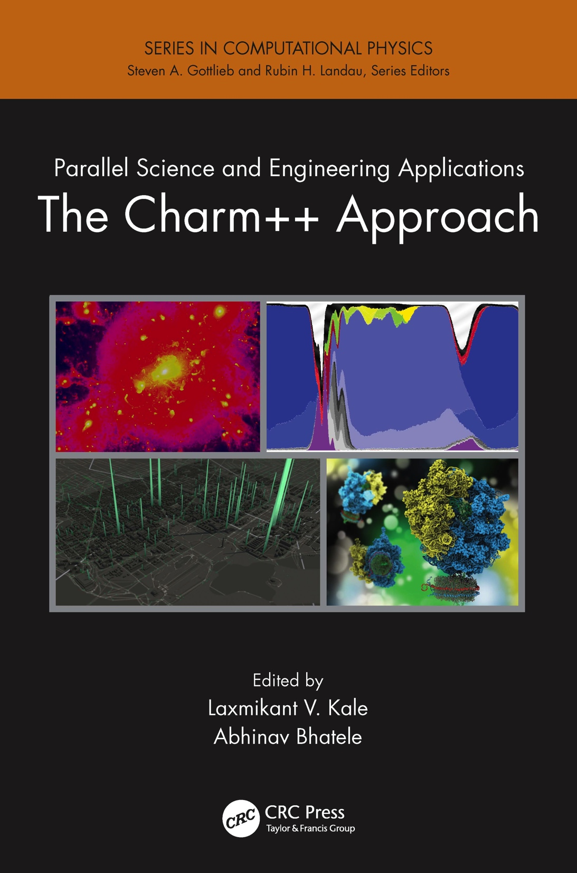
A recently published book
surveys seven major applications developed using Charm++
More info on Charm++:
http://charm.cs.illinois.edu
Including the miniApps

