Slide 1


Getting Ready for Adaptive RTSs
Laxmikant (Sanjay) Kale
http://charm.cs.illinois.edu
Parallel Programming Laboratory
Department of Computer Science
University of Illinois at Urbana Champaign

Slide 2
Overview
Main exascale challenge is variability
  Static and dynamic
  Exacerbated by strong scaling requirements
  Persistence is our [only?] friend
  Good division of labor between “system” and app developer is essential
My Mantra: Overdecomposition, migratability, asynchrony (Oma)
Explain each concept briefly (what it is)
Explain how it empowers RTS: Introspection and adaptivity
Potential costs and how they can be mitigated: overhead, memory, algo overhead
  Soln include considering node as a unit (so, have 8-16 work units per chunk)
Show benefits apps:
  Strong scaling via overdecomposition: NAMD 200+ us step
  Asynchrony -> AMR
What RTSs can do with this empowerment:
  Ldb, FT, power/energy
  Reconfigurability (apps/RTS) and runtime auto-tuning
What can app developers do to get ready for exascale/arts
  Note: our solution (OMA) was needed for dynamic irregular apps even on yesterday’s machines
    Just that it needs to be applied to even regular apps
    How charm++ meets exascale challenges already, almost
      How we got so lucky: because of these irregular apps
  What to do:
    Explore overdecomposition in your apps
    Create control points for runtime manipulation
    Get used to words like “continuations”.. But we need only simpler versions of those

Slide 3
Exascale Challenges
Main challenge: variability
  Static/dynamic
  Heterogeneity: processor types, process variation, ..
  Power/Temperature/Energy
  Component failure
Exacerbated by strong scaling needs from apps
  Why?
To deal with these, we must seek
  Not full automation
  Not full burden on app-developers
  But: a good division of labor between the system and app developers

Slide 4
My Mantra
O
M
I call it a mantra because I will repeat it a lot in this talk. And its going to be my message to App Developers on how to get ready for Adaptive Runtimes

Slide 5
My Mantra
a
O
M

Slide 6
My Mantra
Oh….Maybe the order doesn’t matter
O
M
a

Slide 7
My Mantra
verdecomposition
O
a
M
synchrony
igratability

Slide 8
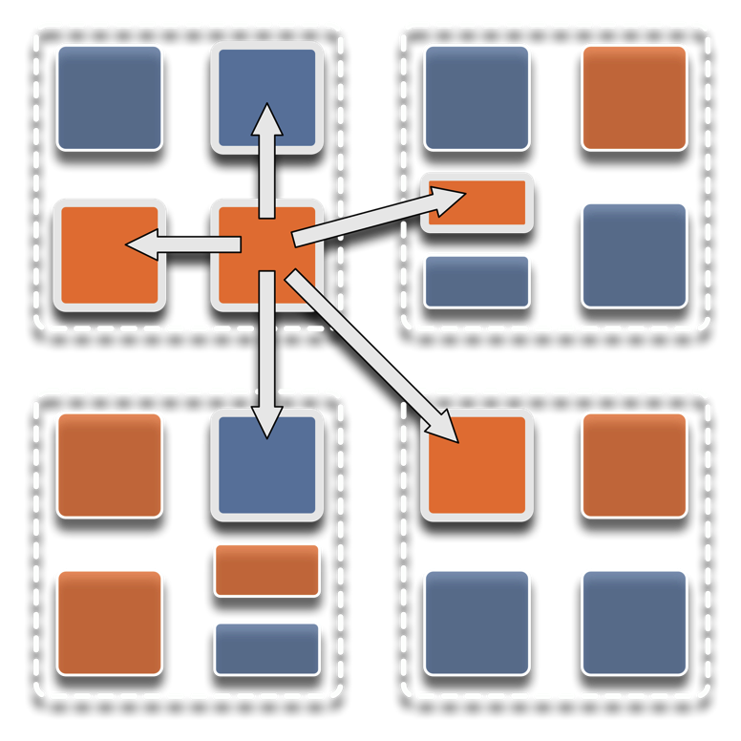
Overdecomposition
Decompose the work units & data units into many more pieces than execution units
  Cores/Nodes/..
Not so hard: we do decomposition anyway

Slide 9
Migratability
Allow these work and data units to be migratable at runtime
  i.e. the programmer or runtime, can move them
Consequences for the app-developer
  Communication must now be addressed to logical units with global names, not to physical processors
  But this is a good thing
Consequences for RTS
  Must keep track of where each unit is
  Naming and location management

Slide 10
Asynchrony:
Message-Driven Execution
Now:
  You have multiple units on each processor
  They address each other via logical names
Need for scheduling:
  What sequence should the work units execute in?
  One answer: let the programmer sequence them
    Seen in current codes, e.g. some AMR frameworks
  Message-driven execution:
    Let the work-unit that happens to have data (“message”) available for it execute next
    Let the RTS select among ready work units
    Programmer should not specify what executes next, but can influence it via priorities

Slide 11
Message-driven Execution
A[..].foo(…)

Slide 12
Empowering the RTS
Adaptive
Runtime System
Introspection
Adaptivity
Asynchrony
Overdecomposition
Migratability
The Adaptive RTS can:
  Dynamically balance loads
  Optimize communication:
    Spread over time, async collectives
  Automatic latency tolerance
  Prefetch data with almost perfect predictability
Notes:
You can have asynchrony without overdecomposition or vice versa, you can have migratability without asynchrony, but you need all three to empower the RTS.You need to add introspection and adaptivity to make a powerful Adaptive Runtime System

Slide 13
Application Examples
to
Demonstrate the Utility of
Overdecomposition,
Migratability,
Asynchrony!

Slide 14
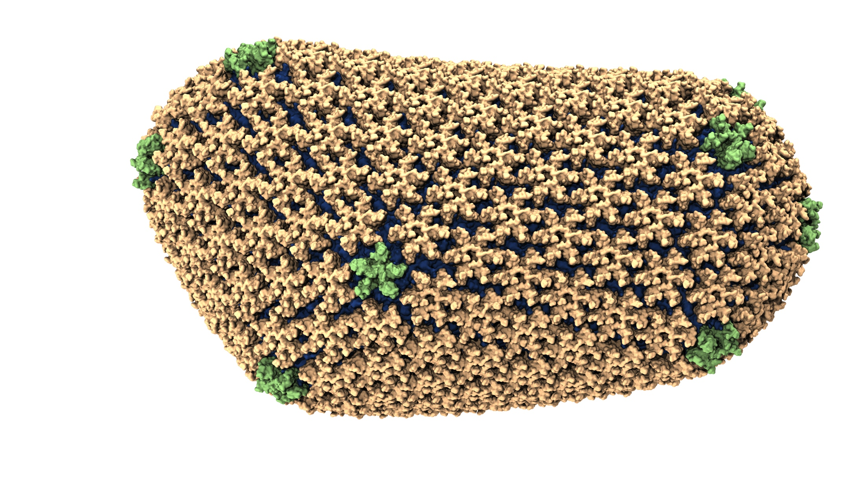
NAMD: Biomolecular Simulations
Collaboration with K. Schulten
With over 45,000 registered users
Scaled to most top US supercomputers
In production use on supercomputers and clusters and desktops
Gordon Bell award in 2002
Recent success: Determination of the structure of HIV capsid by researchers including Prof Schulten

Slide 15
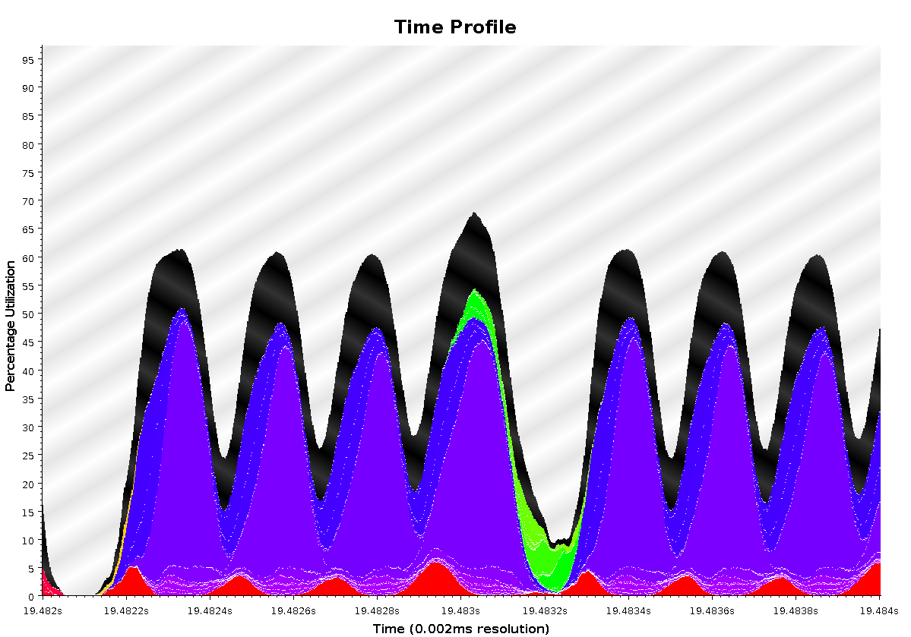
Time Profile of ApoA1 on Power7 PERCS
92,000 atom system, on 500+ nodes (16k cores)
2ms total
A snapshot of optimization in progress.. Not the final result
Overlapped steps, as a result of asynchrony

Slide 16
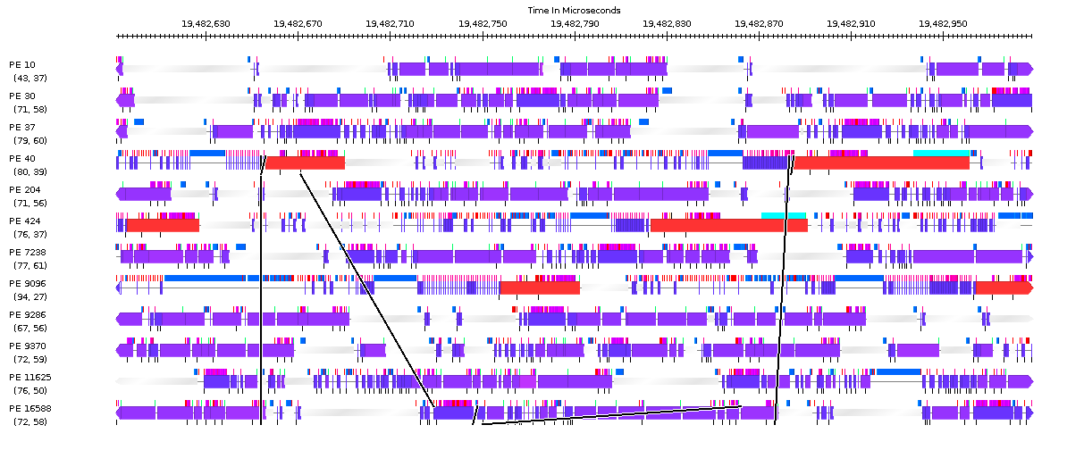
Timeline of ApoA1 on Power7 PERCS
230us

Slide 17
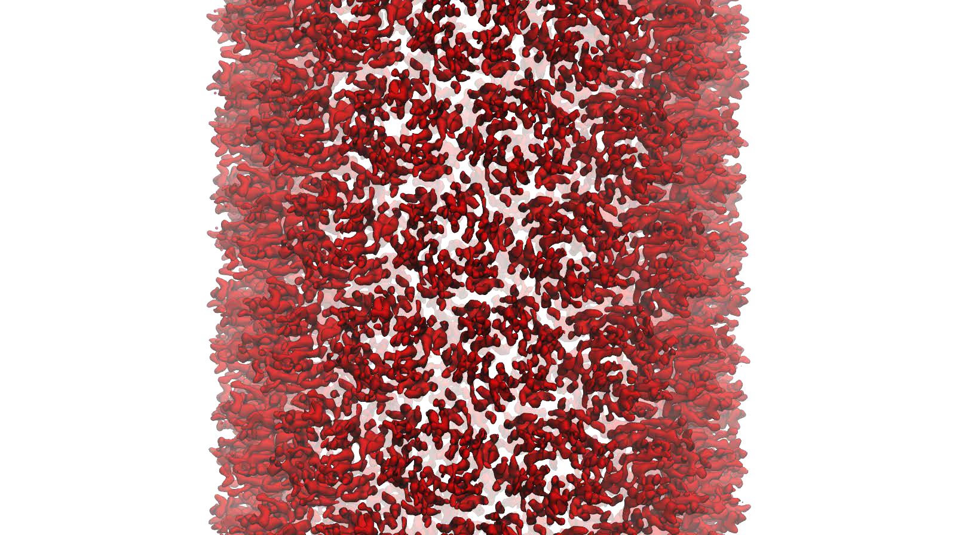
NAMD: Strong Scaling
HIV Capsid was a 64 million atom simulation, including explicit water atoms
Most biophysics systems of interests are 10M atoms or less… maybe 100M
Strong scaling desired to billions of steps

Slide 18
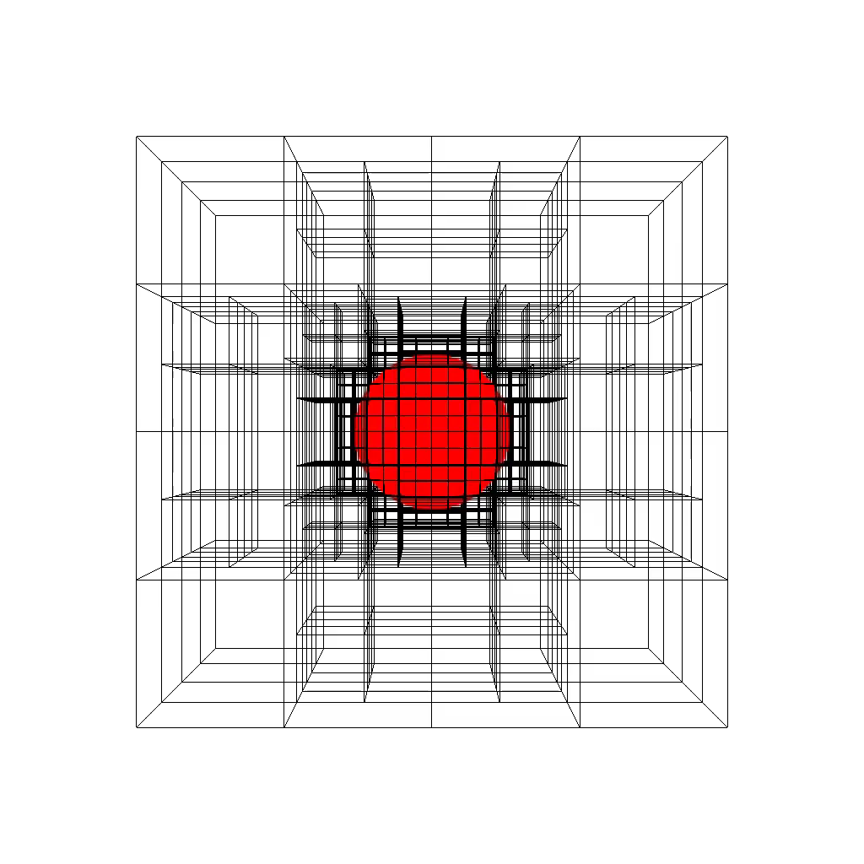
Structured AMR
Structured AMR miniApp
Notes:
Points: how overecomposition was leveraged, logical naming, with location management, Dynamic load balancing, Most importantly, highly asynchronous re-meshing

Slide 19
Structured AMR
Typical MPI Approach
Charm++ Approach
d
00
01
10
11
00
0000
0001
0010
0011
1000
1010
1011
1100
1101
1110
1111
100100
100101
100110
100111
P0
P1
P2
P3
P4
P5
Process based
Contiguous blocks
assigned to a process
Object based
Each block is an independent object
  is the basic execution unit
  can be mapped to any physical process
  is uniquely addressable
  is migratable

Slide 20
Structured AMR
Typical MPI Approach
Charm++ Approach
d
00
01
10
11
00
0000
0001
0010
0011
1000
1010
1011
1100
1101
1110
1111
100100
100101
100110
100111
P0
P1
P2
P3
P4
P5
Mesh Restructuring

Slide 21
Structured AMR
Typical MPI Approach
Charm++ Approach
d
00
01
10
11
00
0000
0001
0010
0011
1000
1010
1011
1100
1101
1110
1111
100100
100101
100110
100111
P0
P1
P2
P3
P4
P5
Mesh Restructuring

Slide 22
Structured AMR
Typical MPI Approach
Charm++ Approach
d
00
01
10
11
00
0000
0001
0010
0011
1000
1010
1011
1100
1101
1110
1111
100100
100101
100110
100111
P0
P1
P2
P3
P4
P5
Mesh Restructuring
Ripple Propagation Algorithm
  Level-by-level
  O(d) global reductions ≈ O(d*logP)
Tree-replication on each process
  O(#blocks) memory per process
Mesh Restructuring
Exchange messages with neighboring blocks
  Update state using a state machine
  Quiescence to detect global consensus
Blocks save current level of neighbors
  O(#blocks/P) memory per process
O(log P) time
Synchronization overhead
O(#blocks/P) space
Memory overhead

Slide 23
Structured AMR: State Machine

Slide 24
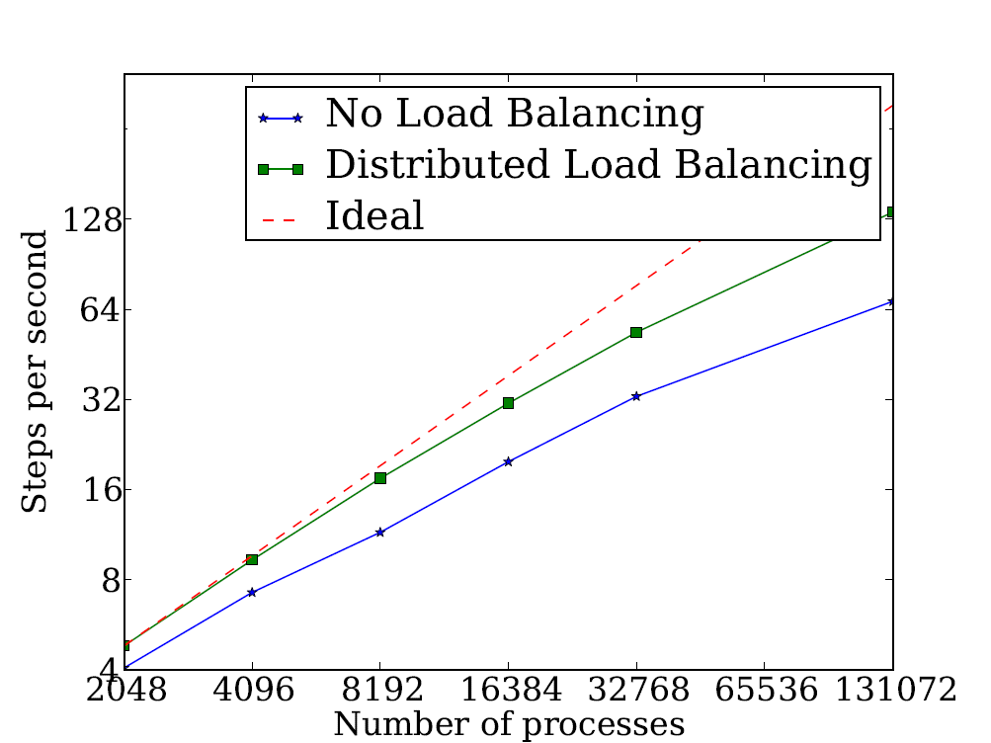
Structured AMR: Performance
Advection Benchmark
First order method in 3d-space
Testbed: IBM BG/Q Mira
Cray XK/6 Titan
Number of Cores

Slide 25
Where are Exascale Issues?
I didn’t bring up exascale at all so far..
  Overdecomposition, migratability, asynchrony were needed on yesterday’s machines too
  And the app community has been using them
  But:
    On *some* of the applications, and maybe without a common general-purpose RTS
The same concepts help at exascale
  Not just help, they are necessary, and adequate
  As long as the RTS capabilities are improved
We have to apply overdecomposition to all (most) apps

Slide 26
Exascale-like capabilities
based on
Overdecomposition,
Migratability,
Asynchrony!

Slide 27
Fault Tolerance in Charm++/AMPI
Four approaches available:
  Disk-based checkpoint/restart
  In-memory double checkpoint w auto. restart
  Proactive object migration
  Message-logging: scalable fault tolerance
Common Features:
  Easy checkpoint: migrate-to-disk
  Based on dynamic runtime capabilities
  Use of object-migration
  Can be used in concert with load-balancing schemes
Notes:
27

Slide 28
In-local-storage Checkpoint/restart
Is practical for many apps
  Relatively small footprint at checkpoint time
Very fast times…
Demonstration challenge:
  Works fine for clusters in production version of Charm++
  For MPI-based implementations running at centers:
    Scheduler does not allow jobs to continue on failure
    Communication layers are not fault tolerant
  Fault injection: dieNow(),
  Spare processors

Slide 31
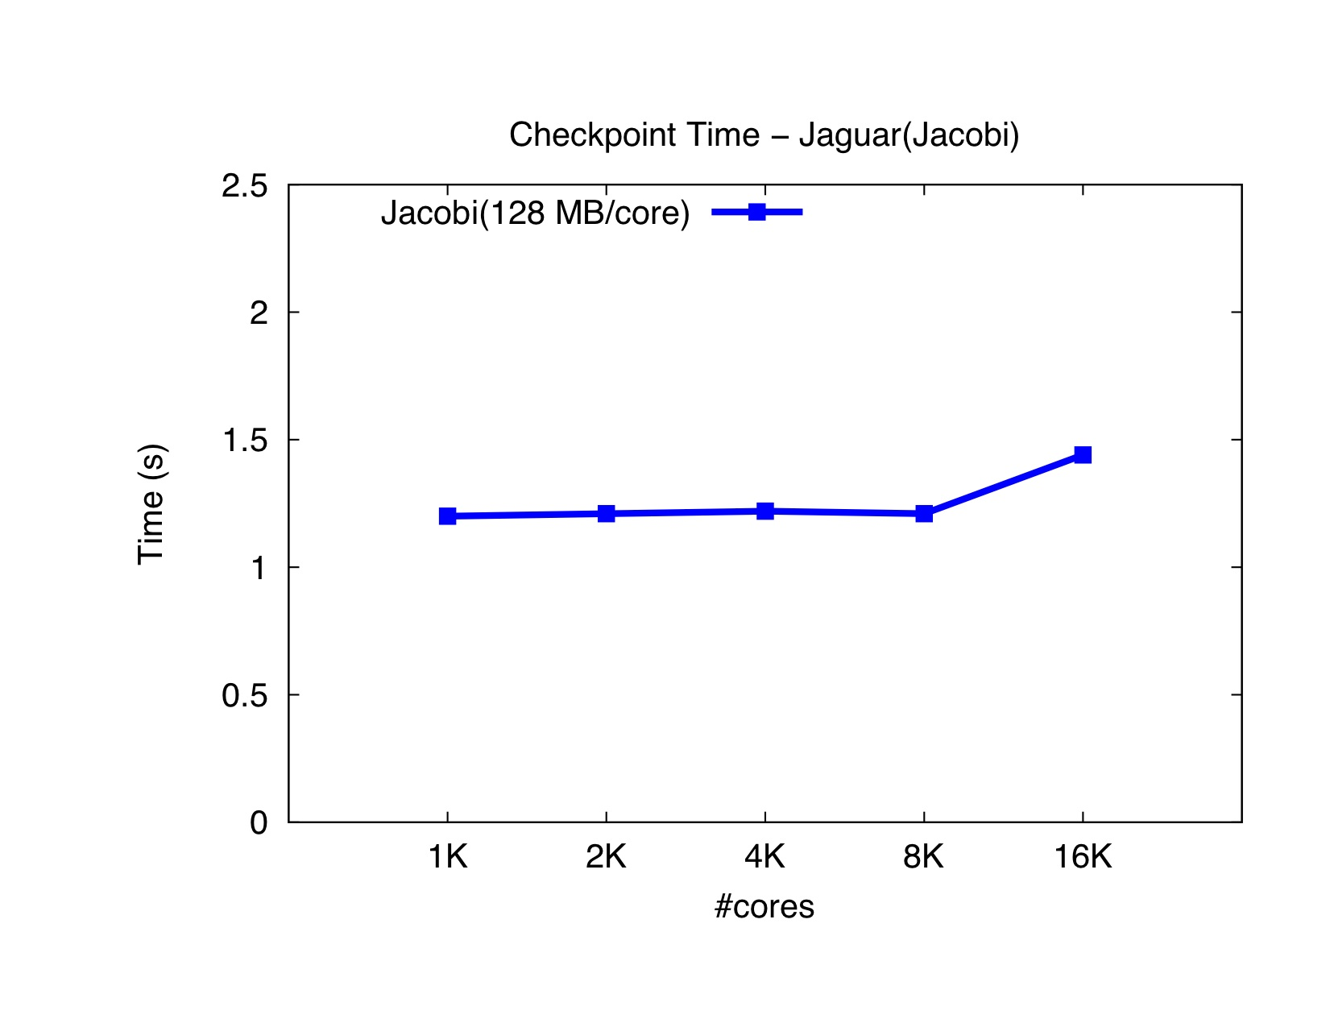

Slide 32
Extensions to fault recovery
Based on the same over-decomposition ideas
  Use NVRAM instead of DRAM for checkpoints
    Non-blocking variants
    [Cluster 2012] Xiang Ni et al.
  Replica-based soft-and-hard-error handling
    As a “gold-standard” to optimize against
    [SC 13] Xiang Ni, E. Meneses, N. Jain, et al.

Slide 33
Saving Cooling Energy
Easy: increase A/C setting
  But: some cores may get too hot
So, reduce frequency if temperature is high (DVFS)
  Independently for each chip
But, this creates a load imbalance!
No problem, we can handle that:
  Migrate objects away from the slowed-down processors
  Balance load using an existing strategy
  Strategies take speed of processors into account
Implemented in experimental version
  SC 2011 paper, IEEE TC paper
Several new power/energy-related strategies
  PASA ‘12: Exploiting differential sensitivities of code segments to frequency change

Slide 34
PARM:Power Aware Resource Manager
Charm++ RTS facilitates malleable jobs
PARM can improve throughput under a fixed power budget using:
  overprovisioning (adding more nodes than conventional data center)
  RAPL (capping power consumption of nodes)
  Job malleability and moldability

Slide 35
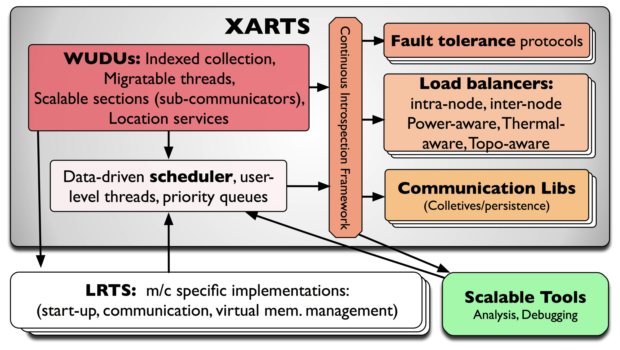
What Do RTSs Look Like: Charm++

Slide 36
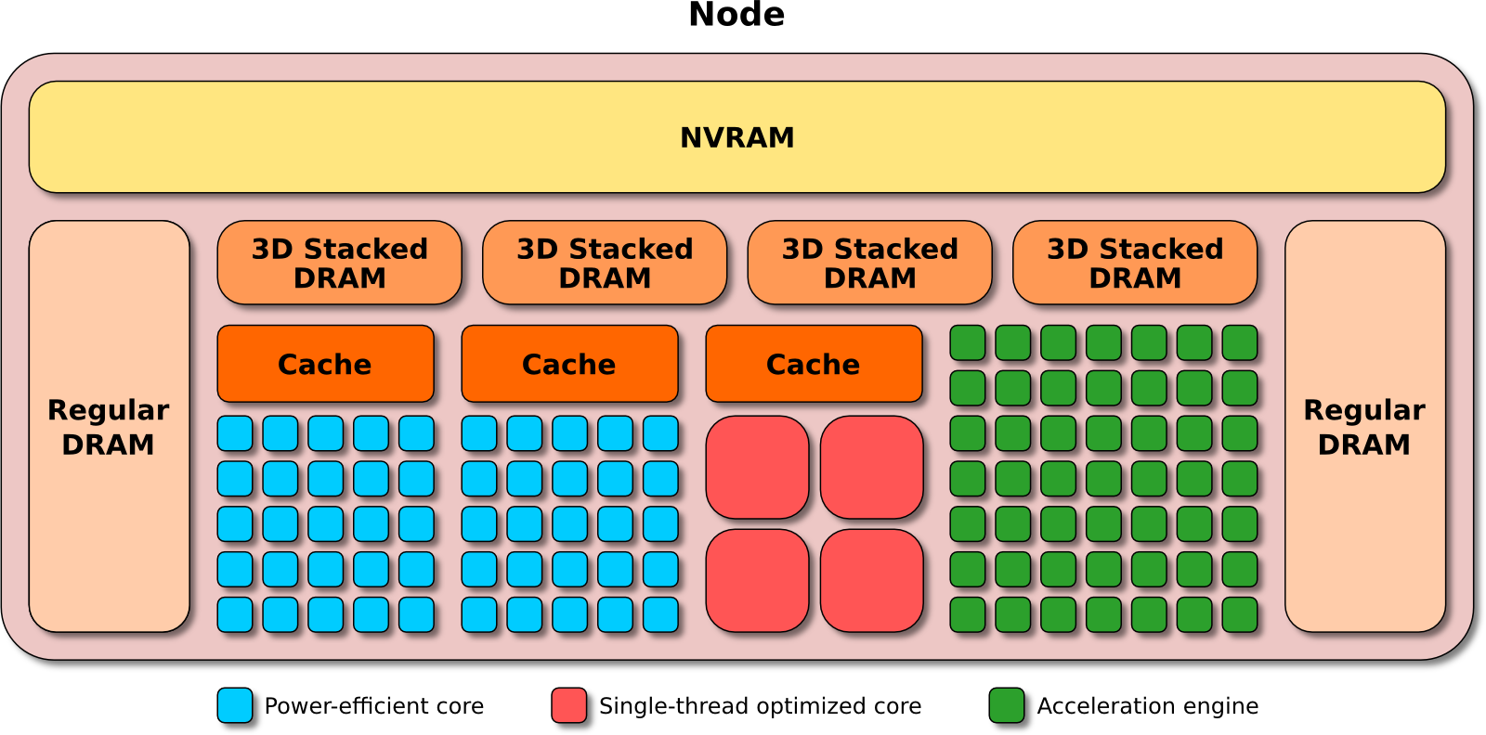
Argo
An Exascale Operating System and Runtime
Key Areas of Innovation:
NodeOS/R
  Core-specialization permits multiple, concurrent kernels
Lightweight Concurrency
  Embed fine-grained tasks and lightweight threads into OS for massive parallelism
Backplane
  Event, Control, and Performance backplanes to support global optimizations
Global View
  “Enclave” abstraction to allow global optimization of power, resilience, perf.
$9.7M ASCR DOE
3 year project, launched Aug 2013
The Crew of the Argo:
Argonne National Laboratory;
Principle Investigator and Chief Architect: Pete Beckman
Chief Scientist: Marc Snir
P. Balaji, R. Gupta, K. Iskra, R. Thakur, K. Yoshii, F. Cappello
Boston University: J. Appavoo, O. Krieger
Lawrence Livermore National Laboratory:
M. Gokhale, E. Leon, B. Rountree, M. Schulz, B. Van Essen
Pacific Northwest National Laboratory: S. Krishnamoorthy, R. Gioiosa
University of Chicago: H. Hoffmann
University of Illinois at UC: L. Kale, E. Bohm, R. Venkataraman
University of Oregon: A. Malony, S. Shende, K. Huck
University of Tennesee Knoxville: J. Dongarra, G. Bosilca

Slide 37
Allowing RTS to Reconfigure Apps
We can push adaptivity further
  With a collaboration between RTS and programmer
The programmer:
  Exposes some knobs (control-points) to the RTS
  Describes their effects in a standard “language”
The RTS:
  Observes the runtime behavior,
  Optimizes what it can without reconfiguration
  When needed, asks app to reconfigure by choosing the right knob and direction

Slide 38
ChaNGa: Cosmology Simulation
Collaboration with Tom Quinn UW
Tree: Represents particle distribution
TreePiece: object/chares containing particles
Notes:
Animation1 - For clustered datasets, TreePieces containing those red nodes receive high volume of request

Slide 39
Clustered Dataset - Dwarf
Highly clustered
Maximum request per processor: > 30K
Idle time due to message delay
Notes:
Animation 1 : Shows volume
Animation 2 : Time profile

Slide 40
Solution: Replication
PE 1
PE 2
PE 3
PE 4
Replicate tree nodes to distribute requests
Requester randomly selects a replica

Slide 41
Replication Impact
Replication distributes requests
Maximum request reduced from 30K to 4.5K
Gravity time reduced from 2.4 s to 1.7 s, on 8k
Notes:
Gravity time reduced from 2.4 s to 1.7 s for 8k cores and from 2.1 s to 0.99 t 16K

Slide 42
Control Point for Replication?
This optimization can be turned into a control point via an abstraction
  For data
    That doesn’t change during a phase, and
    Is requested based on a key
  The RTS can then observe and decide / tune
    If replication is needed,
    Which objects to replicate
    Degree of replication
It turns out to be of general use:
  A cloth simulation, with collision detection, also can use it

Slide 43
Costs of Overdecomposition?
We examined the “Pro”s so far
Cons and remedies:
Scheduling overhead?
  Not much at all
  In fact get benefits due to blocking
Memory in ghost layer increases
  Fuse local regions with compiler support
  Fetch one ghost layer at a time
  Hybridize (pthreads/openMP inside objects/DEBs)
Less control over scheduling?
  i.e. too much asynchrony?
  But can be controlled in various ways by an observant RTS/programmer
For domain-decomposition based solvers, may increase number of iterations
  You can lift it to node-level overdecomposition (use openMP inside)
  Also, other ideas:
Too radical and new?
  Well, its working well for the past 10-15 years in multiple applications, via Charm++ and AMPI

Slide 44
How can
Application Developers
get ready for
Adaptive RTSs?

Slide 45
Its not that weird or new
First, note:
  The techniques I advocated were needed for dynamic irregular apps even on yesterday’s machines
    Just that they need to be applied to even regular apps
    How Charm++ meets exascale challenges already, almost
      How we got so lucky: because of these irregular apps
  The adaptivity that was created via overdecomposition, migratability, & asynchrony, for dynamic applications, is also useful for handling machine variability at exascale

Slide 46
So, What are the Action Items
Explore overdecomposition in your application
  Without using any RTS
Increase the asynchrony in your app
Add migratability in small measures
  But you will need to do some location management yourself
Try coding a small module using an existing adaptive RTS
  E.g. Charm++ modules work with MPI modules
Create control points for runtime manipulation
Get used to words like “continuations”..
  But we need only simpler versions of those

Slide 47
Experiment with Languages/Libraries that support these concepts
Programming models that exhibit some features
  Charm++
  Adaptive MPI
  KAAPI
  ProActive
  FG-MPI (if it adds migration)
  mpC
  HPX (once it embraces migratability)
  StarPU
  ParSEC
  CnC
  MSA (multi-phase Shared arrays)
  Charisma
  Charj
  Chapel: may be a higher level model
  X10: has asynchrony, but not migratable units
So, pick some of them to start experimenting w miniApps

Slide 48
Benefits in Charm++
Over-decomposition
Scalable Tools
Automatic overlap of Communication and Computation
message-driven execution
Perfect prefetch
compositionality
Emulation for Performance Prediction
Migratability
Fault Tolerance
Introspective and adaptive runtime system
Dynamic load balancing (topology-aware, scalable)
Temperature/Power/Energy Optimizations

Slide 49
Summary
Adaptive Runtime Systems are coming
Advice to Application developers
  Get familiar with:
  Do I need to repeat?
  Overdecomposition, Migratability, Asynchrony
  Experiment with new models that support these and are interoperable
    E.g. Charm++ ☺
Charm++ workshop live webcast
http://charm.cs.illinois.edu/charmWorkshop
April 29-30 2014
More info on Charm++:
http://charm.cs.illinois.edu
Overdecomposition
Asynchrony
Migratability

