Slide 1



Parallel Branch-and-Bound for
Two-Stage Stochastic Integer Optimization
Akhil Langer, Ramprasad Venkataraman,
Udatta Palekar*, Laxmikant Kale
Department of Computer Science
*Department of Business Administration
University of Illinois at Urbana-Champaign
30th April, 2014

Slide 2
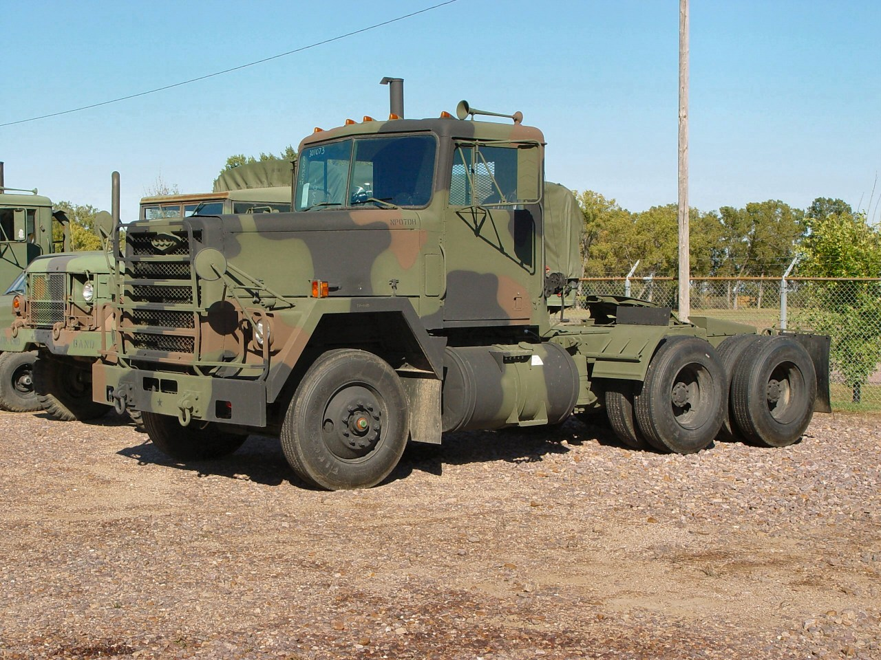

Motivation
On any given day, US TRANSCOM (Transportation Command) must handle
100 railcar shipments
35 ships loading, offloading or underway
1000 truck shipments
480 airlift sorties
  310 military
  170 commercial
70 operational air refueling sorties
7 air evacuation sorties
Aircraft takeoff or landing 90 seconds

Slide 3
Motivation
Headquarters
Scott Air Force Base
Illinois, USA
Air Mobility Command (AMC)
Even in peacetime, mission requirements are subject to enormous uncertainty
Uncertainties – demands, aircraft breakdown, weather, natural disaster, conflict, etc.
AMC must reconcile diverse uncertainty when predicting monthly aircraft utilization

Slide 4
Overview of Stochastic Optimization
Optimization Under Uncertainty
Stage 1 (strategic decision)
Cost of resource allocation + Expected Cost of Stage 2 Decisions
(Integer) Linear Program
costs,
Stage 2 (operational decisions)
Execution cost
(Integer) Linear Program

Slide 5


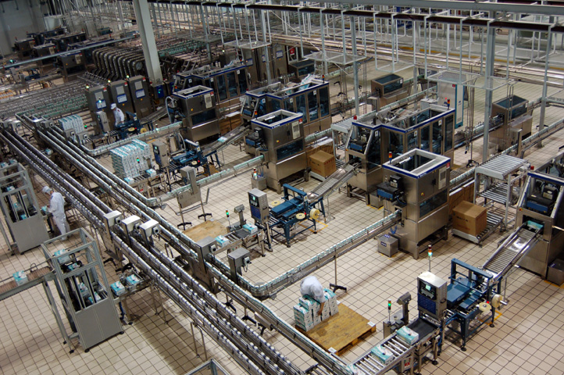

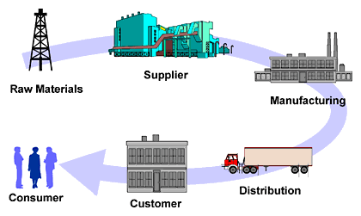
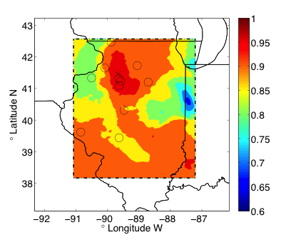

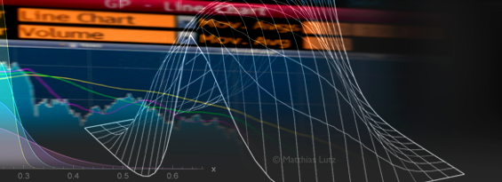

Stochastic Optimization Applications
Agriculture
Telecommunication
Production planning
Forestry
Transportation
Supply-chain Management
Energy-grids
Forestry
Finance
Water Resource Management
…. and many more

Slide 6
Related Work
Extensive Formulation
  Becomes unwieldy with increase in number of scenarios
  Unable to optimize even toy instances
Parallelizing IP is difficult
  Commercial IP Solvers have poor parallel efficiency
PySP solver (SNL)
  Parallel implementation of R-W progressive hedging
  Heuristic requires parameter tuning
  Inefficient because of IP solves
Lubin et al (ANL)
  Dual decomposition
  Poor load balancing
  Scaling up to 32 cores

Slide 7
Motivation
Large-scale stochastic optimization problems intractable on single/multi-core machines
Efficient distributed solvers not available
Goal
Solve large-scale stochastic optimization problems in a timely manner using High Performance Computing

Slide 8
Approach
High Performance Computing
  Facilitates reconciliation of myriad possible outcomes in a timely manner
  Make it feasible to make integral decisions
Identify decomposable structures and their interdependencies
Identify scalability challenges
Propose Parallel Designs for High Parallel Efficiencies
Use of Message-driven Asynchronous Parallel Programming Model
  Improves Programmer Productivity
  Asynchronous collection of measurement metrics

Slide 9
Case Study: Military Aircraft Allocation Problem
Two-stage Formulation
Stage 1
Long term leasing of civilian aircraft,
Allocation of aircraft to missions:
Channel
Contingency
SAAM
Stage 2
Select Aircraft routes,
and
Assign demand to aircraft

Slide 10
Case Study: Military Aircraft Allocation Problem
Cost benefit Analysis – Deterministic vs Stochastic optimization
Average Cost Benefit: 10%
Maximum benefits: 57%
Robustness: 66% reduction in variance
Cost of hedging: 5%
Sample Data set size - 5 day problem with 120 scenarios:
#Stage 1 Integer variables: 135
#Stage 2 Variables : 1.6M
#Stage 2 Constraints : 1M

Slide 11
Parallel Design
Master Worker Design
Stage 1 Integer Program
stage 1 decision
stage 1 decision
Stage 2 Linear Program
Design Considerations
Coarse Grained decomposition
Unpredictable Grain sizes
Maintaining responsiveness

Slide 12
Parallel Design
Master Worker Design - Performance
Time
Processors
Timeline
Scaling
Scalability limited by the number of scenarios
Stage 1 bottleneck
  Parallel efficiency decreases with increase in stage 1 size

Slide 13
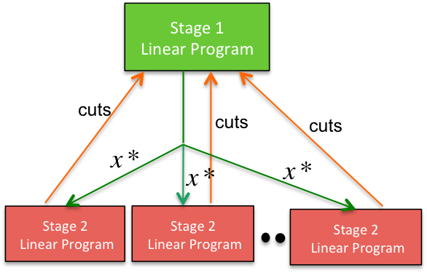
Parallel Design
Nested Parallelism
Stage 1
Integer Program
Stage 1
Linear Program
cuts
cuts
cuts
cuts
cuts
cuts
Stage 2
Linear Program
Stage 2
Linear Program
Stage 2
Linear Program
Stage 2
Linear Program
Stage 2
Linear Program
Stage 2
Linear Program
Nested Parallelism
Simultaneous evaluation of scenarios Parallel exploration of Branch-and-Bound vertices

Slide 14




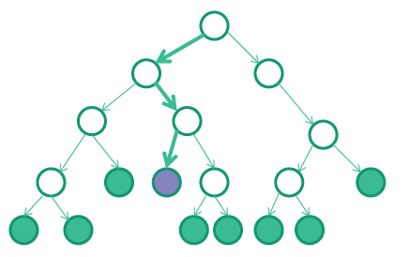
Nested Parallelism
Design Challenges
Fundamental unit of computation- Linear Program Optimization
  Coarse grained decomposition Unpredictable grain sizes
Solver Libraries maintain internal state
  Advanced/warm start
  Limits concurrency because of memory overheads
Variable Amount of Available Parallelism
Better Utilization Better Performance
Some LP Solvers
CLP
GLPK

Slide 15
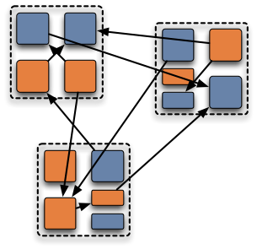
Parallel Programming Model
Charm++ parallel programming model fits well into B&B parallelism
  Object-based expression
  One-sided messaging
  Prioritized execution

Slide 16
Stage 1 Manager
Nested Parallelism: Design
Stage 1 Solvers Load Information
Stage 2 Manager
Issue Vertex Migration
Stage 2 Work Queue
Approach Object Migration is expensive Dedicate processors to solvers Unpredictable grain sizes Use pull-based load balancing
Vertex Request
Assign Scenarios
Stage 1 Decisions
Work Request
Stage 1 Solvers
Feedback (cuts)
Time
Stage 2 Solvers
Processors

Slide 17
Nested Parallelism: Design A
Dedicated solver instances per vertex
Stage 2
Solver Instance
Stage 2
Solver Instance
Stage 2
Solver Instance
v1
v2
v1
Stage 1
Solver Instance
Stage 1
Solver Instance
Stage 1
Solver Instance
Stage 2
Solver Instance
Stage 2
Solver Instance
Stage 2
Solver Instance
Stage 2
Solver Instance
v3
Stage 1
Solver Instance
Stage 2
Solver Instance
Stage 2
Solver Instance
v4
Stage 1
Solver Instance
Stage 2
Solver Instance
v1
v2
v3
v4

Slide 18
Design A Performance
Testbed
HPC Cluster – 3216 cores
Intel X5650 2.66 GHZ
LP Solver
Gurobi optimizer
with Academic licenses
Cause of variation in performance across trials
  Incumbents found in different order
Memory requirements inhibit large-scale optimization

Slide 19
Nested Parallelism: Design B
Interleaved vertex optimization on shared solver instance
Stage 2
Solver Instance
v1
Stage 1
Solver Instance
Stage 2
Solver Instance
Stage 2
Solver Instance
v2
Stage 1
Solver Instance
Stage 2
Solver Instance
Stage 2
Solver Instance
v3
Stage 1
Solver Instance
Stage 2
Solver Instance
v1
v2
v3
v4
Stage 2
Solver Instance
v4
Stage 1
Solver Instance
Stage 2
Solver Instance

Slide 20
Performance Comparison
Design A
SIPS preliminary design
Design B
SIPS optimized design
Cause of Variation across trials
Incumbents found in different order | Linear programs use advanced start Sequence of vertex optimization determines the solution, when LPs are degenerate
Memory requirements inhibit large-scale optimization | No memory limitations

Slide 21
Performance Diagnosis
Why is Design B Faster than Design A?
Improvement in
Stage 1 solve times
Reduction in number of
rounds per tree vertex
Design A
Design B
Design A
Design B

Slide 22
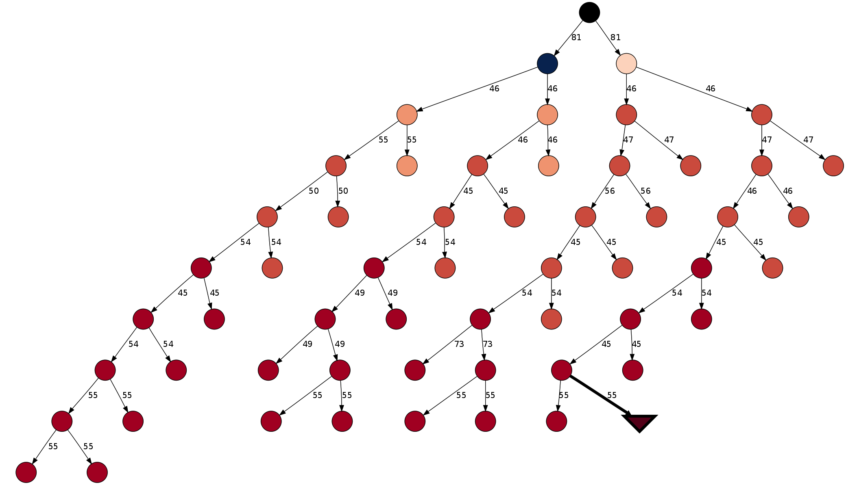
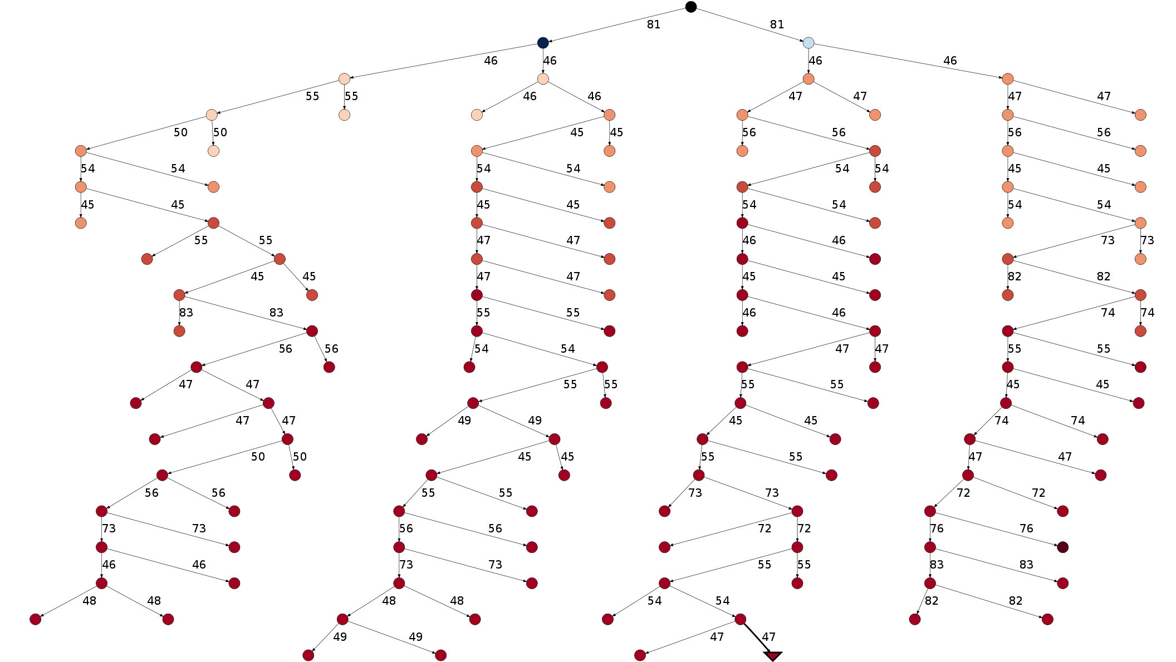
Performance Diagnosis
Large variation in performance across trials
How bad is performance variation?
Makes it difficult to guarantee better performance with increase in the number of processors But better performance as compared to Design A

Slide 23
Performance Results
Design B
Performance measurement in presence of variation
Fraction of trials achieving certain parallel efficiency (with baseline as 3 cores)

Slide 24
Strong Scaling Results
SIPS Performance
96x speedup from 3 cores to 480 cores Parallel efficiency greater than 0.4 at 120 cores in ~100% of the cases
VS
Gurobi Integer Program Solver Performance
Typical parallel efficiency of 0.1 at 32 cores¹
Akhil Langer, Ramprasad Venkataraman, Udatta Palekar, and Laxmikant Kale. Parallel Branch-and-bound for Two-stage Stochastic Integer Optimization. In Proceedings of the 20th IEEE International Conference on High Performance Computing, HiPC 2013. Best Paper Award
¹Koch, Thorsten, Ted Ralphs, and Yuji Shinano. "Could we use a million cores to solve an integer program?." Mathematical Methods of Operations Research 76.1 (2012): 67-93.

Slide 25
TAKEAWAYS
HPC enables stochastic optimization problems that are otherwise intractable by commercial state-of-the-art solvers
Novel ideas (such as state sharing amongst tree vertices) can significantly reduce memory overheads and further reduce time to solution
Asynchronous parallel programming model for maximum productivity and performance
  Object based expression facilitates placement and migration of computations
  One-sided messaging suits asynchronous nature of BnB
  Prioritized execution for faster response time to high priority vertices

Slide 26
THANK YOU!
Parallel Branch-and-Bound for
Two-Stage Stochastic Integer Optimization
Akhil Langer, Ramprasad Venkataraman,
Udatta Palekar*, Laxmikant Kale
Department of Computer Science
*Department of Business Administration
University of Illinois at Urbana-Champaign
30th April, 2014

Slide 27
Backup Slides

Slide 28


Military Aircraft Scheduling with
Dynamic Mission Re-planning
Planned itineraries are subject to disruptions, such as
Weather Disruption
Aircraft Breakdown
Each scenario has a sequence of events
  Delay aircraft take-off
  Reroute itineraries
  Keep flying till weather becomes clear
Penalize changes in itinerary
How to get Stage 2 feedback or cuts?

Slide 29
Solving Stochastic Linear Programs using Gurobi

