Slide 1



Scalable and Asynchronous Algorithms for
Structured Adaptive Mesh Refinement
Akhil Langer and Laxmikant Kale
Parallel Programming Laboratory
Department of Computer Science
University of Illinois at Urbana-Champaign, USA
Student Research Symposium
IEEE High Performance Computing Conference (HiPC 2013),
Bengaluru, India
18th December, 2013

Slide 2
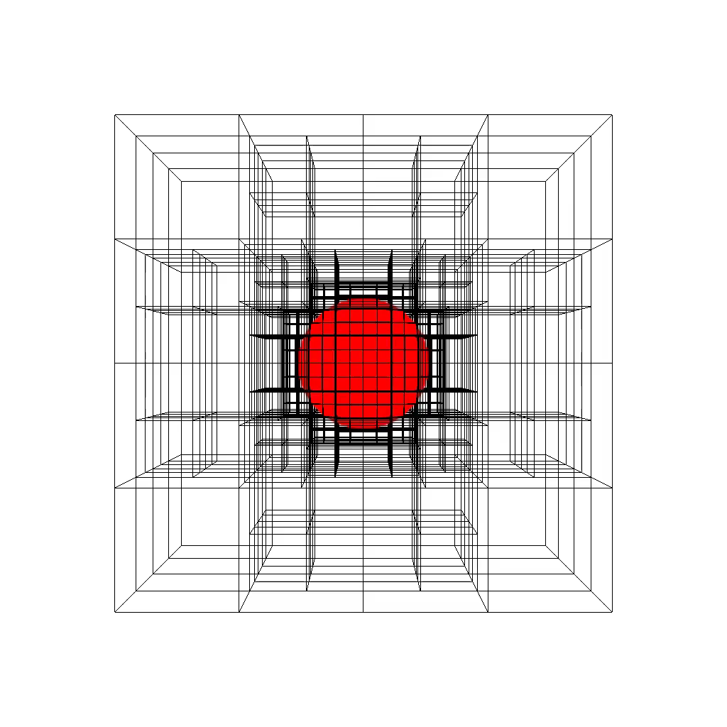
What is Adaptive Mesh Refinement (AMR)?
Used for solving Partial Differential equations Higher resolution only in difficult regions of the mesh AMR rule - Neighbors maintain a refinement level difference of 1
Benchmark available at git://charm.cs.uiuc.edu/users/alanger/amr
Generated using VisIt Visualization tool

Slide 3
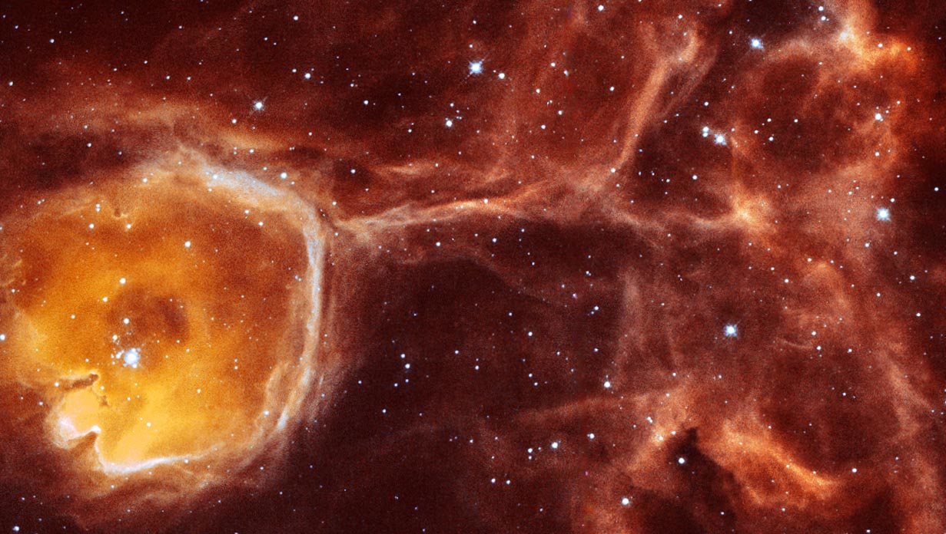
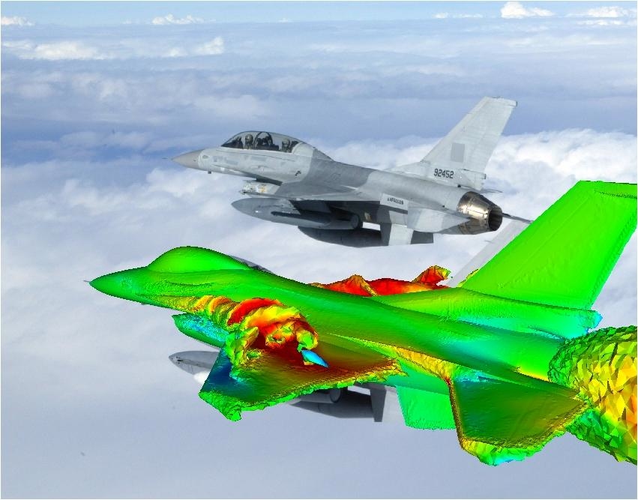
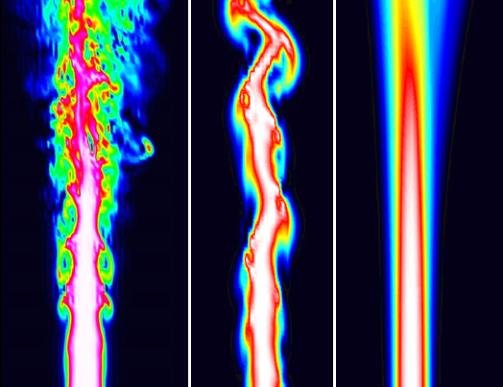
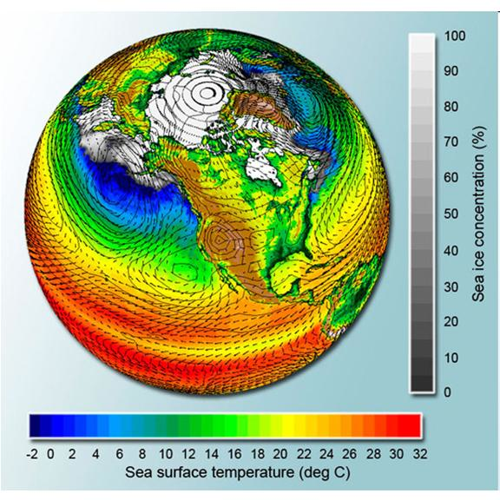
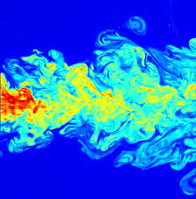
AMR makes it possible to solve problems otherwise intractable using uniform meshes
Computational Fluid Dynamics
Combustion
Astrophysics
http://web.mit.edu/astrophysics/
http://www.cfd4aircraft.com/int_conf/IC3/
http://www.psc.edu/science/2008/sc2/
Climate Modeling
Turbulence
Mantle Convection Modeling
http://www.drroyspencer.com/2009/07/how-do-climate-models-work/
http://www.thenakedscientists.com/HTML/news/news/1000133/
http://burstedde.ins.uni-bonn.de/research/papers/BursteddeBurtscherGhattasEtAl09.pdf
AMR simulations constitute significant portion of many of the world’s supercomputers usage
Existing Frameworks
Enzo-P, Chombo, PARAMESH, SAMRAI, FLASH, p4est, deal.II, etc.

Slide 4
d
P0
P1
P2
P3
P4
P5

Slide 5
Typical MPI Approach
Charm++ Approach
d
00
01
10
11
00
0000
0001
0010
0011
1000
1010
1011
1100
1101
1110
1111
100100
100101
100110
100111
P0
P1
P2
P3
P4
P5
Process based
Contiguous blocks assigned to a process
Object based
Each block treated as an independent object
An Object
  is the basic execution unit
  can be mapped to any physical process
  is uniquely addressable
  is migratable

Slide 6
Typical MPI Approach
Charm++ Approach
d
00
01
10
11
00
0000
0001
0010
0011
1000
1010
1011
1100
1101
1110
1111
100100
100101
100110
100111
P0
P1
P2
P3
P4
P5
Mesh Restructuring

Slide 7
Typical MPI Approach
Charm++ Approach
d
00
01
10
11
00
0000
0001
0010
0011
1000
1010
1011
1100
1101
1110
1111
100100
100101
100110
100111
P0
P1
P2
P3
P4
P5
Mesh Restructuring

Slide 8
Typical MPI Approach
Charm++ Approach
d
00
01
10
11
00
0000
0001
0010
0011
1000
1010
1011
1100
1101
1110
1111
100100
100101
100110
100111
P0
P1
P2
P3
P4
P5
Mesh Restructuring
Ripple Propagation Algorithm
  Level-by-level
  O(d) global reductions ≈ O(d*logP)
Tree-replication on each process
  O(#blocks) memory per process
Mesh Restructuring
Exchange messages with neighboring blocks
  Update state using a state machine
  Quiescence to detect global consensus
Blocks save current level of neighbors
  O(#blocks/P) memory per process
Synchronization overhead
O(log P) time
Memory overhead
O(#blocks/P) space

Slide 9
More Details of Charm++ Approach
Dynamic load balancing
  Charm++ Distributed Load Balancer based on Gossip Protocol
Charm++ Location Manager
  Object to Physical Process map
  Distributed Hash Table with Local caches
  Ensures message delivery in minimal number of hops

Slide 10
Algorithmic Benefits
Typical Traditional Approach
Charm++ Approach
O(#blocks) memory per process
O(d) global reductions for Mesh Restructuring
  Synchronized
O(P) data structure for neighbor lookup
  O(log P) lookup time
Complex implementation
O(#blocks/P) memory per process
O(1) Quiescence detection
  Highly Asynchronous
Distributed Hash Table
  O(1) lookup time
Simple Implementation
  1300 SLOC for 2D and 1900 SLOC for 3D

Slide 11
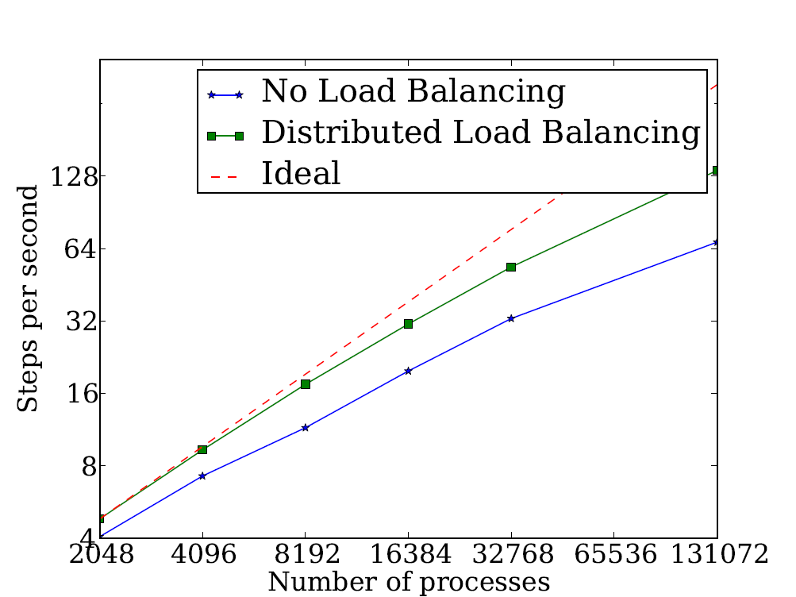
Performance Results
Testbed
IBM BG/Q Supercomputer Mira
Cray XK/6 Titan
Advection Benchmark
First order method in 3d-space
Number of Processes

Slide 12

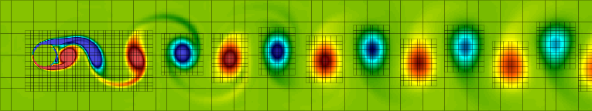
Impact on Production Frameworks
Takeaways
Increased Performance
Solved Memory Bottleneck in Traditional Approaches
O(1) collectives for mesh restructuring
Efficient neighbor lookup
Improved Productivity
Block is a basic execution unit
Simplified expression of program logic
Benchmark available from
git://charm.cs.uiuc.edu/users/alanger/amr
Thank you for your attention!
Questions?
See you at the Poster Session
  Enzo
  framework for multi-physics hydrodynamic astrophysical calculations
  Renamed to Cello
    the next generation Enzo
    http://mngrid.ucsd.edu/projects/cello/
  Chombo
  Software for Adaptive Solutions of Partial Differential Equations
  commons.lbl.gov/display/chombo/
  Currently incorporating the proposed algorithms
  Publications
  Langer, Akhil, et al. Scalable Algorithms for Distributed-Memory Adaptive Mesh Refinement. In 2012 IEEE 24th International Symposium on Computer Architecture and High Performance Computing (SBAC-PAD). 2012.
L. Kale, A. Arya, N. Jain, A. Langer, et al. Migratable Objects + Active Messages + Adaptive Runtime = Productivity + Performance. A Submission to 2012 HPC Class II Challenge, SC 12, Tech. Rep. 12-47, Parallel Programming Laboratory.

