Slide 1




Parallel Branch-and-Bound for
Two-Stage Stochastic Integer Optimizations
Akhil Langer*, Ramprasad Venkataraman*,
Udatta Palekar§, and Laxmikant Kale*
*Department of Computer Science
§Department of Business Administration
University of Illinois at Urbana-Champaign, USA
IEEE High Performance Computing Conference (HiPC 2013),
Bengaluru, India
20th December, 2013
Research Supported by MITRE Corp. and US Air Mobility Command

Slide 2
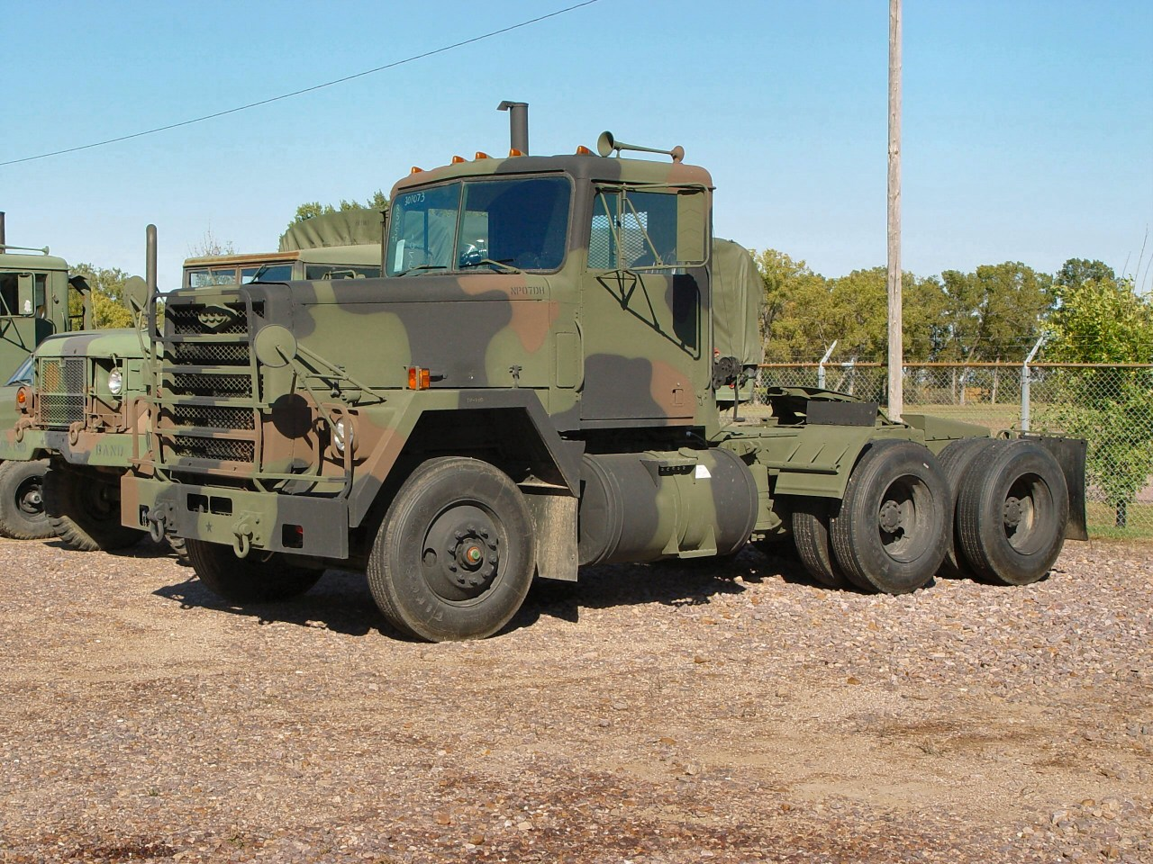

On any given day, US TRANSCOM (Transportation Command) must handle
100 railcar shipments
35 ships loading, offloading or underway
1000 truck shipments
480 airlift sorties
  310 military
  170 commercial
70 operational air refueling sorties
7 air evacuation sorties
Aircraft takeoff or landing 90 seconds

Slide 3
Air Mobility Command (AMC)
Head Quarters
Scott Air Force Base
Illinois, USA
Even in peacetime, mission requirements are subject to enormous uncertainty
Myriad possible outcomes confound decision support e.g. aircraft breakdown, weather, natural disaster, conflict, etc.
AMC must reconcile this diverse uncertainty when predicting monthly aircraft utilization

Slide 4
Stochastic Programming: Optimization Under Uncertainty
Stage1 (strategic decision)
Cost of resource allocation
Integer Program (IP)
Stage 2 (operational decisions)
Expected execution cost
Linear Program (LP)

Slide 5
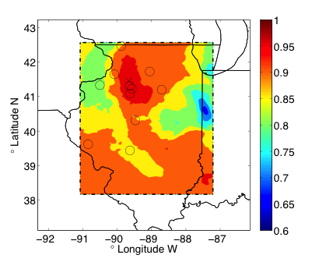
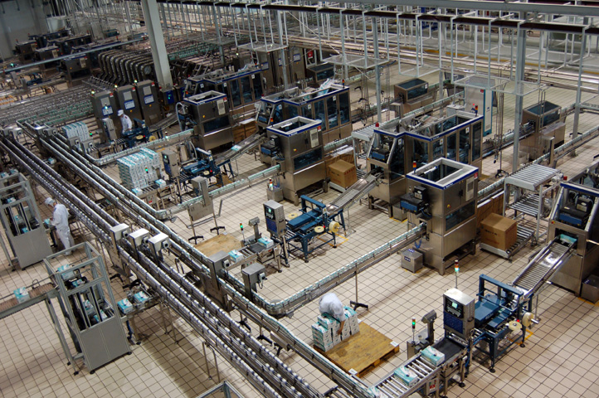
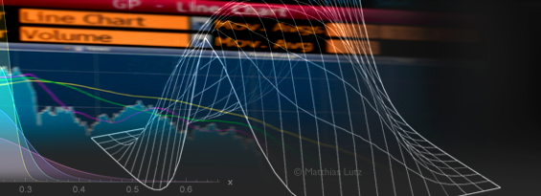
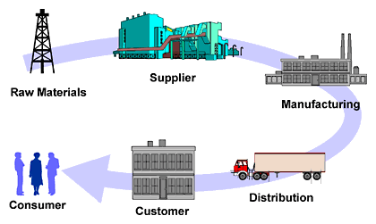
Other Examples
 | Energy Grid Optimizations |  | Production Planning
 | Financial Planning |  | Supply Chain Management

Slide 6
What is different/ new that we are doing?
Solving large scale stochastic optimization problems Not looked before because stochastic-optimization is hard problem Stochastic Integer Programing Solver (SIPS) Combine Stochastic Programming with High Performance Computing
High Performance Computing
Facilitates reconciliation of myriad possible outcomes in a timely manner
+
Makes it feasible to solve integer programs

Slide 7
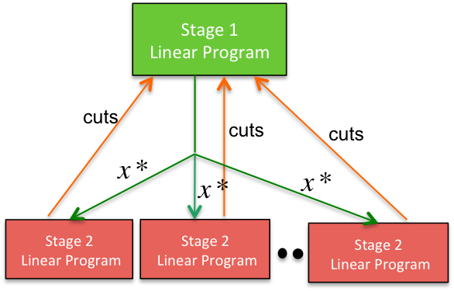
Nested Parallelism with Branch-and-Bound and Benders decomposition
Stage 1
Linear Program
cuts
cuts
cuts
Stage 2
Linear Program
Stage 2
Linear Program
Stage 2
Linear Program
Nested Parallelism
Simultaneous evaluation of scenarios Parallel exploration of Branch-and-Bound vertices

Slide 8




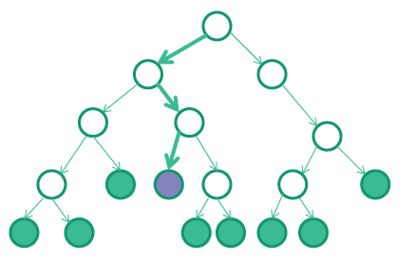
DESIGN CONSIDERATIONS
Fundamental unit of computation- Linear Program Optimization
  Coarse grained decomposition -- Unpredictable grain sizes
Solve Libraries maintain internal state
  Limits concurrency because of memory overheads
Variable Amount of Available Parallelism
Better Utilization Better Performance
Some LP Solvers
CLP
GLPK

Slide 9
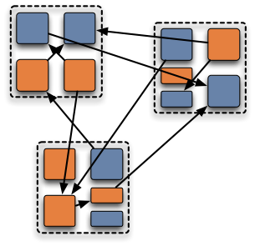
Parallel Programming Model
Charm++ parallel programming model fits well into B&B parallelism
  One-sided messaging
  Prioritized execution
  Object-based expression
Parallel Design
Stage 1 Manager
Stage 1 Solvers Load Information
Stage 2 Manager
Object Migration is expensive Dedicate processors to solvers Unpredictable grain sizes Use pull-based load balancing
Issue Vertex Migration
Stage 2 Work Queue
Vertex Request
Assign Scenarios
Stage 1 Decisions
Work Request
Stage 1 Solvers
Feedback (cuts)
Stage 2 Solvers

Slide 10
Stage 2
Solver Instance
Stage 2
Solver Instance
Stage 2
Solver Instance
v1
v2
v1
Stage 1
Solver Instance
Stage 1
Solver Instance
Stage 1
Solver Instance
Stage 2
Solver Instance
Stage 2
Solver Instance
Stage 2
Solver Instance
Stage 2
Solver Instance
v3
Stage 1
Solver Instance
Stage 2
Solver Instance
Stage 2
Solver Instance
v4
Stage 1
Solver Instance
Stage 2
Solver Instance

Slide 11
Performance
Cause of variation in performance across trials
  Incumbents found in different order
Memory requirements inhibit large-scale optimization

Slide 12
Stage 2
Solver Instance
v1
Stage 1
Solver Instance
Stage 2
Solver Instance
Stage 2
Solver Instance
v2
Stage 1
Solver Instance
Stage 2
Solver Instance
Stage 2
Solver Instance
v3
Stage 1
Solver Instance
Stage 2
Solver Instance
Stage 2
Solver Instance
v4
Stage 1
Solver Instance
Stage 2
Solver Instance

Slide 13
Performance
SIPS optimized design
Cause of Variation across trials
Incumbents found in different order | Linear programs use advanced start Sequence of vertex optimization determines the solution, when LPs are degenerate
Memory requirements inhibit large-scale optimization | No memory limitations

Slide 14
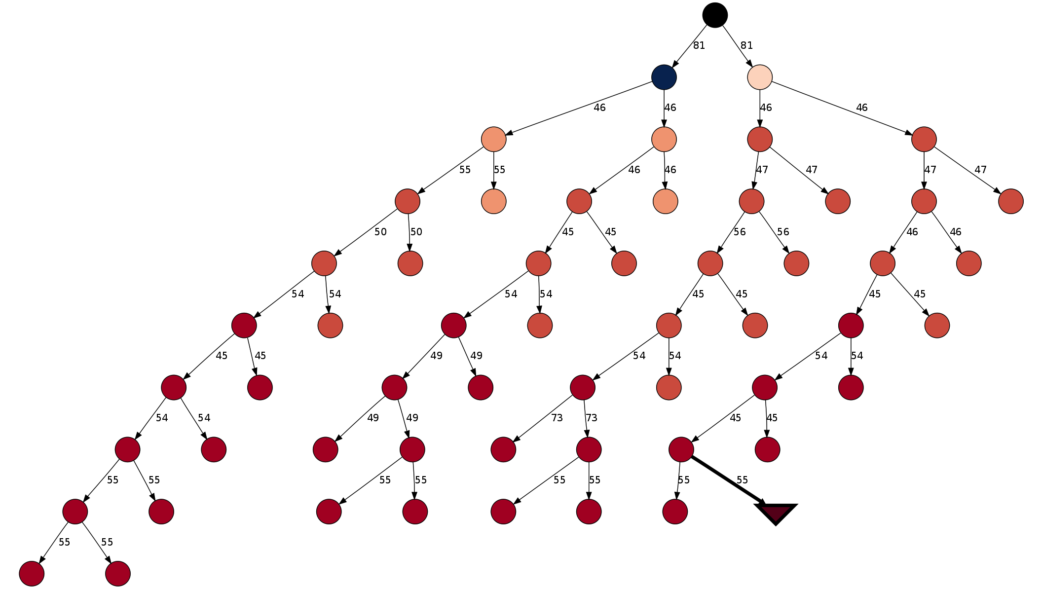
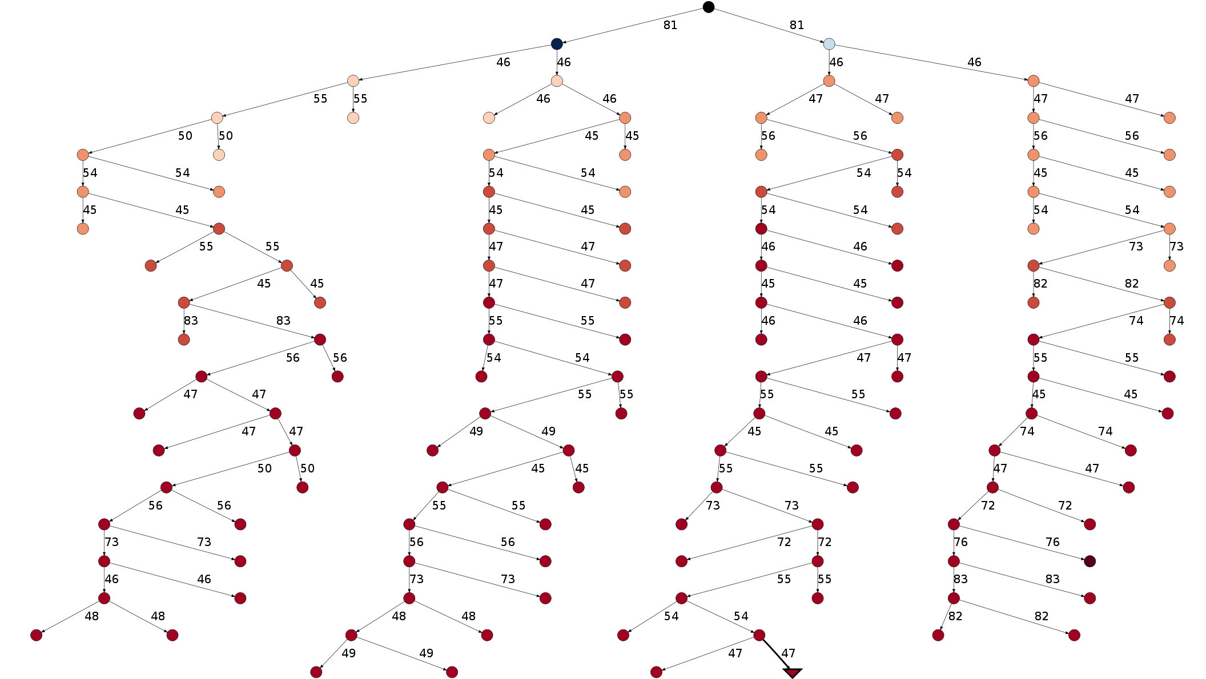
Performance Diagnosis
Large variation in performance across trials
Why is performance variation bad?
Makes it difficult to guarantee better performance with increase in the number of processors

Slide 15
Performance Results
Testbed
HPC Cluster – 3216 cores
Intel X5650 2.66 GHZ
24 GB RAM
LP Solver
Gurobi optimizer
with Academic licenses
Performance measurement in the presence of variation
Fraction of trials achieving a certain parallel efficiency

Slide 16
Strong Scaling Results
SIPS Performance
32x speedup from 3 cores to 480 cores Parallel Efficiency greater than 0.4 at 120 cores in ~100% of the cases
VS
Gurobi Integer Program Solver Performance
Typical parallel efficiency of 0.1 at 32 cores¹
¹Koch, Thorsten, Ted Ralphs, and Yuji Shinano. "Could we use a million cores to solve an integer program?." Mathematical Methods of Operations Research 76.1 (2012): 67-93.

Slide 17
Takeaways
HPC enables stochastic optimization problems that are otherwise intractable by commercial state-of-the-art solvers
Novel ideas (such as state sharing amongst tree vertices) can significantly reduce memory overheads and further reduce time to solution
Asynchronous parallel programming model for maximum productivity and performance
  Object based expression facilitates placement and migration of computations
  One-sided messaging suits asynchronous nature of BnB
  Prioritized execution for faster response time to high priority vertices
  Thank you for your attention!
  Questions?

