Slide 1


The Coming Era of
Adaptive Control Systems in HPC
Laxmikant (Sanjay) Kale
http://charm.cs.illinois.edu

Slide 2
Just as I was preparing this
I read an abstract of a talk yesterday:
  “Supercomputing has had two "easy" decades”
    where most of the increased performance of supercomputers came from the increase in uniprocessor performance
I thought we were having fun these decades
  But not because it was easy
But then, I trust Marc Snir (who said this)..
  And he did put those quotes
  So, it means its going to get even harder
    We all know why: sophisticated apps, complex machines
  More fun, and more employment!

Slide 3
What control systems am I talking about?
Runtime Systems?
Java runtime:
  JVM + Java class library
  Implements JAVA API
MPI runtime:
  Implements MPI standard API
  Mostly mechanisms
I want to focus on runtimes that are “smart”
  i.e. include strategies in addition to mechanisms
  Many mechanisms to enable adaptive strategies

Slide 4
Why?
And what kind of adaptive runtime system I have in mind?
Let us take a detour

Slide 5
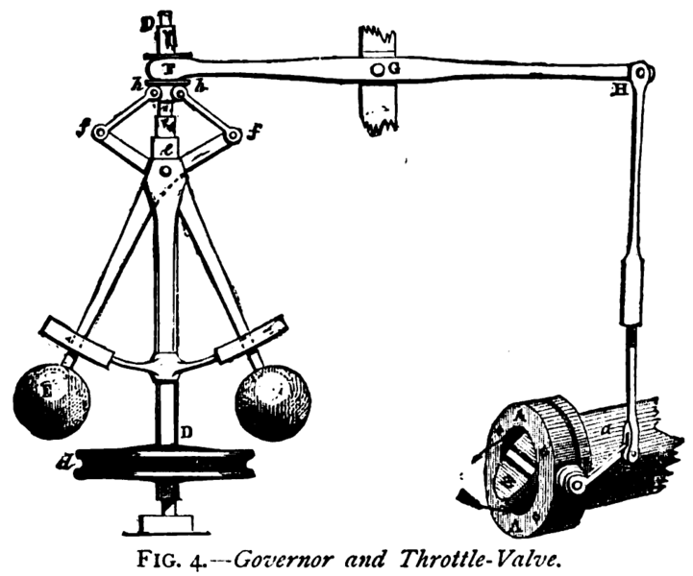
Source: Wikipedia

Slide 6
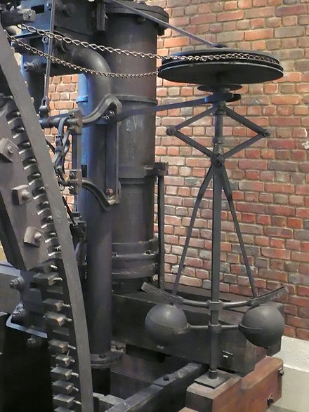
Governors
Around 1788 AD, James Watt and Mathew Boulton solved a problem with their steam engine
  They added a cruise control… well, RPM control
  How to make the motor spin at the same constant speed
  If it spins faster, the large masses move outwards
  This moves a throttle valve so less steam is allowed in to push the prime mover
Source: wikipedia

Slide 7
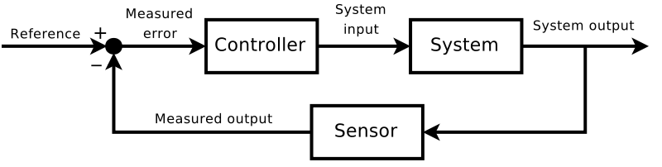
Feedback Control Systems Theory
This was interesting:
  You let the system “misbehave”, and use that misbehavior to correct it..
  Of course, there is a time-lag here
  Later Maxwell wrote a paper about this, giving impetus to the area of “control theory”
Source: Wikipedia

Slide 8
Control theory
The control theory was concerned with stability, and related issues
  Fixed delay makes for highly analyzable system with good math demonstration
We will just take the basic diagram and two related notions:
  Controllability
  Observability

Slide 9
A modified system diagram
System
Output variables
Metrics
that we care about
Observable/ Actionable variables
Control variables
controller

Slide 10

Source: Wikipedia
Archimedes is supposed to have said, of the lever:
Give me a place to stand on,
and I will move the Earth

Slide 11
Need to have the lever
Observability:
  If we can’t observe it, can’t act on it
Controllability:
  If no appropriate control variable is available, we can’t control the system
    (bending the definition a bit)
So: an effective control system needs to have a rich set of observable and controllable variables

Slide 12
A modified system diagram
System
some of these are
Metrics
that we care about
Output variables
Observable/ Actionable variables
Control variables
controller
These include one or more:
Objective functions (minimize, maximize, optimize)
Constraints: “must be less than”, ..

Slide 13
Feedback Control Systems in HPC?
Let us consider two “systems”
  And examine them for opportunities for feedback control
A parallel “job”
  A single application running in some partition
A parallel machine
  Running multiple jobs from a queue

Slide 14
A Single Job
System output variables that we care about:
  (Other than the job’s science output)
  Execution time, energy, power, memory usage, ..
  First two are objective functions
  Next two are (typically) constraints
  We will talk about other variables as well, later
What are the observables?
  Maybe message sizes, rates? Communication graphs?
What are the control variables?
  Very few. Maybe MPI buffer size? Bigpages?

Slide 15
Control System for a single job?
Hard to do, mainly because of the paucity of control variables
This was a problem with “Autopilot”, Dan Reed’s otherwise exemplary research project
  Sensors, actuators and controllers could be defined, but the underlying system did not present opportunities
We need to “open up” the single job to expose more controllable knobs

Slide 16
Alternatives
Each job has its own ARTS control system, for sure
But should this be:
  Specially written for that application?
  A common code base?
  A framework or DSL that includes an ARTS?
This is an open question, I think..
  But it must be capable of interacting with the machine-level control system
My opinion:
  Common RTS, but specializable for each application

Slide 17
The Whole Parallel Machine
Consists of nodes, job scheduler, resource allocator, job queue, ..
Output variables:
  Throughput, energy bill, energy per unit of work, power, availability, reliability, ..
Again, very little control
  About the only decision we make is which job to run next, and which nodes to give to it..
  Maybe a few more ideas now, in the context of energy:
    How many nodes to leave idle
    What power limit to assign to a job

Slide 18
The Big Question/s:
How to add more control variables?
How to add more observables?
And then, how to build a powerful adaptive control system?

Slide 19
It so happens ☺
My group’s research over the past 15-20 years can be thought of as a quest to add more observables and control variables
  Programming models, languages ,libraries, including:
    Charm++, AMPI, Charisma, MSA, Charj,
Now, I’d like to consolidate the experience and knowledge gained, and express it in a new abstract programming model

Slide 20
XMAPP
XMAPP is an abstract programming model:
  That means it characterizes a set of prog. models
For a programming model to belong to this set, it must support
  X: Overdecomposition
    (as in: 8X objects than cores)
  M: Migratability
  A: Asynchrony
    and Adaptivity, as a consequence of all the above
So, XMAPP stands for:
  Overdecomposition-based Migratibility, Asynchrony and Adaptivity in Parallel Programming

Slide 21
Members of XMAPP-class
The programming models in XMAPP, or exhibit some features of it
  Charm++
  Adaptive MPI
  KAAPI
  ProActive
  FG-MPI (if it adds migration)
  HPX (once it embraces migratability)
  ParSEC
  CnC
  MSA (multi-phase Shared arrays)
  Charisma
  Charj
  DRMS (old abstraction from IBM research..)
  Chapel: may be a higher level model
  X10: has asynchrony, but not migratable units
  Tascel
Also, general work on adaptivity is relevant: Trilinos, Hank Hoffman/UIC, …

Slide 22
Over-decomposition
Let the programmer decompose a computation into entities
  Work units, data-units, composites
  Into coarse-grained set of objects
  Independent of number of processors
Let the entities communicate with each other without reference to processors
  So each entity is like a virtual processor by itself
Let an intelligent runtime system assign these entities to processors
  RTS can change this assignment during execution
This empowers the control system
  A large number of observables
  Many control variables created

Slide 23
Grainsize
It is important to understand what I mean by coarse-grained entities
  You don’t write sequential programs that some system will auto-decompose
  You don’t write programs when there is one object for each float
  You consciously choose a grainsize, BUT choose it independent of the number of processors
    Or parameterize it, so you can tune later

Slide 24
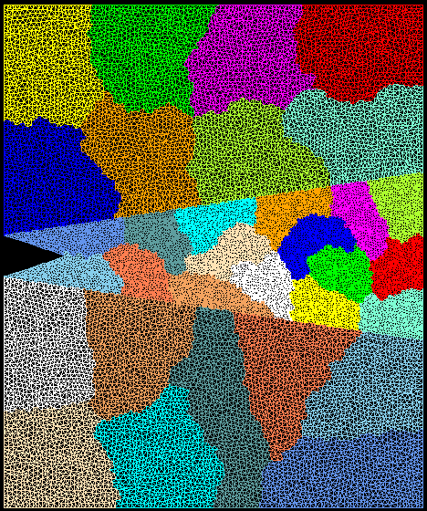
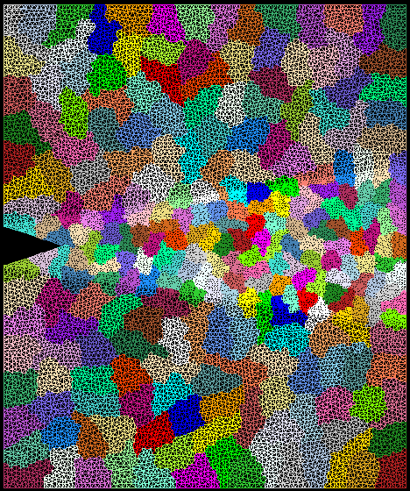
Crack Propagation
This is 2D, circa 2002…
but shows over-decomposition for unstructured meshes..
Decomposition into 16 chunks (left) and 128 chunks, 8 for each PE (right). The middle area contains cohesive elements. Both decompositions obtained using Metis. Pictures: S. Breitenfeld, and P. Geubelle

Slide 25
Grainsize example: NAMD
High Performing examples: (objects are the work-data units in Charm++)
On Blue Waters, 100M atom simulation,
  128K cores (4K nodes), 5,510,202 objects
Edison, Apoa1(92K atoms)
  4K cores , 33124 objects
Hopper, STMV, 1M atoms,
  15,360 cores, 430,612 objects

Slide 26
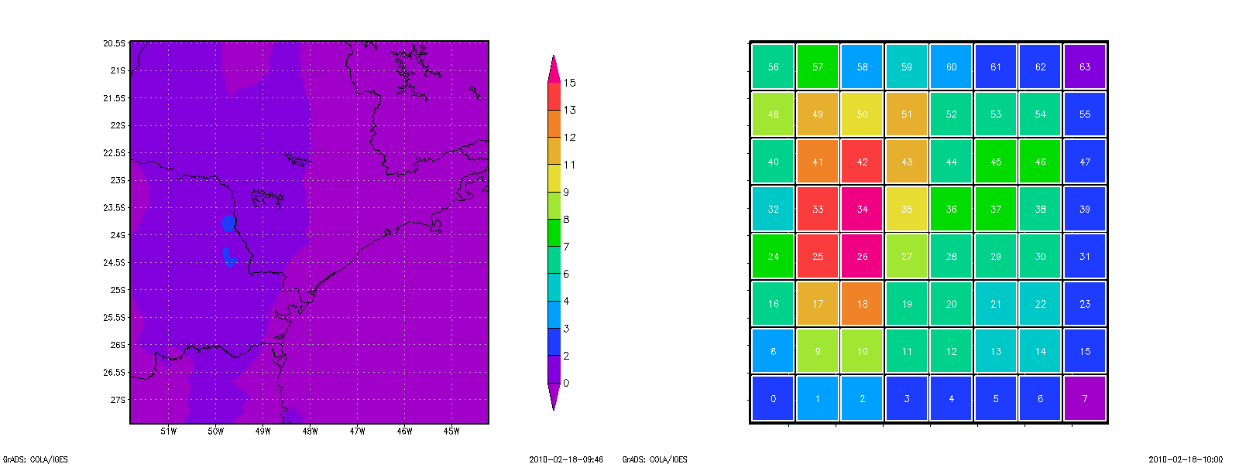

Grainsize: Weather Forecasting in BRAMS
Brams: Brazillian weather code (based on RAMS)
AMPI version (Eduardo Rodrigues, with Mendes , J. Panetta, ..)
Instead of using 64 work units on 64 cores, used 1024 on 64

Slide 27
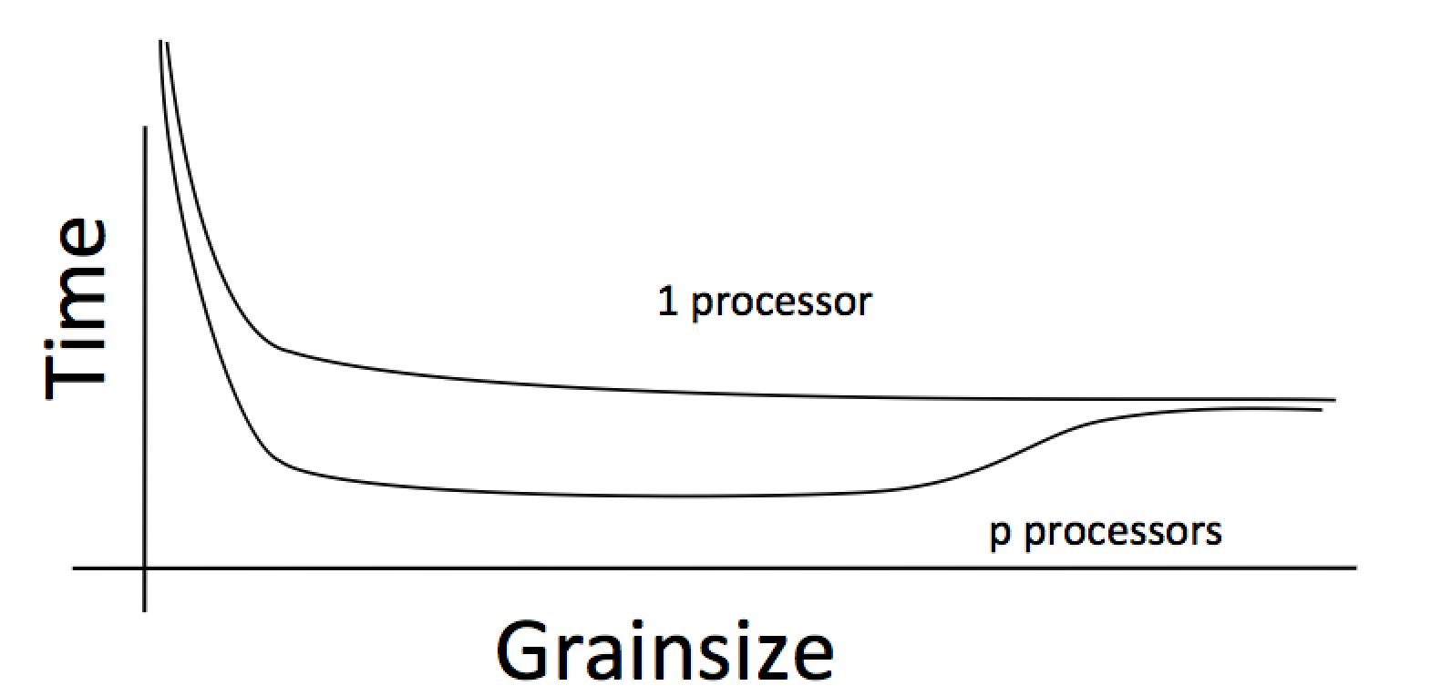
Working definition of grainsize :
amount of computation per remote interaction
Choose grainsize to be just large enough to amortize the overhead

Slide 28
Grainsize in a common setting
2 MB/chare,
256 objects per core

Slide 29

Impact on communication
Current use of communication network:
  Compute-communicate cycles in typical MPI apps
  So, the network is used for a fraction of time,
  and is on the critical path
So, current communication networks are over-engineered for by necessity
P1
P2
BSP based application

Slide 30
Impact on communication
With overdecomposition
  Communication is spread over an iteration
  Also, adaptive overlap of communication and computation
P1
P2
Overdecomposition enables overlap

Slide 31
Object-based over-decomposition: Charm++
Multiple “indexed collections” of C++ objects
Indices can be multi-dimensional and/or sparse
Programmer expresses communication between objects
  with no reference to processors
System implementation
User View

Slide 32
A[..].foo(…)

Slide 33
Note the control points created
Scheduling (sequencing) of multiple method invocations waiting in scheduler’s queue
Observed variables: execution time, object communication graph (who talks to whom)
Migration of objects
  System can move them to different processors at will, because..
This is already very rich…
  What can we do with that??

Slide 34
Optimizations Enabled/Enhanced by These New Control Variables
Communication optimization
Load balancing
Meta-balancer
Heterogeneous Load balancing
Power/temperature/energy optimizations
Resilience
Shrink/Expand sets of nodes
Application reconfiguration to add control points
Adapting to memory capacity

Slide 35
Principle of Persistence
Once the computation is expressed in terms of its natural (migratable) objects
Computational loads and communication patterns tend to persist, even in dynamic computations
So, recent past is a good predictor of near future
In spite of increase in irregularity and adaptivity, this principle still applies at exascale, and is our main friend.
Notes:
35

Slide 36
Measurement-based Load Balancing
Regular Timesteps
Detailed, aggressive Load Balancing
Instrumented Timesteps
Refinement Load Balancing

Slide 37
XMAPP ideas and features have been demonstrated in full-scale production Charm++ applications

Slide 38
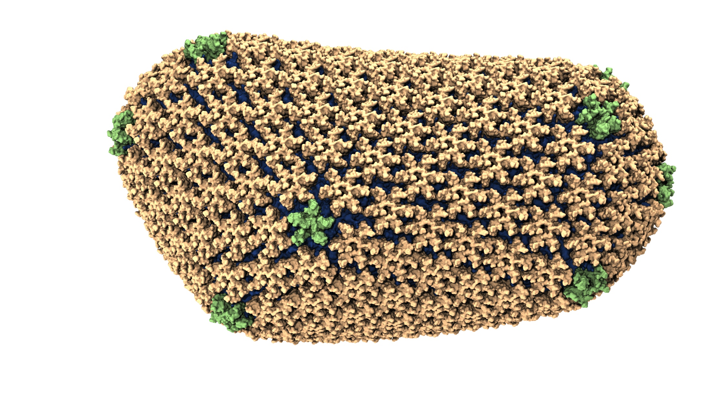
NAMD: Biomolecular simulations
Collaboration with K. Schulten
With over 45,000 registered users
Scaled to most top US supercomputers
In production use on supercomputers and clusters and desktops
Gordon Bell award in 2002
Recent success: Determination of the structure of HIV capsid by researchers including Prof Schulten

Slide 39

ChaNGa: Parallel Gravity
Evolution of Universe and Galaxy Formation
Collaborative project (NSF)
  with Tom Quinn, Univ. of Washington
Gravity, gas dynamics
Barnes-Hut tree codes
  Oct tree is natural decomp
  Geometry has better aspect ratios, so you “open” up fewer nodes
  But is not used because it leads to bad load balance
  Assumption: one-to-one map between sub-trees and PEs
  Binary trees are considered better load balanced
  With Charm++: use Oct-Tree, and let Charm++ map subtrees to processors

Slide 40
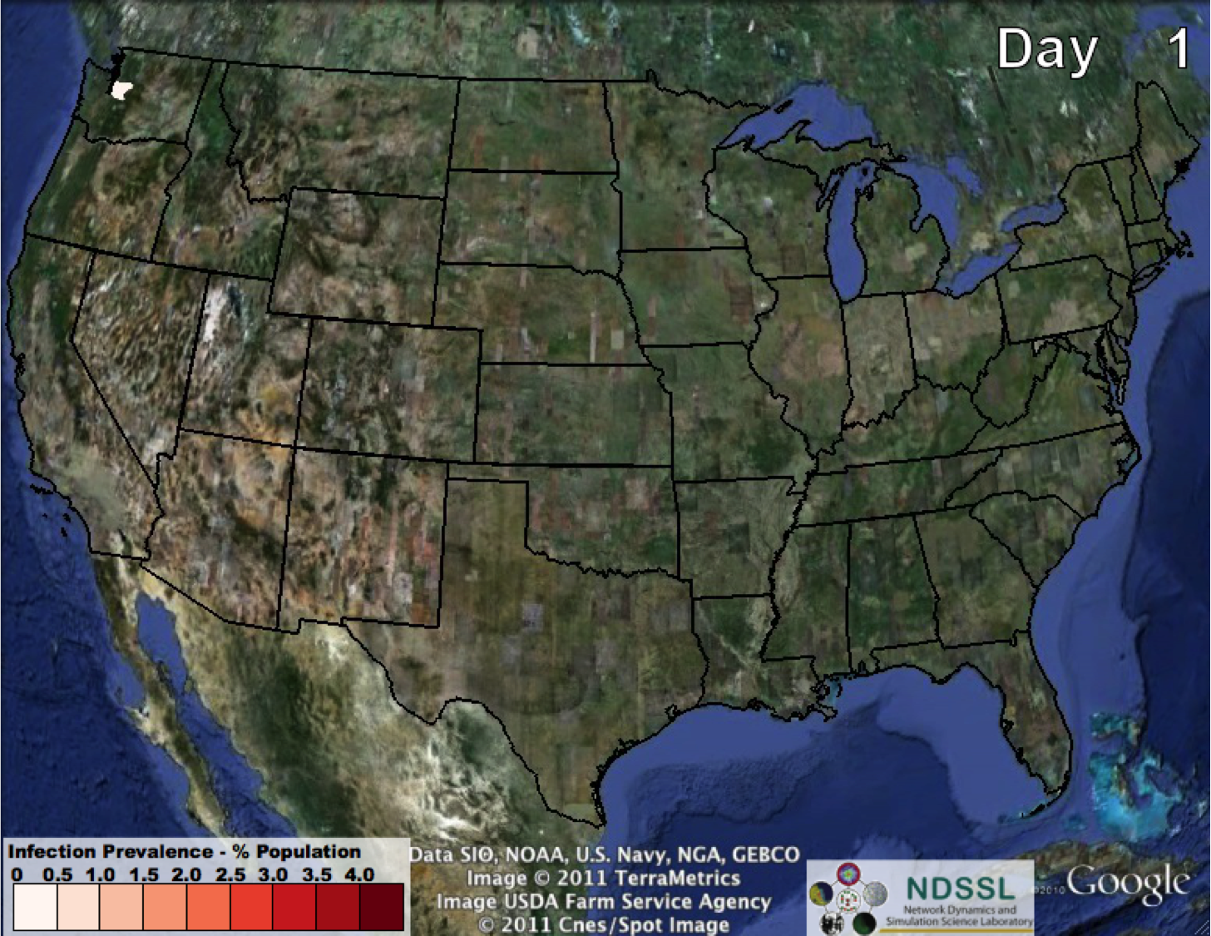
EpiSimdemics
Keith Bisset, Madhav Marathe
Spread of Infection:
Agent-based Simulation

Slide 41

An upcoming book
Surveys seven major applications developed using Charm++

Slide 42
Saving Cooling Energy
Easy: increase A/C setting
  But: some cores may get too hot
So, reduce frequency if temperature is high
  Independently for each core or chip
But, this creates a load imbalance!
No problem, we can handle that
  Migrate objects away from the slowed-down procs
  Balance load using an existing strategy
  Strategies take speed of processors into account
Implemented in experimental version
  SC 2011 paper, IEEE TC paper
Several new power/energy-related strategies
  PASA ‘12: Exploiting differential sensitivities of code segments to frequency change

Slide 43
Fault Tolerance in Charm++/AMPI
Four Approaches:
  Disk-based checkpoint/restart
  In-memory double checkpoint/restart
  Proactive object migration
  Message-logging with parallel restart: scalable fault tolerance
Common Features:
  Leverages object-migration capabilities
  Based on dynamic runtime capabilities
Several new results in the last year:
  FTXS 2012: scalability of in-mem scheme
  Hiding checkpoint overhead .. with semi-blocking..
  Energy efficiency of FT protocols : best paper SBAC-PAD
Ships in Charm++ distribution, for years
Notes:
43

Slide 44
Another idea for increasing controllable variables:
Reconfigurable Applications

Slide 45
App based Creation of Control Points
A richer set of control points can be generated if we enlist help from the application
  Or its DSL runtime, or compiler
The idea is:
  Application exposes some control knobs
  Describes the effects of the knobs
  The RTS observes performance variables, identifies the knobs that will help the most, and turns them in the right direction
Examples: granularity, yield frequencies in inner loops, CPU-Accelerator balance

Slide 46
Load Balancing Framework
Charm++ load balancing framework is an example of “customizable” RTS
Which strategy to use, and how often to call it, can be decided for each application separately
But if the programmer exposes one more control point, we can do more:
  Control point: iteration boundary
  User makes a call each iteration saying they can migrate at that point
  Let us see what we can do: metabalancer

Slide 47
Meta-Balancer
Automating load balancing related decision making
Monitors the application continuously
  Asynchronous collection of minimum statistics
Identifies when to invoke load balancing for optimal performance based on
  Predicted load behavior and guiding principles
  Performance in recent past

Slide 48
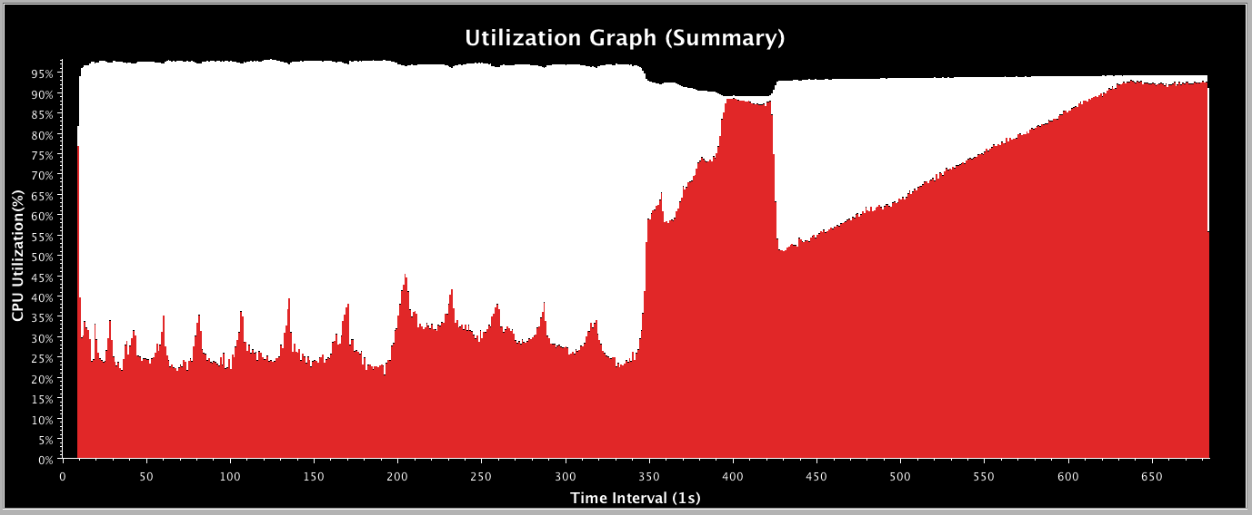
Fractography: Without LB

Slide 49
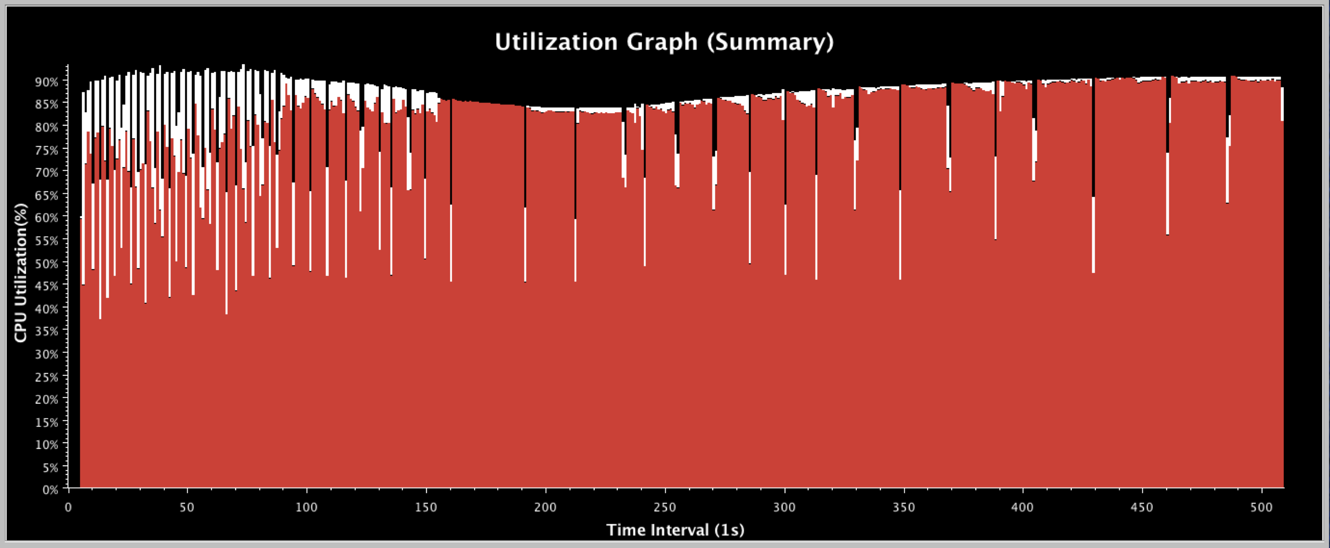
Meta-Balancer on Fractography
Identifies the need for frequent load balancing in the beginning
Frequency of load balancing decreases as load becomes balanced
Increases overall processor utilization and gives gain of 31%

Slide 50
Shrink/Expand job
If a job is told to reduce the number of nodes it is using..
It can do so now by migrating objects..
Same with expanding the set of nodes used
Empowered by migratability

Slide 51

Inefficient Utilization within a cluster
Allocate A !
16 Processor system
Conflict !
B Queued
Job A
Job B
10 processors
8 processors
Job A
Job B
Current Job Schedulers can lead to low system utilization !

Slide 52
Adaptive Job Scheduler
Scheduler can take advantage of the adaptivity of XMAPP jobs
Improve system utilization and response time
Scheduling decisions
  Shrink existing jobs when a new job arrives
  Expand jobs to use all processors when a job finishes
Processor map sent to the job
  Bit vector specifying which processors a job is allowed to use
    00011100 (use 3 4 and 5!)
Handles regular (non-adaptive) jobs

Slide 53
Two Adaptive Jobs
A Expands !
Allocate A !
16 Processor system
Allocate B !
B Finishes
Shrink A
Job A
Job B
Max_pe = 10
Min_pe = 1
Min_pe = 8
Max_pe= 16
Job A
Job B

Slide 54
Job1
Job2
Jobk
Per job RTS
Per job RTS
Per job RTS
Rich Interaction desirable: currently there is very little
Whole Machine RTS

Slide 55
Whole machine runtime
Job schedulers and resource allocators:
  Accept more flexible QoS specifications from jobs
    Creating more control variables
  “moldable” specification:
    This job needs between 3000-5000 nodes
    Memory requirements..
    Topology sensitivity, speedup profiles,…
  Malleable:
    this job can be told to shrink/expand after it has started

Slide 56
Whole machine control
Monitor failures, and act in job-specific ways
Global power constraints:
  Inform, negotiate with and constrain jobs
Thermal management
I/O system and job I/O interactions
Shrink and Expand jobs as needed to optimize multiple metrics

Slide 57
Novel, Revolutionary and Old?
These concepts have been around for a while
  E.g. Charm++ even in the present form is 13-15 years old
An analogy might help

Slide 58
Dinosaurs, mammals and primates
When the asteroid created a shock to the ecosystem
  For us, multiple asteroids together:
    End of frequency scaling,
    Complex heterogeneous hardware,
    Thermal, power, energy issues,
    Component failures
    increasingly complex apps
  Dinosaurs (well.. MPI) and mammals (XMAPP) both existed
    But dinosaurs died out, mammals survived, and evolved further
    The premium on “smart” rather than “big” in the ecosystem eventually saw the emergence of humans
      Well.. Bending the truth a bit for the sake of analogy
    Well, dinosaurs survived as birds… maybe MPI 5?
Notes:
Really needs a picture, ass

Slide 59
XMAPP models: adoption
It is challenging to get the community to adopt a new programming model
  And here we are talking about a whole class of them!
It helps
  To get a few from-scratch success stories
  Some apps may get “refactored” to use the new model (Episimdemics)
But large-scale adoption will be helped if we can support true “interoperability”

Slide 60
Interoperation of Parallel Languages
Implement a library in the language that suits it the most, and use them together!
MPI + UPC, MPI + OpenMP + Charm++

Slide 61
Is Interoperation Feasible in Production Applications?
Application | Library | Productivity | Performance
CHARM in MPI (on Chombo) | HistSort in Charm++ | 195 lines removed | 48x speed up in Sorting
EpiSimdemics | MPI IO | Write to single file | 256x faster input
NAMD | FFTW | 280 lines less | Similar performance
Charm++’s Load Balancing | ParMETIS | Parallel graph partitioning | Faster applications

Slide 62
Conclusions
We need a much richer control system
  For each parallel job
  For parallel machine as a whole
Current status: paucity of control variables
Programming models can help create new observable and controllable variables
As far as I can see,
  XMAPP class programming models,
  with overdecomposition and migratability, and
  the resultant asynchrony and adaptivity are the main vehicle for this..
  Do you see other ideas?

Slide 63
Conclusion
HPC community suggestions:
  Develop new XMAPP models
    But: make sure you develop it in the context of at least two reasonable-size applications
  Collaborate and compete on runtime adaptation strategies, based on the common assumptions of XMAPP models
    Possibly develop standards for mature pieces
See you at Charm++ BOF at SC: Tuesday noon
I am looking for a postdoc and/or a research programmer
More info on Charm++:
http://charm.cs.illinois.edu

