Slide 1


Characteristics of Adaptive Runtime Systems in HPC
Laxmikant (Sanjay) Kale
http://charm.cs.illinois.edu

Slide 2
What runtime are we talking about?
Java runtime:
  JVM + Java class library
  Implements JAVA API
MPI runtime:
  Implements MPI standard API
  Mostly mechanisms
I want to focus on runtimes that are “smart”
  i.e. include strategies in addition mechanisms
  Many mechanisms to enable adaptive strategies

Slide 3
Why?
And what kind of adaptive runtime system I have in mind?
Let us take a detour

Slide 4
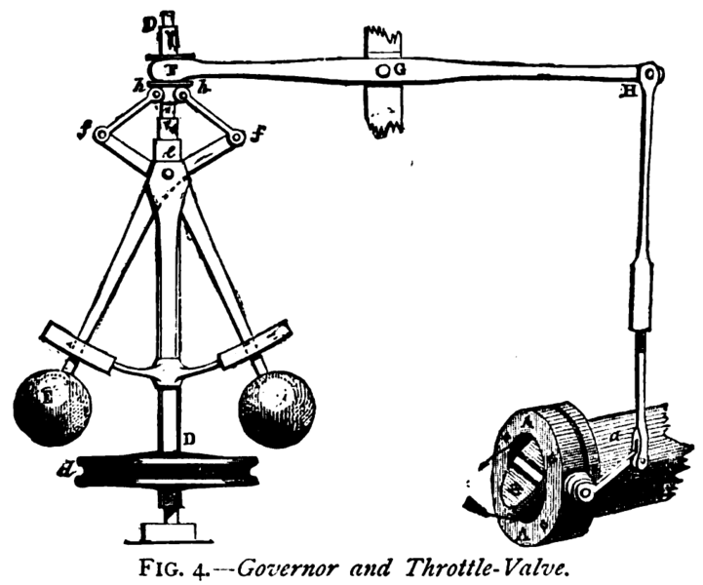
Source: wikipedia

Slide 5
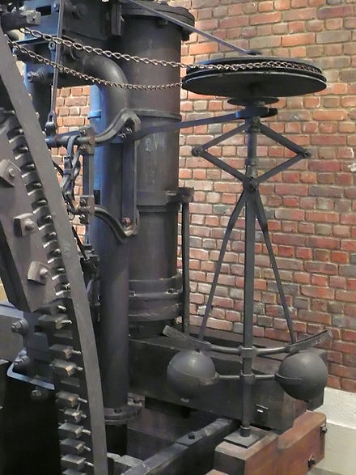
Governors
Around 1788 AD, James Watt and Mathew Boulton solved a problem with their steam engine
  They added a cruise control… well, RPM control
  How to make the motor spin at the same constant speed
  If it spins faster, the large masses move outwards
  This moves a throttle valve so less steam is allowed in to push the prime mover
Source: wikipedia

Slide 6
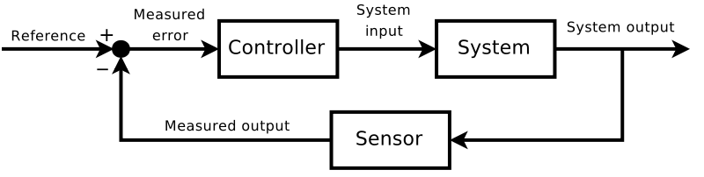
Feedback Control Systems Theory
This was interesting:
  You let the system “misbehave”, and use that misbehavior to correct it..
  Of course, there is a time-lag here
  Later Maxwell wrote a paper about this, giving impetus to the area of “control theory”
Source: wikipedia

Slide 7
Control theory
The control theory was concerned with stability, and related issues
  Fixed delay makes for highly analyzable system with good math demonstration
We will just take the basic diagram and two related notions:
  Controllability
  Observability

Slide 8
A modified system diagram
System
Output variables
Metrics
That we care about
Observable / Actionable variables
Control variables
controller

Slide 9

Source: wikipedia
Archimedes is supposed to have said, of the lever:
Give me a place to stand on, and I will move the Earth

Slide 10
Need to have the lever
Observability:
  If we can’t observe it, can’t act on it
Controllability:
  If no appropriate control variable is available, we can’t control the system
    (bending the definition a bit)
So: an effective control system needs to have a rich set of observable and controllable variables

Slide 11
A modified system diagram
System
Output variables
Metrics
That we care about
Observable / Actionable variables
Control variables
controller
These include one or more:
Objective functions (minimize, maximize, optimize)
Constraints: “must be less than”, ..

Slide 12
Feedback Control Systems in HPC?
Let us consider two “systems”
  And examine them for opportunities for feedback control
A parallel “job”
  A single application running in some partition
A parallel machine
  Running multiple jobs from a queue

Slide 13
A Single Job
System output variables that we care about:
  (Other than the job’s science output)
  Execution time, energy, power, memory usage, ..
  First two are objective functions
  Next two are (typically) constraints
  We will talk about other variables as well, later
What are the observables?
  Maybe message sizes, rates? Communication graphs?
What are the control variables?
  Very few…. Maybe MPI buffer size? bigpages?

Slide 14
Control System for a single job?
Hard to do, mainly because of the paucity of control variables
This was a problem with “Autopilot”, Dan Reed’s otherwise exemplary research project
  Sensors, actuators and controllers could be defined, but the underlying system did not present opportunities
We need to “open up” the single job to expose more controllable knobs

Slide 15
Alternatives
Each job has its own ARTS control system, for sure
But should this be:
  Specially written for that application?
  A common code base?
  A framework or DSL that includes an ARTS?
This is an open question, I think..
  But it must be capable of interacting with the machine-level control system
My opinion:
  Common RTS, but specializable for each application

Slide 16
The Whole Parallel Machine
Consists of nodes, job scheduler, resource allocator, job queue, ..
Output variables:
  Throughput, Energy bill, energy per unit of work, power, availability, reliability, ..
Again, very little control
  About the only decision we make is which job to run next, and which nodes to give to it..

Slide 17
The Big Question/s:
How to add more control variables?
How to add more observables?

Slide 18
One method we have explored
Overdecomposition and processor independent programming

Slide 19
Object based over-decomposition
Let the programmer decompose computation into objects
  Work units, data-units, composites
Let an intelligent runtime system assign objects to processors
  RTS can change this assignment during execution
This empowers the control system
  A large number of observables
  Many control variables created

Slide 20
Object-based over-decomposition: Charm++
Multiple “indexed collections” of C++ objects
Indices can be multi-dimensional and/or sparse
Programmer expresses communication between objects
  with no reference to processors
System implementation
User View

Slide 21
A[..].foo(…)

Slide 22
Note the control points created
Scheduling (sequencing) of multiple method invocations waiting in scheduler’s queue
Observed variables: execution time, object communication graph (who talks to whom)
Migration of objects
  System can move them to different processors at will, because..
This is already very rich…
  What can we do with that??

Slide 23
Optimizations Enabled/Enhanced by These New Control Variables
Communication optimization
Load balancing
Meta-balancer
Heterogeneous Load balancing
Power/temperature/energy optimizations
Resilience
Shrink/Expand sets of nodes
Application reconfiguration to add control points
Adapting to memory capacity

Slide 24
Principle of Persistence
Once the computation is expressed in terms of its natural (migratable) objects
Computational loads and communication patterns tend to persist, even in dynamic computations
So, recent past is a good predictor of near future
In spite of increase in irregularity and adaptivity, this principle still applies at exascale, and is our main friend.
Notes:
24

Slide 25
Measurement-based Load Balancing
Regular Timesteps
Detailed, aggressive Load Balancing
Instrumented Timesteps
Refinement Load Balancing

Slide 26
Load Balancing Framework
Charm++ load balancing framework is an example of “customizable” RTS
Which strategy to use, and how often to call it, can be decided for each application separately
But if the programmer exposes one more control point, we can do more:
  Control point: iteration boundary
  User makes a call each iteration saying they can migrate at that point
  Let us see what we can do: metabalancer

Slide 27
Meta-Balancer
Automating load balancing related decision making
Monitors the application continuously
  Asynchronous collection of minimum statistics
Identifies when to invoke load balancing for optimal performance based on
  Predicted load behavior and guiding principles
  Performance in recent past

Slide 28
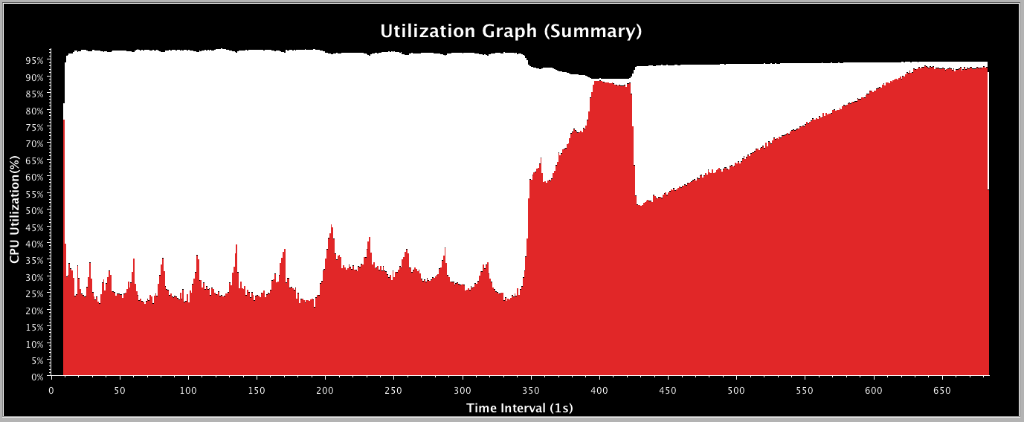
Fractography: Without LB

Slide 29
Fractography: Periodic
iterations
Frequent load balancing leads to high overhead and no benefit
Infrequent load balancing leads to load imbalance and results in no gains

Slide 30
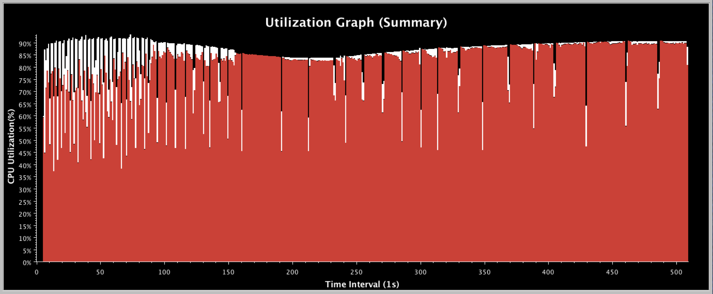
Meta-Balancer on Fractography
Identifies the need for frequent load balancing in the beginning
Frequency of load balancing decreases as load becomes balanced
Increases overall processor utilization and gives gain of 31%

Slide 31
Saving Cooling Energy
Easy: increase A/C setting
  But: some cores may get too hot
Reduce frequency if temperature is high
  Independently for each core or chip
This creates a load imbalance!
Migrate objects away from the slowed-down processors
  Balance load using an existing strategy
  Strategies take speed of processors into account
Recently implemented in experimental version
  SC 2011 paper
Several new power/energy-related strategies

Slide 32
Saving Cooling Energy
Easy: increase A/C setting
  But: some cores may get too hot
So, Reduce frequency if temperature is high
  Independently for each core or chip
But, This creates a load imbalance!
No prolem, we can handle that:
  Migrate objects away from the slowed-down Procs
  Balance load using an existing strategy
  Strategies take speed of processors into account
Implemented in experimental version
  SC 2011 paper
  IEEE TC paper
Several new power/energy-related strategies
  PASA ‘12: Exploiting differential sensitivities of code segments to freq change

Slide 33
Fault Tolerance in Charm++/AMPI
Four Approaches:
  Disk-based checkpoint/restart
  In-memory double checkpoint/restart
  Proactive object migration
  Message-logging: scalable fault tolerance
Common Features:
  Leverages object-migration capabilities
  Based on dynamic runtime capabilities
Several new results in the last year:
  FTXS 2012: scalability of in-mem scheme
  Hiding checkpoint overhead .. with semi-blocking..
  Energy efficiency of FT protocols : best paper SBAC-PAD
Ships in Charm++ distribution, for years
Notes:
33

Slide 34
In-memory double checkpointing
Is practical for many apps
  Relatively small footprint at checkpoint time
  Also, you can use non-volatile node-local storage (e.g. FLASH)

Slide 35
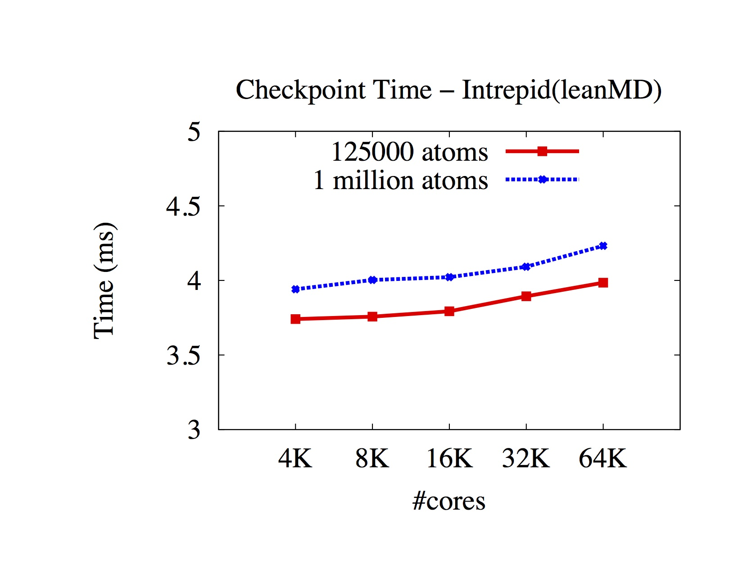

Slide 36
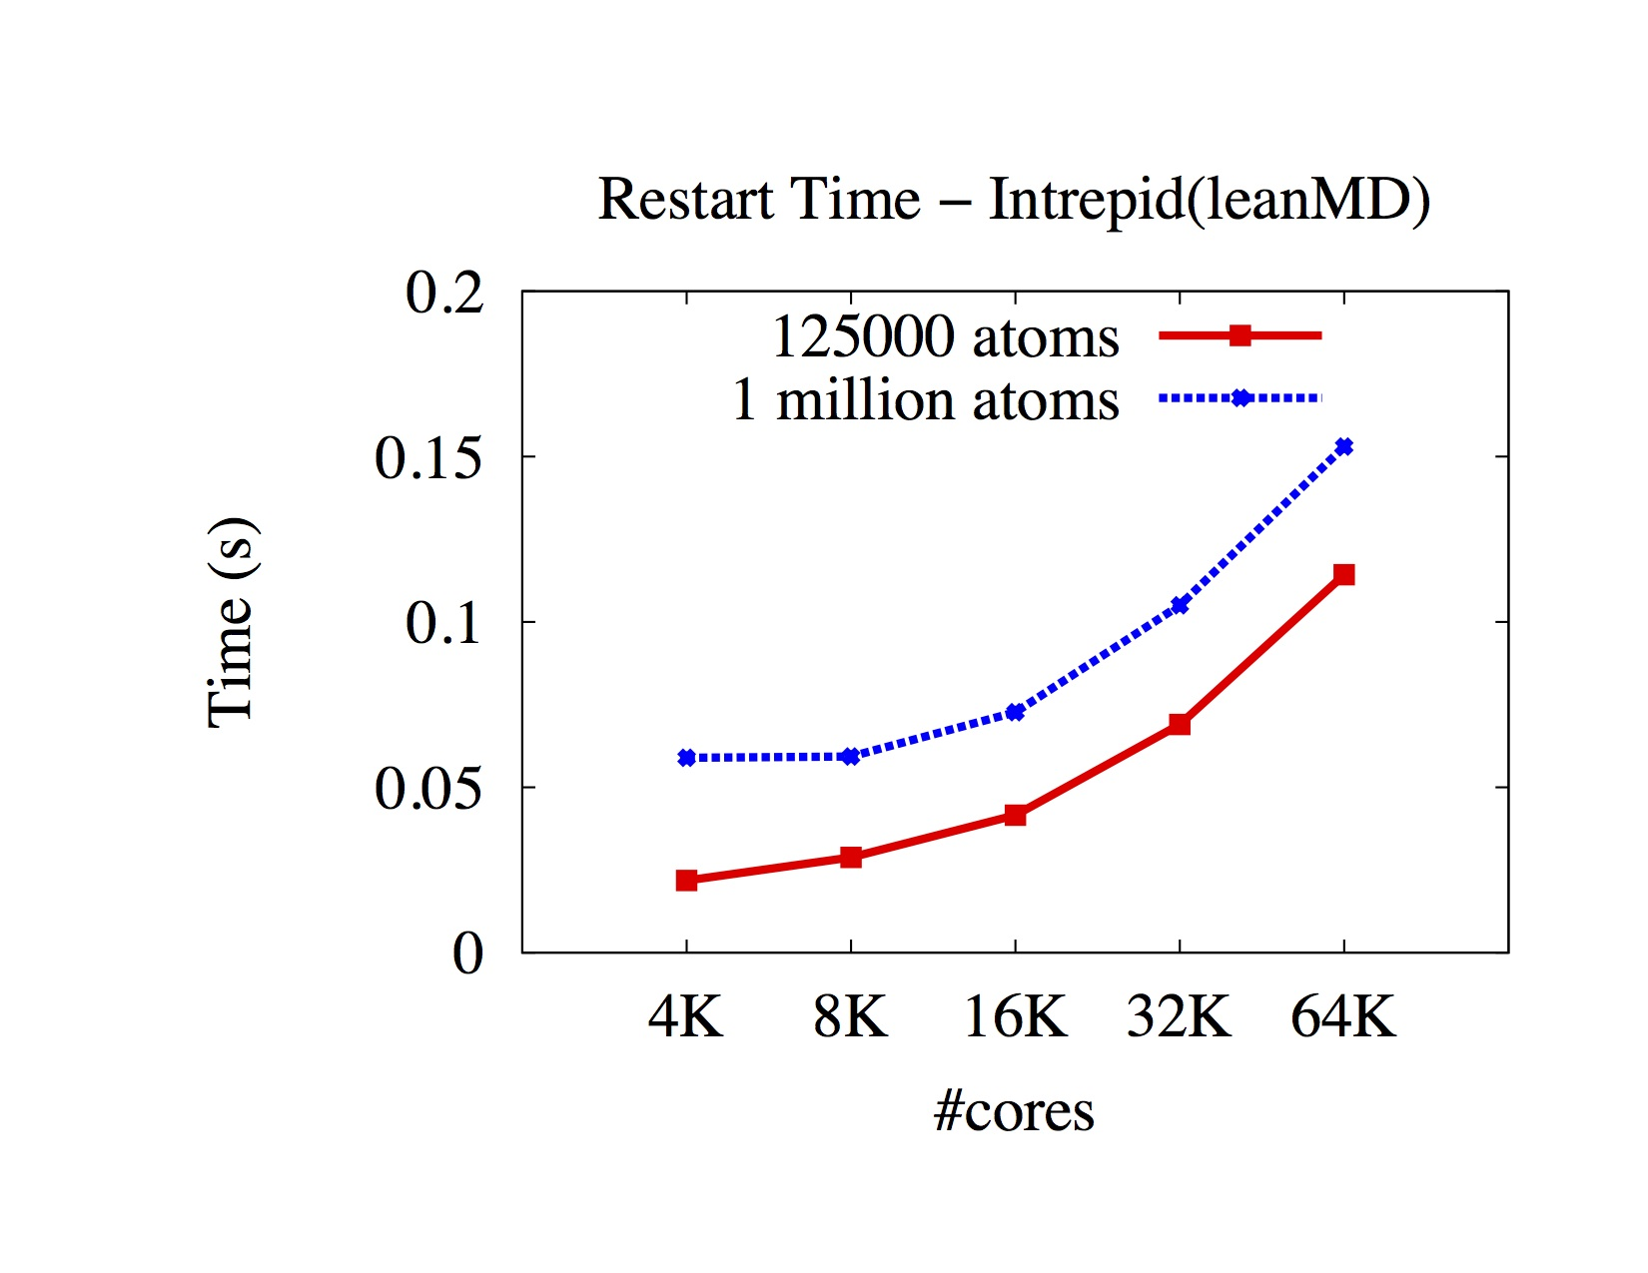

Slide 37
Blocking vs Semi-Blocking

Slide 38
Results: Strong Scaling runs of ChaNGa
The extra control exposed by the underlying communication layer was critical to attain this result
Notes:
Here is the result of semi-blocking checkpoint using ChaNGa benchmark for strong scaling. The problem size is 100M particles.

Slide 39
App based Creation of Control Points
A richer set of control points can be generated if we enlist help from the application
  Or its DSL runtime, or compiler
The idea is:
  Application exposes some control knobs
  Describes the effects of the knobs
  The RTS observes performance variables, identifies the knobs that will help the most, and turns them in the right direction
Examples: granularity, yield frequencies in inner loops, CPU-Accelerator balance

Slide 40
Shrink/Expand job
If a job is told to reduce the number of nodes it is using..
It can do so now by migrating objects..
Same with expanding the set of nodes used
Empowered by migratability

Slide 41

Inefficient Utilization within a cluster
Allocate A !
16 Processor system
Conflict !
B Queued
Job A
Job B
10 processors
8 processors
Job A
Job B
Current Job Schedulers can lead to low system utilization !

Slide 42
Adaptive Job Scheduler
Scheduler can take advantage of the adaptivity of AMPI and Charm++ jobs
Improve system utilization and response time
Scheduling decisions
  Shrink existing jobs when a new job arrives
  Expand jobs to use all processors when a job finishes
Processor map sent to the job
  Bit vector specifying which processors a job is allowed to use
    00011100 (use 3 4 and 5!)
Handles regular (non-adaptive) jobs

Slide 43
Two Adaptive Jobs
A Expands !
Allocate A !
16 Processor system
Allocate B !
B Finishes
Shrink A
Job A
Job B
Max_pe = 10
Min_pe = 1
Min_pe = 8
Max_pe= 16
Job A
Job B

Slide 44
Job1
Job2
Jobk
Per job RTS
Per job RTS
Per job RTS
Rich Interaction desirable: currently there is very little
Whole Machine RTS

Slide 45
Whole machine runtime
Job schedulers and resource allocators:
  Accept more flexible QoS specifications from jobs
    Creating more control variables
  “moldable” specification:
    This job needs between 3000-5000 nodes
    Memory requirements..
    Topology sensitivity, speedup profiles,…
  Malleable:
    this job can be told to shrink/expand after it has started

Slide 46
Whole machine control
Monitor failures, and act in job-specific ways
Global power constraints:
  Inform, negotiate with and constrain jobs
Thermal management
I/O system and job I/O interactions
Shrink and Expand jobs as needed to optimize multiple metrics

Slide 47
Conclusions
We need a much richer control system
  For each parallel job
  For parallel machine as a whole
Current status: paucity of control variables
Programming models can help create new observable and controllable variables
As far as I can see,
  overdecomposition is the main vehicle for this..
  Do you see other ideas?

Slide 48

An upcoming book
Surveys seven major applications developed using Charm++

