Slide 1


Application-Oriented CS Research:
NAMD and Charm++
Laxmikant (Sanjay) Kale
http://charm.cs.illinois.edu

Slide 2
Outline
1991, start of a collaboration (Skeel, initial teams)
1994: NAMD version 1..
1995-96: new design, computes, charm++ based, iso-efficiency (Jim, Attila, Bob, ..)
Then on: co-evolution, synergy
Position paper in 1994: App oriented
Ideas in Charm++
Future of Charm++

Slide 3
Points
Humbling.. “the key to my success”..
History: 1991, NIH, v1, v2: Attila, Jim, .. Gnerations of students in CS
  NAMD on clusters
  Iso-efficiency based analysis
Sturdiness of concepts: a code designed and developed in 1995, 16 node HP cluster, continues to scale to 600k cores!
Advice to the young scientists: re: interdisciplinary research
CS centered app oriented
  CFD with Pratap, NAMD
Synergy picture
Historically: Rocket center, ChaNGa, OpenAtom,
Conceptual evolution of Charm++:
  Chares with dynamic seed balancing, and group
  Indexed collections: namd , changa, openatom examples
  Dagger and structured dagger
  Measurement based load balancers, fault tolerance, communication optimizations, power optimizations
  projections
Future of Charm++ : exascale, cloud, midscale
Future of NAMD

Slide 4
“The key to my success…”
It is humbling to receive this award in Sidney Fernbach’s name!
I feel that it honors many generations of students and co-workers, not just us
Outline some history, and the path I have taken so far
  A few technical points to illustrate it
  Any lessons?
  A look to future

Slide 5
Acknowledgements
Amitabh Sinha
Attila Gursoy
Jim Phillips
Milind Bhandarkar
Robert Brunner
Krishnan Varadarajan
Sameer Kumar
Gengbin Zheng
Eric Bohm
Chee Wai Lee
Chao Huang
David Kunzman
Isaac Dooley
Abhinav Bhatele
Chao Mei
Esteban Meneses
Yanhua Sun
Lata, my wife, first and foremost..
  My two sons,
  Brothers…
Klaus Schulten, Bob Skeel
Early NAMD developers:
  Mark Nelson, Bill Humphrey, Jim Phillips, …
PPL students involved in NAMD
All the other PPL students
  NAMD always part of PPL work!
Numerous other influences and guidance's

Slide 6
Early History
Spring 1991:
  Just about to be tenured, based on my work on parallel logic programming and state space search..
  Had extracted the kernel of the parallel search engine, and called it the “Chare Kernel”
  Had started working on a CFD collaboration with Prof. Vanka
  Klaus Schulten visited me, and asked me to be on his proposal in biophysics to NIH
  His group had already built a transputer based computer on their own, in Germany…!

Slide 7
Early History
The collaboration had Bob Skeel as the 3rd PI
Sabbatical : read up a bit more on molecular biology…
  turned out to be not directly useful
Next couple of years: learning MD, helping with existing application codes, ..
1994: early version of NAMD
1995: re-architected version of NAMD using principles of Charm++ programming model
  Bob Skeel, Attila Gursoy, Jim Phillips,..
  Also: Mark Nelson, Bill Humphrey, Andrew Dalke, ..

Slide 8
Computer Scientists’ role in HPC
Around this time, I developed a little “philosophy” on this issue..
We computer scientists tend to be “platonic”
  Pursue an idea just because its “beautiful”
  Ignoring needs of practical science/engineering applications
Alternatively:
  Worked on a single application … essentially as programmers!
  But that doesn’t lead to broad enabling technology
What is needed:
  Application oriented, yet computer science centered research
  Work on multiple applications,
  Develop abstractions triggered by needs of one, but in a way that’s useful for many
  Accrete abstractions in practical parallel software systems

Slide 9
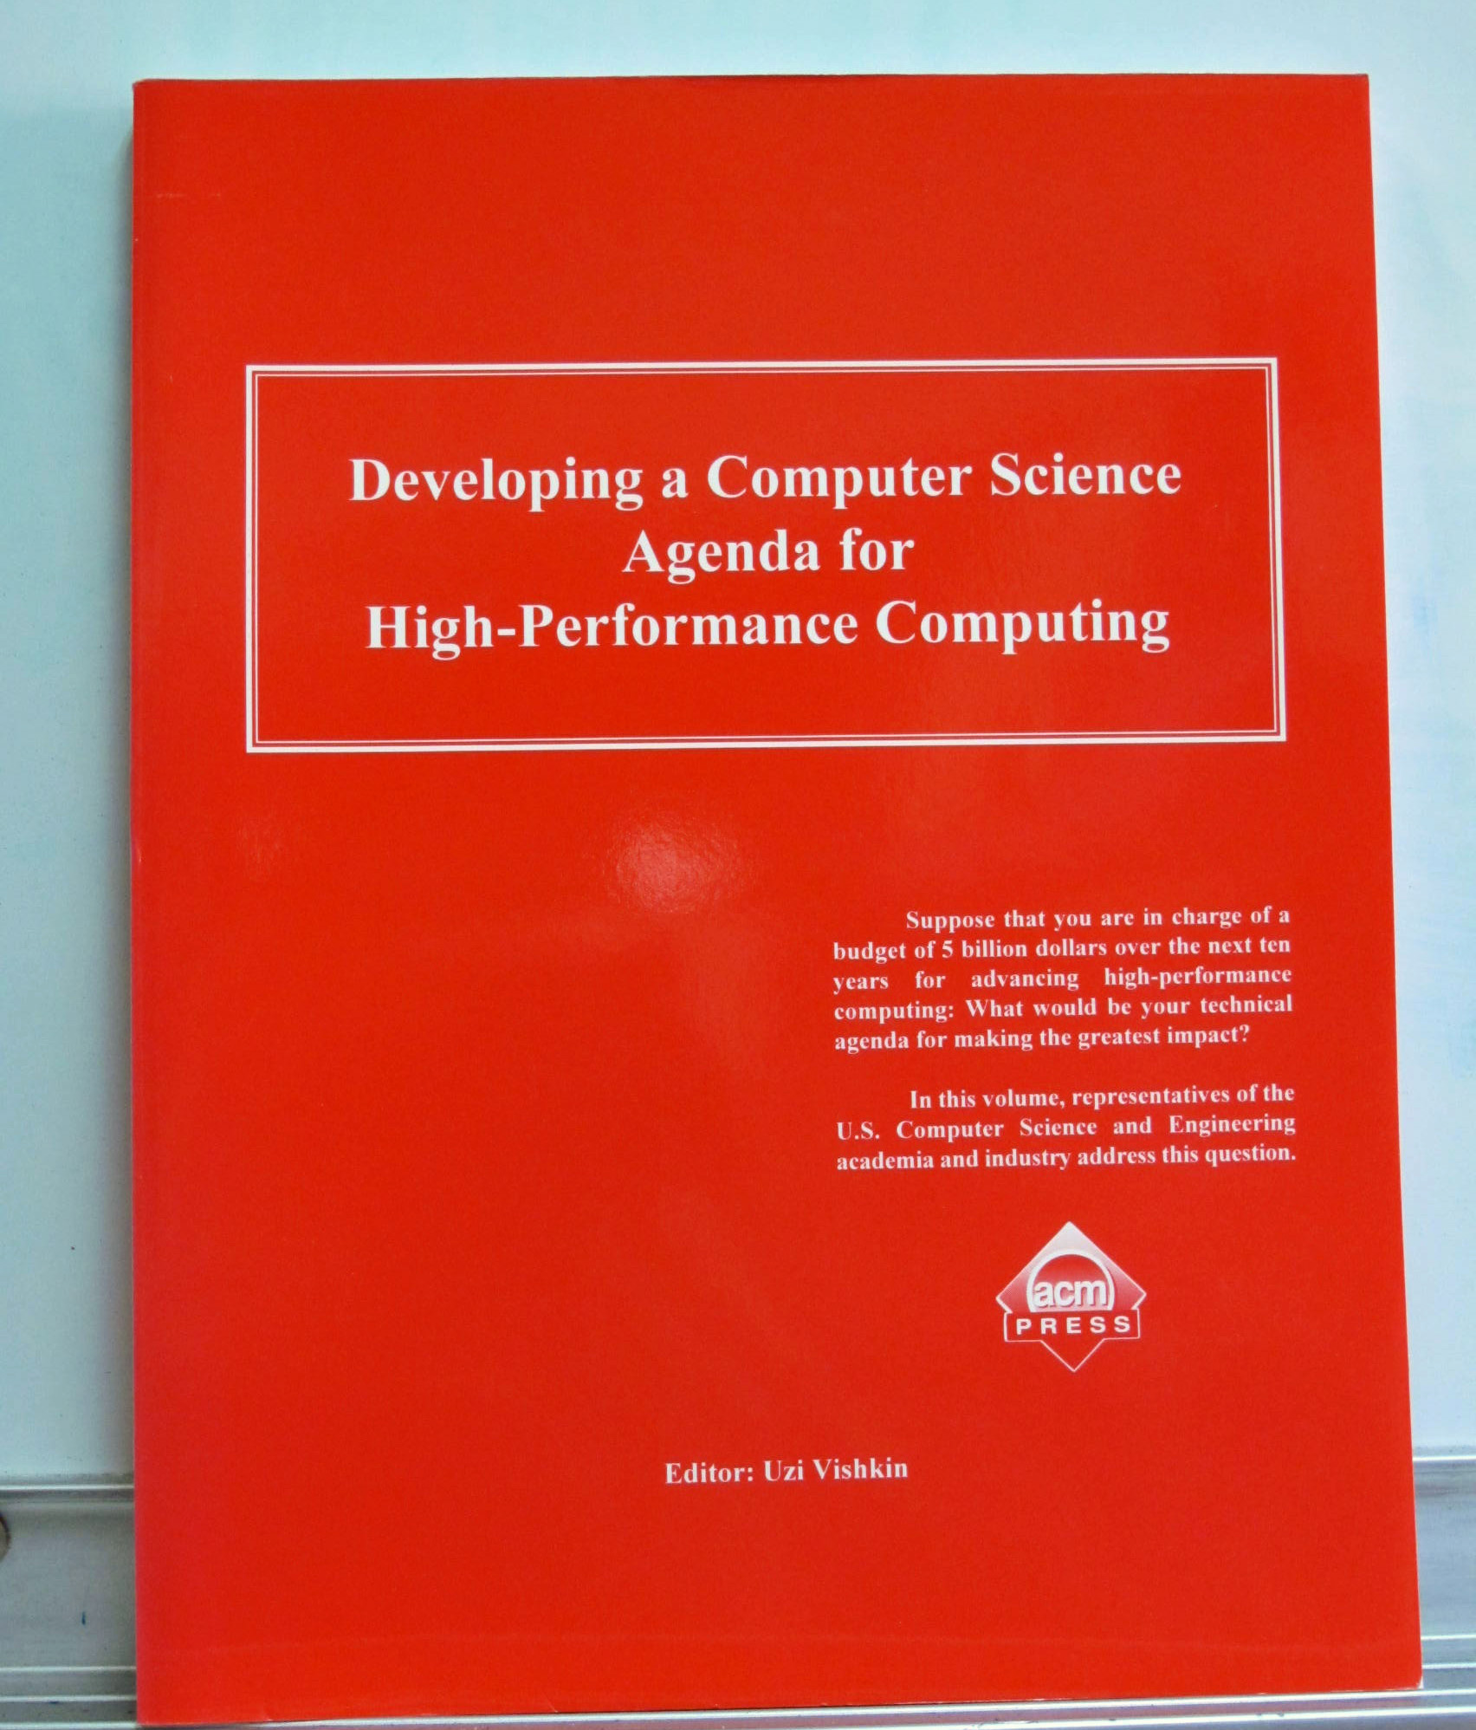

Slide 12
Interdisciplinary Research
Everyone extolls (and extolled) the virtues of interdisciplinary research
However, it’s a tough road
  Scientists/engineers may look at you as their programmer
  Klaus was a great collaborator because he didn’t
  We need a recognition of our CS work as a legitimate “research” --- development of abstractions
  Within your own discipline, for many people, such interdisciplinary work “doesn’t count”
I strongly believed that only such interdisciplinary work, with real applications rather than benchmarks and kernels, will lead to abstractions and techniques which may have a long term impact on the state of art
Advice to a young scientist:
  Get tenure first!
  Then pursue such work to your heart’s content
  Beware that recognition make come late, IF you succeed

Slide 13
Our Guiding Principles: in Charm
No reliance on magic
  (at least until you learn the trick)
  Parallelizing compilers have achieved close to technical perfection, but are not enough
  Sequential programs obscure too much information
Seek an optimal division of labor between the system and the programmer
Design abstractions based solidly on use-cases
  Application-oriented yet computer-science centered approach
2/4/13
13
Notes:
13

Slide 14
Object based over-decomposition
Let the programmer decompose computation into objects
  Work units, data-units, composites
Let an intelligent runtime system assign objects to processors
  RTS can change this assignment during execution
This empowers the RTS
  The research agenda started with the simple precept above, just before NAMD,
  Continued until now!

Slide 15
Object-based over-decomposition: Charm++
Multiple “indexed collections” of C++ objects
Indices can be multi-dimensional and/or sparse
Programmer expresses communication between objects
  with no reference to processors
System implementation
User View

Slide 16
Benefits of Charm++ model
Scalable Tools
Automatic overlap of Communication and Computation
Over-decomposition and message-driven execution
Perfect pefetch
compositionality
Emulation for Perf Prediction
Migratability
Fault Tolerance
Introspective and adaptive runtime system
Dynamic load balancing (topology-aware, scalable)
Temperature/Power/Energy Optimizations

Slide 17
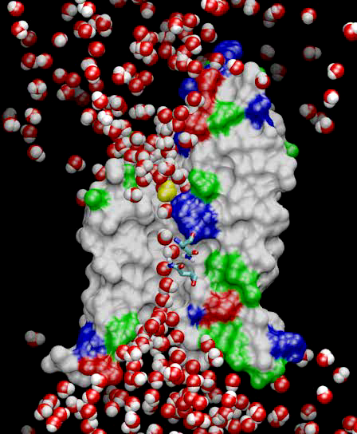
Molecular Dynamics, as I saw it
Collection of [charged] atoms
  With bonds
  Newtonian mechanics
  Thousands to millions atoms
At each time-step
  Calculate forces on each atom
    Bonds
    Non-bonded: electrostatic and van der Waal’s
      Short-distance: every timestep
      Long-distance: using PME (3D FFT)
      Multiple Time Stepping : PME every 4 timesteps
  Calculate velocities
  Advance positions
Challenge: femtosecond time-step, millions needed!

Slide 18
Traditional Approaches: non isoefficient
In 1996-2002
Replicated Data:
  All atom coordinates stored on each processor
    Communication/Computation ratio: P log P
Partition the atoms array across processors
  Nearby atoms may not be on the same processor
  C/C ratio: O(P)
Distribute force matrix to processors
  Matrix is sparse, non uniform
  C/C Ratio: sqrt(P)
Not Scalable
Not Scalable
Not Scalable

Slide 19
Spatial Decomposition Via Charm
Atoms distributed to cubes based on their location
Size of each cube :
  Just a bit larger than cut-off radius
  Communicate only with neighbors
  Work: for each pair of nbr objects
C/C ratio: O(1)
However:
  Load Imbalance
  Limited Parallelism
Charm++ is useful to handle this
Cells, Cubes or “Patches”

Slide 20
Object Based Parallelization for MD:
Force Decomposition + Spatial Decomposition
Now, we have many objects to load balance:
  Each diamond can be assigned to any proc.
  Number of diamonds (3D):
    14 - Number of Patches
    2 - away variation:
      Half-size cubes
      5x5x5 interactions
More recent expositions and variants of this idea: Blue Matter, Desmond, Snir

Slide 21
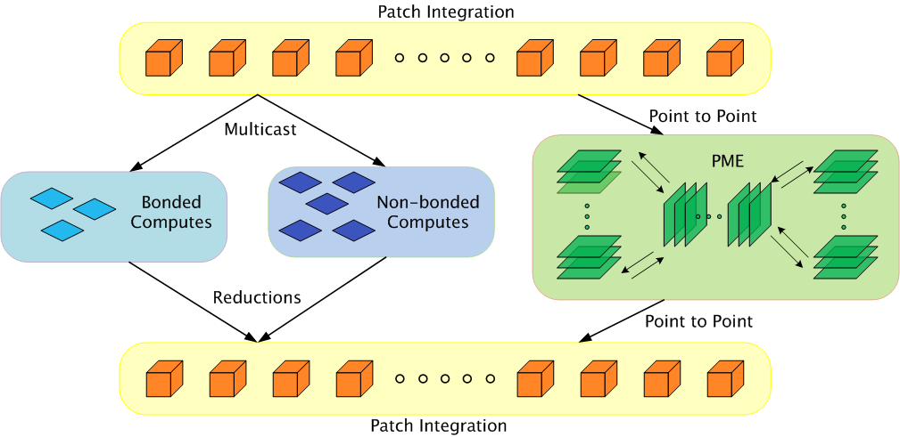
Parallelization using Charm++

Slide 22
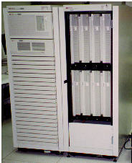
Sturdy design!
This design,
  done in 1995 or so, running on 12 node HP cluster
Has survived
  With minor refinements
Until today
  Scaling to 500,000+ cores on Blue Waters!
  300,000 Cores of Jaguar, or BlueGene/P
1993

Slide 23
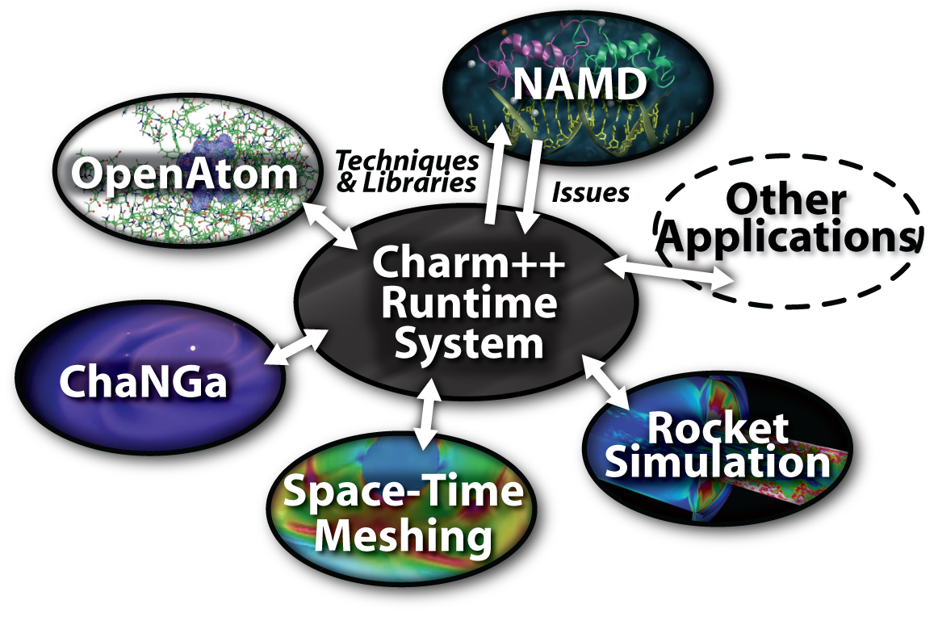
Charm++ and CSE Applications
Well-known Biophysics molecular simulations App
Gordon Bell Award, 2002
Nano-Materials..
Synergy
Enabling CS technology of parallel objects and intelligent runtime systems has led to several CSE collaborative applications
ISAM
Computational Astronomy
_{CharmSimdemics}
_{Stochastic}
_{Optimization}

Slide 24
Many Computer Science Innovations/Abstractions/Tools were developed as a result of this synergistic model

Slide 25
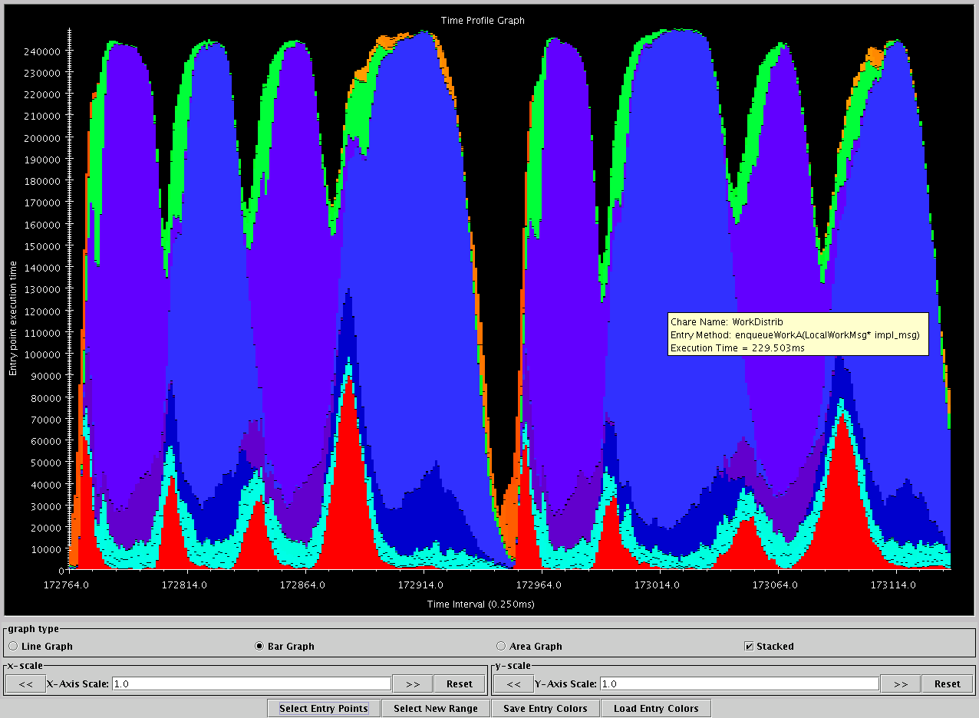
94% efficiency
Projections: Charm++ Performance Analysis Tool
started with 1994 dissertation of Amitabh Sinha
Shallow valleys, high peaks, nicely overlapped PME
green: communication
Red: integration
Blue/Purple: electrostatics
Orange: PME
turquoise: angle/dihedral
Apo-A1, on BlueGene/L, 1024 procs
Time intervals on X axis, activity added across processors on Y axis

Slide 26
Structured dagger
Triggered by the abstraction needs coming from the CFD work and NAMD
A notation (Script-like) for expressing internal dependencies and allowable concurrencies within an object

Slide 27
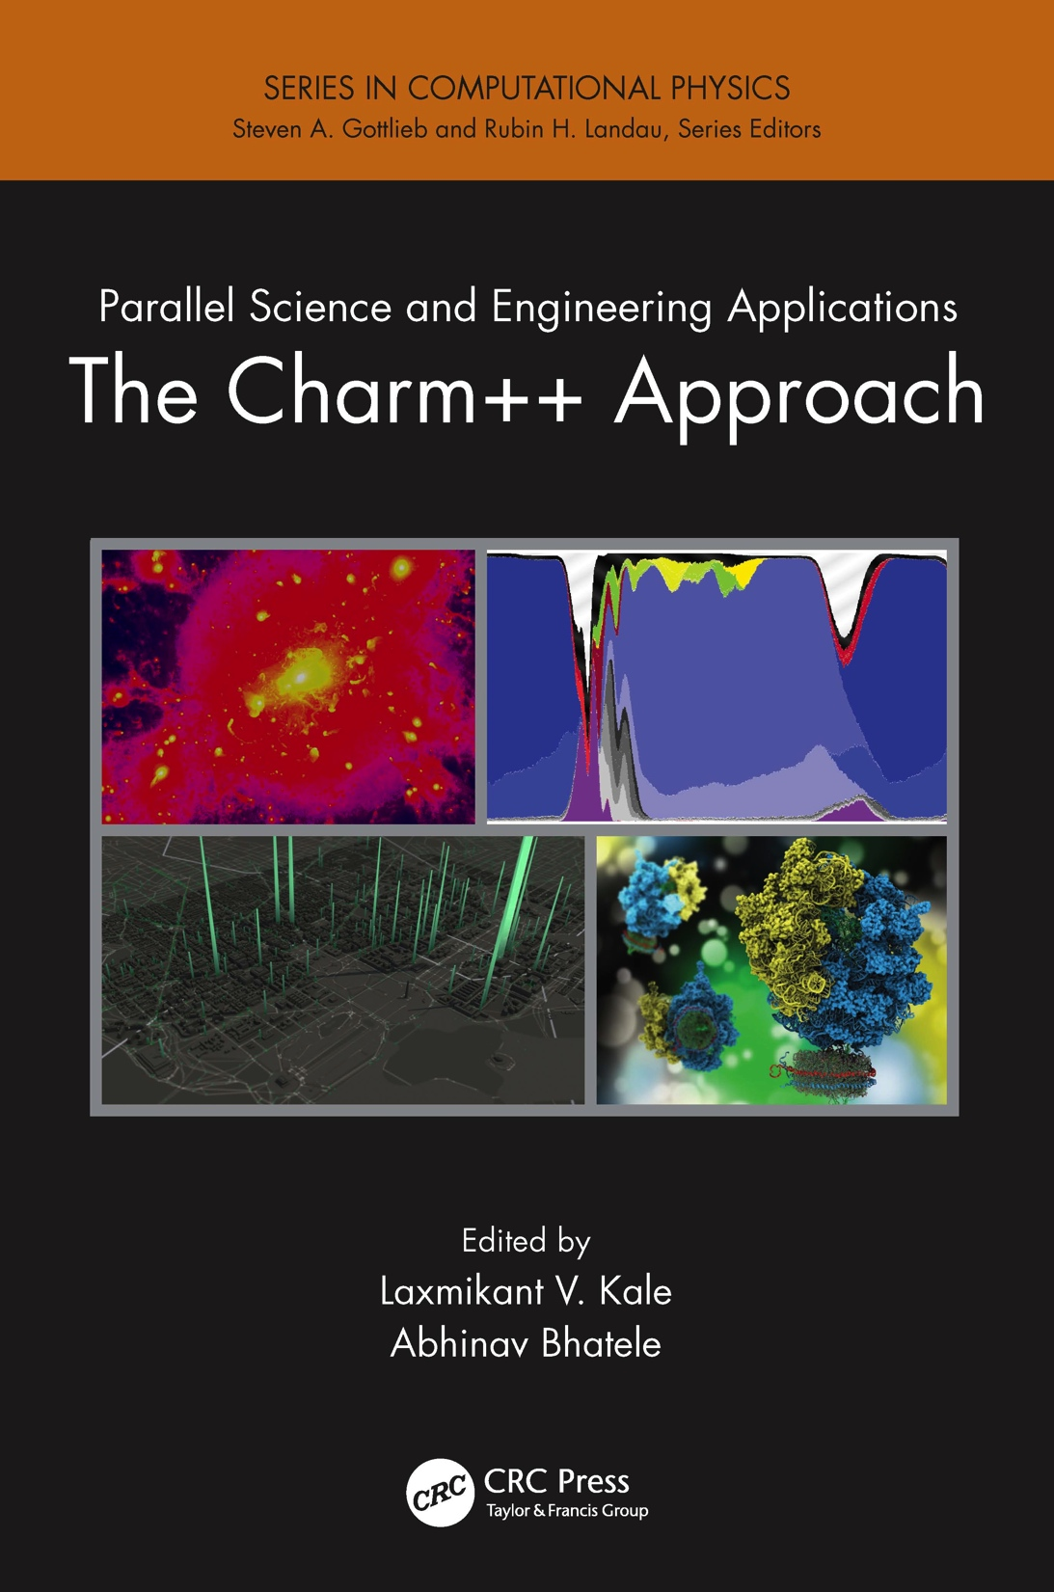
An upcoming book
Surveys seven major applications developed using Charm++

Slide 28
Conclusion
It has been an exhilarating journey
  May be a bit slow and plodding
  Or may be contemplative
Challenges for NAMD
  Strong scaling: take time-per-step < 100 us
  Use of accelerators
Challenges for Charm++
  Exascale: much research needed
  Deploy at Midscale and on Clouds
  Adoption
The journey continues
Paper: Charm++ and NAMD performance on Cray’s uGNI:
  Yanhua Sun, Today from 2:00-2:30PM in 355-EF
Charm++ BoF, Thursday 12:15-1:15, 255A

