Slide 1


Composable and modular Exascale Programming Models with intelligent runtime systems:
To Virtualize or Not?!
Of course, virtualize
Laxmikant (Sanjay) Kale
http://charm.cs.illinois.edu
Parallel Programming Laboratory
Department of Computer Science
University of Illinois at Urbana Champaign

Slide 2
Observations: exascale machines
Just restating, with a bit of my take added
Many (1000+) cores in a “node”
Heterogeneous cores:
  specialization saves energy
  Possibly reconfigurable hardware
Main reason for accelerators:
  “cache” idea had outlived its utility
  So: explicit control over data movement
    Scratchpad memories a la Cell, GPGPU, ..
  Hardware context switches for tolerating latency
Communication challenges: variable speeds?

Slide 3
Application Segmentation
We may have to specialize architectures to classes of applications
  Two dimensions: memory-per-core, bisection bandwidth
  Of the 4 quadrants formed, more than 1 are populated by real apps, I think
  We can design *very* different machines for each class
    E.g. For many apps we may need to go to a machine design with (say) no external DRAM. Use all the pins for communication.., and say use a simple grid network.
We need a serious study of applications
  Emphasizing exascale problem instances
  Use something like BigSim to do parametric studies to quantify needs of application

Slide 4
Observations: Exascale applications
Development of new models must be driven by the needs of exascale applications
  Multi-resolution
  Multi-module (multi-physics)
  Dynamic/adaptive : to handle application variation
  Adapt to a volatile computational environment
  Exploit heterogeneous architecture
So? Consequences:
  Must support automated resource management
  Must support interoperability and parallel composition

Slide 5
Decomposition Challenges
Current method is to decompose to processors
  But this has many problems
  deciding which processor does what work in detail is difficult at large scale
Decomposition should be independent of number of processors
  Our design principle since early 1990’s
    (in Charm++ and AMPI)

Slide 6
Processors vs “WUDU”s
Eliminate “processor” from programmer’s vocabulary
  Well, almost
Decomposition into:
  Work-Units and Data Units (WUDUs)
  Work-units: code, one or more data units
  Data-units: sections of arrays, meshes, ..
  Amalgams:
    Objects with associated work-units,
    Threads with own stack and heap
Who does decomposition?
  Programmer, compiler, or both

Slide 7
Different kinds of units
Migration units:
  objects, migratable threads (i.e. “processes”), data sections
DEBs: units of scheduling
  Dependent Execution Block
  Begins execution after one or more (potentially) remote dependence is satisfied
SEBs: units of analysis
  Sequential Execution Blocks
  A DEB is partitioned into one or more SEBs
  Has a “reasonably large” granularity, and uniformity in code structure
  Loop nests, functions, ..

Slide 8
Migratable objects programming model
Names for this model:
  Overdecompostion approach
  Object-based overdecomposition
  Processor virtualization
  Migratable-objects programming model

Slide 9
Empower Adaptive Runtime System
Decomposing program into a large number of WUDUs empowers the RTS, which can:
  Migrate WUDUs at will
  Schedule DEBS at will
  Instrument computation and communication at the level of these logical units
    WUDU x communicates y bytes to WUDU z every iteration
    SEB A has a high cache miss ratio
  Maintain historical data to track changes in application behavior
    E.g. to trigger load balancing

Slide 10
Over-decomposition and message-driven execution
Scalable Tools
Automatic overlap, pefetch, compositionality
Emulation for Perf Prediction
Migratability
Fault Tolerance
Introspective and adaptive runtime system
Dynamic load balancing (topology-aware, scalable)
Temperature/power considerations
Higher-level abstractions
Languages and Frameworks
Control Points

Slide 11
Utility for Multi-cores, Many-cores, Accelerators:
Objects connote and promote locality
Message-driven execution
  A strong principle of prediction for data and code use
  Much stronger than principle of locality
    Can use to scale memory wall:
    Prefetching of needed data:
      into scratch pad memories, for example
Scheduler
Scheduler
Message Q
Message Q
Notes:
Replace figure with a new drawing

Slide 12
Impact on communication
Current machines are over-engineered for communication by necessity:
  Compute-communicate cycles in typical MPI apps
  So, the network is used for a fraction of time,
  and is on the critical path
With overdecomposition (virtualization)
  Communication is spread over an iteration
  Also, adaptive overlap of communication and computation

Slide 13
Compositionality
It is important to support parallel composition
  For multi-module, multi-physics, multi-paradigm applications..
What I mean by parallel composition
  B || C where B and C are independently developed modules
  B is parallel module by itself, and so is C
  Programmers who wrote B were unaware of C
This is not supported well by MPI
  Developers support it by breaking abstraction boundaries
    E.g. wildcard recvs in module A to process messages for module B
  Nor by OpenMP implementations :

Slide 14
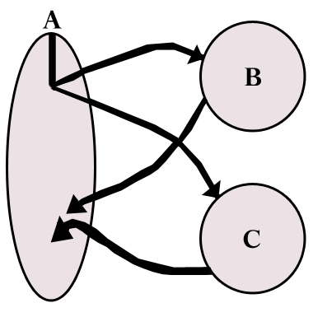
Without message-driven execution (and virtualization), you get either:
Space-division
B
C
Time
Notes:
Replace “scanned” diagram on the left with a better one, in all the slides that use this.

Slide 15
OR: Sequentialization
B
C
Time

Slide 16
Parallel Composition: A1; (B || C ); A2
  Recall: Different modules, written in different languages/paradigms, can overlap in time and on processors, without programmer having to worry about this explicitly

Slide 17
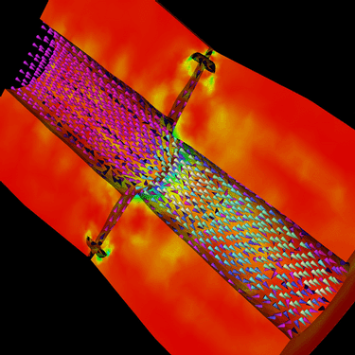
Decomposition Independent of numCores
Rocket simulation example under traditional MPI
With migratable-objects:
  Benefit: load balance, communication optimizations, modularity
Solid
Solid
. . .
Solid
Fluid
Fluid
Fluid
1 2 P
Solid₁
Solid₂
Solid₃
. . .
Solid_{n}
Fluid₁
Fluid₂
. . .
Fluid_{m}
Notes:
17
In traditional MPI paradigm. The number of partitions of both modules is typically equal to the number of processor P
And although the i’th elements of fluid module and solid module are not connected geometrically in the simulation, they are glued together on the I’th processor.
Under Charm++/AMPI framework, the two modules each get their own set of parallel objects. And the size of the arrays are not restricted or related.
The benefit of this is performance optimizations and better modularity.
Problem: due to the asynchronous method invocation, the flow of control is buried deep into the object code

Slide 18
Load Balancing
Static
  Irregular applications
  Programmer shouldn’t have to figure out ideal mapping
Dynamic:
  Applications are increasingly using adaptive strategies
  Abrupt refinements
  Continuous migration of work: e.g. particles in MD
Challenges:
  Performance limited by most overloaded processor
  The chance that one processor is severely overloaded gets higher as #processors increases
Migratable Objects Empower Automated Load Balancing!

Slide 19
Principle of Persistence
Once the computation is expressed in terms of its natural (migratable) objects
Computational loads and communication patterns tend to persist, even in dynamic computations
So, recent past is a good predictor of near future
In spite of increase in irregularity and adaptivity, this principle still applies at exascale, and is our main friend.
Notes:
19

Slide 20
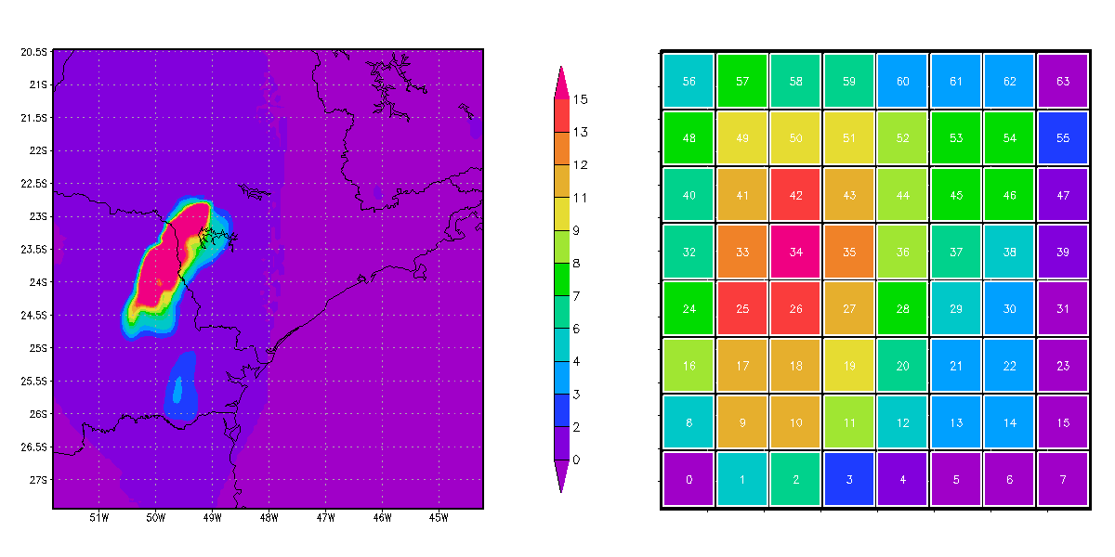
A quick Example:
Weather Forecasting in BRAMS
Brams: Brazillian weather code (based on RAMS)
AMPI version (Eduardo Rodrigues, with Mendes and J. Panetta)

Slide 21
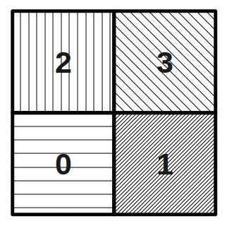
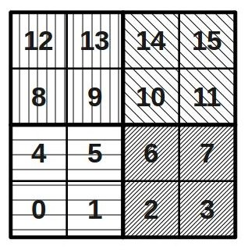
Basic Virtualzation of BRAMS

Slide 22
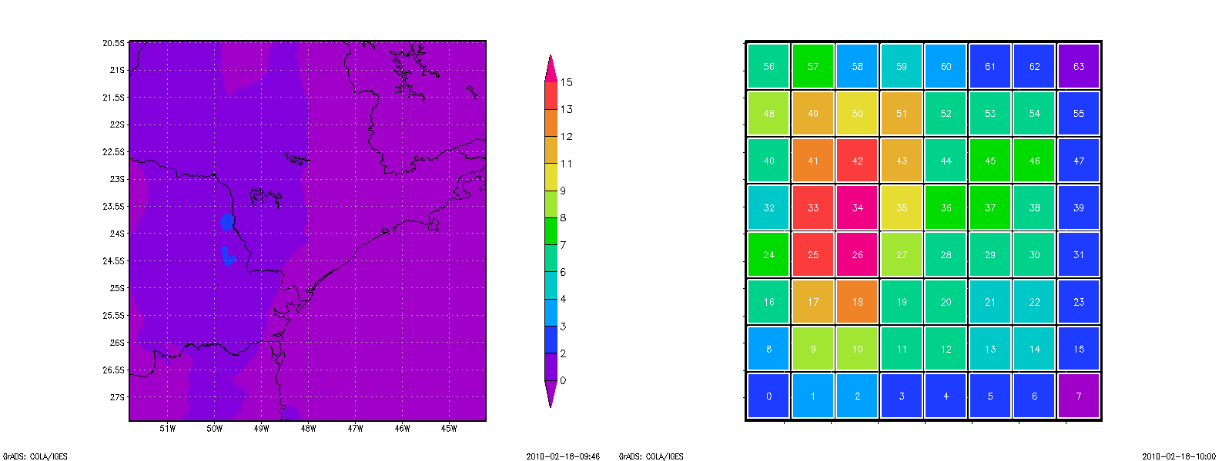


Slide 23
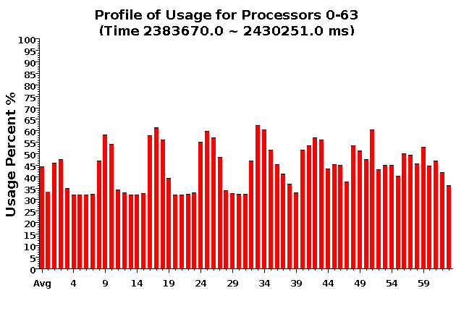
Baseline: 64 objects on 64 processors

Slide 24
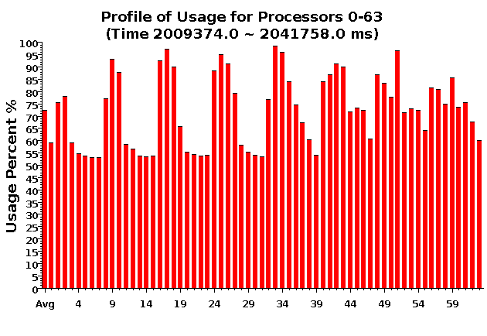
Over-decomposition: 1024 objects on 64 processors:
Benefits from communication/computation overlap

Slide 25
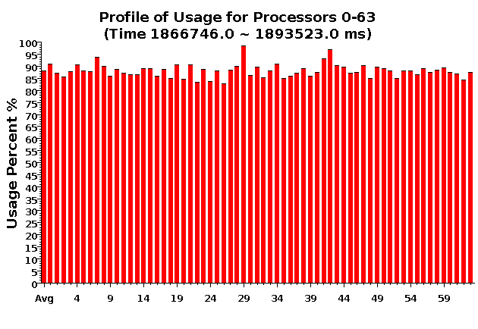
With Load Balancing:
1024 objects on 64 processors
No overdecomp (64 threads) | 4988 sec
Overdecomp into 1024 threads | 3713 sec
Load balancing (1024 threads) | 3367 sec

Slide 26
Load Balancing for Large Machines: I
Centralized balancers achieve best balance
  Collect object-communication graph on one processor
  But won’t scale beyond tens of thousands of nodes
Fully distributed load balancers
  Avoid bottleneck but… Achieve poor load balance
  Not adequately agile
Hierarchical load balancers
  Careful control of what information goes up and down the hierarchy can lead to fast, high-quality balancers
Need for a universal balancer that works for all applications

Slide 27
Load Balancing for Large Machines: II
Interconnection topology starts to matter again
  Was hidden due to wormhole routing etc.
  Latency variation is still small
  But bandwidth occupancy is a problem
Topology aware load balancers
  Some general heuristic have shown good performance
    But may require too much compute power
  Also, special-purpose heuristic work fine when applicable
  Still, many open challenges

Slide 28
Dealing with Thermal Variation
Some cores/chips might get too hot
  We want to avoid
    Running everyone at lower speed,
    Conservative (expensive) cooling
Reduce frequency (DVFS) of the hot cores?
  Works fine for sequential computing
  In parallel:
    There are dependences/barriers
    Slowing one core down by 40% slows the whole computation by 40%!
      Big loss when the #processors is large
Migratable Objects to the rescue!

Slide 29
Temperature-aware Load Balancing
Reduce frequency if temperature is high
  Independently for each core or chip
Migrate objects away from the slowed-down processors
  Balance load using an existing strategy
  Strategies take speed of processors into account
Recently implemented in experimental version
  SC 2011 paper

Slide 30
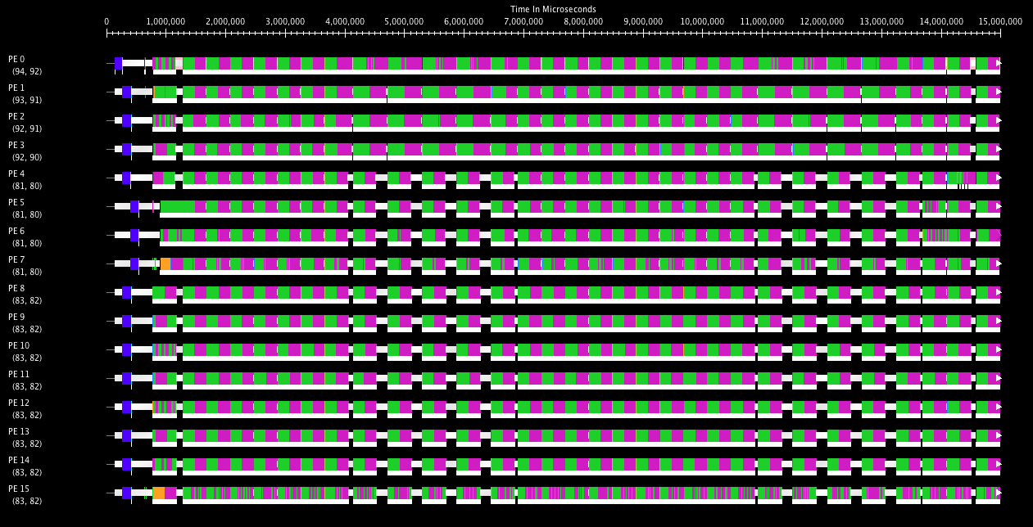
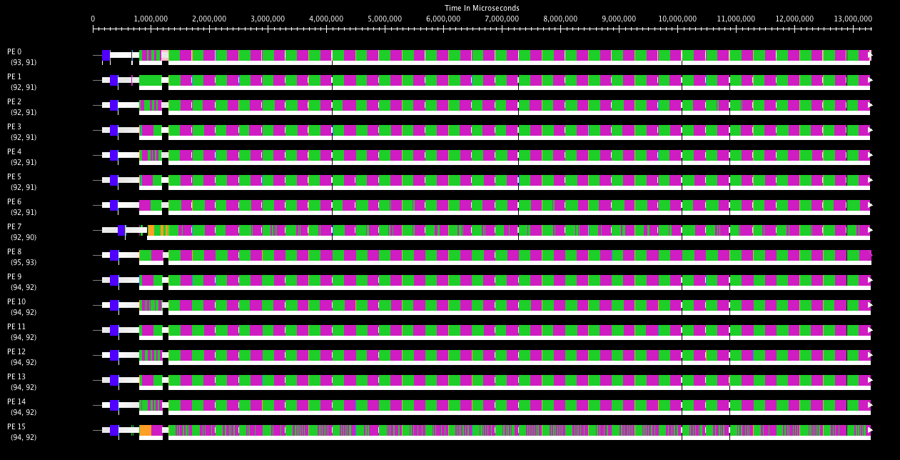
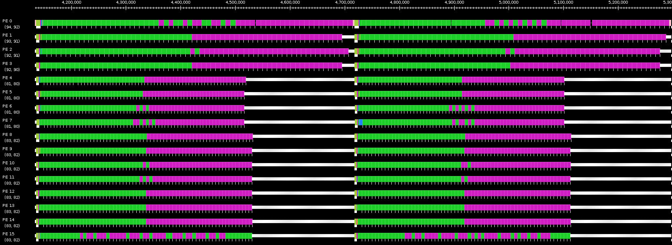
Benefits of Temperature Aware LB
Projections timeline without (top) and with (bottom) temperature aware LB
Zoomed projection timeline for two iterations without temperature aware LB

Slide 31
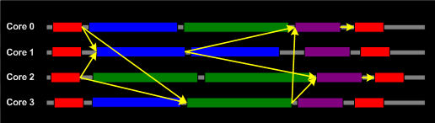
Other Power-related Optimizations
Other optimizations are in progress:
  Staying within given energy budget, or power budget
    Selectively change frequencies so as to minimize impact on finish time
  Reducing power consumed with low impact on finish time
    Identify code segments (methods) with high miss-rates
      Using measurements (principle of persistence)
    Reduce frequencies for those,
    and balance load with that assumption
  Use critical paths analysis:
    Slow down methods not on critical paths
    Aggressive: migrate critical-path objects to faster cores

Slide 32
Scalable Fault tolerance
Faults will be common at exascale
  Failstop, and soft failures are both important
Checkpoint-restart will not scale
  Requires all nodes to roll back even when just one fails
    Inefficient: computation and power
  As MTBF goes lower, it becomes infeasible

Slide 33
Message-Logging
Basic Idea:
  Messages are stored by sender during execution
  Periodic checkpoints still maintained
  After a crash, reprocess “recent” messages to regain state
Does it help at exascale?
  Not really, or only a bit: Same time for recovery!
With virtualization,
  work in one processor is divided across multiple virtual processors; thus, restart can be parallelized
  Virtualization helps fault-free case as well
Notes:
33

Slide 34
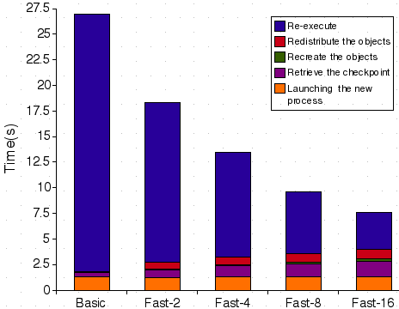
Message-Logging (cont.)
Fast Parallel restart performance:
  Test: 7-point 3D-stencil in MPI, P=32, 2 ≤ VP ≤ 16
  Checkpoint taken every 30s, failure inserted at t=27s
34
Notes:
34

Slide 35
Power
Power consumption is continuous
Normal Checkpoint-Resart method
Progress
Progress is slowed down with failures
Time

Slide 36
Power consumption is lower during recovery
Message logging + Object-based virtualization
Progress is faster with failures

Slide 37
Virtualization:
Pros, Cons, and Remedies
We examined the “Pro”s so far.
Cons and remedies:
  Memory in ghost layer increases
    Fuse local regions with compiler support
    Fetch one ghost layer at a time
    Hybridize (pthreads/openMP inside objects/DEBs)
  Less control over scheduling?
    i.e. too much asynchrony?
    But can be controlled in various ways by an observant RTS
  Too radical and new?
    Well, its working well for the past 10-15 years in multiple applications, via Charm++ and AMPI
  Too old?
    What can I say. May be we can invent a new name

Slide 38
New Programming Models
Simplify parallel programming, improve productivity
Two broad themes:
Frameworks
  Encapsulate common data-structure specific code
  Or domain specific code
  Avoids duplication/promotes reuse of expensive parallel software
Simpler but incomplete languages:
  Restricting modes of interactions among parallel entities leads to simpler languages
  Each language may be incomplete but:
    Addresses important subclasses of algorithms
    Together with other models, lead to a complete toolkit

Slide 39
Interoperability allows faster evolution of programming models
Evolution doesn’t lead to a single winner species, but to a stable and effective ecosystem.
Similarly, we will get to a collection of viable programming models that co-exists well together.

Slide 40
Compiler Support
Needed, but in a low-brow way
  Not for auto-parallelization
A basic compiler infrastructure
  Easy to extend
  Allows code restructuring
  Supports syntax that improves productivity
  Basic, well-understood analyses
    E.g. live-variables analysis for checkpointing
  Inserting Control-points to provide knobs to RTS
Rose?

Slide 41
Less-technical points
Where are the youngsters??
  We have a big problem for the field if young computer scientists are not joining this field
Need for dialogue:
  friendly, no-holds-barred, and extensive discussion among the 20 or so leading researchers in the field
  Feasible now, because most of us are senior (well ☺ ) researchers, in no need for jockeying, and facing the largest challenge of our times for this field

Slide 42
Summary
Do away with the notion of processors
  Adaptive Runtimes, enabled by migratable-objects programming model (aka virtualization)
    Are necessary at exascale
    Need to become more intelligent and introspective
    Help manage accelerators, balance load, tolerate faults,
Interoperability, concurrent composition become even more important
  Supported by virtualization
New programming models and frameworks
  Create an ecosystem/toolbox of programming paradigms rather than one “super” language
  Avoid premature standardization

