Slide 1


Techniques for effective Petascale Application Development based on adaptive runtime systems
Laxmikant (Sanjay) Kale
http://charm.cs.illinois.edu
Parallel Programming Laboratory
Department of Computer Science
University of Illinois at Urbana Champaign

Slide 2
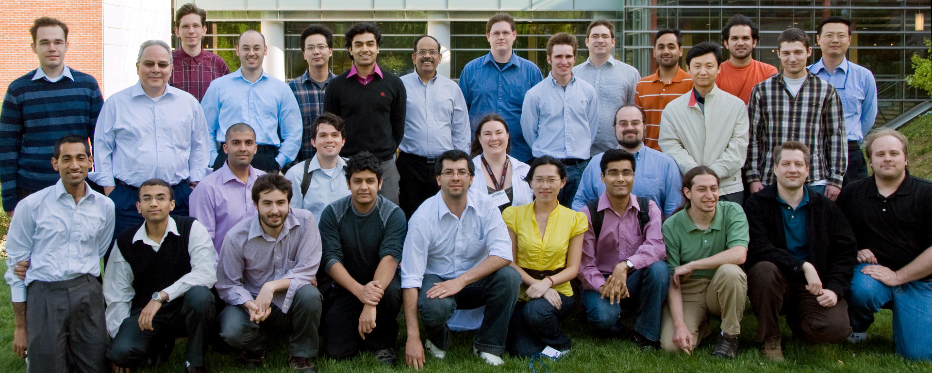
Parallel Programming Laboratory

Slide 3
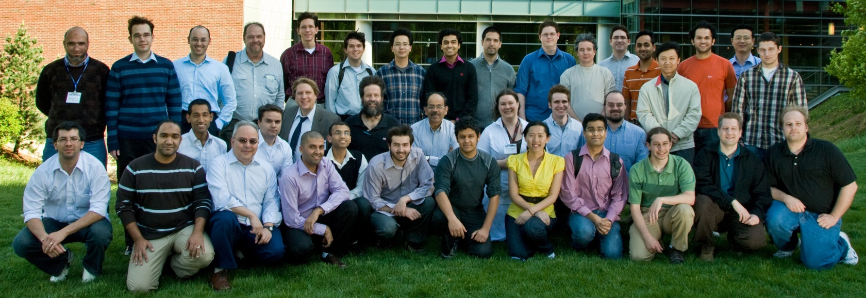
Parallel Programming Laboratory with Collaborators

Slide 4
Summarizing the State of Art
Petascale
  Very powerful but complex parallel computers are being built
  Application domains exist that need that kind of power
New generation of applications
  Use sophisticated algorithms
  Dynamic adaptive refinements
  Multi-scale, multi-physics
Challenge:
  Parallel programming is more complex than sequential
  Difficulty in achieving performance that scales to PetaFLOP/S and beyond
  Difficulty in getting correct behavior from programs
Notes:
4

Slide 5
Our Guiding Principles
No magic
  Parallelizing compilers have achieved close to technical perfection, but are not enough
  Sequential programs obscure too much information
Seek an optimal division of labor between the system and the programmer
Design abstractions based solidly on use-cases
  Application-oriented yet computer-science centered approach
L. V. Kale, “Application Oriented and Computer Science Centered HPCC Research”, Developing a Computer Science Agenda for High-Performance Computing, New York, NY, USA, 1994, ACM Press, pp. 98-105.
Notes:
5

Slide 6
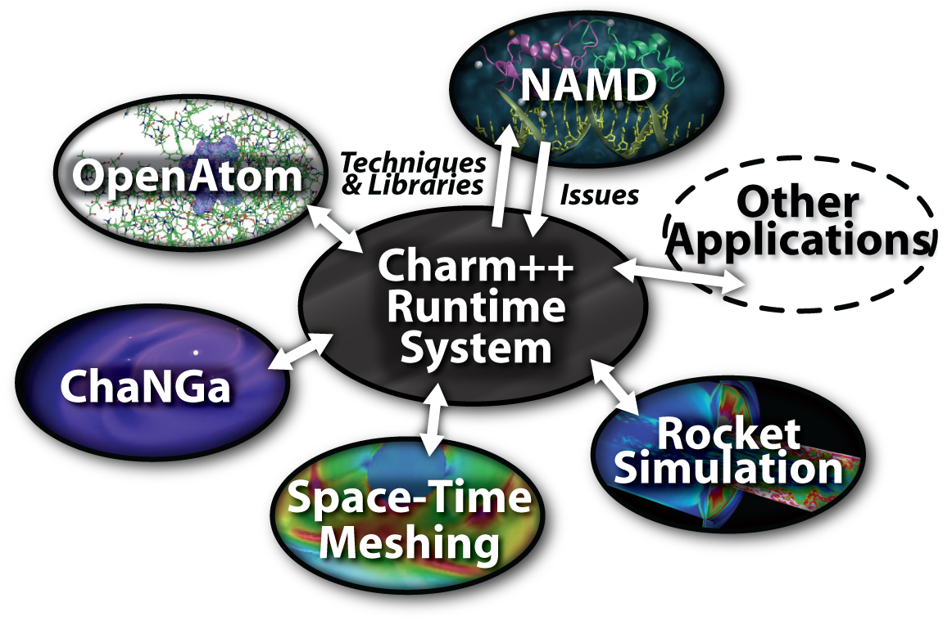
Charm++ and CSE Applications
Well-known Biophysics molecular simulations App
Gordon Bell Award, 2002
Nano-Materials..
Synergy
Enabling CS technology of parallel objects and intelligent runtime systems has led to several CSE collaborative applications
Computational Astronomy

Slide 7
A Glance at History
Precursors: Rediflow (Keller), Actors, ABCL (Yonezawa)
1987: Chare Kernel arose from parallel Prolog work
  Dynamic load balancing for state-space search, Prolog, ..
1992: Charm++
1994: Position Paper:
  Application Oriented yet CS Centered Research
  NAMD : 1994, 1996
Charm++ in almost current form: 1996-1998
  Chare arrays,
  Measurement Based Dynamic Load balancing
1997 : Rocket Center: a trigger for AMPI
2001: Era of ITRs:
  Quantum Chemistry collaboration: OpenAtom
  Computational Astronomy collaboration: ChaNGa
2008: Multicore meets Pflop/s, Blue Waters

Slide 8
Over-decomposition and message-driven execution
Scalable Tools
Automatic overlap, pefetch, compositionality
BigSim
Migratability
Fault Tolerance
Introspective and adaptive runtime system
Dynamic load balancing (topology-aware, scalable)
Temperature/power considerations
Higher-level abstractions
Charisma, MSA, CharJ
Control Points

Slide 9
Decomposition Challenges
Current method is to decompose to processors
  But this has many problems
  deciding which processor does what work in detail is difficult at large scale
Decomposition should be independent of number of processors
  Berkeley white paper recently discovered this
  Our design principle since early 1990’s.

Slide 10
Challenge: Compositionality
It is important to support compositionality
  For multi-module, multi-physics, multi-paradigm applications..
What I mean by parallel composition
  B || C where B and C are independently developed modules
  B is parallel module by itself, and so is C
  Programmers who wrote B were unaware of C
This is not supported well by MPI
  Developers support it by breaking abstraction boundaries
    E.g. wildcard recvs in module A to process messages for module B
  Nor by OpenMP implementations :

Slide 11
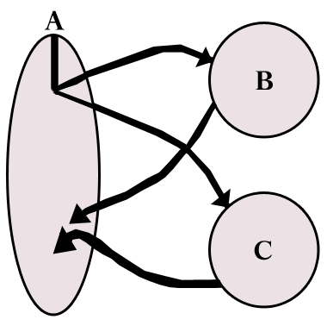
Without message-driven execution (and virtualization), you get either:
Space-division
B
C
Time
Notes:
Replace “scanned” diagram on the left with a better one, in all the slides that use this.

Slide 12
OR: Sequentialization
B
C
Time

Slide 13
Object Based Over-decomposition
Let
  the programmer decompose computation into objects
    Work units, data-units, composites
  Let an intelligent runtime system assign objects to processors
  RTS can change this assignment (mapping) during execution
Locality of data references is a critical attribute for performance
  A parallel object can access only its own data
  Asynchronous method invocation for accessing other’s data

Slide 14
Object Based Over-decomposition: Charm++
Multiple “indexed collections” of C++ objects
Indices can be multi-dimensional and/or sparse
Programmer expresses communication between objects
  with no reference to processors
System implementation
User View

Slide 15
Object Based Over-decomposition: AMPI
Each MPI process is implemented as a user-level thread
Threads are light-weight and migratable!
  <1 microsecond context switch time, potentially >100k threads per core
Each thread is embedded in a charm++ object (chare)
MPI processes
Virtual Processors (user-level migratable threads)
Real Processors

Slide 16
Over-decomposition and message-driven execution
Automatic overlap, pefetch, compositionality

Slide 17
Utility for Multi-cores, Many-cores, Accelerators:
Objects connote and promote locality
Message-driven execution
  A strong principle of prediction for data and code use
  Much stronger than principle of locality
    Can use to scale memory wall:
    Prefetching of needed data:
      into scratch pad memories, for example
Scheduler
Scheduler
Message Q
Message Q
Notes:
Replace figure with a new drawing

Slide 18
Parallel Decomposition and Processors
MPI-style encourages
  Decomposition into P pieces, P: #PEs
  If your natural decomposition is a cube, P must be a cube!
Charm++/AMPI style “virtual processors”
  Decompose into natural objects of the application
  Let the runtime map them to processors
  Decouple decomposition from load balancing

Slide 19
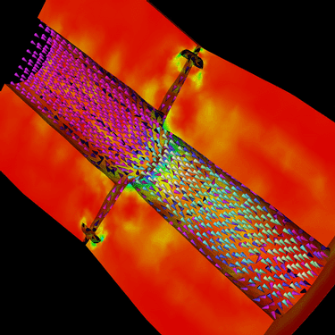
Decomposition Independent of numCores
Rocket simulation example under traditional MPI
With Charm++/AMPI
  Benefit: load balance, communication optimizations, modularity
Solid
Solid
. . .
Solid
Fluid
Fluid
Fluid
1 2 P
Solid₁
Solid₂
Solid₃
. . .
Solid_{n}
Fluid₁
Fluid₂
. . .
Fluid_{m}
Notes:
19
In traditional MPI paradigm. The number of partitions of both modules is typically equal to the number of processor P
And although the i’th elements of fluid module and solid module are not connected geometrically in the simulation, they are glued together on the I’th processor.
Under Charm++/AMPI framework, the two modules each get their own set of parallel objects. And the size of the arrays are not restricted or related.
The benefit of this is performance optimizations and better modularity.
Problem: due to the asynchronous method invocation, the flow of control is buried deep into the object code

Slide 20
Parallel Composition: A1; (B || C ); A2
  Recall: Different modules, written in different languages/paradigms, can overlap in time and on processors, without programmer having to worry about this explicitly

Slide 21
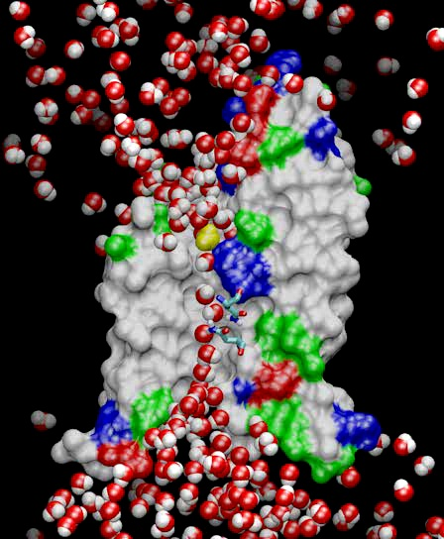
NAMD: A Production MD program
NAMD
Fully featured program
NIH-funded development
Distributed free of charge (~35,000 registered users)
Binaries and source code
Installed at supercomputing centers
User training and support
Large published simulations
Notes:
21

Slide 22
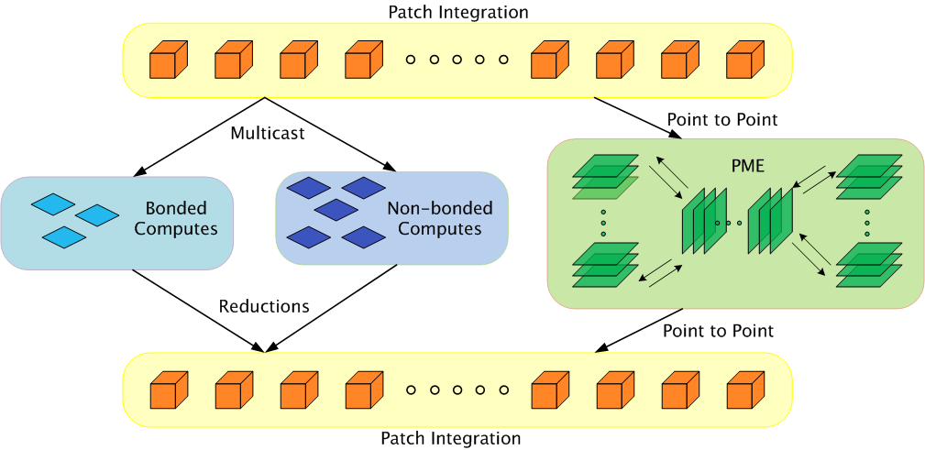
Parallelization Using Charm++
The computation is decomposed into “natural” objects of the application, which are assigned to processors by Charm++ RTS
Bhatele, A., Kumar, S., Mei, C., Phillips, J. C., Zheng, G. & Kale, L. V. 2008 Overcoming Scaling Challenges in Biomolecular Simulations across Multiple Platforms. In Proceedings of IEEE International Parallel and Distributed Processing Symposium, Miami, FL, USA, April 2008.

Slide 23
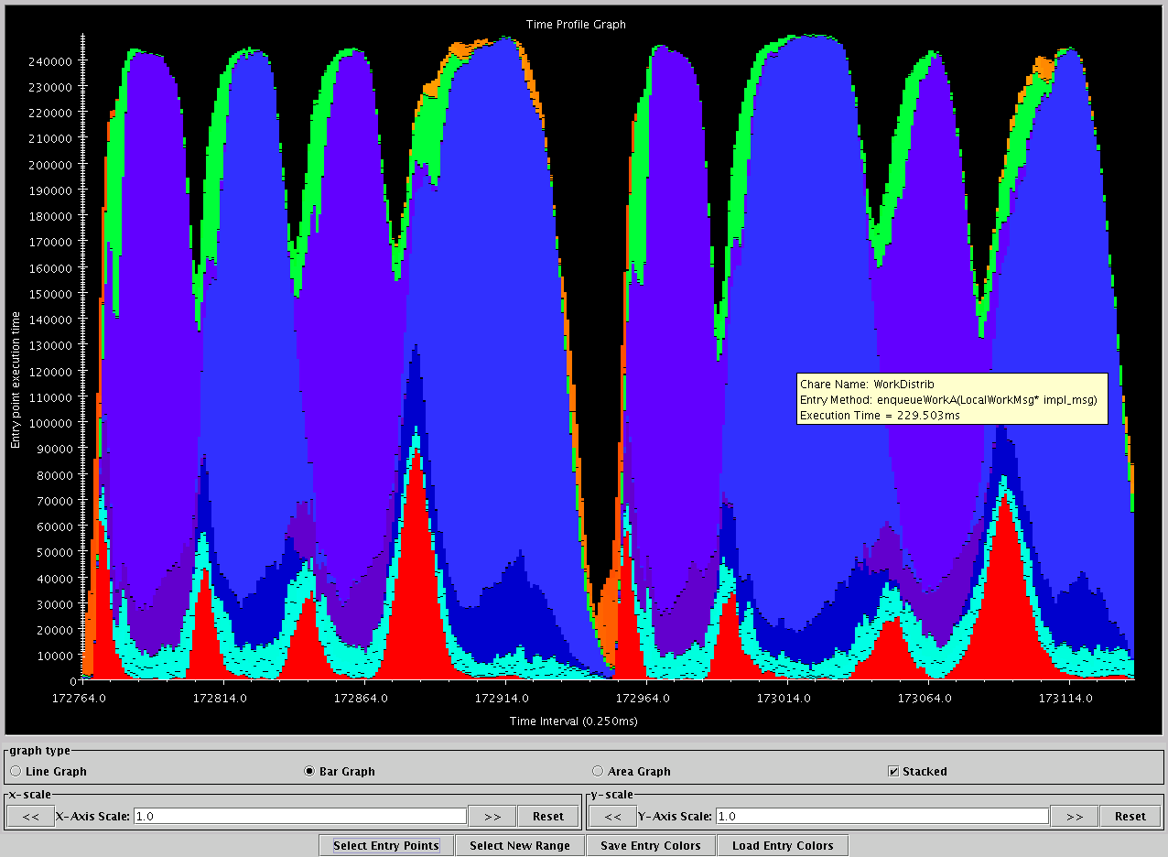
Apo-A1, on BlueGene/L, 1024 procs
Charm++’s “Projections” Analysis tool
Time intervals on x axis, activity added across processors on Y axis
green: communication
Red: integration
Blue/Purple: electrostatics
Orange: PME
turquoise: angle/dihedral
Time

Slide 24
Performance of NAMD
Blue Gene results based on work on DCMF many-to-many pattern by Sameer Kumar, IBM Research
Time (ms per step)
STMV: ~1 million atoms
ApoA1: ~92K atoms
No. of cores

Slide 25
Over-decomposition and message-driven execution
Scalable Tools
Automatic overlap, pefetch, compositionality
BigSim
Migratability
Fault Tolerance
Introspective and adaptive runtime system
Dynamic load balancing (topology-aware, scalable)
Temperature/power considerations

Slide 26
Challenge: Load Balancing
Static
  Irregular applications
  Programmer shouldn’t have to figure out ideal mapping
Dynamic:
  Applications are increasingly using adaptive strategies
  Abrupt refinements
  Continuous migration of work: e.g. particles in MD
Challenges:
  Performance limited by most overloaded processor
  The chance that one processor is severely overloaded gets higher as #processors increases
Migratable Objects Empower Automated Load Balancing!

Slide 27
Principle of Persistence
Once the computation is expressed in terms of its natural (migratable) objects
Computational loads and communication patterns tend to persist, even in dynamic computations
So, recent past is a good predictor of near future
Notes:
27

Slide 28
Measurement-based Load Balancing
Regular Timesteps
Detailed, aggressive Load Balancing
Instrumented Timesteps
Refinement Load Balancing

Slide 29

ChaNGa: Parallel Gravity
Evolution of Universe and Galaxy Formation
Collaborative project (NSF)
  with Tom Quinn, Univ. of Washington
Gravity, gas dynamics
Barnes-Hut tree codes
  Oct tree is natural decomp
  Geometry has better aspect ratios, so you “open” up fewer nodes
  But is not used because it leads to bad load balance
  Assumption: one-to-one map between sub-trees and PEs
  Binary trees are considered better load balanced
  With Charm++: Use Oct-Tree, and let Charm++ map subtrees to processors

Slide 30
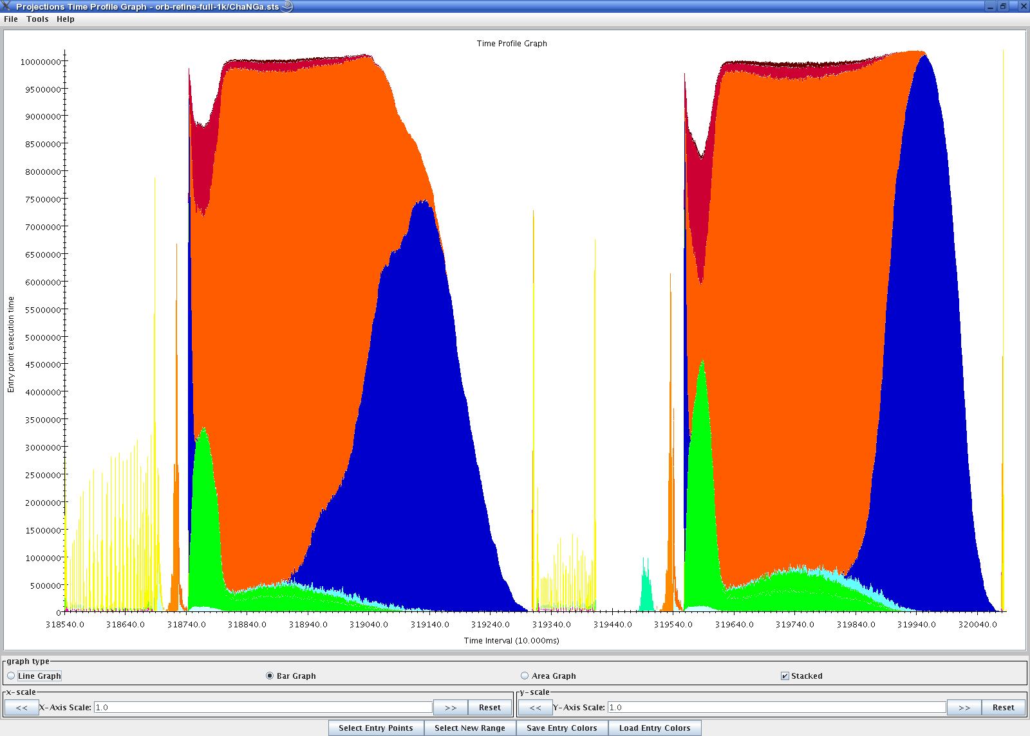
Load Balancing with OrbRefineLB
dwarf 5M on 1,024 BlueGene/L processors
5.6s
5.0s
Need sophisticated balancers and ability to choose the right ones automatically

Slide 31
ChaNGa Preliminary Performance
ChaNGa: Parallel Gravity Code
Developed in Collaboration with Tom Quinn (Univ. Washington) using Charm++

Slide 32
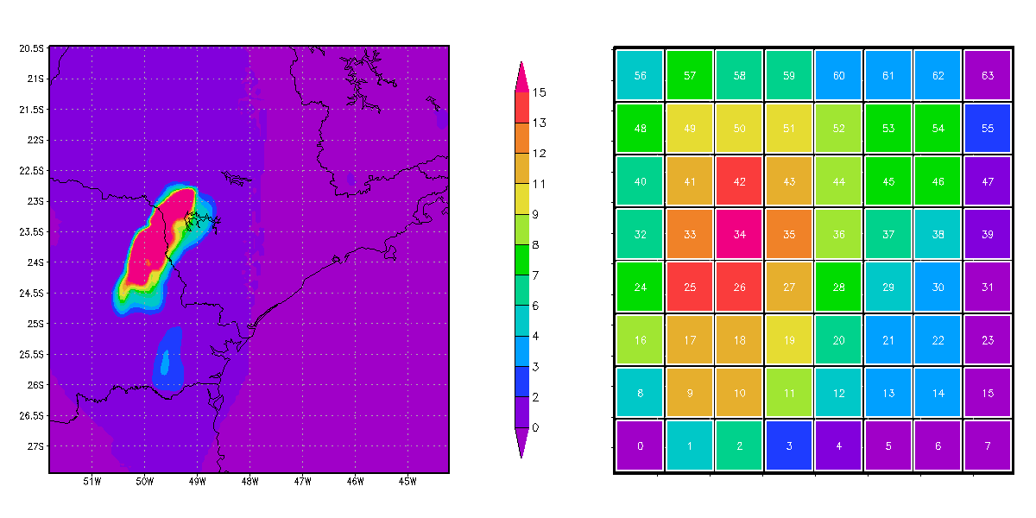
Another Example:
Weather Forecasting in BRAMS
Brams: Brazillian weather code (based on RAMS)
AMPI version (Eduardo Rodriegez, with Mendes and J. Panetta)

Slide 33
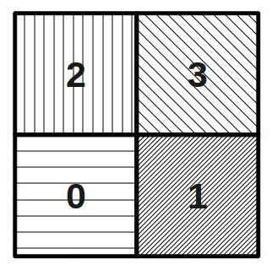
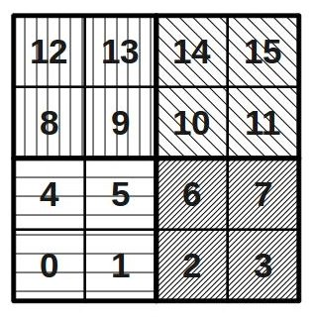
Basic Virtualzation of BRAMS

Slide 34
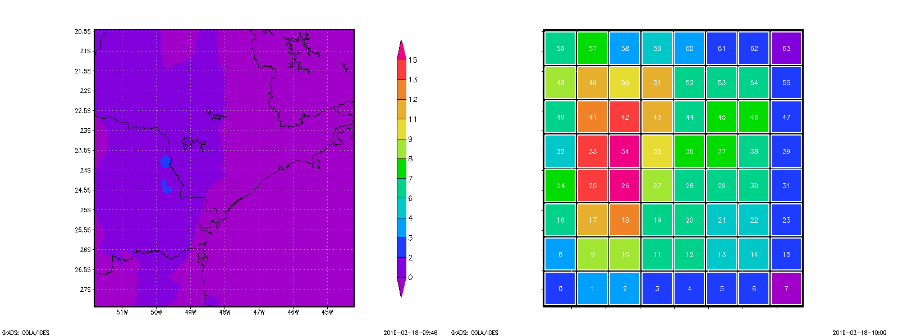


Slide 35
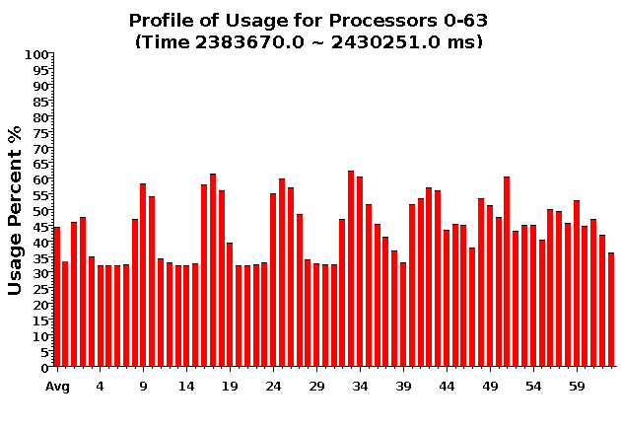
Baseline: 64 objects on 64 processors

Slide 36
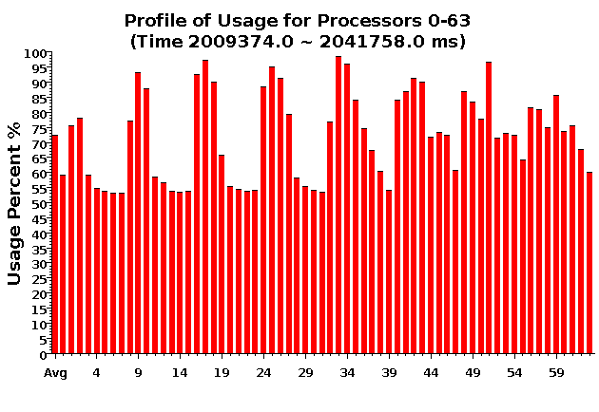
Over-decomposition: 1024 objects on 64 processors:
Benefits from communication/computation overlap

Slide 37
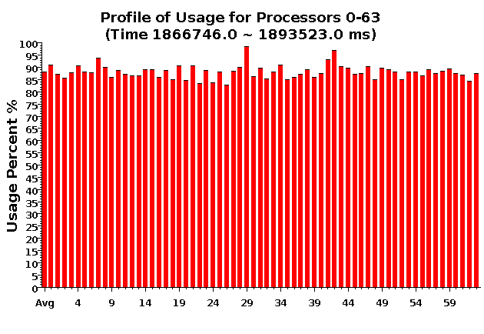
With Load Balancing:
1024 objects on 64 processors
No overdecomp (64 threads) | 4988 sec
Overdecomp into 1024 threads | 3713 sec
Load balancing (1024 threads) | 3367 sec

Slide 38
Load Balancing for Large Machines: I
Centralized balancers achieve best balance
  Collect object-communication graph on one processor
  But won’t scale beyond tens of thousands of nodes
Fully distributed load balancers
  Avoid bottleneck but… Achieve poor load balance
  Not adequately agile
Hierarchical load balancers
  Careful control of what information goes up and down the hierarchy can lead to fast, high-quality balancers
Need for a universal balancer that works for all applications

Slide 39
Load Balancing for Large Machines: II
Interconnection topology starts to matter again
  Was hidden due to wormhole routing etc.
  Latency variation is still small
  But bandwidth occupancy is a problem
Topology aware load balancers
  Some general heuristic have shown good performance
    But may require too much compute power
  Also, special-purpose heuristic work fine when applicable
  Still, many open challenges

Slide 40
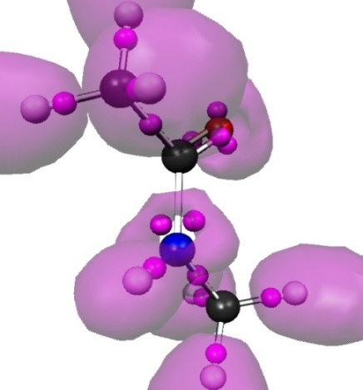
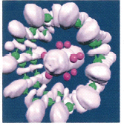
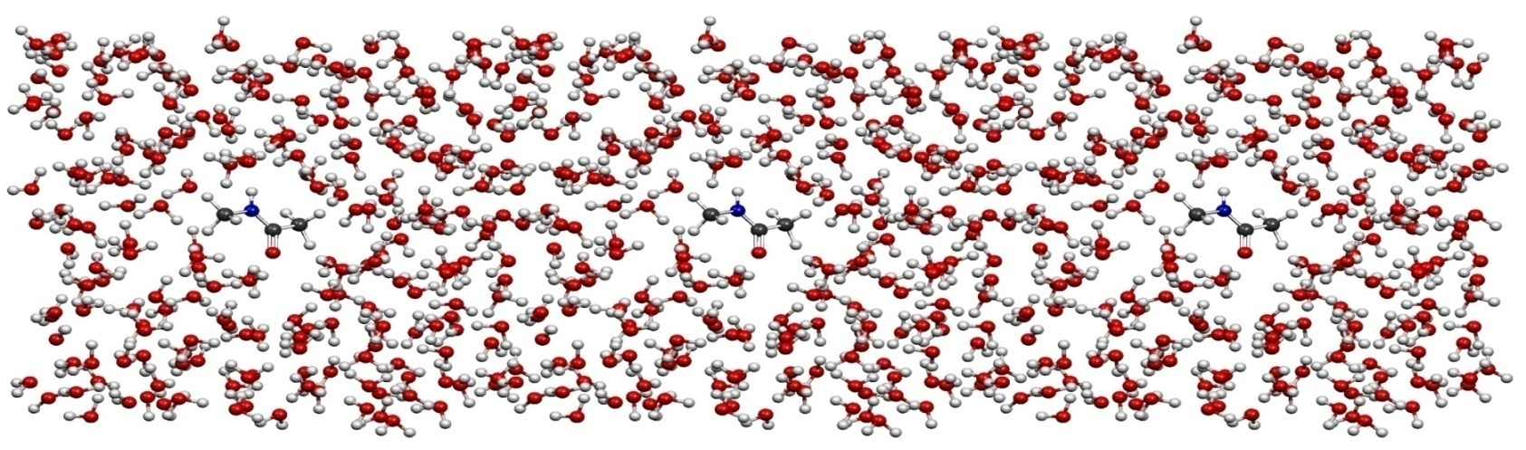
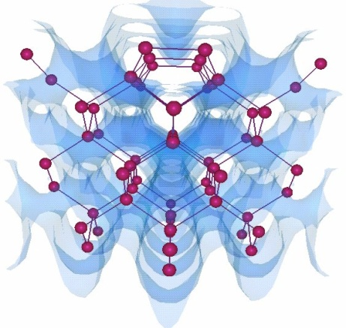
OpenAtom
Car-Parinello Molecular Dynamics
NSF ITR 2001-2007, IBM, DOE
Molecular Clusters :
Nanowires:
G. Martyna (IBM)
M. Tuckerman (NYU)
L. Kale (UIUC)
Semiconductor Surfaces:
3D-Solids/Liquids:
Using Charm++ virtualization, we can efficiently scale small (32 molecule) systems to thousands of processors

Slide 41
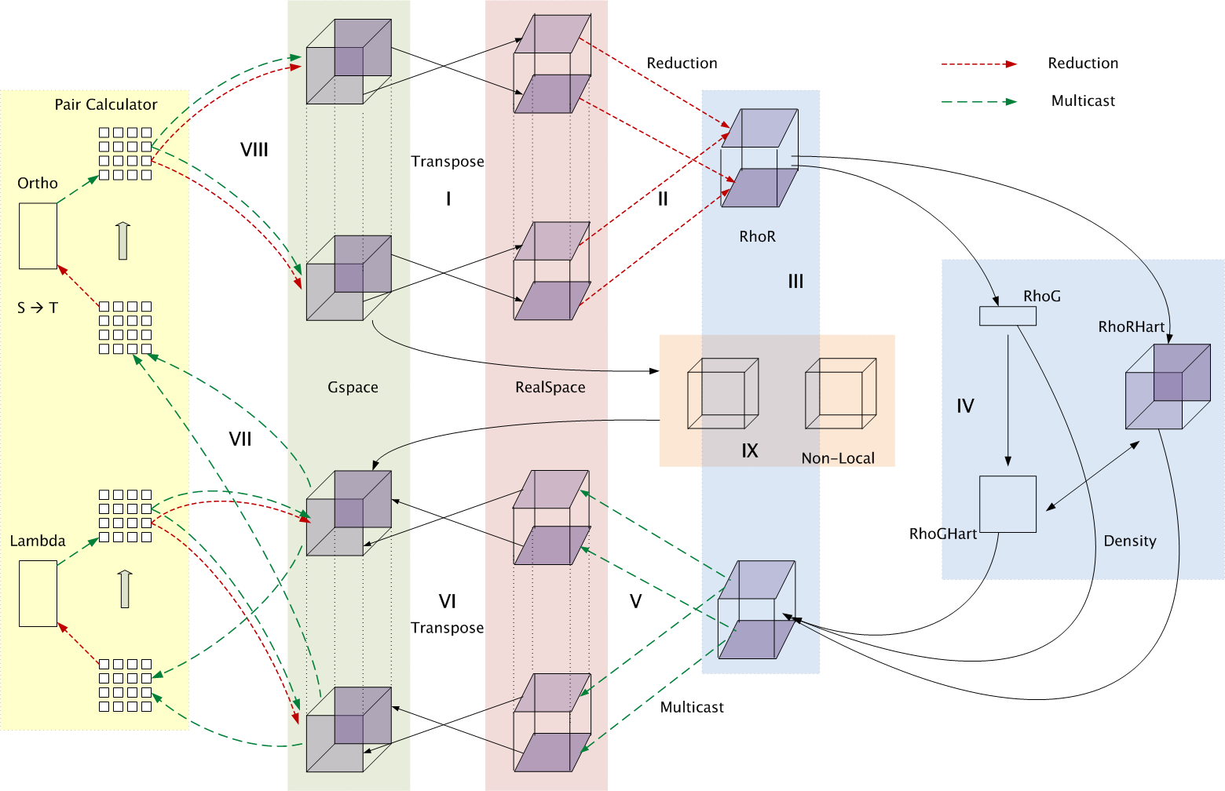
Decomposition and Computation Flow

Slide 42
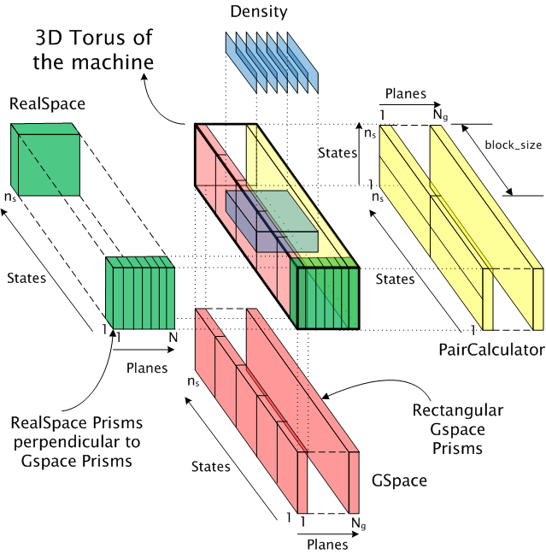
Topology Aware Mapping of Objects

Slide 43
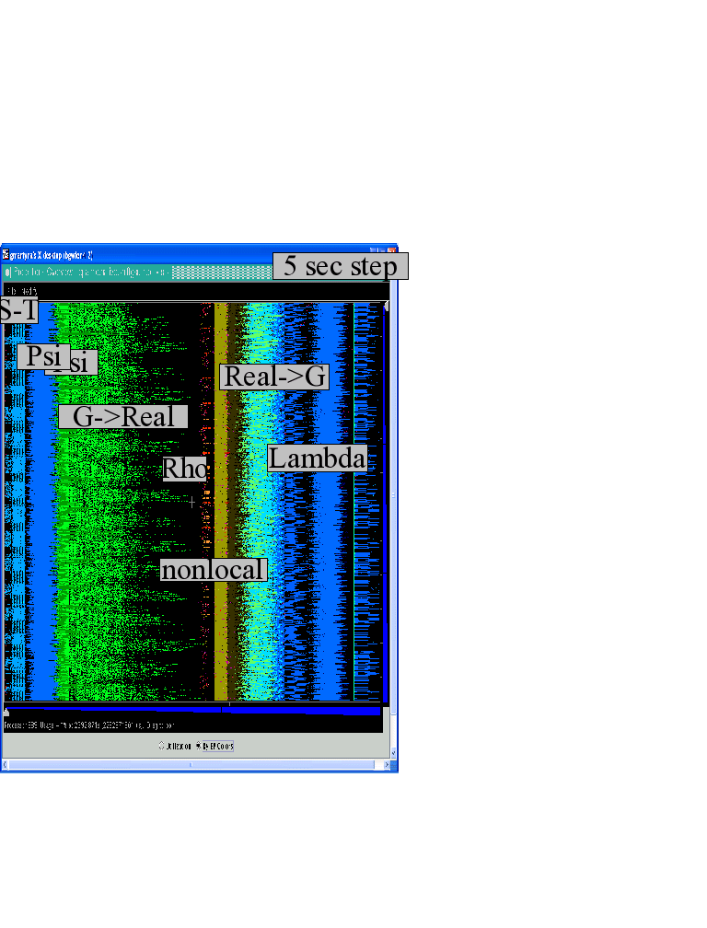
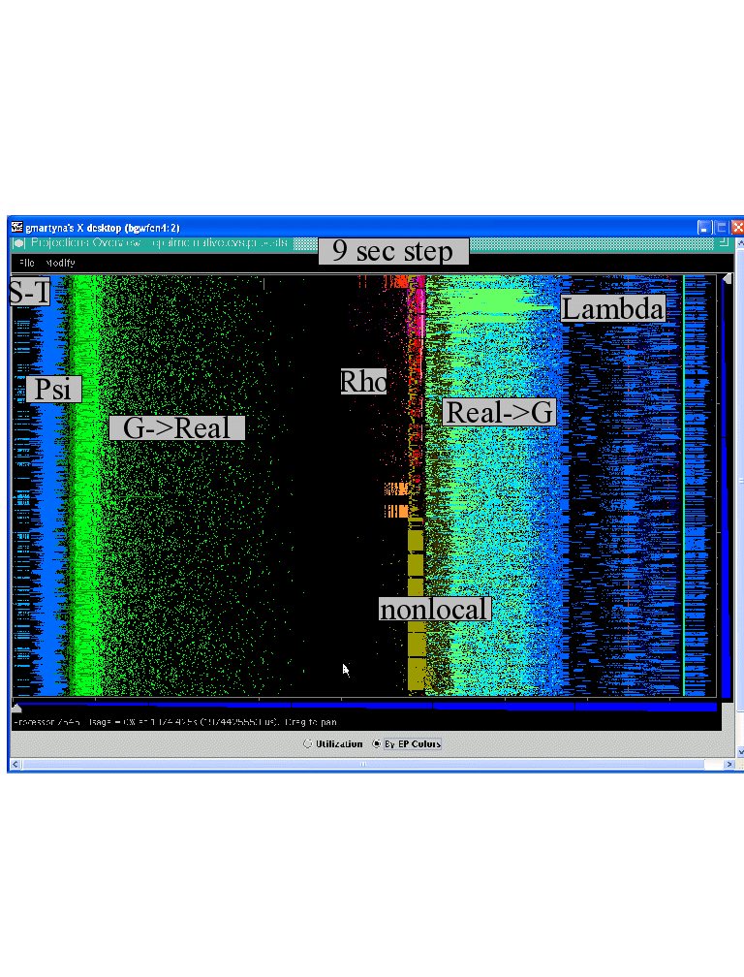

Improvements by topological aware mapping of computation to processors
Punchline: Overdecomposition into Migratable Objects created the degree of freedom needed for flexible mapping
The simulation of the right panel, maps computational work to processors taking the network connectivity into account while the left panel simulation does not. The “black’’ or idle time processors spent waiting for computational work to arrive on processors is significantly reduced at left. (256waters, 70R, on BG/L 4096 cores)

Slide 44
Over-decomposition and message-driven execution
Scalable Tools
Automatic overlap, pefetch, compositionality
BigSim
Migratability
Fault Tolerance
Introspective and adaptive runtime system
Dynamic load balancing (topology-aware, scalable)
Temperature/power considerations

Slide 45

Dealing with Thermal Variation
Some cores/chips might get too hot
  We want to avoid
    Running everyone at lower speed,
    Conservative (expensive) cooling
Reduce frequency (DVFS) of the hot cores?
  Works fine for sequential computing
  In parallel:
    There are dependences/barriers
    Slowing one core down by 40% slows the whole computation by 40%!
      Big loss when the #processors is large
Migratable Objects to the rescue!

Slide 46
Temperature-aware Load Balancing
Reduce frequency if temperature is high
  Independently for each core or chip
Migrate objects away from the slowed-down procs
  Balance load using an existing strategy
  Strategies take speed of processors into account
Recently implemented in experimental version
  IPDPS workshop paper

Slide 47
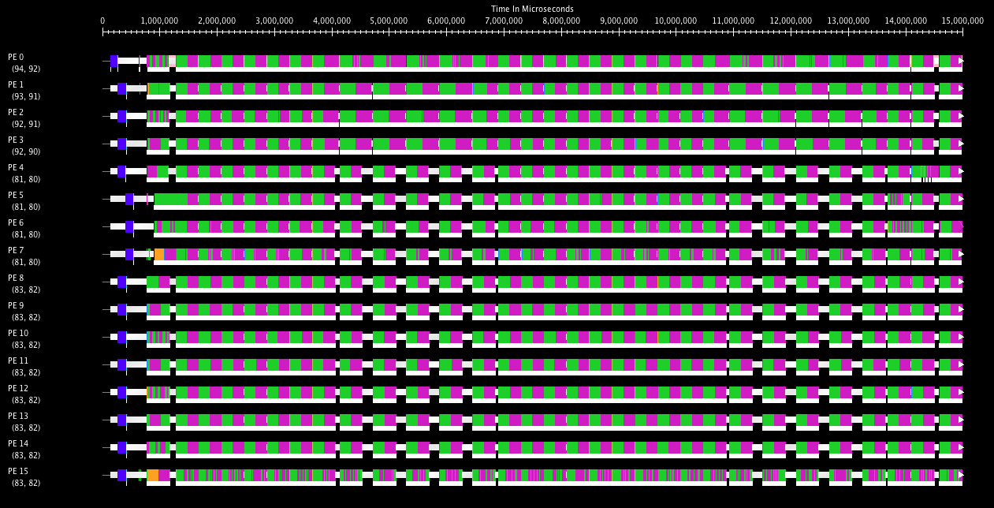
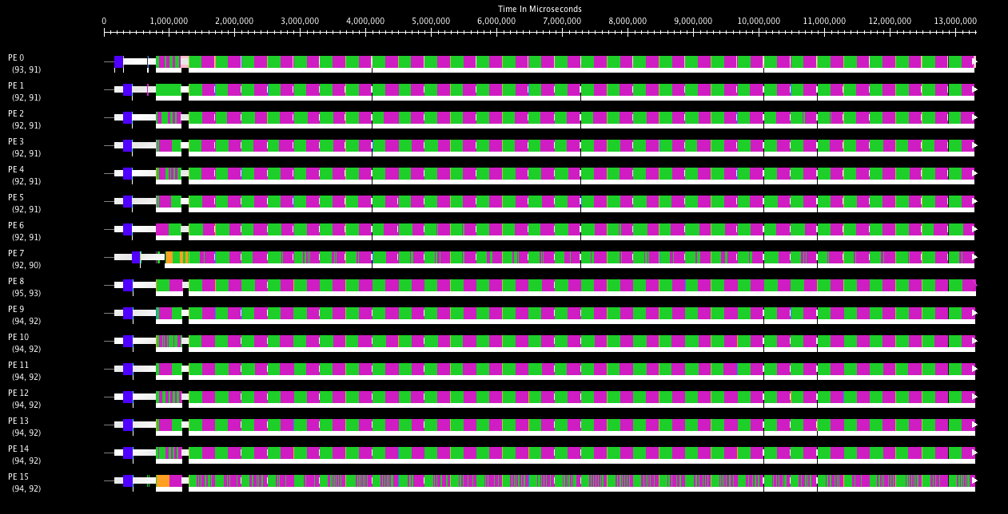
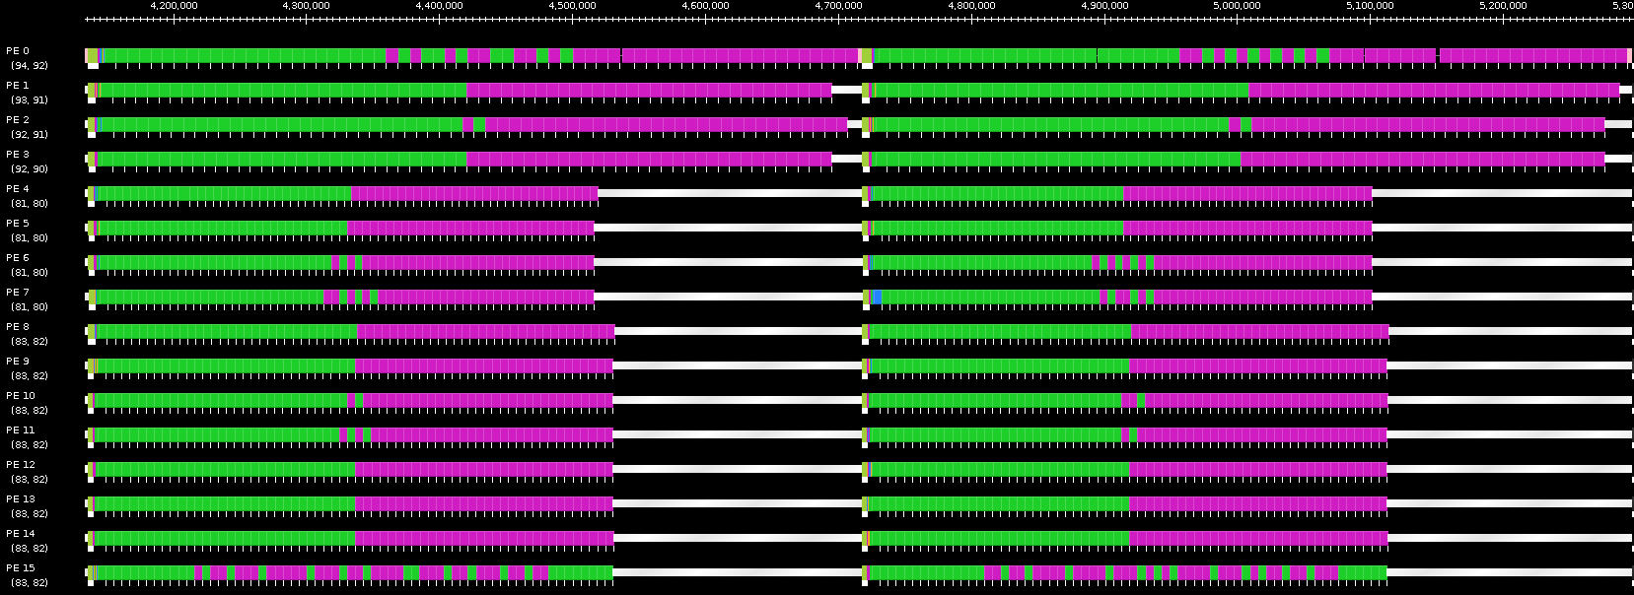
Benefits of Temperature Aware LB
Projections timeline without (top) and with (bottom) temperature aware LB
Zoomed projection timeline for two iterations without temperature aware LB

Slide 48
Other Power-related Optimizations
Other optimizations are in progress:
  Staying within given energy budget, or given power budget
    Selectively change frequencies so as to minimize impact on finish time
  Reducing power consumed with low impact on finish time
    Identify code segments (methods) with high miss-rates
      Using measurements (principle of persistence)
    Reduce frequencies for those,
    and balance load with that assumption
  Use critical paths analysis:
    Slow down methods not on critical paths
    More aggressive: migrate critical-path objects to faster cores

Slide 49
Over-decomposition and message-driven execution
Scalable Tools
Automatic overlap, pefetch, compositionality
BigSim
Migratability
Fault Tolerance

Slide 50
Fault Tolerance in Charm++/AMPI
Four Approaches Available:
  Disk-based checkpoint/restart
  In-memory double checkpoint/restart
  Proactive object migration
  Message-logging: scalable fault tolerance
Common Features:
  Easy checkpoint: migrate-to-disk
  Based on dynamic runtime capabilities
  Use of object-migration
  Can be used in concert with load-balancing schemes
Notes:
50

Slide 51
Message-Logging
Basic Idea:
  Messages are stored by sender during execution
  Periodic checkpoints still maintained
  After a crash, reprocess “recent” messages to regain state
Implementation in Charm++/AMPI:
  Since the state depends on the order of messages received, the protocol ensures that the new receptions occur in the same order
  Upon failure, roll back is “localized” around failing point: no need to roll back all the processors!
  With virtualization, work in one processor is divided across multiple virtual processors; thus, restart can be parallelized
  Virtualization helps fault-free case as well
Notes:
51

Slide 52
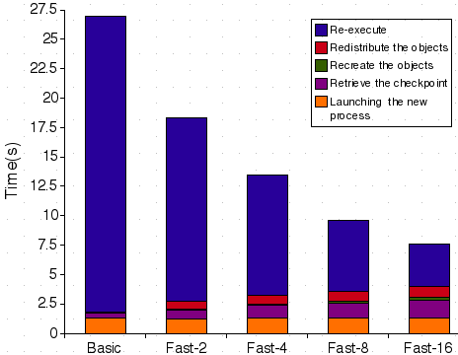
Message-Logging (cont.)
Fast Parallel restart performance:
  Test: 7-point 3D-stencil in MPI, P=32, 2 ≤ VP ≤ 16
  Checkpoint taken every 30s, failure inserted at t=27s
52
Notes:
52

Slide 53
Power
Normal Checkpoint-Resart method
Progress is slowed down with failures
Power consumption is continuous
Progress
Time

Slide 54
Our Checkpoint-Resart method
(Message logging + Object-based virtualization)
Progress is faster with failures
Power consumption is lower during recovery

Slide 55
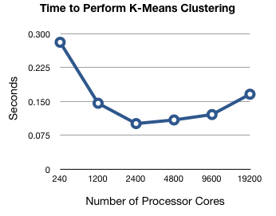
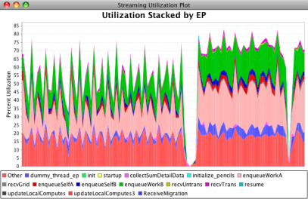
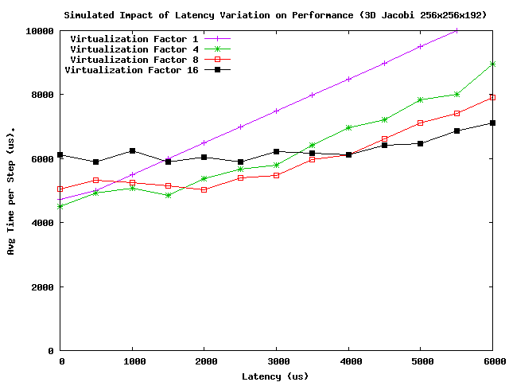
Scalable Performance Analysis
Scalable performance analysis idioms
  And tool support for them
Parallel performance analysis
  Use end-of-run when machine is available to you
  E.g. parallel k-means clustering
Live streaming of performance data
  stream live performance data out-of-band in user-space to enable powerful analysis idioms
What-if analysis using BigSim
  Emulate once, use traces to play with tuning strategies, sensitivity analysis, future machines
See: Chee Wai Lee et al, HIPS 2008, (and Chee Wai’s PhD thesis)
At http://charm.cs.illinois.edu./research/parallel_perf/

Slide 56
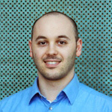
Challenge:
Scalable Debugging
See: Papers by Filippo Gioachin,
(and his Ph.D. thesis)
At http://charm.cs.illinois.edu/research/parallel_debug/

Slide 57
Challenge:
How to tune performance when
you don’t have access to
the machine at scale
See: BigSim project papers at http://charm.cs.illinois.edu
BigSim leverages object-based virtualization to support such tuning

Slide 58
Over-decomposition and message-driven execution
Scalable Tools
Automatic overlap, pefetch, compositionality
BigSim
Migratability
Fault Tolerance
Introspective and adaptive runtime system
Dynamic load balancing (topology-aware, scalable)
Temperature/power considerations
Higher-level abstractions
Charisma, MSA, CharJ

Slide 59
Raising the Level of Abstraction
What we have seen so far, will help:
  by automating resource management, FT, ..
But: parallel interactions are still low-level
Clearly, we need new programming models

Slide 60
Simplifying Parallel Programming
By giving up completeness!
  A paradigm may be simple, but
    not suitable for expressing all parallel patterns
    yet, if it can cover a significant classes of patterns (applications, modules), it is useful
  A collection of incomplete models, backed by a few complete ones, will do the trick
Our own examples: both outlaw non-determinism
  Multiphase Shared Arrays (MSA): restricted shared memory
    LCPC ‘04
  Charisma: Static data flow among collections of objects
    LCR’04, HPDC ‘07

Slide 61
MSA: Multiphase Shared Arrays
Observations:
  General shared address space abstraction is complex
  Certain special cases are simple, and cover most uses
In the simple model:
A program consists of
  A collection of Charm threads, and
  Multiple collections of data-arrays
    Partitioned into pages (user-specified)
Each array is in one mode at a time
  But its mode may change from phase to phase
Modes
  Write-once
  Read-only
  Accumulate
  Owner-computes
C
C
C
C
A
B

Slide 62
Charisma: Static Data Flow
Observation: many CSE applications or modules involve static data flow in a fixed network of entities
The amount of data may vary from iteration to iteration, but who talks to whom remains unchanged
Notes:
User code contains as little parallel control flow as possible, eg. Physics, computation,

Slide 63
Charisma: Sequential-Parallel Separation
Program consists of
  Orchestration (.or) code
    Global flow of control and data
  “Physics” code
    Regular C++
    User variables
    Sequential methods
parallel
parallel
modules
Sequential Modules
Notes:
User code contains as little parallel control flow as possible, eg. Physics, computation,

Slide 64
Charisma++ example (Simple)
  while (e > threshold)
    forall i in J
    <+e, lb[i], rb[i]> := J[i].compute(rb[i-1],lb[i+1]);

Slide 65
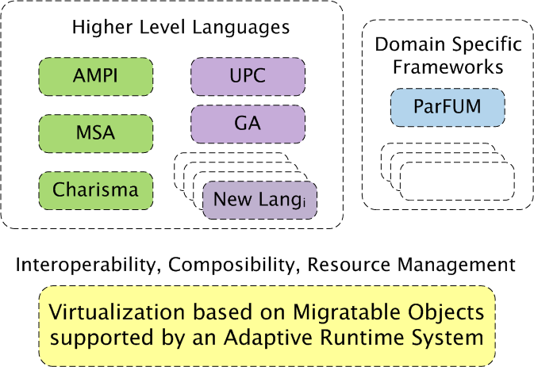
A View of an Interoperable Future
X10

Slide 66
Summary
Challenges in Resource management
    Decomposition and Compositionality
    Dynamic Load balancing
    Fault Tolerance
  Over-decomposition with Adaptive Runtime System helps
  Scalable Performance analysis, and debugging
  Early performance tuning ( BigSim)
Challenges in Raising the level of abstraction
  Via “Incomplete yet simple” paradigms, and
  domain-specific frameworks
  Supported by an interoperable runtime system
Exciting times ahead
More Info: http://charm.cs.illinois.edu/

