Slide 1
Hierarchical Load Balancing for Charm++ Applications on Large Supercomputers
Gengbin Zheng, Esteban Meneses,
Abhinav Bhatele and Laxmikant V. Kale
Parallel Programming Lab
University of Illinois at Urbana Champaign

Slide 2
Motivations
Load balancing is key to scalability on very large supercomputers
Load balancing becomes challenging
Increasing machine and problem size leads to more complex and costly load balancing algorithms
Considerable large amount of resource needed
Scale load balancing itself

Slide 3
Periodic Load Balancing
Perform load balancing periodically
E.g. stop and go scheme
Persistent tasks
Pay load balancing cost only when it is needed
Task and data migrate as needed

Slide 4
Charm++
Parallel C++
Objects with methods that can be called remotely
Migratable objects
Dynamic load balancing
Fault tolerance
An MPI implementation on Charm++

Slide 5
Principle of Persistence
Principle of Persistence
Once an application is expressed in terms of interacting objects, object communication patterns and computational loads tend to persist over time
In spite of dynamic behavior
Abrupt and large,but infrequent changes (e.g. AMR)
Slow and small changes (e.g. particle migration)
Parallel analog of principle of locality
Heuristics, that holds for most CSE applications

Slide 6
Measurement Based Load Balancing
Based on Principle of persistence
Runtime instrumentation (LB Database)
communication volume and computation time
Measurement based load balancers
Use the database periodically to make new decisions
Many alternative strategies can use the database
Centralized vs distributed
Greedy vs refinement
Taking communication into account
Taking dependencies into account (More complex)
Topology-aware

Slide 7
Load Balancing Strategies
Centralized
Object load data are sent to processor 0
Integrate to a complete object graph
Migration decision is broadcasted from processor 0
Global barrier
Distributed
Load balancing among neighboring processors
Build partial object graph
Migration decision is sent to its neighbors
No global barrier

Slide 8
Limitations of Centralized Strategies
Now consider an application with 1M objects on 64K processors
Limitations (inherently not scalable)
Central node - memory/communication bottleneck
Decision-making algorithms tend to be very slow

Slide 9
Load Balancing Execution Time
Execution time of load balancing algorithms on 1M tasks

Slide 10
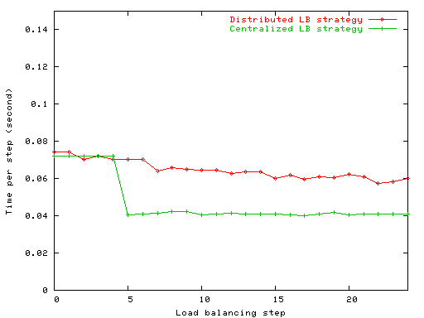
Limitations of Distributed Strategies
Each processor periodically exchange load information and migrate objects among neighboring processors
Performance improved slowly
Lack of global information
Difficult to converge quickly to as good a solution as a centralized strategy
Result with NAMD on 256 processors

Slide 11
A Hybrid Load Balancing Strategy
Dividing processors into independent sets of groups, and groups are organized in hierarchies (decentralized)
Aggressive load balancing in sub-groups, combined with
Refinement-based cross-group load balancing
Each group has a leader (the central node) which performs centralized load balancing
Reuse existing centralized load balancing

Slide 12
Hierarchical Tree (an example)
64K processor hierarchical tree
Level 2
1
Level 1
0
1024
63488
64512
64
Level 0
0
…
1023
1024
…
2047
…...
63488
…
64511
64512
…
65535
1024
Apply different strategies at each level
Notes:
Example
More aggressive one at low level
Take advantage of faster communication
Less aggressive one at higher level
Refine-based algorithm

Slide 13
Issues
Load data reduction
Semi-centralized load balancing scheme
Reducing data movement
Token-based local balancing
Topology-aware tree construction

Slide 14
Token-based HybridLB Scheme
Refinement-based Load balancing
1
Load Data
0
1024
63488
64512
Load Data (OCG)
0
…
1023
1024
…
2047
…...
63488
…
64511
64512
…
65535
Greedy-based Load balancing
token
object

Slide 15
Performance Study with Synthetic Benchmark
lb_test benchmark on Ranger Cluster (1M objects)
Notes:
1/64

Slide 16
Load Balancing Time (lb_test)
lb_test benchmark on Ranger Cluster

Slide 17
Performance (lb_test)
lb_test benchmark on Ranger Cluster

Slide 18
Performance Study with Synthetic Benchmark
lb_test benchmark on Blue Gene/P (1M objects)
Notes:
1/64

Slide 19
NAMD Hierarchical LB
NAMD implements its own specialized load balancing strategies
Based on Charm++ load balancing framework
Extended NAMD comprehensive and refinement-based solution
Work on subset of processors

Slide 20
NAMD LB Time

Slide 21
NAMD LB Time (Comprehensive)

Slide 22
NAMD LB Time (Refinement)

Slide 23
NAMD Performance

Slide 24
Conclusions
Load balancing is challenging and potentially costly on very large machines
Hierarchical load balancing is effective
Using 64K cores with synthetic benchmark
And 16K with real application

Slide 25
Thank you!
Any questions?

