Slide 1
Memory-Aware Scheduling for LU in Charm++
Isaac Dooley, Chao Mei, Jonathan Lifflander, Laxmikant V. Kale

Slide 2
Problem
Unrestricted parallelism may lead to a continuous increase of memory usage on a node
  e.g. LU lookahead
Previous solutions
  Statically restricting concurrency (HPL)
  Dynamically restrict, but also restrict some tasks (to eliminate deadlock) (Husbands and Yelick)

Slide 3
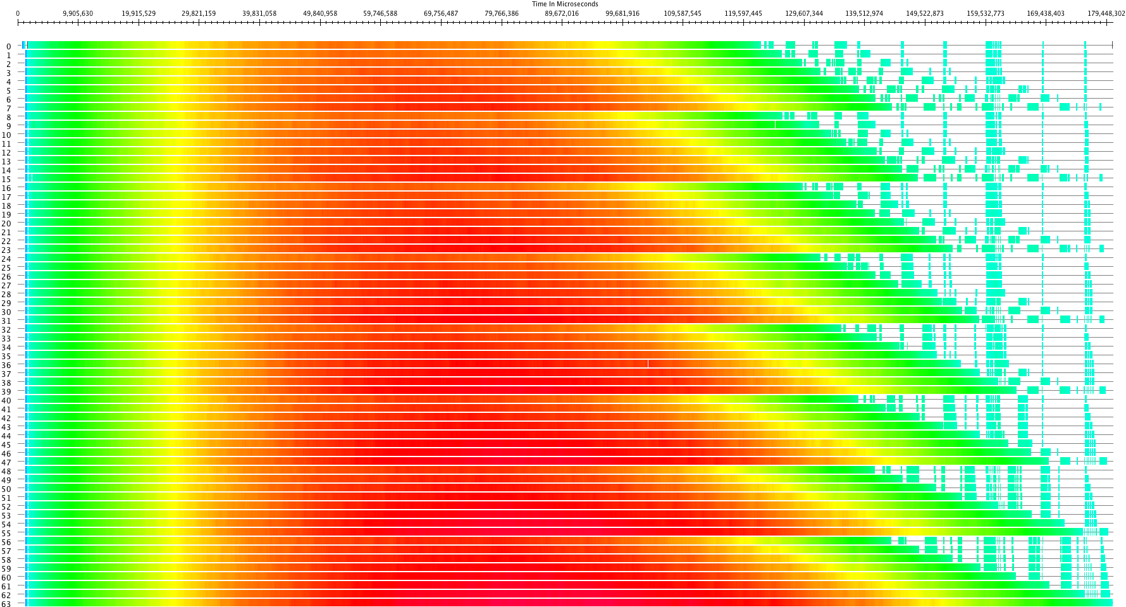
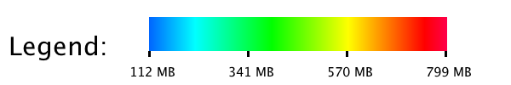
A timeline view, colored by memory usage, of an LU program run on 64 processors of BG/P using a Block-Cyclic Mapping for a N = 32768 sized matrix with 512 x 512 sized blocks. The traditional block-cyclic mapping suffers from limited concurrency at the end (the right portion of this plot). This is most problematic in small matrices.

Slide 4
Goal
Language runtime system should provide a mechanism to schedule for memory usage
  Adaptive runtime systems (RTS) are the future
Memory-aware scheduling is a case-study of one of the adaptive techniques that could be exploited in RTS
  Use Charm++ RTS as the framework to study such technique

Slide 5
Charm++ Essentials
Computation: expressed as a collection of objects that intreract via asynchronous method invocations
  RTS controls the mapping objects to PEs
  Adaptive techniques are naturally introduced
AMPI provides the same functions for MPI apps
  Schedulers in Charm++ RTS
  Queues with priorities

Slide 6
Memory-Aware Scheduling
In parallel interface file
  Tag entry method known to decrease memory with[memcritical]
  At runtime set a memory threshold
Scheduler
  When the threshold is reached:
    Perform linear scan of priority queues
    Schedule the first task known to reduce memory usage
    Repeat until the memory usage is below the threshold

Slide 7
Memory-Aware Scheduling
Overhead
  In LU program with N = 32768 x 32768 matrix, and 512 x 512 block size, average time spent in scheduler code is 0.0239 seconds
  LU factorization takes 168.4 seconds
  Negligible overhead of 0.014%

Slide 8
LU in Charm++
LU solve on diagonal
Broadcast of L and U across the row and column
Triangular solve for L and U in the row and column
Trailing updates for submatrix

Slide 9
Mapping Blocks to Processors
Block-cyclic mapping reduces concurrency at the end
  However, it decreases the cost of communication (by limiting the number of processors for each multicast across the row and column)
  For smaller matrices, another mapping scheme may perform better, due to better load balance (even if it involves more processors in the multicast)

Slide 10
Balanced Snake Mapping
Traverse in roughly decreasing amount of work
  As the diagram shows
Assign to processor which has been assigned the smallest amount of work so far
  Keep alist of processors and the amount of work each has been assigned

Slide 11
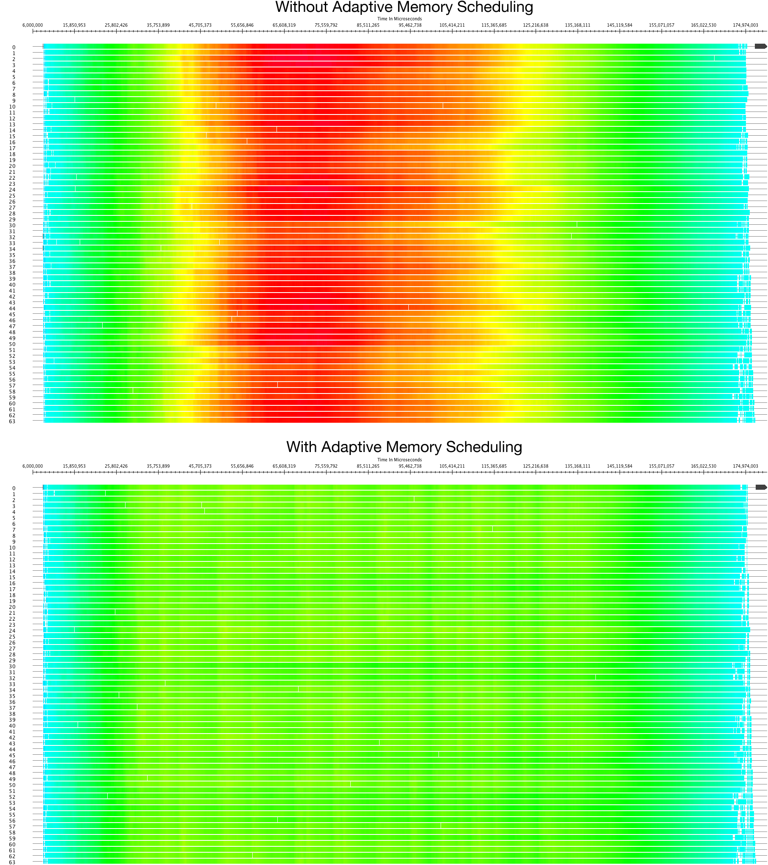

Balanced Snake Mapping

Slide 12
Memory Increase in LU
Trailing updates may be delayed
  Only needed for next diagonal and the next set of triangular solves (which may also be delayed)
  These are scheduled using priorities
  Trailing updates accumulate in the queue (because of the relatively low priority), increasing memory usage
  Override priority and schedule immediately if memory threshold is reached

Slide 13
With Memory-Aware Scheduling

Slide 14
Without Memory-Aware Scheduling

Slide 15
Memory-Aware Scheduling

Slide 16
Performance

Slide 17
Future work
Make the scheduler automatically detect which entry method will be marked memory critical
Respect priorities within messages marked memory critical in the scheduler
Allow other messages to be marked as increasing memory, or having no effect on memory

Slide 18
Conclusion
A general memory-aware scheduling technique is demonstrated
  Could be used in other RTS
  Using Charm++ as a case study
A new LU block mapping in a message-driven system
  Performs better for small matrices

