Slide 1
Automating Topology Aware Task Mapping on Large Parallel Machines
Abhinav S Bhatele
Advisor: Laxmikant V. Kale
University of Illinois at Urbana-Champaign

Slide 2
Current Machines and their Topologies
3D Mesh – Cray XT3/4/5
3D Torus – Blue Gene/L, Blue Gene/P
Fat-tree, CLOS network – Infiniband, Federation
Kautz Graph – SiCortex
Future Topologies – Blue Waters, Blue Gene/Q?
Notes:
Hypercubes
N-dimensional
Hybrid
Topology at the level of a node

Slide 3
Application Characteristics
Computation-bound applications
Communication-heavy applications
Latency tolerant
Latency sensitive

Slide 4
Motivation
Consider a 3D mesh/torus interconnect
Message latencies can be modeled by
(L_{f}/B) x D + L/B
L_{f} = length of flit, B = bandwidth,
D = hops, L = message size
When (L_{f} * D) << L, first term is negligible
But in presence of contention …

Slide 5
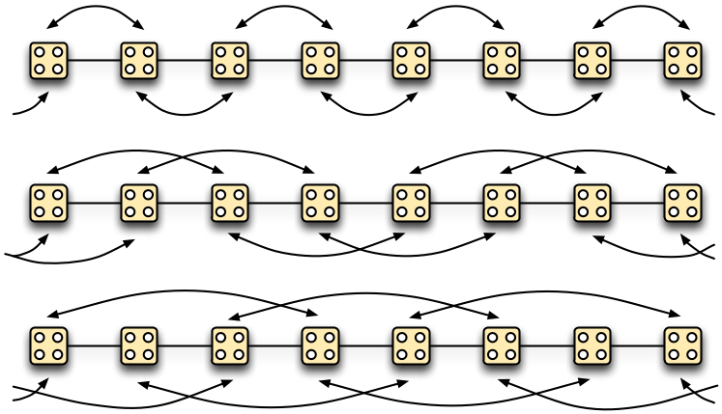
Equidistant-pairs Benchmark
Pair each rank with a partner which is ‘n’ hops away
1 hop
2 hops
3 hops

Slide 6
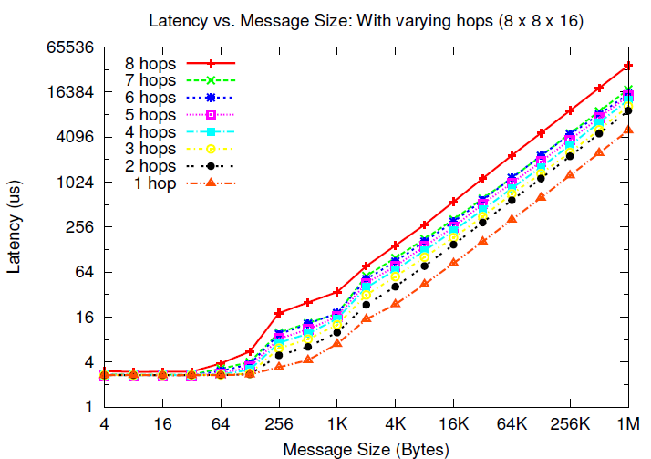
Blue Gene/P
7.39 times
Notes:
1 to 2 – 1.84
1 to 3 – 2.11
1 to 4 - 2.55
1 to 7 – 3.54
1 to 8 – 7.396

Slide 7
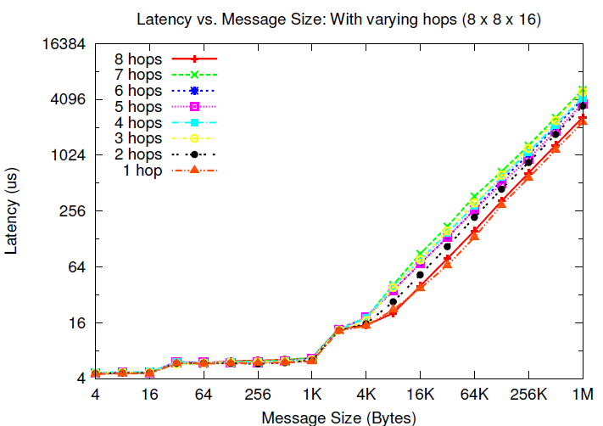
Cray XT3
2.23 times
Bhatele A., Kale L. V., Quantifying Network Contention on Large Parallel Machines, Parallel Processing Letters (Special Issue on Large-Scale Parallel Processing), 2009.

Slide 8
Automatic Mapping Framework
Obtain the processor topology graph and communication graph for the application
Pattern matching to identify 2D/3D/4D near-neighbor communication patterns
Use different heuristics depending on the communication graph
Structured patterns
Irregular patterns

Slide 9
Topology Manager API†
The application needs information such as
Dimensions of the partition
Rank to physical co-ordinates and vice-versa
TopoManager: a uniform API
On BG/L and BG/P: provides a wrapper for system calls
On XT3/4/5, there are no such system calls
Provides a clean and uniform interface to the application
† http://charm.cs.uiuc.edu/~bhatele/phd/topomgr.htm
Notes:
This can be used by MPI Topology functions

Slide 10
Object Communication Graph
Obtaining this graph:
Manually
Profiling (e.g. IBM’s HPCT tools)
Charm++’s instrumentation framework
Visualizing the graph
Pattern matching

Slide 11
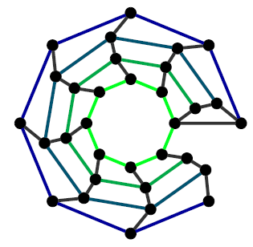
WRF Communication Graph
0 1 30 31
Pattern matching to find out if the communication graph is 2D and what are the dimensions of the graph?
0
1
31
32
26
27
25
1
28
0
24
29
31
30

Slide 12
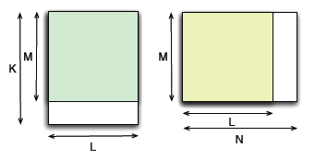
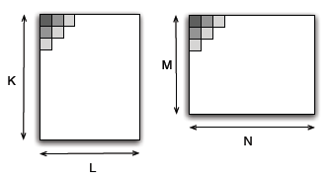
Mapping Heuristics
Maximum Overlap
Expand from Corners

Slide 13
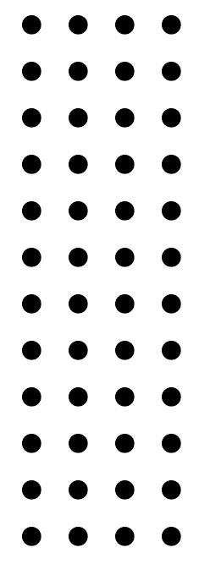
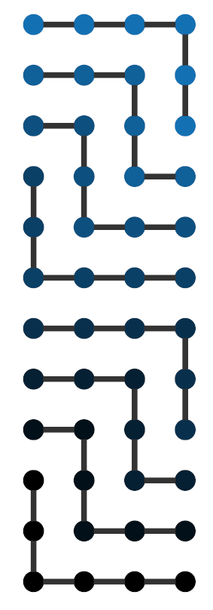
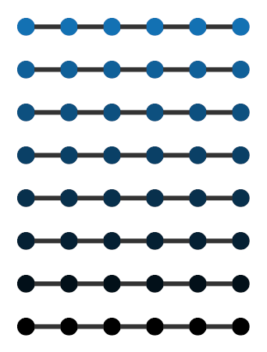
Object Graph – 8 x 6
Processor Graph – 12 x 4
Aleliunas, R. and Rosenberg, A. L. On Embedding Rectangular Grids in Square Grids. IEEE Trans. Comput., 31(9):907–913, 1982

Slide 14
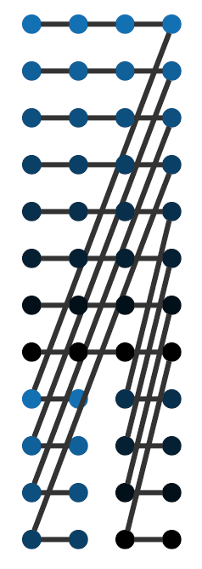
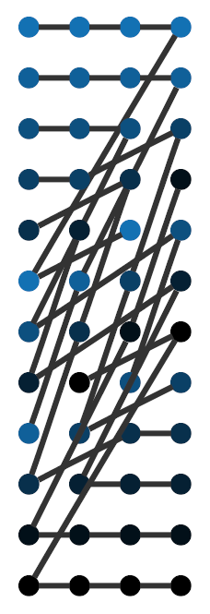
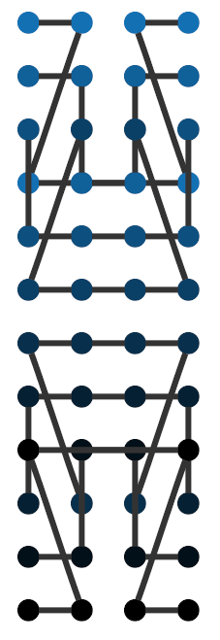
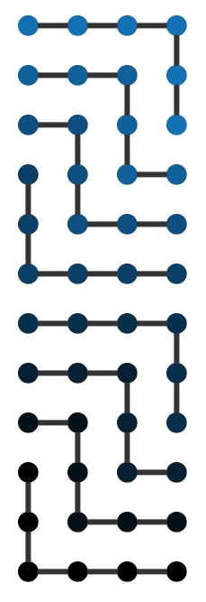
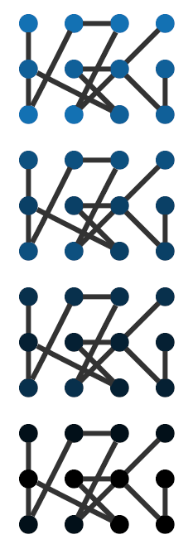
Different mapping heuristics
Bhatele A., Chung I., Kale L. V., Automated Mapping of Structured Communication Graphs onto Mesh Interconnects, in preparation, 2009.

Slide 15
Evaluation Metric: Hop-bytes
Weighted sum of message sizes where the weights are the number of links traversed by each message
Indication of the communication traffic on the network
Another metric: maximum dilation

Slide 16
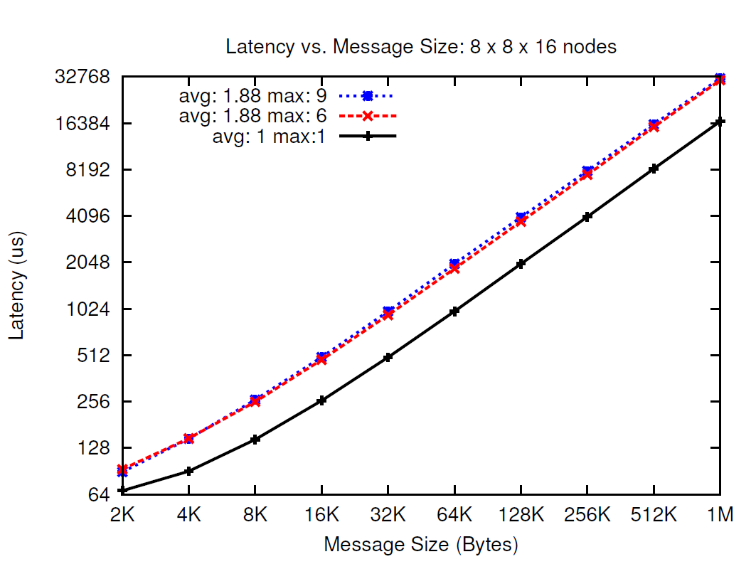
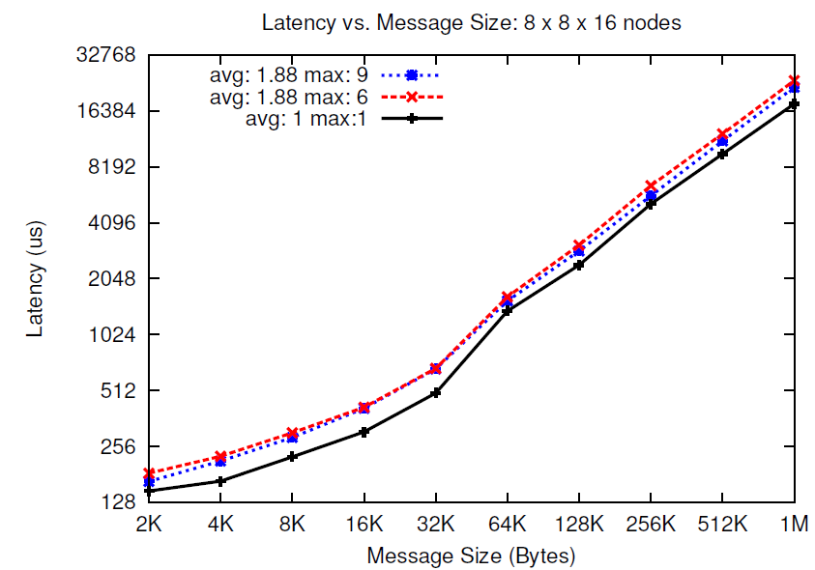
Blue Gene/P (Intrepid)
Cray XT4 (Jaguar)

Slide 17
Evaluation
Hops 292 292 432 284 236 348
Dilation 11 11 8 7 3 5
Notes:
Easily extendable to 3D ?

Slide 18
Mapping of MPI Applications
Work with IBM (I-Hsin Chung)
Using HPCT to dump communication patterns
Derive a mapping offline and use in a subsequent run
Applications: MILC, POP, WRF
Map 2D communication patterns to 3D tori of BG/P

Slide 19
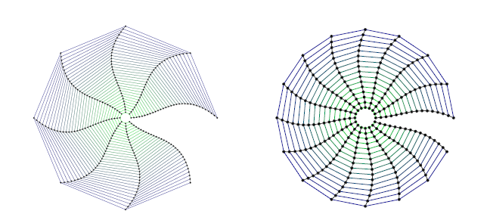
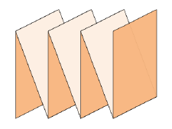
Communication graphs for POP and WRF on 256 processors
Folding of 2D graph to 3D mesh
Hops Reduction – 64%
Communication Time Reduction – 45%
Performance Improvement - 17%
*
* FOLD - H. Yu, I.-H. Chung, and J. Moreira. Topology mapping for Blue Gene/L supercomputer. In SC ’06: page 116, New York, NY, USA, 2006.

Slide 20
OpenAtom Performance on Cray XT3
Runs on Cray XT3 (Bigben) at Pittsburgh Supercomputing Center, VN mode
(with system reservation to obtain complete 3D mesh shapes)
A. Bhatele, E. Bohm, and L. V. Kale. A Case Study of Communication Optimizations on
3D Mesh Interconnects. In Euro-Par 2009, LNCS 5704, pages 1015–1028, 2009.

Slide 21
Remaining and Future Work
Consider weighted communication graphs
Mapping of irregular communication graphs
Unstructured mesh applications, MD codes
Future Work
Dynamic Load Balancing for MPI applications
Complex topologies of the future

Slide 22
I am on the job market …
Acknowledgements:
Prof. Laxmikant V. Kale Prof. David A. Padua
Prof. William D. Gropp Dr. Matthew H. Reilly
IBM Watson Research Center (Blue Gene/L): Fred Mintzer, Glenn Martyna
Pittsburgh Supercomputing Center (Cray XT3): Chad Vizino, Shawn Brown
Argonne National Laboratory (Blue Gene/P): Pete Beckman, Tisha Stacey
Oak Ridge National Laboratory (Cray XT4/5): Donald Frederick, Patrick Worley
Funded in part by the Center for Simulation of Advanced Rockets (Univ. of Illinois) through
DOE Grant B341494
E-mail: bhatele, kale @ illinois.edu Webpage: http://charm.cs.illinois.edu/~bhatele

