Slide 1


Scalable Fault Tolerance Schemes using Adaptive Runtime Support
Laxmikant (Sanjay) Kale
http://charm.cs.uiuc.edu
Parallel Programming Laboratory
Department of Computer Science
University of Illinois at Urbana Champaign

Slide 2
Presentation Outline
10/1/2009
2
What is object based decomposition
  Its embodiment in Charm++ and AMPI
  Its general benefits
  Its features that are useful for fault tolerance schemes
Our Fault Tolerance work in Charm++ and AMPI
  Disk-based checkpoint/restart
  In-memory double checkpoint/restart
  Proactive object-migration
  Message-logging
Notes:
2

Slide 3
Object based over-decomposition
Programmers decompose computation into objects
  Work units, data-units, composites
  Decomposition independent of number of processors
  Typically, many more objects than processors
Intelligent runtime system assigns objects to processors
RTS can change this assignment (mapping) during execution

Slide 4
Object-based over-decomposition: Charm++
Multiple “indexed collections” of C++ objects
Indices can be multi-dimensional and/or sparse
Programmer expresses communication between objects
  with no reference to processors
System implementation
User View

Slide 5
Object-based over-decomposition: AMPI
Each MPI process is implemented as a user-level thread
Threads are light-weight, and migratable!
  <1 microsecond context switch time, potentially >100k threads per core
Each thread is embedded in a charm+ object (chare)
MPI processes
Virtual Processors (user-level migratable threads)
Real Processors

Slide 6
Some Properties of this approach Relevant to Fault Tolerance
Object-based Virtualization leads to Message Driven Execution
Dynamic load balancing by migrating objects
No dependence on processor number:
  E.g. 3D cube of objects, can be mapped to a non-cube number of processors
Scheduler
Scheduler
Message Q
Message Q

Slide 7
Charm++/AMPI are well established systems
The Charm++ model has succeeded in CSE/HPC
Because:
  Resource management, …
15% of cycles at NCSA, 20% at PSC, were used on Charm++ apps, in a one year period
So, work on fault tolerance for Charm++ and AMPI is directly useful to real apps
Also, with AMPI, it applies to MPI applications

Slide 8
Fault Tolerance in Charm++ & AMPI
Four Approaches Available:
  Disk-based checkpoint/restart
  In-memory double checkpoint/restart
  Proactive object migration
  Message-logging: scalable rollback, parallel restart
Common Features:
  Based on dynamic runtime capabilities
  Use of object-migration
  Can be used in concert with load-balancing schemes
Notes:
8

Slide 9
Disk-Based Checkpoint/Restart
Basic Idea:
  Similar to traditional checkpoint/restart; “migration” to disk
Implementation in Charm++/AMPI:
  Blocking coordinated checkpoint: MPI_Checkpoint(DIRNAME)
Pros:
  Simple scheme, effective for common cases
  Virtualization enables restart with any number of processors
Cons:
  Checkpointing and data reload operations may be slow
  Work between last checkpoint and failure is lost
  Job needs to be resubmitted and restarted
Notes:
9

Slide 10
SyncFT: In-Memory double Checkpoint/Restart
Basic Idea:
  Avoid overhead of disk access for keeping saved data
  Allow user to define what makes up the state data
Implementation in Charm++/AMPI:
  Coordinated checkpoint
  Each object maintains two checkpoints:
    on local processor’s memory
    on remote buddy processor’s memory
  A dummy process is created to replace crashed process
  New process starts recovery on another processor
    use buddy’s checkpoint to recreate state of failing processor
    perform load balance after restart
Notes:
10

Slide 11
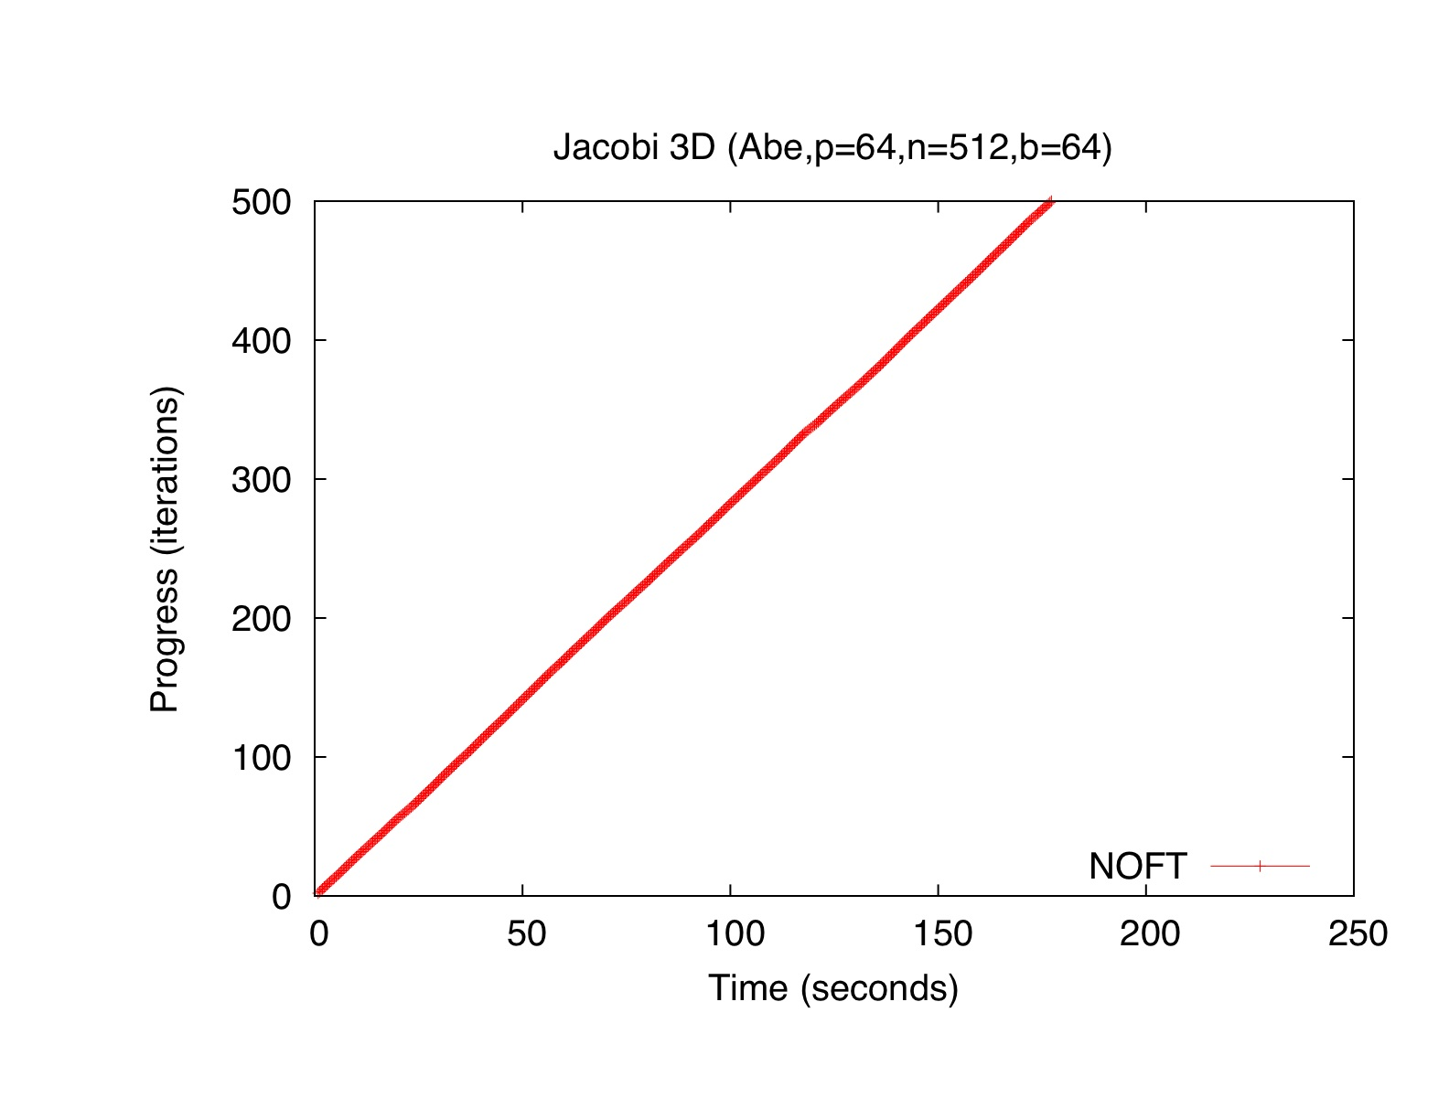
Over

Slide 12
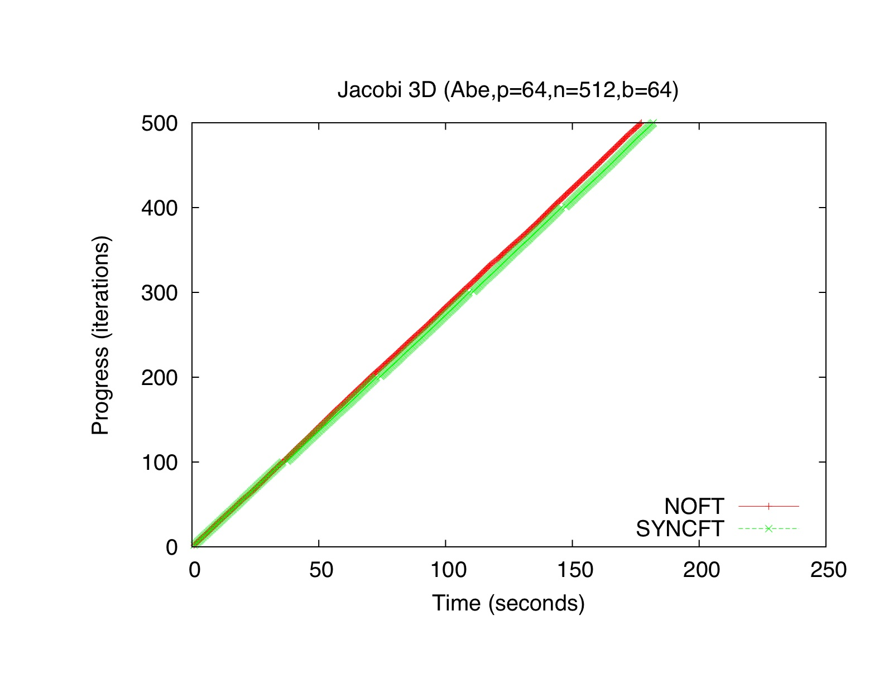

Slide 13
In-Memory Double Checkpoint/Restart (cont.)
Comparison to disk-based checkpointing:
Notes:
13

Slide 14
In-Memory Double Checkpoint/Restart (cont.)
Recovery Performance:
  Molecular Dynamics LeanMD code, 92K atoms, P=128
  Load Balancing (LB) effect after failure:
Notes:
14

Slide 15
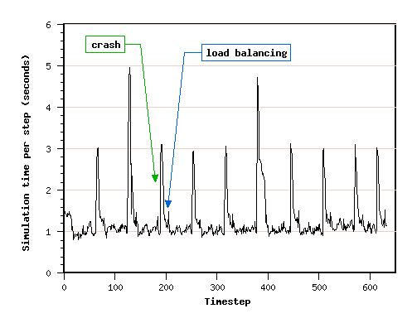
In-Memory Double Checkpoint/Restart (cont.)
Application Performance:
  Molecular Dynamics LeanMD code, 92K atoms, P=128
  Checkpointing every 10 timesteps; 10 crashes inserted:
Notes:
15

Slide 16
In-Memory Double Checkpoint/Restart (cont.)
Pros:
  Faster checkpointing than disk-based
  Reading of saved data also faster
  Only one processor fetches checkpoint across network
Cons:
  Memory overhead may be high
  All processors are rolled back, despite individual failure
  All the work since last checkpoint is redone by every processor
Publications:
  Zheng, Huang & Kale: ACM-SIGOPS, April 2006
  Zheng, Shi & Kale: IEEE-Cluster’2004, Sep.2004
Notes:
16

Slide 17
Proactive Object Migration
Basic Idea:
  Use knowledge about impending faults
  Migrate objects away from processors that may fail soon
  Fall back to checkpoint/restart when faults not predicted
Implementation in Charm++/AMPI:
  Each object has a unique index
  Each object is mapped to a home processor
    objects need not reside on home processor
    home processor knows how to reach the object
  Upon getting a warning, evacuate the processor
    reassign mapping of objects to new home processors
    send objects away, to their home processors
Notes:
17

Slide 18
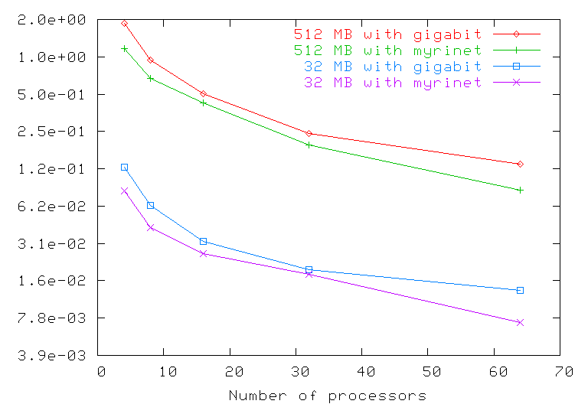
Proactive Object Migration (cont.)
Evacuation time as a function of #processors:
  5-point stencil code in Charm++, IA-32 cluster
Notes:
18

Slide 19
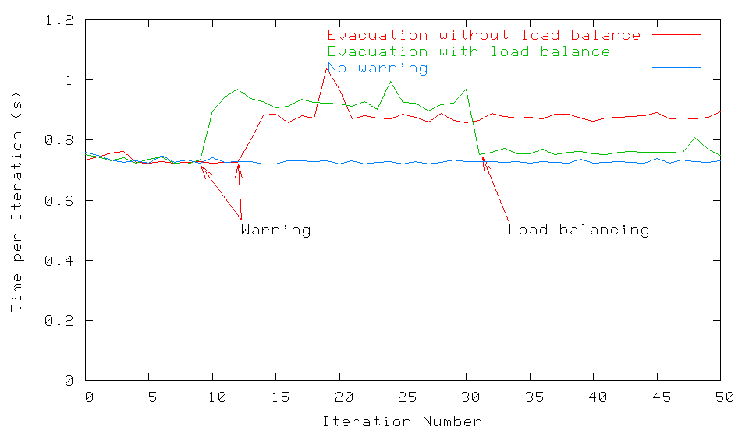
Proactive Object Migration (cont.)
Performance of an MPI application
  Sweep3d code, 150x150x150 dataset, P=32, 1 warning
  5-point stencil code in Charm++, IA-32 cluster
Notes:
19

Slide 20
Proactive Object Migration (cont.)
Pros:
  No overhead in fault-free scenario
  Evacuation time scales well, only depends on data and network
  No need to roll back when predicted fault happens
Cons:
  Effectiveness depends on fault predictability mechanism
  Some faults may happen without advance warning
Publications:
  Chakravorty, Mendes & Kale: HiPC, Dec.2006
  Chakravorty, Mendes, Kale et al: ACM-SIGOPS, April 2006
Notes:
20

Slide 21
Message-Logging
Basic Idea:
  Messages are stored by sender during execution
  Periodic checkpoints still maintained
  After a crash, reprocess “recent” messages to regain state
Implementation in Charm++/AMPI:
  Since the state depends on the order of messages received, the protocol ensures that the new receptions occur in the same order
  Upon failure, roll back is “localized” around failing point: no need to roll back all the processors!
  With virtualization, work in one processor is divided across multiple virtual processors; thus, restart can be parallelized
  Virtualization helps fault-free case as well
Notes:
21

Slide 22
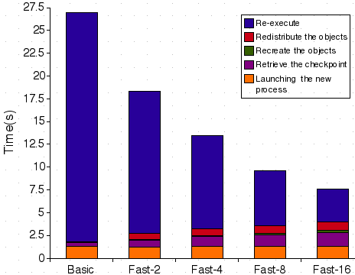
Message-Logging (cont.)
Fast restart performance:
  Test: 7-point 3D-stencil in MPI, P=32, 2 ≤ VP ≤ 16
  Checkpoint taken every 30s, failure inserted at t=27s
22
Notes:
22

Slide 23
Power
Normal Checkpoint-Resart method
Progress is slowed down with failures
Power consumption is continuous
Progress
Time

Slide 24
Our Checkpoint-Resart method
(Message logging + Object-based virtualization)
Progress is faster with failures
Power consumption is lower during recovery
Progress
Time

Slide 25
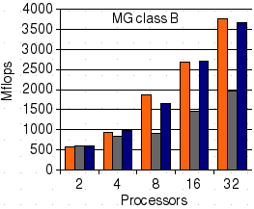
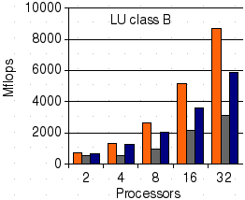
Message-Logging (cont.)
Fault-free performance:
  Is ok with large-grain, but significant los with fine-grained
  Test: NAS benchmarks, MG/LU
  Versions: AMPI, AMPI+FT, AMPI+FT+multipleVPs
25
Notes:
25

Slide 26
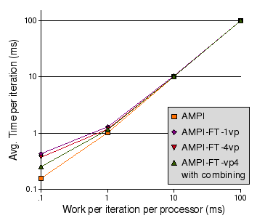
Message-Logging (cont.)
Protocol Optimization:
  Combine protocol messages: reduces overhead and contention
  Test: synthetic compute/communicate benchmark
26
Notes:
26

Slide 28
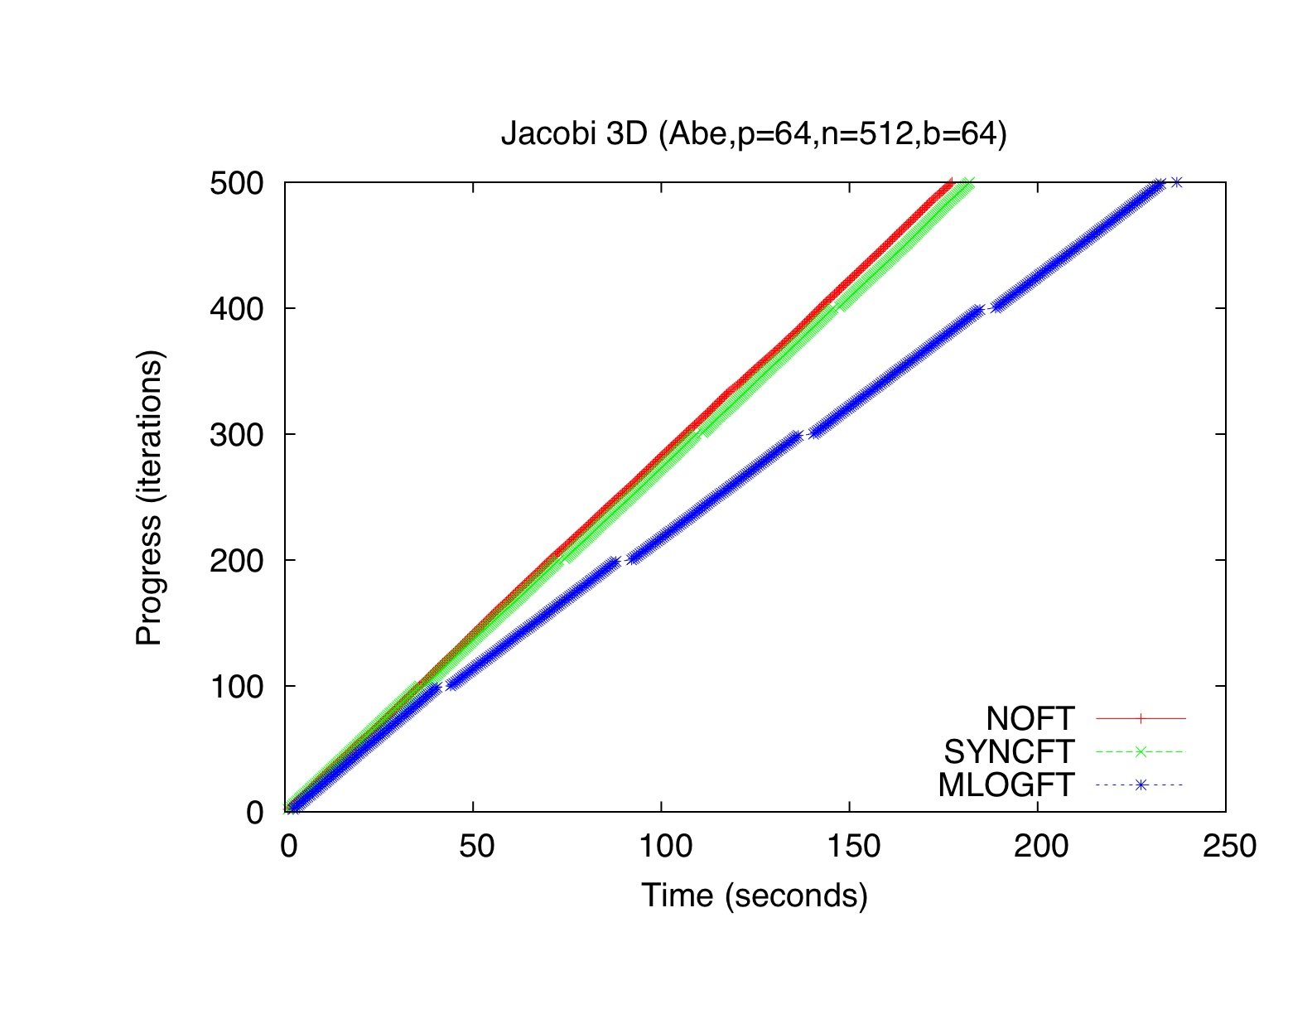

Slide 29
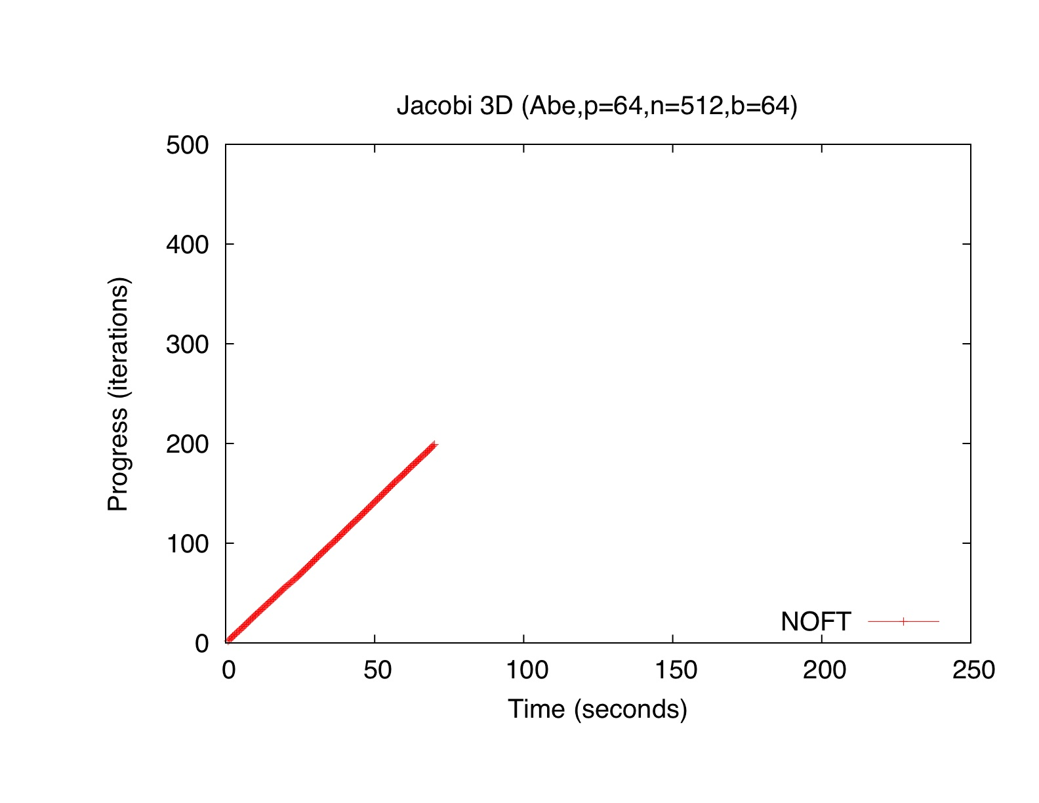

Slide 30
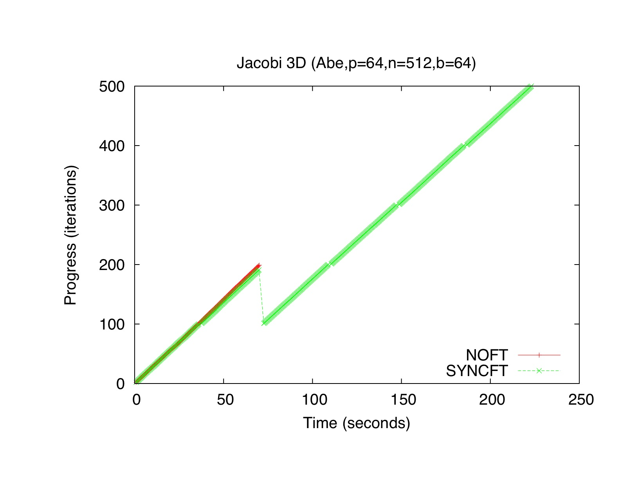

Slide 31
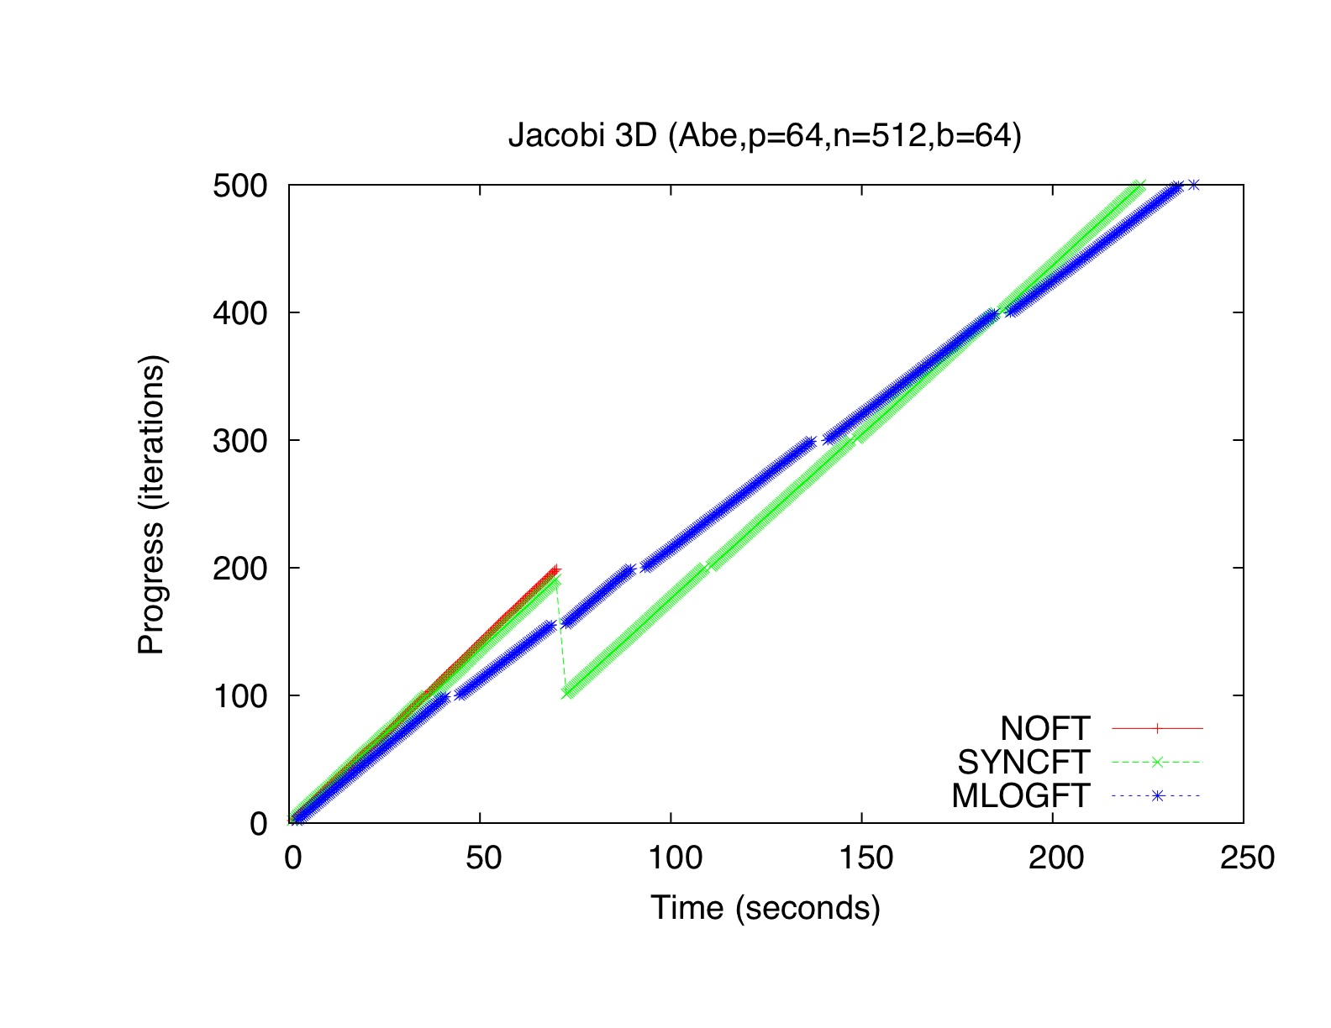

Slide 32
Message-Logging (cont.)
Pros:
  No need to roll back non-failing processors
  Restart can be accelerated by spreading work to be redone
  No need of stable storage
Cons:
  Protocol overhead is present even in fault-free scenario
  Increase in latency may be an issue for fine-grained applications
Publications:
  Chakravorty: UIUC PhD Thesis, Dec.2007
  Chakravorty & Kale: IPDPS, April 2007
  Chakravorty & Kale: FTPDS workshop at IPDPS, April 2004
Notes:
32

Slide 33
Current PPL Research Directions
Message-Logging Scheme
  Decrease latency overhead in protocol
  Decrease memory overhead for checkpoints
  Stronger coupling to load-balancing
  Newer schemes to reduce message-logging overhead
    Clustering: a set of cores are sent back to their checkpt
      Greg Bronevetsky’s suggestion
    Other collaboration with Franck Capello
Notes:
33

Slide 34
Some external Gaps
Scheduler that won’t kill a job
  Broader need: a scheduler that allows flexible bi-directional communication between jobs and scheduler
Fault prediction
  Needed if proactive Fault Tolerance is of use
Local disks!
Need to better integrate knowledge from distributed systems
  They have sophisticated techniques, but HPC metrics and context is substantially different

Slide 35
Messages
We have interesting fault tolerance schemes
  Read about them
We have an approach to parallel programming
  That has benefits in the era of complex machines, and sophisticated applications
  That is used by real apps
  That provides beneficial features for FT schemes
  That is available via the web
  SO: please think about developing new FT schemes of your own for this model
More info, papers, software: http://charm.cs.uiuc.edu
And please pass the word on: we are hiring

