Slide 1
Load Balancing and Topology Aware Mapping for Petascale Machines
Abhinav S Bhatele
Parallel Programming Laboratory, Illinois

Slide 2
Outline
Scalable Load Balancing
Current Supercomputers and their Topologies
Topology Aware Mapping
Motivation
Examples
Tools and Techniques

Slide 3
Load Balancing

Slide 4
Load Balancing
Load Imbalance can severely hurt performance
The time to completion is bound by the slowest processor
Hence, when dividing 121 units of work among 10 processors
12 units to 9 processors and 13 units to 1 (simple round-robin scheme)
13 units to 9 processors and 4 units to 1 (intelligent blocking)

Slide 5
Load Balancing Strategies
Static: Achieved through initial data distribution
Dynamic
Blocks of data which can be moved around during the execution
Measurement-based
Automatic (by the runtime)

Slide 6
Another classification
Balance computational load
Balance computational as well as communication load
Minimize communication volume on the network
Minimize communication traffic
Bytes passing through each link on the network

Slide 7
Scalable Load Balancing
Centralized Strategies perform better but take longer
Memory/communication bottleneck
Distributed Strategies are fast but have incomplete knowledge
Hybrid/ Hierarchical Strategies
Allow using different strategies at different levels

Slide 8
Hierarchical Strategies
64K processor hierarchical tree
Level 2
1
Level 1
0
1024
63488
64512
64
Level 0
0
…
1023
1024
…
2047
…...
63488
…
64511
64512
…
65535
1024
Apply different strategies at each level

Slide 9
References
Trinilos (developed at Sandia): http://trilinos.sandia.gov/
Charm++ Load Balancing Framework: https://charm.cs.uiuc.edu/research/ldbal/

Slide 10
Topology Aware Mapping

Slide 11
Current Machines and their Topologies
3D Mesh – Cray XT3/4/5
3D Torus – Blue Gene/L, Blue Gene/P
Fat-tree, CLOS network – Infiniband, Federation
Kautz Graph – SiCortex
Future Topologies?
Notes:
Hypercubes
N-dimensional
Hybrid
Topology at the level of a node

Slide 12
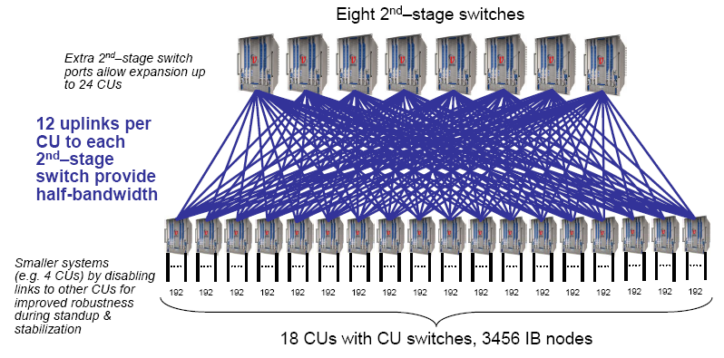
RoadRunner

Slide 13
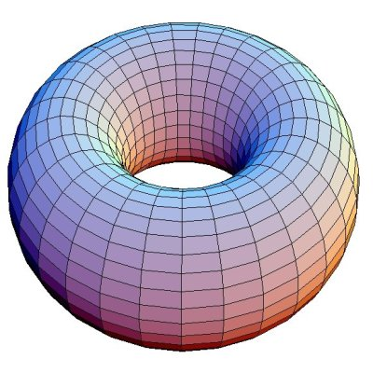
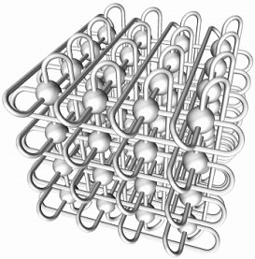
Blue Gene/P
Midplane: smallest unit with torus in all dimensions: 8 x 8 x 8
All bigger partitions formed from this unit of 512 nodes
Intrepid at ANL: 40960 nodes

Slide 14
Cray XT5
The full installation is a torus
Typically the batch scheduler does not allocate cuboidal shapes
Jaguar (XT4) at ORNL: 8,064 nodes, torus dimensions 21 x 16 x 24
Jaguarpf (XT5) at ORNL: 21 x 32 x 24

Slide 15
Is topology important?
For machines as large as these?
Yes.
For all applications?
No.

Slide 16
Motivation
Consider a 3D mesh/torus interconnect
Message latencies can be modeled by
(L_{f}/B) x D + L/B
L_{f} = length of flit, B = bandwidth,
D = hops, L = message size
When (L_{f} * D) << L, first term is negligible
But in presence of contention …

Slide 17
Validation through Benchmarks

Slide 18
MPI Benchmarks†
Quantification of message latencies and dependence on hops
No sharing of links (no contention)
Sharing of links (with contention)
† http://charm.cs.uiuc.edu/~bhatele/phd/contention.htm
Abhinav Bhatele, Laxmikant V. Kale, An Evaluation of the Effect of Interconnect Topologies on Message Latencies in Large Supercomputers, In Workshop on Large-Scale Parallel Processing (IPDPS), 2009.

Slide 19
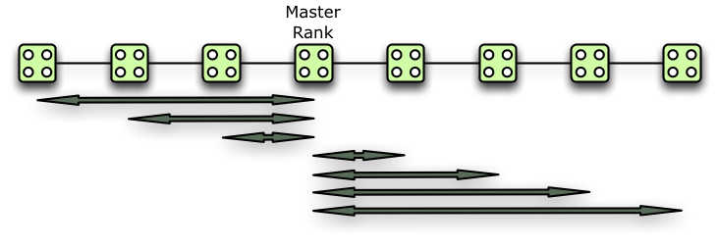
WOCON: No contention
A master rank sends messages to all other ranks, one at a time (with replies)

Slide 20
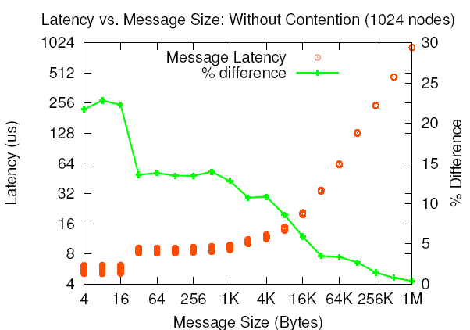
WOCON: Results
(L_{f}/B) x D + L/B
ANL Blue Gene/P
PSC XT3

Slide 21
WICON: With Contention
Divide all ranks into pairs and everyone sends to their respective partner simultaneously
Near Neighbor: NN
Random: RND

Slide 22
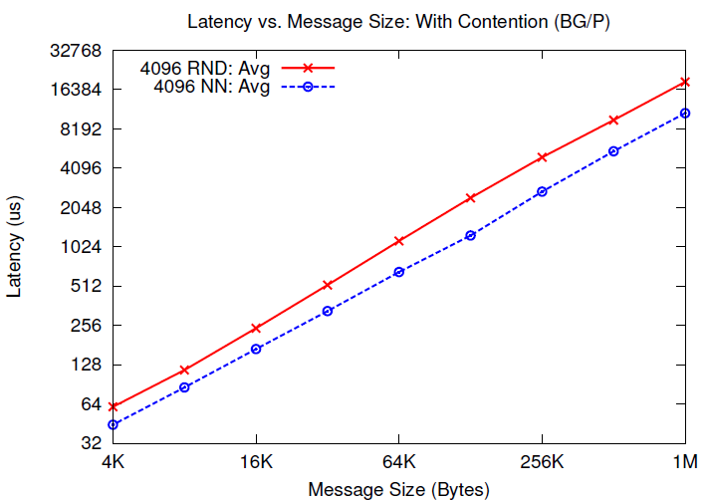
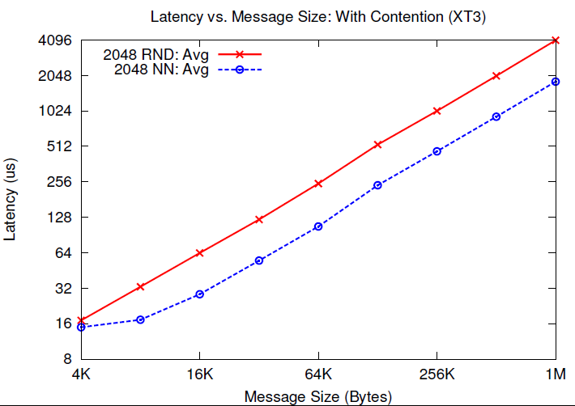
WICON: Results
ANL Blue Gene/P
PSC XT3
Notes:
BG/P = 1.737 times
XT3 = 2.24 times

Slide 23
Stressing-a-link Benchmark
Controlled Congestion
Quantify contention effects on a particular link

Slide 24
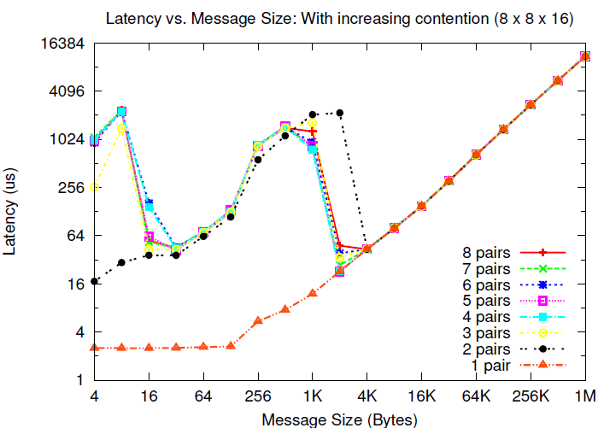
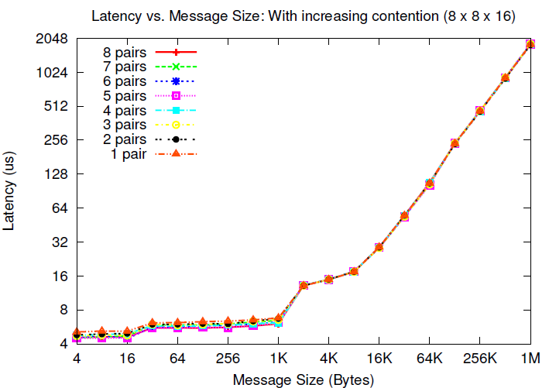
ANL Blue Gene/P
PSC XT3

Slide 25
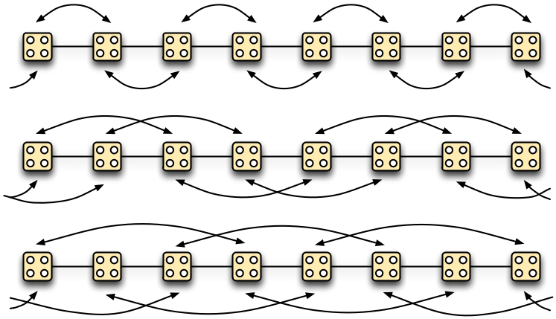
Equidistant-pairs Benchmark
Pair each rank with a partner which is ‘n’ hops away

Slide 26
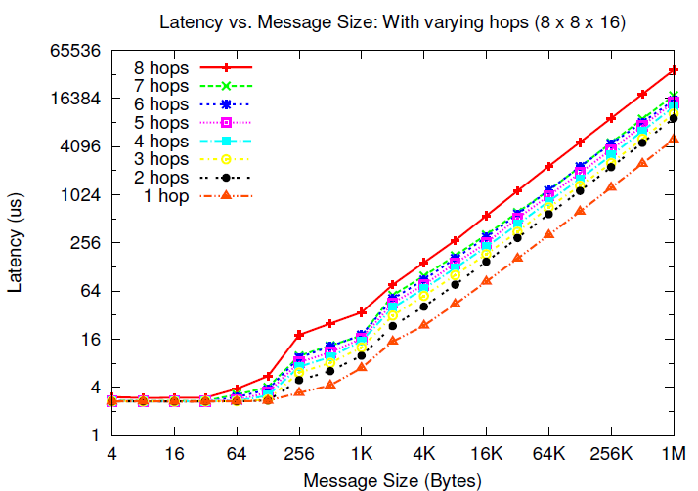
Blue Gene/P
7.39 times
Notes:
1 to 2 – 1.84
1 to 3 – 2.11
1 to 4 - 2.55
1 to 7 – 3.54
1 to 8 – 7.396

Slide 27
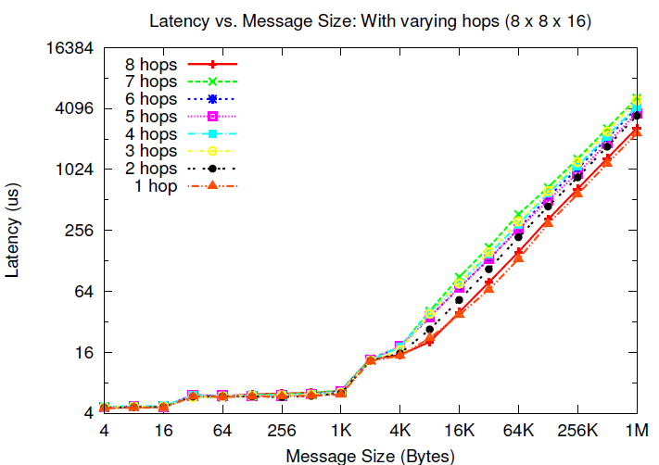
Cray XT3
2.23 times

Slide 28
Can we avoid congestion?
Yes. If we can minimize the distance each message travels
Solution: topology aware mapping
Initially
At runtime (as a part of load balancing)

Slide 29
Example Application: NAMD

Slide 30
Molecular Dynamics
A system of [charged] atoms with bonds
Use Newtonian Mechanics to find the positions and velocities of atoms
Each time-step is typically in femto-seconds
At each time step
calculate the forces on all atoms
calculate the velocities and move atoms around
Notes:
Motivate why is it challenging to parallelize: Generally a few thousand atoms,
one time-step is a few seconds
This needs to be parallelized onto a large number of processors.
The no. of time-steps is large (million to billion) since interesting phenomena happens on the scale of ns or ms
1 fs = 10-15 secs

Slide 31
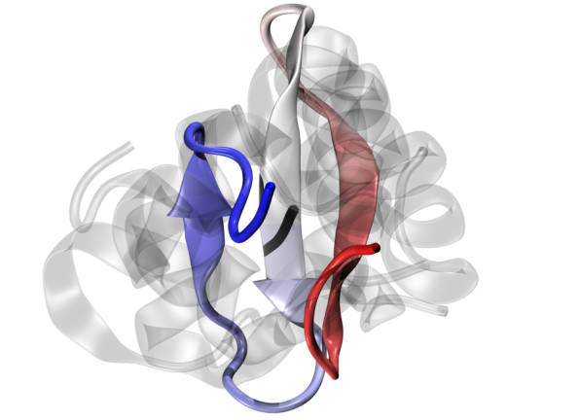
NAMD: NAnoscale Molecular Dynamics
Naïve force calculation is O(N²)
Reduced to O(N logN) by calculating
Bonded forces
Non-bonded: using a cutoff radius
Short-range: calculated every time step
Long-range: calculated every fourth time-step (PME)
Notes:
The Particle-Mesh Ewald algorithm is used, which transfers the electric charge of each atom to electric potential on a grid and uses a 3D FFT to calculate the influence of all
atoms on each atom.

Slide 32
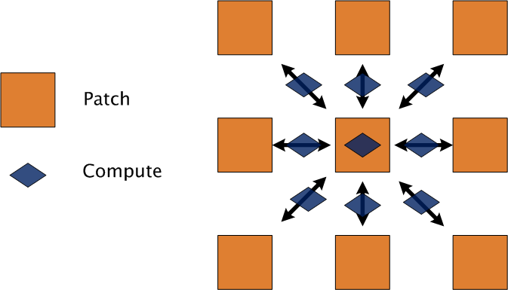
NAMD’s Parallel Design
Hybrid of spatial and force decomposition
Notes:
Patches are assigned statically
Computes are migratable (non-bonded ones) controlled by LDB
Comm to comp ratio is constant

Slide 33
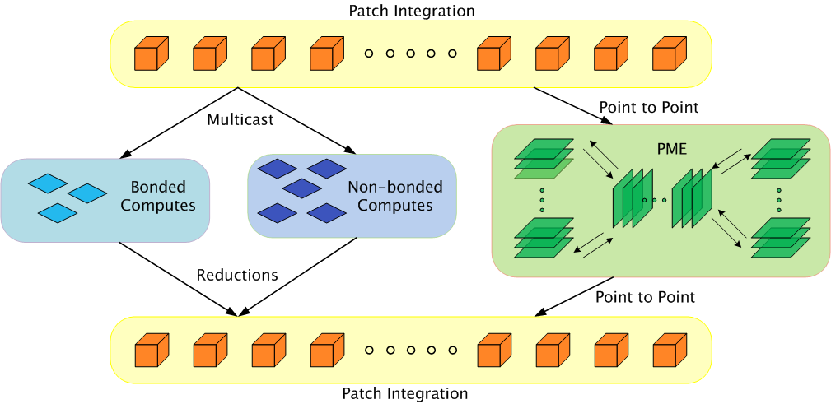
Parallelization using Charm++
Static Mapping
Load Balancing
Bhatele, A., Kumar, S., Mei, C., Phillips, J. C., Zheng, G. & Kale, L. V., Overcoming Scaling Challenges in Biomolecular Simulations across Multiple Platforms. In Proceedings of IEEE International Parallel and Distributed Processing Symposium, Miami, FL, USA, April 2008.

Slide 34
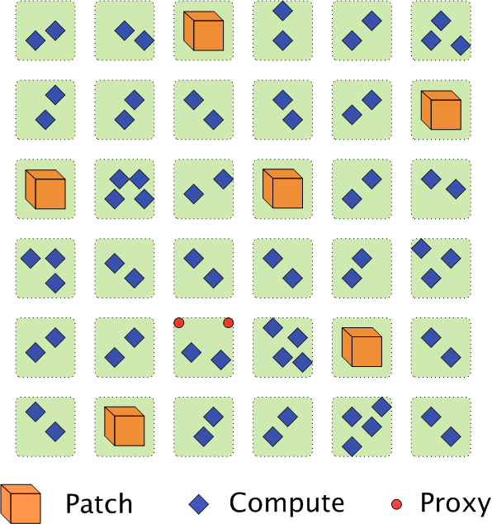
Communication in NAMD
Each patch multicasts its information to many computes
Each compute is a target of two multicasts only
Use ‘Proxies’ to send data to different computes on the same processor

Slide 35
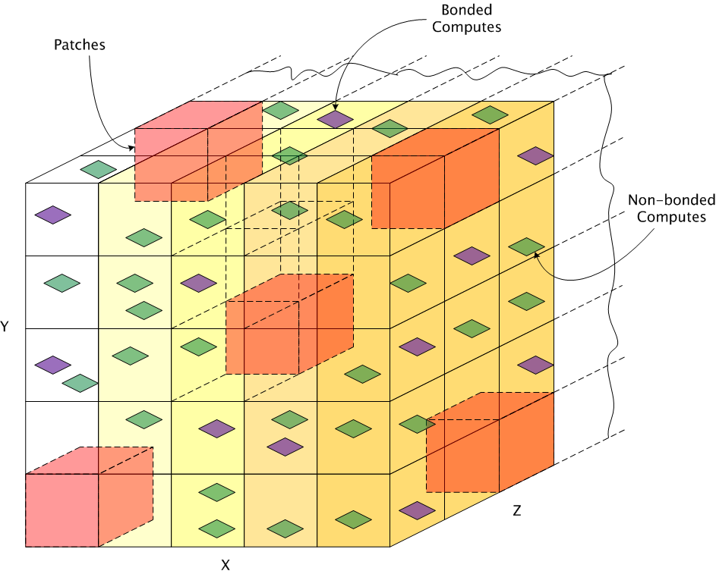
Topology Aware Techniques
Static Placement of Patches

Slide 36
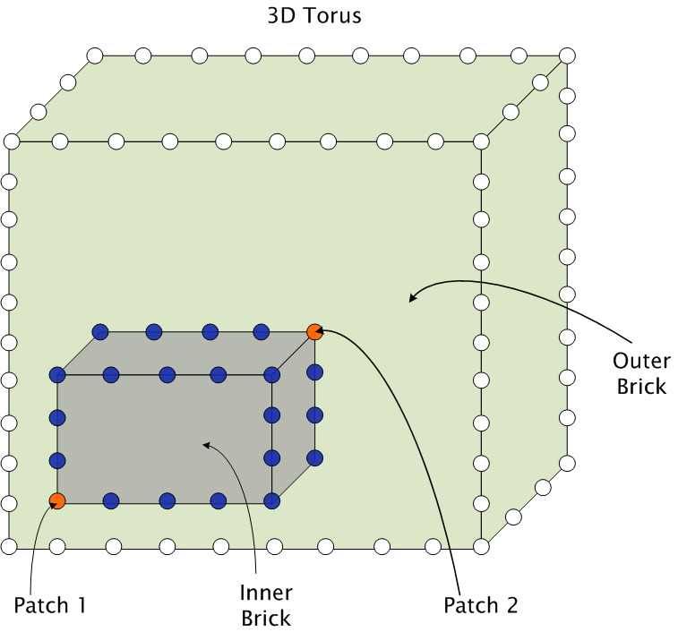
Topology Aware Techniques (contd.)
Placement of computes

Slide 37
Load Balancing in Charm++
Principle of Persistence
Object communication patterns and computational loads tend to persist over time
Measurement-based Load Balancing
Instrument computation time and communication volume at runtime
Use the database to make new load balancing decisions

Slide 38
NAMD’s Load Balancing Strategy
NAMD uses a dynamic centralized greedy strategy
There are two schemes in play:
A comprehensive strategy (called once)
A refinement scheme (called several times during a run)
Algorithm:
Pick a compute and find a “suitable” processor to place it on

Slide 39
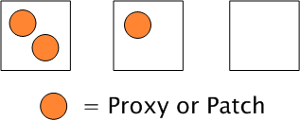
Choice of a suitable processor
Among underloaded processors, try to:
Find a processor with the two patches or their proxies
Find a processor with one patch or a proxy
Pick any underloaded processor
Highest Priority
Lowest Priority
Notes:
Preference to load, then number of proxies

Slide 40
Load Balancing Metrics
Load Balance: Bring Max-to-Avg Ratio close to 1
Communication Volume: Minimize the number of proxies
Communication Traffic: Minimize hop bytes
Hop-bytes = Message size X Distance traveled by message
Agarwal, T., Sharma, A., Kale, L.V., Topology-aware task mapping for reducing communication contention on large parallel machines, In Proceedings of IEEE International Parallel and Distributed Processing Symposium, Rhodes Island, Greece, April 2006.

Slide 41
Results: Hop-bytes

Slide 42
Results: Performance
Abhinav Bhatele and Laxmikant V. Kale. Dynamic Topology Aware Load Balancing Algorithms for MD Applications. In Proceedings of International Conference on Supercomputing, 2009.

Slide 43
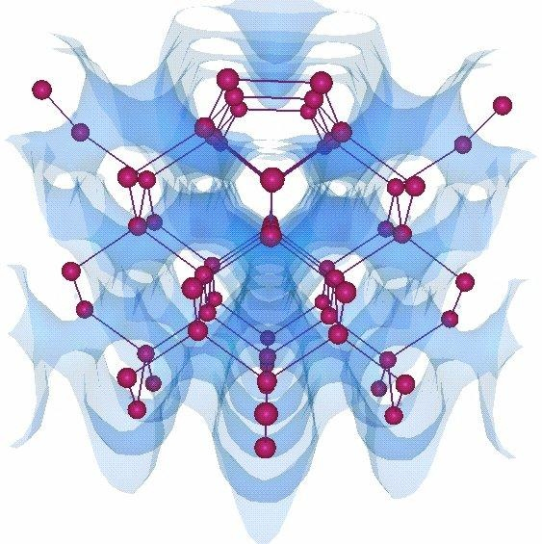
OpenAtom
Ab-Initio Molecular Dynamics code
Communication is static and structured
Challenge: Multiple groups of objects with conflicting communication patterns

Slide 44
Parallelization using Charm++
Eric Bohm, Glenn J. Martyna, Abhinav Bhatele, Sameer Kumar, Laxmikant V. Kale, John A. Gunnels, and Mark E. Tuckerman. Fine Grained Parallelization of the Car-Parrinello ab initio MD Method on Blue Gene/L. IBM J. of R. and D.: Applications of Massively Parallel Systems, 52(1/2):159-174, 2008.
Abhinav Bhatele, Eric Bohm, Laxmikant V. Kale, A Case Study of Communication Optimizations on 3D Mesh Interconnects, To appear in Proceedings of Euro-Par (Topic 13 - High Performance Networks), 2009.

Slide 45
Topology Mapping of Chare Arrays
Plane-wise
communication
State-wise
communication
Joint work with Eric J. Bohm

Slide 46
Results on Blue Gene/P (ANL)

Slide 47
Results on XT3 (Bigben@PSC)

Slide 48
Tools and Techniques

Slide 49
Topology Aware Mapping
Broadly three requirements
Processor topology graph
Object communication graph
Efficient and scalable mapping algorithms

Slide 50
Application Characteristics
Computation-bound applications
Communication-heavy applications
Latency tolerant: NAMD
Latency sensitive: OpenAtom

Slide 51
Topology Manager API†
The application needs information such as
Dimensions of the partition
Rank to physical co-ordinates and vice-versa
TopoManager: a uniform API
On BG/L and BG/P: provides a wrapper for system calls
On XT3/4/5, there are no such system calls
Provides a clean and uniform interface to the application
† http://charm.cs.uiuc.edu/~bhatele/phd/topomgr.htm
Notes:
This can be used by MPI Topology functions

Slide 52
TopoMgrAPI
getDimNX(), getDimNY(), getDimNZ(), getDimNT()
rankToCoordinates(), coordinatesToRank()
getHopsBetweenRanks()

Slide 53
Object Communication Graph
Obtaining this graph:
Manually
Profiling (e.g. IBM’s HPCT tools)
Charm++’s instrumentation framework
Visualizing the graph
Pattern matching

Slide 54
Communication Scenarios
Static Regular Graph: 3D Stencil
Structured Mesh applications such as MILC
POP, MILC, WRF
Static Irregular Graph: Unstructured Mesh applications such as UMT2K
Dynamic Communication Graph: MD codes, Unstructured Mesh codes with AMR
Use pattern matching to get an idea

Slide 55
Simple 2D/3D Graph
Many science applications have a near-neighbor communication pattern
POP: Parallel Ocean Program
MILC: MIMD Lattice Computation
WRF: Weather Research and Forecasting

Slide 56
WRF Communication Graph
0 1 30 31
0
1
31
32

Slide 57
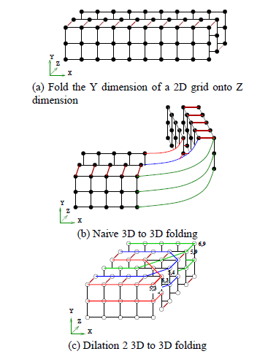
Folding of 2D/3D to 3D
For more objects than processors:
- Blocking Techniques
SMP nodes ?
Hao Yu, I-Hsin Chung and Jose Moreira, Topology Mapping for Blue Gene/L Supercomputer, In Proceedings of the ACM/IEEE Supercomputing Conference, 2006

Slide 58
Irregular Graphs
Heuristic Techniques
Pairwise Exchanges
Greedy Strategies

Slide 59
Automatic Mapping Framework
Obtain the communication graph (previous run, at runtime)
Pattern matching to identify communication patterns
Apply heuristic techniques for different scenarios to arrive at a mapping solution automatically

Slide 60
Summary
Scalable Load Balancing: Hierarchical
Machines of Petascale Era: ‘Exploitable’ Topologies
MPI Benchmarks show:
Contention for the same links by different messages slows all of them down
Topology aware mapping to avoid contention
Carefully see if application would benefit from this
Tools and Techniques
TopoMgrAPI
Obtaining the object graph: Instrumentation
Pattern Matching
Techniques: Folding, Heuristics

Slide 61
Summary
1. Topology is important again
2. Even on fast interconnects such as Cray
3. In presence of contention, bandwidth occupancy effects message
latencies significantly
4. Increases with the number of hops each message travels
5. Topology Manager API: A uniform API for IBM and Cray machines
6. Different algorithms depending on the communication patterns
7. Eventually, an automatic mapping framework

Slide 62
Acknowledgements: 1. Argonne National Laboratory: Pete Beckman, Tisha Stacey 2. Pittsburgh Supercomputing Center: Chad Vizino, Shawn Brown 3. Oak Ridge National Laboratory: Patrick Worley, Donald Frederick
4. Grants: DOE Grant B341494 funded by CSAR, DOE grant DE-FG05-08OR23332 through
ORNL LCF, and a NIH Grant PHS 5 P41 RR05969-04 for Molecular Dynamics
References:
1. Abhinav Bhatele, Laxmikant V. Kale, Quantifying Network Contention on Large Parallel Machines, Parallel Processing Letters (Special issue on Large-Scale Parallel Processing), 2009
2. Abhinav Bhatele, Laxmikant V. Kale, Benefits of Topology-aware Mapping for Mesh Topologies, Parallel Processing Letters (Special issue on Large-Scale Parallel Processing), Vol: 18 Issue:4, Pages: 549-566, 2008
E-mail: bhatele, kale @ illinois.edu
Webpage: http://charm.cs.illinois.edu

Slide 63
Thanks!

