Slide 1
A Case Study of Communication Optimizations on 3D Mesh Interconnects
Abhinav Bhatele, Eric Bohm, Laxmikant V. Kale
Parallel Programming Laboratory
Euro-Par 2009
University of Illinois at Urbana-Champaign

Slide 2
Outline
Motivation
Solution: Mapping of OpenAtom
Performance Benefits
Bigger Picture:
Resources Needed
Heuristic Solutions
Automatic Mapping

Slide 3
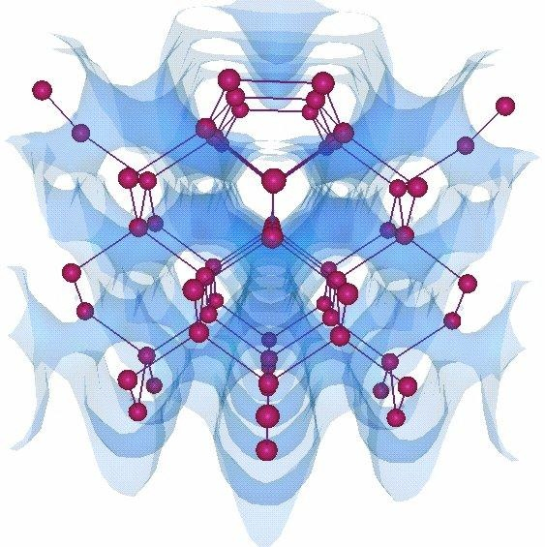
OpenAtom
Ab-Initio Molecular Dynamics code
Consider electrostatic interactions between the nuclei and electrons
Calculate different energy terms
Divided into different phases with lot of communication
Notes:
(1) quantum mechanical ki-
netic energy of non-interacting electrons, (2) Coulomb interaction between elec-
trons or the Hartree energy, (3) correction of the Hartree energy to account for
the quantum nature of the electrons or the exchange-correlation energy, and (4)
interaction of electrons with atoms in the system or the external energy.

Slide 4
OpenAtom on Blue Gene/L
w32 = 32 water molecules with 70 Ry cutoff
Runs on Blue Gene/L at IBM T J Watson Research Center, CO mode

Slide 5
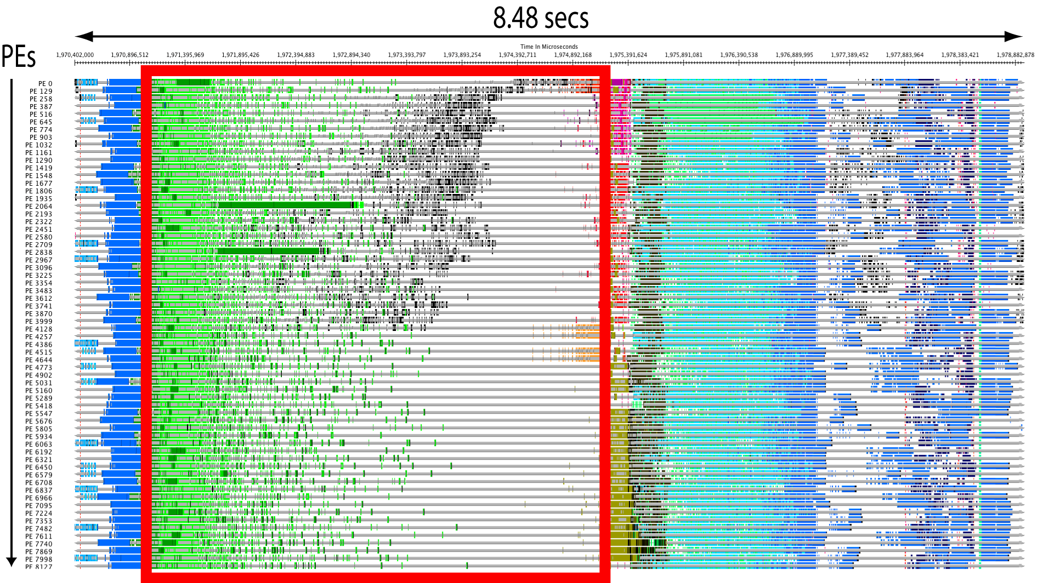
The problem lies in …
Performance Analysis and Visualization Tool: Projections (part of Charm++) – Timeline View

Slide 6
Solution –
Topology Aware Mapping

Slide 7
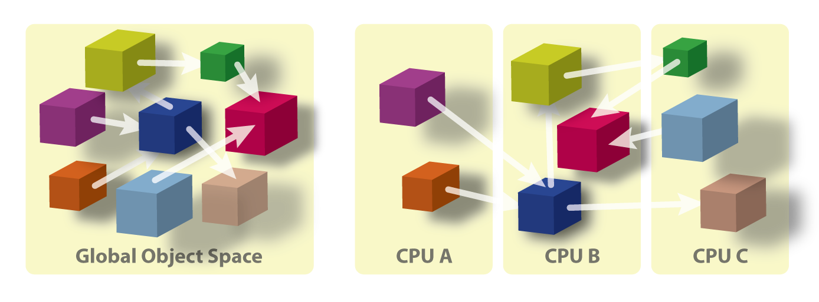
Processor Virtualization
Programmer: Decomposes the computation into objects
Runtime: Maps the computation on to the processors
User View
System View

Slide 8
Benefits of Charm++
Computation is divided into objects/chares/virtual processors (VPs)
Separates decomposition from mapping
VPs can be flexibly mapped to actual physical processors (PEs)

Slide 9
Topology Manager API†
The application needs information such as
Dimensions of the partition
Rank to physical co-ordinates and vice-versa
TopoManager: a uniform API
On BG/L and BG/P: provides a wrapper for system calls
On XT3/4/5, there are no such system calls
Provides a clean and uniform interface to the application
† http://charm.cs.uiuc.edu/~bhatele/phd/topomgr.htm
Notes:
This can be used by MPI Topology functions

Slide 10
Parallelization using Charm++
Eric Bohm, Glenn J. Martyna, Abhinav Bhatele, Sameer Kumar, Laxmikant V. Kale, John A. Gunnels, and Mark E. Tuckerman. Fine Grained Parallelization of the Car-Parrinello ab initio MD Method on Blue Gene/L. IBM J. of R. and D.: Applications of Massively Parallel Systems, 52(1/2):159-174, 2008.

Slide 11
Mapping Challenge
Load Balancing: Multiple VPs per PE
Multiple groups of communicating objects
Intra-group communication
Inter-group communication
Conflicting communication requirements

Slide 12
Topology Mapping of Chare Arrays
RealSpace and GSpace have state-wise
communication
Paircalculator and GSpace have plane-wise
communication

Slide 13
Performance Improvements on BG/L
w32 = 32 water molecules with 70 Ry cutoff
Runs on Blue Gene/L at IBM T J Watson Research Center, CO mode, Year: 2006

Slide 14
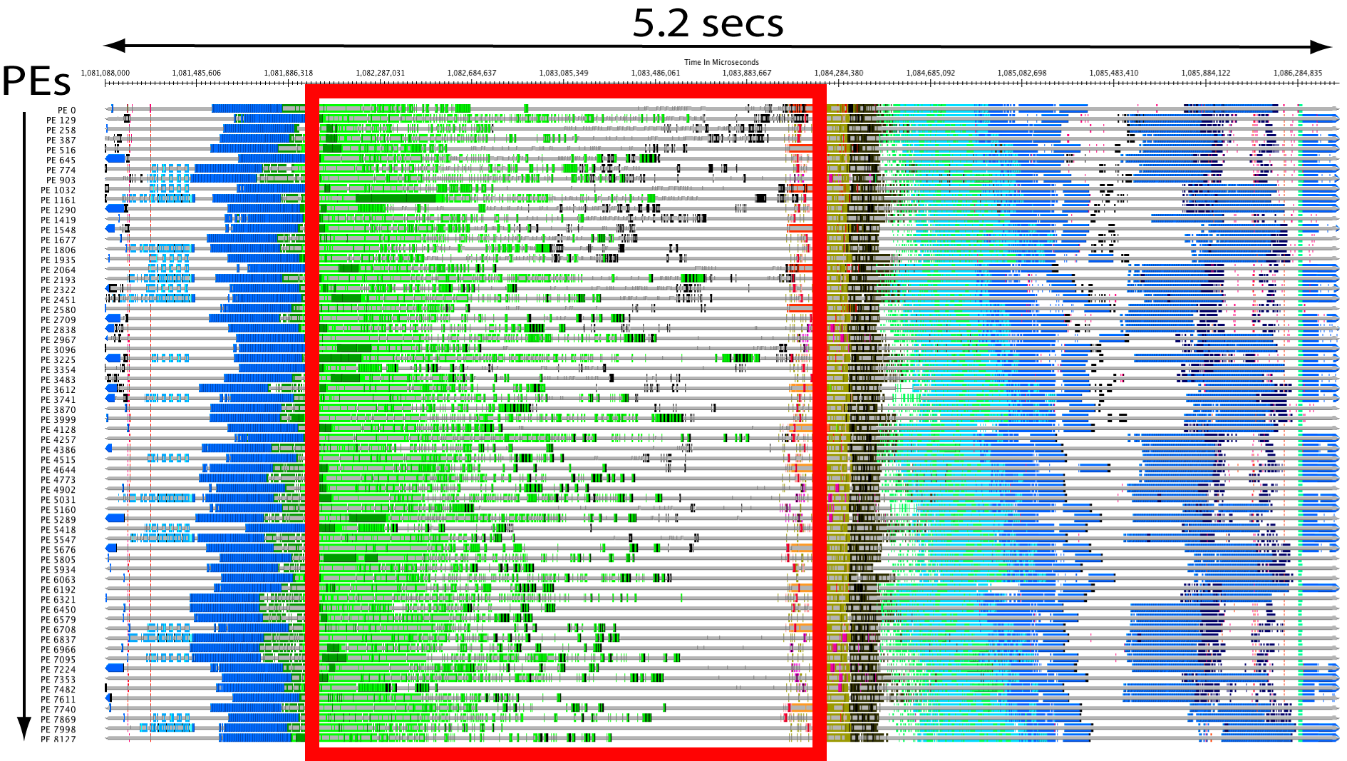
Improved Timeline Views

Slide 15
Results on Blue Gene/L
GST_BIG = 64 Ge, 128 Sb and 256 Te molecules with 20 Ry cutoff
Runs on Blue Gene/L at IBM T J Watson Research Center, CO mode

Slide 16
Results on Blue Gene/P
w256 = 256 water molecules with 70 Ry cutoff
Runs on Blue Gene/P at Argonne National Laboratory, VN mode

Slide 17
Results on Cray XT3
Runs on Cray XT3 (Bigben) at Pittsburgh Supercomputing Center, VN mode
(with system reservation to obtain complete 3d mesh shapes)

Slide 18
Performance Analysis
w256M_70Ry on Blue Gene/L
Performance Analysis and Visualization Tool: Projections – Idle time added across all processors

Slide 19
Reduction in Communication Volume
w256M_70Ry on Blue Gene/P
Data obtained from Blue Gene/P’s Uniform Performance Counters

Slide 20
Relative Performance Improvement
w256M_70Ry

Slide 21
Bigger picture
Different kinds of applications:
Computation bound
Communication bound
Latency tolerant
Latency sensitive
Technique:
Obtain processor topology and application communication graph
Heuristic Techniques for mapping

Slide 22
Why does distance affect message latencies?
Consider a 3D mesh/torus interconnect
Message latencies can be modeled by
(L_{f}/B) x D + L/B
L_{f} = length of flit, B = bandwidth,
D = hops, L = message size
When (L_{f} * D) << L, first term is negligible
But in presence of contention …

Slide 23
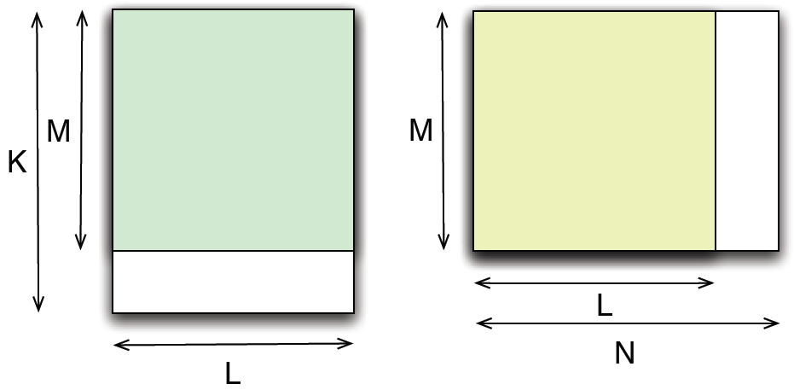
Automatic Topology Aware Mapping
Many MPI applications exhibit a simple two-dimensional near-neighbor communication pattern
Examples: MILC, WRF, POP, Stencil, …

Slide 24
DOE Grant B341494 (CSAR), DOE Grant DE-FG05-08OR23332 (ORNL LCF) and NSF Grant ITR 0121357
Acknowledgements:
Shawn Brown and Chad Vizino (PSC)
Glenn Martyna, Sameer Kumar, Fred Mintzer (IBM)
Teragrid for running time on Bigben (XT3)
ANL for running time on Blue Gene/P
E-mail: bhatele@illinois.edu
Webpage: http://charm.cs.illinois.edu
Funding

