Slide 1
Dynamic Topology Aware Load Balancing Algorithms for MD Applications
Abhinav Bhatele, Laxmikant V. Kale
University of Illinois at Urbana-Champaign
Sameer Kumar
IBM T. J. Watson Research Center
Notes:
NAMD, a MD application
Emergence of 3D Torus/Mesh architectures
Topology-aware techniques specific to such machines
Reduce contention for the same links and hence message latencies

Slide 2
Motivation: Contention Experiments
Bhatele, A., Kale, L. V. 2008 An Evaluation of the Effect of Interconnect Topologies on Message Latencies in Large Supercomputers. In Proceedings of Workshop on Large-Scale Parallel Processing (IPDPS), Rome, Italy, May 2009.

Slide 3
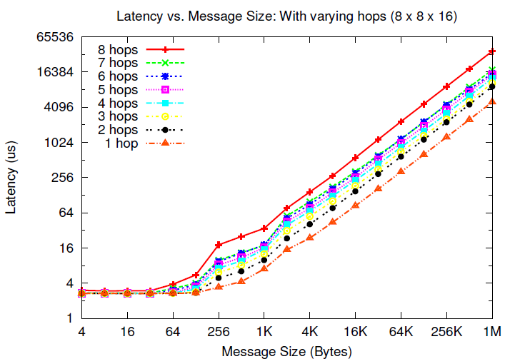
Results: Blue Gene/P
7.39 times
Notes:
1 to 2 – 1.84
1 to 3 – 2.11
1 to 4 - 2.55
1 to 7 – 3.54
1 to 8 – 7.396

Slide 4
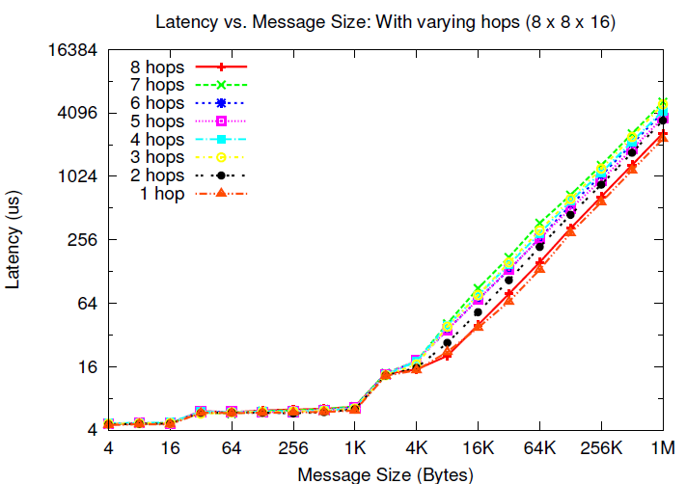
Results: Cray XT3
2.23 times

Slide 5
Molecular Dynamics
A system of [charged] atoms with bonds
Use Newtonian Mechanics to find the positions and velocities of atoms
Each time-step is typically in femto-seconds
At each time step
calculate the forces on all atoms
calculate the velocities and move atoms around
Notes:
Motivate why is it challenging to parallelize: Generally a few thousand atoms,
one time-step is a few seconds
This needs to be parallelized onto a large number of processors.
The no. of time-steps is large (million to billion) since interesting phenomena happens on the scale of ns or ms
1 fs = 10-15 secs

Slide 6
NAMD: NAnoscale Molecular Dynamics
Naïve force calculation is O(N²)
Reduced to O(N logN) by calculating
Bonded forces
Non-bonded: using a cutoff radius
Short-range: calculated every time step
Long-range: calculated every fourth time-step (PME)
Notes:
The Particle-Mesh Ewald algorithm is used, which transfers the electric charge of each atom to electric potential on a grid and uses a 3D FFT to calculate the influence of all
atoms on each atom.

Slide 7
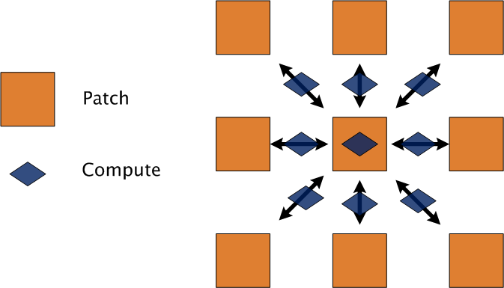
NAMD’s Parallel Design
Hybrid of spatial and force decomposition
Notes:
Patches are assigned statically
Computes are migratable (non-bonded ones) controlled by LDB
Comm to comp ratio is constant

Slide 8
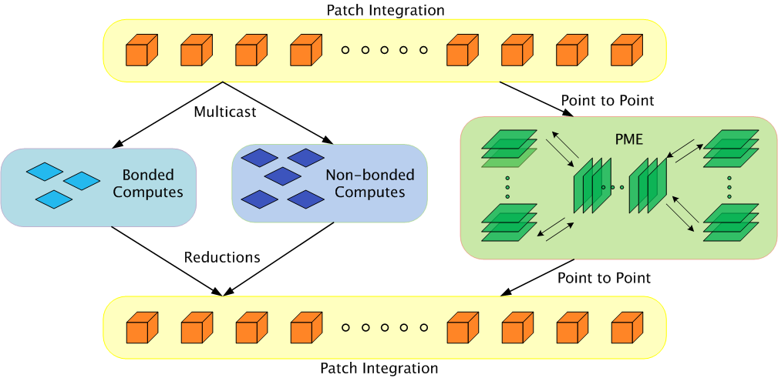
Parallelization using Charm++
Static Mapping
Load Balancing
Bhatele, A., Kumar, S., Mei, C., Phillips, J. C., Zheng, G. & Kale, L. V. 2008 Overcoming Scaling Challenges in Biomolecular Simulations across Multiple Platforms. In Proceedings of IEEE International Parallel and Distributed Processing Symposium, Miami, FL, USA, April 2008.

Slide 9
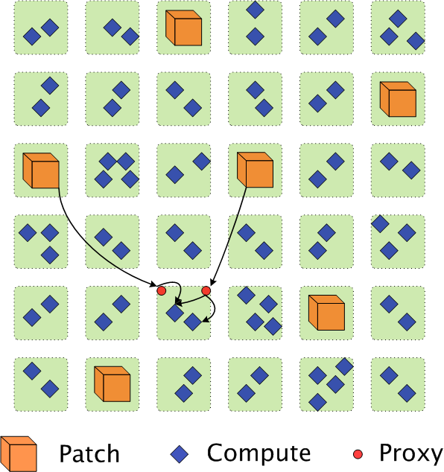
Communication in NAMD
Each patch multicasts its information to many computes
Each compute is a target of two multicasts only
Use ‘Proxies’ to send data to different computes on the same processor

Slide 10
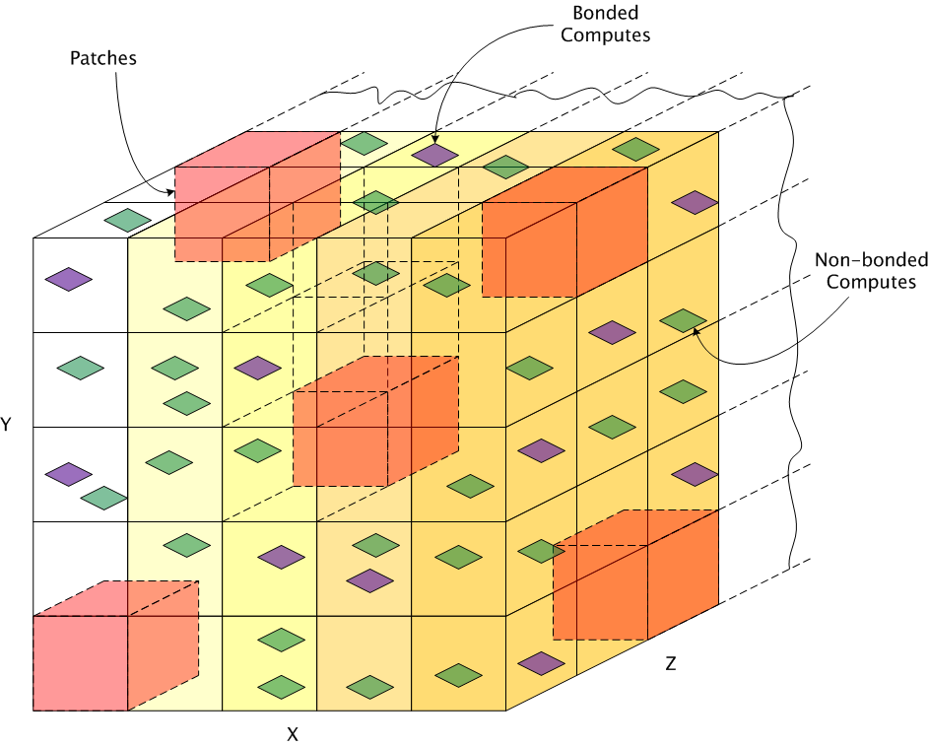
Topology Aware Techniques
Static Placement of Patches

Slide 11
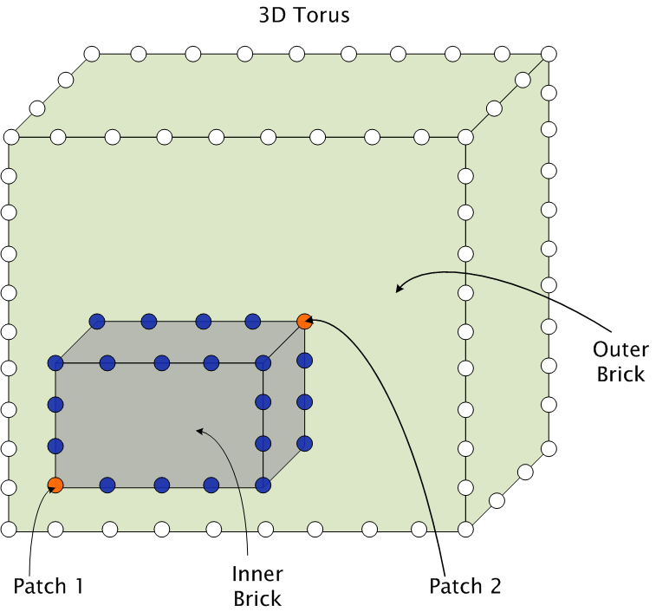
Topology Aware Techniques (contd.)
Placement of computes

Slide 12
Load Balancing in Charm++
Principle of Persistence
Object communication patterns and computational loads tend to persist over time
Measurement-based Load Balancing
Instrument computation time and communication volume at runtime
Use the database to make new load balancing decisions

Slide 13
NAMD’s Load Balancing Strategy
NAMD uses a dynamic centralized greedy strategy
There are two schemes in play:
A comprehensive strategy (called once)
A refinement scheme (called several times during a run)
Algorithm:
Pick a compute and find a “suitable” processor to place it on

Slide 14
Choice of a suitable processor
Among underloaded processors, try to:
Find a processor with the two patches or their proxies
Find a processor with one patch or a proxy
Pick any underloaded processor
Highest Priority
Lowest Priority
Notes:
Preference to load, then number of proxies

Slide 15
Load Balancing Metrics
Load Balance: Bring Max-to-Avg Ratio close to 1
Communication Volume: Minimize the number of proxies
Communication Traffic: Minimize hop bytes
Hop-bytes = ∑ Message size * Hops traveled by message
Agarwal, T., Sharma, A., Kale, L.V. 2008 Topology-aware task mapping for reducing communication contention on large parallel machines, In Proceedings of IEEE International Parallel and Distributed Processing Symposium, Rhodes Island, Greece, April 2006.

Slide 16
Results: Hop-bytes

Slide 17
Results: Performance

Slide 18
Results: Hop-bytes

Slide 19
Results: Performance

Slide 20
Ongoing Work
Observed that a simplified model was used for recording communication load
Addition of new proxies disturbs the actual load
Correction factor on addition/removal of proxies
Leads to improvements of ~10%

Slide 21
Future Work
SMP-aware techniques
Favor intra-node communication
A scalable distributed load balancing strategy
Generalized Scenario:
multicasts: each object is the target of multiple multicasts
use topological information to minimize communication
Understanding the effect of various factors on load balancing in detail

Slide 22
Thanks!
NAMD Development Team:
Parallel Programming Lab (PPL), UIUC – Abhinav Bhatele, David Kunzman, Chee Wai Lee, Chao Mei, Gengbin Zheng, Laxmikant V. Kale
Theoretical and Computational Biophysics Group (TCBG), UIUC – James C. Phillips, Klaus Schulten
IBM Research - Sameer Kumar
Acknowledgments:
Argonne National Laboratory, Pittsburgh Supercomputing Center (Shawn Brown, Chad Vizino, Brian Johanson), TeraGrid

