Slide 1


Object-based Over-Decomposition
Can Enable
Powerful Fault Tolerance Schemes
Laxmikant (Sanjay) Kale
http://charm.cs.uiuc.edu
Parallel Programming Laboratory
Department of Computer Science
University of Illinois at Urbana Champaign

Slide 2
Presentation Outline
5/5/2009
2
What is object based decomposition
  Its embodiment in Charm++ and AMPI
  Its general benefits
  Its features that are useful for fault tolerance schemes
Our Fault Tolerance work in Charm++ and AMPI
  Disk-based checkpoint/restart
  In-memory double checkpoint/restart
  Proactive object-migration
  Message-logging
Appeal for research in leveraging these features in FT research
Notes:
2

Slide 3
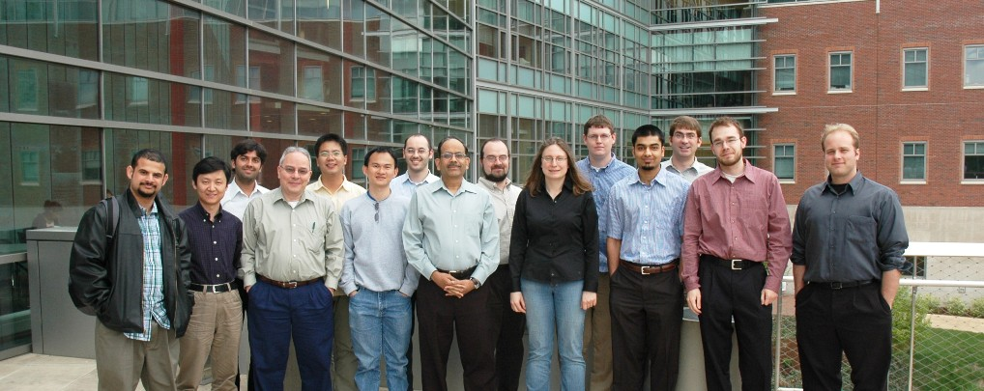
Parallel Programming Lab - PPL
PPL, April’2008
3
http://charm.cs.uiuc.edu
  Open positions ☺
Notes:
3

Slide 4
PPL Mission and Approach
To enhance Performance and Productivity in programming complex parallel applications
  Performance: scalable to thousands of processors
  Productivity: of human programmers
  Complex: irregular structure, dynamic variations
Application-oriented yet CS-centered research
  Develop enabling technology, for a wide collection of apps.
  Embody it into easy to use abstractions
  Implementation: Charm++
    Object-oriented runtime infrastructure
    Freely available for non-commercial use
Notes:
4

Slide 5
Our Guiding Principles
L. V. Kale, "Application Oriented and Computer Science Centered HPCC Research", Developing a Computer Science Agenda for High-Performance Computing, New York, NY, USA, 1994, Publ: ACM Press, pp. 98-105.
5/4/2009
5
No magic
  Parallelizing compilers have achievedd close to technical perfection, but are not enough
  Sequential programs obscure too much information
Seek an optimal division of labor between the system and the programmer
Design abstractions based solidly on use-cases
  Application-oriented yet computer-science centered approach
Notes:
5

Slide 6
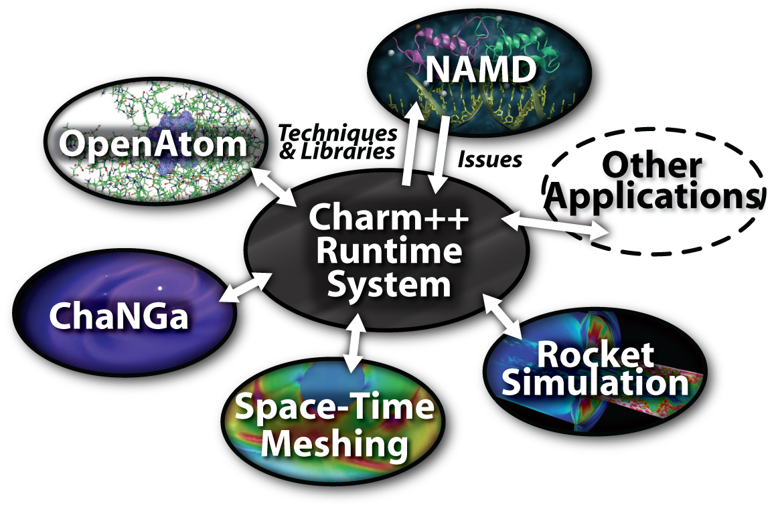
Charm++ and CSE Applications
Well-known Biophysics molecular simulations App
Gordon Bell Award, 2002
Nano-Materials..
Synergy
Enabling CS technology of parallel objects and intelligent runtime systems has led to several CSE collaborative applications
Computational Astronomy

Slide 7
Object based over-decomposition
Objects:
  Locality of data references is a critical attribute for performance
  A parallel object can access only its own data
  Asynchronous method invocation for accessing other’s data
Over-Decompostion
  the programmer decompose computation into objects
    Work units, data-units, composites
  Let an intelligent runtime system assign objects to processors
  RTS can change this assignment (mapping) during execution

Slide 8
Object-based over-decomposition: Charm++
Multiple “indexed collections” of C++ objects
Indices can be multi-dimensional and/or sparse
Programmer expresses communication between objects
  with no reference to processors
System implementation
User View

Slide 9
Object-based over-decomposition: AMPI
Each MPI process is implemented as a user-level thread
Threads are light-weight, and migratable!
  <1 microsecond contex tswitch time, potentially >100k threads per core
Each thread is embedded in a charm+ object (chare)
MPI processes
Virtual Processors (user-level migratable threads)
Real Processors

Slide 10
Benefits of Object-based overdecomposition
Software engineering
  Number of virtual processors can be independently controlled
  Separate VPs for different modules
Message driven execution
  Adaptive overlap of communication
  Predictability :
    Automatic out-of-core
    Prefetch to local stores
  Asynchronous reductions
Dynamic mapping
  Heterogeneous clusters
    Vacate, adjust to speed, share
  Automatic checkpointing, more advanced Fault Tolerance schemes
  Change set of processors used
  Automatic dynamic load balancing
  Communication optimization

Slide 11
Some Relevant Properties of this approach:
Message Driven Execution
Object-based Virtualization leads to Message Driven Execution
Scheduler
Scheduler
Message Q
Message Q

Slide 12
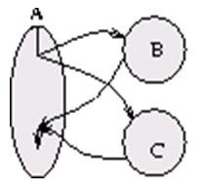
Some Relevant Properties of this approach:
Parallel Composition:
A1; (B || C ); A2
  Recall: Different modules, written in different languages/paradigms, can overlap in time and on processors, without programmer having to worry about this explicitly

Slide 13
Without message-driven execution (and virtualization), you get either:
Space-division

Slide 14
OR: Sequentialization

Slide 15
Charm++/AMPI are well established systems
The Charm++ model has succeeded in CSE/HPC
Because:
  Resource management, …
15% of cycles at NCSA, 20% at PSC, were used on Charm++ apps, in a one year period
So, work on fault tolerance for Charm++ and AMPI is directly useful to real apps

Slide 16
Fault Tolerance in Charm++ & AMPI
Four Approaches Available:
  Disk-based checkpoint/restart
  In-memory double checkpoint/restart
  Proactive object migration
  Message-logging
Common Features:
  Based on dynamic runtime capabilities
  Use of object-migration
  Can be used in concert with load-balancing schemes
Notes:
16

Slide 17
Disk-Based Checkpoint/Restart
Basic Idea:
  Similar to traditional checkpoint/restart; “migration” to disk
Implementation in Charm++/AMPI:
  Blocking coordinated checkpoint: MPI_Checkpoint(DIRNAME)
Pros:
  Simple scheme, effective for common cases
  Virtualization enables restart with any number of processors
Cons:
  Checkpointing and data reload operations may be slow
  Work between last checkpoint and failure is lost
  Job needs to be resubmitted and restarted
Notes:
17

Slide 18
In-Memory Double Checkpoint/Restart
Basic Idea:
  Avoid overhead of disk access for keeping saved data
  Allow user to define what makes up the state data
Implementation in Charm++/AMPI:
  Coordinated checkpoint
  Each object maintains two checkpoints:
    on local processor’s memory
    on remote buddy processor’s memory
  A dummy process is created to replace crashed process
  New process starts recovery on other processors
    use buddy’s checkpoint to recreate state of failing processor
    perform load balance after restart
Notes:
18

Slide 19
In-Memory Double Checkpoint/Restart (cont.)
Evaluation of Checkpointing Overhead:
  3D-Jacobi code in AMPI, 200 MB data, IA-32 cluster
  Execution of 100 iterations, 8 checkpoints taken
19
Notes:
19

Slide 20
In-Memory Double Checkpoint/Restart (cont.)
Comparison to disk-based checkpointing:
Notes:
20

Slide 21
In-Memory Double Checkpoint/Restart (cont.)
Recovery Performance:
  Molecular Dynamics LeanMD code, 92K atoms, P=128
  Load Balancing (LB) effect after failure:
Notes:
21

Slide 22
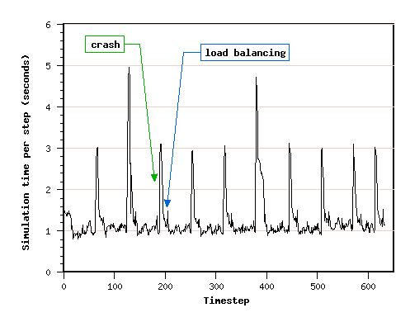
In-Memory Double Checkpoint/Restart (cont.)
Application Performance:
  Molecular Dynamics LeanMD code, 92K atoms, P=128
  Checkpointing every 10 timesteps; 10 crashes inserted:
Notes:
22

Slide 23
In-Memory Double Checkpoint/Restart (cont.)
Pros:
  Faster checkpointing than disk-based
  Reading of saved data also faster
  Only one processor fetches checkpoint across network
Cons:
  Memory overhead may be high
  All processors are rolled back, despite individual failure
  All the work since last checkpoint is redone by every processor
Publications:
  Zheng, Huang & Kale: ACM-SIGOPS, April 2006
  Zheng, Shi & Kale: IEEE-Cluster’2004, Sep.2004
Notes:
23

Slide 24
Proactive Object Migration
Basic Idea:
  Use knowledge about impending faults
  Migrate objects away from processors that may fail soon
  Fall back to checkpoint/restart when faults not predicted
Implementation in Charm++/AMPI:
  Each object has a unique index
  Each object is mapped to a home processor
    objects need not reside on home processor
    home processor knows how to reach the object
  Upon getting a warning, evacuate the processor
    reassign mapping of objects to new home processors
    send objects away, to their home processors
Notes:
24

Slide 25
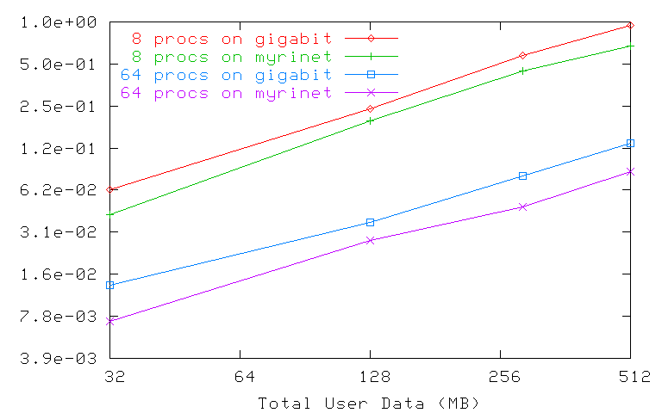
Proactive Object Migration (cont.)
Evacuation time as a function of data size:
  5-point stencil code in Charm++, IA-32 cluster
Notes:
25

Slide 26
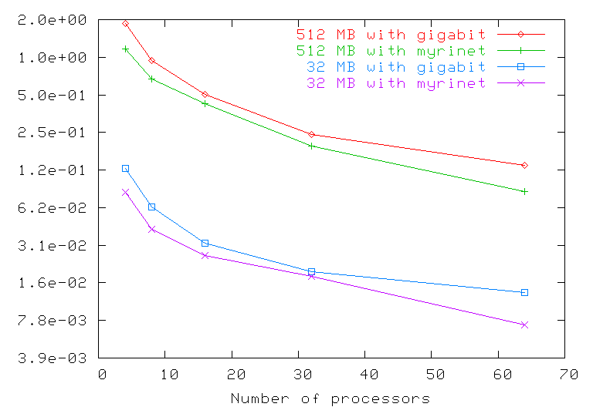
Proactive Object Migration (cont.)
Evacuation time as a function of #processors:
  5-point stencil code in Charm++, IA-32 cluster
Notes:
26

Slide 27
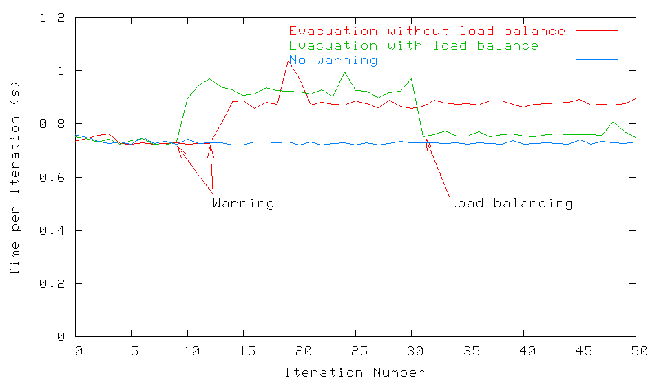
Proactive Object Migration (cont.)
Performance of an MPI application
  Sweep3d code, 150x150x150 dataset, P=32, 1 warning
  5-point stencil code in Charm++, IA-32 cluster
Notes:
27

Slide 28
Proactive Object Migration (cont.)
Pros:
  No overhead in fault-free scenario
  Evacuation time scales well, only depends on data and network
  No need to roll back when predicted fault happens
Cons:
  Effectiveness depends on fault predictability mechanism
  Some faults may happen without advance warning
Publications:
  Chakravorty, Mendes & Kale: HiPC, Dec.2006
  Chakravorty, Mendes, Kale et al: ACM-SIGOPS, April 2006
Notes:
28

Slide 29
Message-Logging
Basic Idea:
  Messages are stored by sender during execution
  Periodic checkpoints still maintained
  After a crash, reprocess “recent” messages to regain state
Implementation in Charm++/AMPI:
  Since the state depends on the order of messages received, the protocol ensures that the new receptions occur in the same order
  Upon failure, roll back is “localized” around failing point: no need to roll back all the processors!
  With virtualization, work in one processor is divided across multiple virtual processors; thus, restart can be parallelized
  Virtualization helps fault-free case as well
Notes:
29

Slide 30
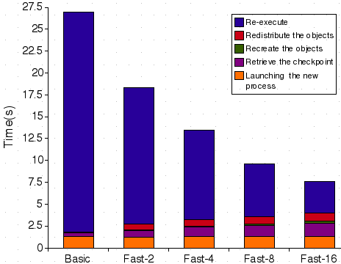
Message-Logging (cont.)
Fast restart performance:
  Test: 7-point 3D-stencil in MPI, P=32, 2 ≤ VP ≤ 16
  Checkpoint taken every 30s, failure inserted at t=27s
30
Notes:
30

Slide 31
Power
Normal Checkpoint-Resart method
Progress is slowed down with failures
Power consumption is continuous
Progress
Time

Slide 32
Our Checkpoint-Resart method
(Message logging + Object-based virtualization)
Progress is faster with failures
Power consumption is lower during recovery

Slide 33
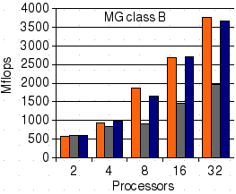
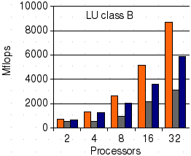
Message-Logging (cont.)
Fault-free performance:
  Test: NAS benchmarks, MG/LU
  Versions: AMPI, AMPI+FT, AMPI+FT+multipleVPs
33
Notes:
33

Slide 34
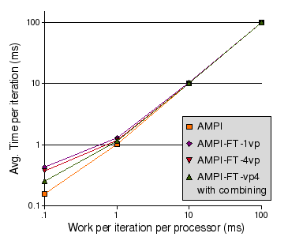
Message-Logging (cont.)
Protocol Optimization:
  Combine protocol messages: reduces overhead and contention
  Test: synthetic compute/communicate benchmark
34
Notes:
34

Slide 35
Message-Logging (cont.)
Pros:
  No need to roll back non-failing processors
  Restart can be accelerated by spreading work to be redone
  No need of stable storage
Cons:
  Protocol overhead is present even in fault-free scenario
  Increase in latency may be an issue for fine-grained applications
Publications:
  Chakravorty: UIUC PhD Thesis, Dec.2007
  Chakravorty & Kale: IPDPS, April 2007
  Chakravorty & Kale: FTPDS workshop at IPDPS, April 2004
Notes:
35

Slide 36
Current PPL Research Directions
Message-Logging Scheme
  Decrease latency overhead in protocol
  Decrease memory overhead for checkpoints
  Stronger coupling to load-balancing
  Newer schemes to reduce message-logging overhead
Notes:
36

Slide 37
But we are not experts in FT
The message-driven objects model provides many benefits for fault tolerance schemes
  Not just our schemes, but your schemes too
  Multiple objects per processor:
    latencies of protocols can be hidden
  Parallel recovery by leveraging “multiple objects per processor”
  Can combine benefits by using system level or BLCR schemes specialized to take advantage of objects (or user-level threads)
  I am sure you can think of many new schemes
We are willing to help
  (without needing to be co-authors)
  E.g. a simplified version of Charm RTS for you to use?

Slide 38
Messages
We have an interesting fault tolerance schemes
  Read about them
We have an approach to parallel programming
  That has benefits in the era of complex machines, and sophisticated applications
  That is used by real apps
  That provides beneficial features for FT schemes
  That is available via the web
  SO: please think about developing new FT schemes of your own for this model
More info, papers, software: http://charm.cs.uiuc.edu
And please pass the word on: we are hiring

Slide 39
PPL Funding Sources
National Science Foundation
  BigSim, Cosmology, Languages
Dep. of Energy
  Charm++ (Load-Balance, Fault-Tolerance), Quantum Chemistry
National Institutes of Health
  NAMD
NCSA/NSF, NCSA/IACAT
  Blue Waters project (Charm++, BigSim, NAMD), Applications
Dep. of Energy / UIUC Rocket Center
  AMPI, Applications
NASA
  Cosmology/Visualization
Notes:
39

