Slide 1
Effects of contention on message latencies in large supercomputers
IS TOPOLOGY IMPORTANT AGAIN?
Abhinav S Bhatele and Laxmikant V Kale
Parallel Programming Laboratory, UIUC
E-mail: bhatele, kale @ illinois.edu
Webpage: http://charm.cs.uiuc.edu

Slide 2
Outline
Why should we consider topology aware mapping
for optimizing performance?
Demonstrate the effects of contention on
message latencies through simple MPI benchmarks
Case Study: OpenAtom

Slide 3
The Mapping Problem
Given a set of communicating parallel “entities”, map them onto physical processors
Entities
COMM_WORLD ranks in case of an MPI program
Objects in case of a Charm++ program
Aim
Balance load
Minimize communication traffic

Slide 4
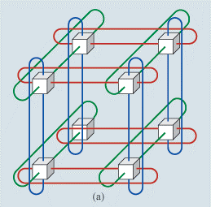
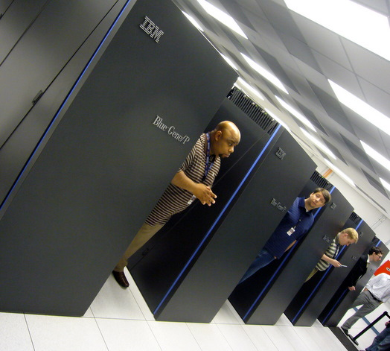
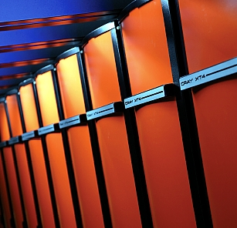
Target Machines
3D torus/mesh interconnects
Blue Gene/P at ANL:
40,960 nodes, torus - 32 x 32 x 40
XT4 (Jaguar) at ORNL:
8,064 nodes, torus - 21 x 16 x 24
Other interconnects
Fat-tree

Slide 5
Motivation
Consider a 3D mesh/torus interconnect
Message latencies can be modeled by
(L_{f}/B) x D + L/B
L_{f} = length of flit, B = bandwidth,
D = hops, L = message size
When (L_{f} * D) << L, first term is negligible
But in presence of contention …

Slide 6
MPI Benchmarks†
Quantification of message latencies and dependence on hops
No sharing of links (no contention)
Sharing of links (with contention)
† http://charm.cs.uiuc.edu/~bhatele/phd/contention.htm

Slide 7
WOCON: No contention
A master rank sends messages to all other ranks, one at a time (with replies)

Slide 8
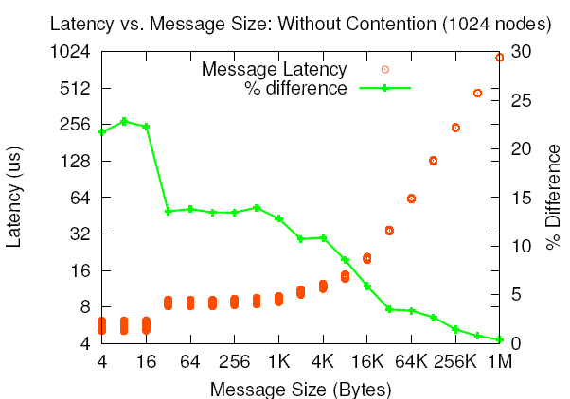
WOCON: Results
(L_{f}/B) x D + L/B
ANL Blue Gene/P
PSC XT3

Slide 9
WICON: With Contention
Divide all ranks into pairs and everyone sends to their respective partner simultaneously
Near Neighbor: NN
Random: RND

Slide 10
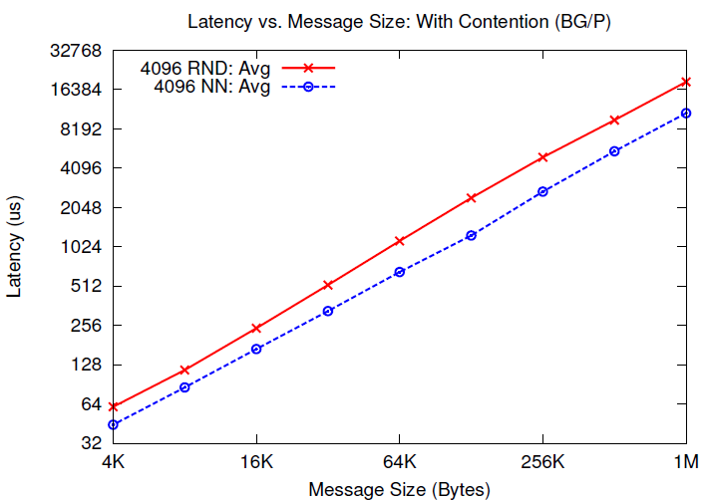
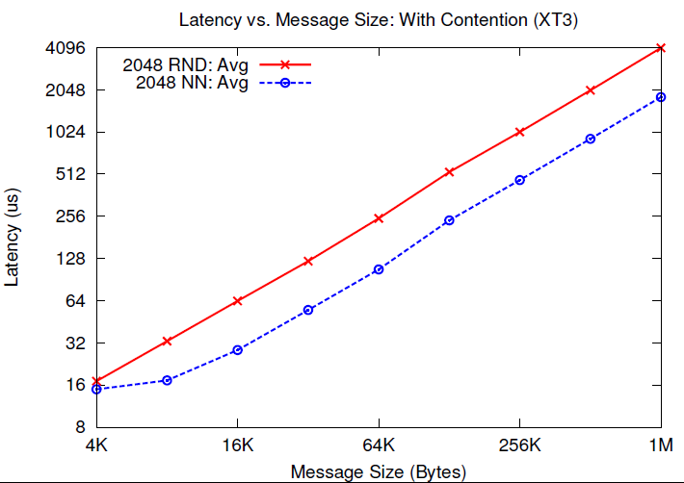
WICON: Results
ANL Blue Gene/P
PSC XT3
Notes:
BG/P = 1.737 times
XT3 = 2.24 times

Slide 11
WICON2: Controlled Contention
Pair each rank with a partner which is ‘n’ hops away

Slide 13
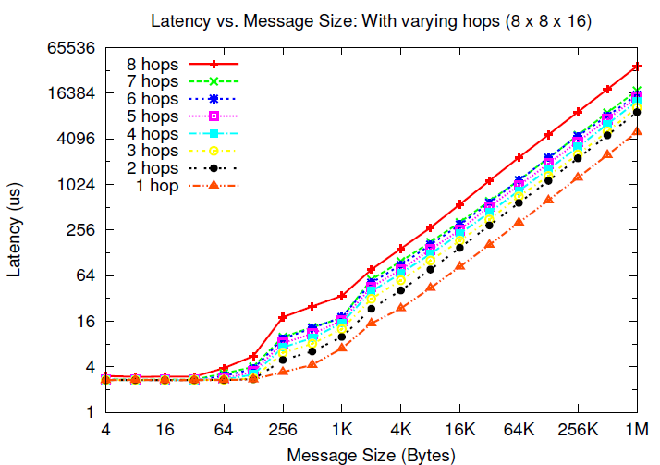
WICON2: Blue Gene/P
7.39 times
Notes:
1 to 2 – 1.84
1 to 3 – 2.11
1 to 4 - 2.55
1 to 7 – 3.54
1 to 8 – 7.396

Slide 14
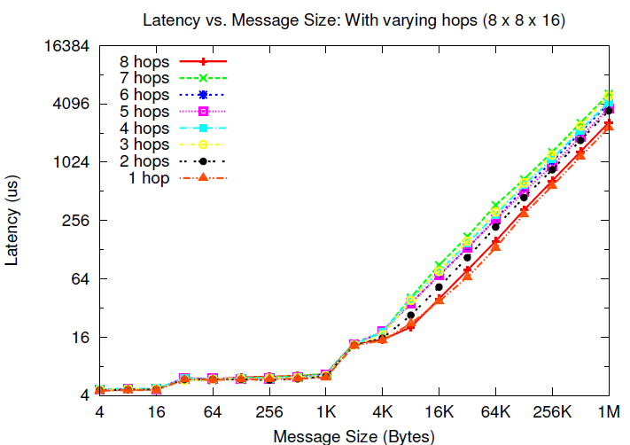
WICON2: Cray XT3
2.23 times

Slide 15
More tests …

Slide 16
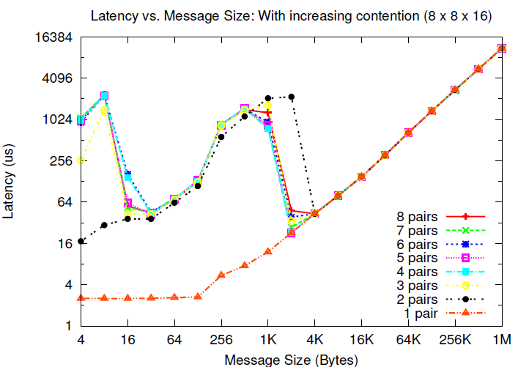
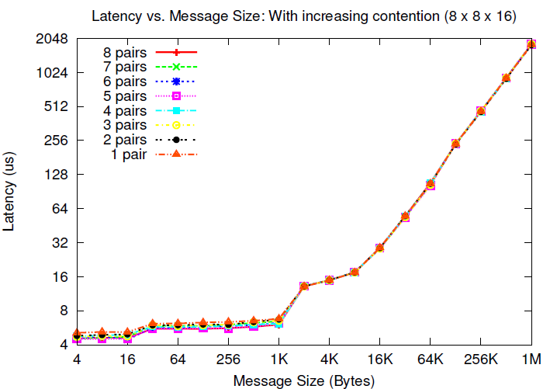
ANL Blue Gene/P
PSC XT3

Slide 17
More tests …

Slide 18
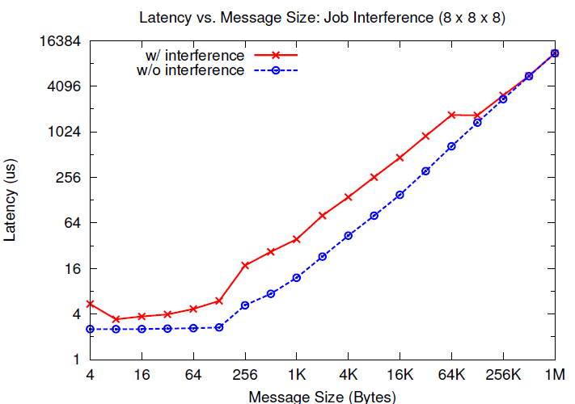
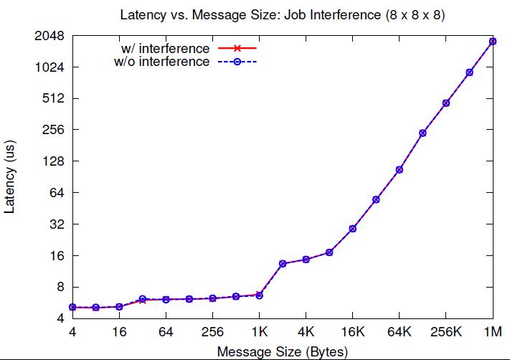
ANL Blue Gene/P
PSC XT3

Slide 19
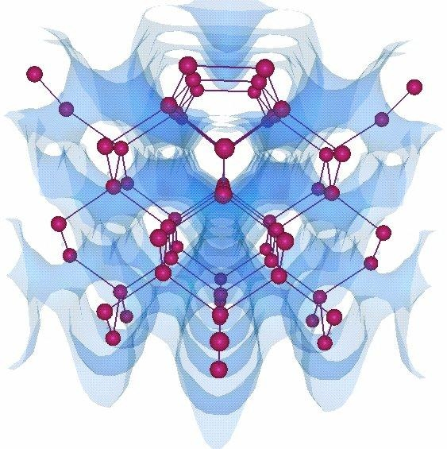
OpenAtom
Ab-Initio Molecular Dynamics code
Communication is static and structured
Challenge: Multiple groups of objects with conflicting communication patterns

Slide 20
Parallelization using Charm++
[10] Eric Bohm, Glenn J. Martyna, Abhinav Bhatele, Sameer Kumar, Laxmikant V. Kale, John A. Gunnels, and Mark E. Tuckerman. Fine Grained Parallelization of the Car-Parrinello ab initio MD Method on Blue Gene/L. IBM J. of R. and D.: Applications of Massively Parallel Systems, 52(1/2):159-174, 2008.

Slide 21
Topology Mapping of Chare Arrays
Plane-wise
communication
State-wise
communication
Joint work with Eric J. Bohm

Slide 22
Results on Blue Gene/P (ANL)

Slide 23
Results on XT3 (BigBen@PSC)

Slide 24
Summary
1. Topology is important again
2. Even on fast interconnects such as Cray
3. In presence of contention, bandwidth occupancy effects message
latencies significantly
4. Increases with the number of hops each message travels
5. Topology Manager API: A uniform API for IBM and Cray machines
6. Case Studies: OpenAtom, NAMD, Stencil
7. Eventually, an automatic mapping framework

Slide 25
Acknowledgements: 1. Argonne National Laboratory: Pete Beckman, Tisha Stacey 2. Pittsburgh Supercomputing Center: Chad Vizino, Shawn Brown 3. Oak Ridge National Laboratory: Patrick Worley, Donald Frederick 4. IBM: Robert Walkup, Sameer Kumar 5. Cray: Larry Kaplan 6. Matt Reilly
References:
1. Abhinav Bhatele, Laxmikant V. Kale, Dynamic Topology Aware Load Balancing Algorithms for MD Applications, To appear in Proceedings of International Conference on Supercomputing (ICS), 2009
2. Abhinav Bhatele, Eric Bohm, Laxmikant V. Kale, A Case Study of Communication Optimizations on 3D Mesh Interconnects, To appear in Proceedings of Euro-Par, 2009
3. Abhinav Bhatele, Laxmikant V. Kale, Benefits of Topology-aware Mapping for Mesh Topologies, Parallel Processing Letters (Special issue on Large-Scale Parallel Processing), Vol: 18 Issue:4, Pages: 549-566, 2008
E-mail: bhatele, kale @ illinois.edu
Webpage: http://charm.cs.uiuc.edu

