Slide 1
Effects of Contention on Message Latencies in Large Supercomputers
IS TOPOLOGY IMPORTANT AGAIN?
Abhinav S Bhatele and Laxmikant V Kale
ACM Research Competition, SC ‘08

Slide 2
Outline
Why should we consider topology aware mapping
for optimizing performance?
Demonstrate the effects of contention on
message latencies through simple MPI benchmarks
Obtaining topology information: TopoManager API
Case Study: OpenAtom

Slide 3
The Mapping Problem
Given a set of communicating parallel “entities”, map them onto physical processors
Entities
COMM_WORLD ranks in case of an MPI program
Objects in case of a Charm++ program
Aim
Balance load
Minimize communication traffic

Slide 4
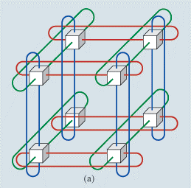
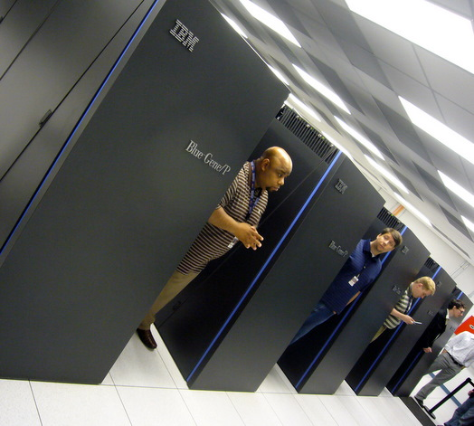
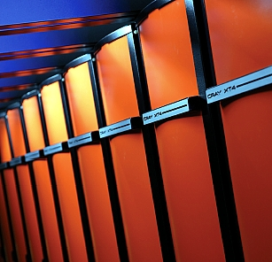
Target Machines
3D torus/mesh interconnects
Blue Gene/P at ANL:
40,960 nodes, torus - 32 x 32 x 40
XT4 (Jaguar) at ORNL:
8,064 nodes, torus - 21 x 16 x 24
Other interconnects
Fat-tree
Kautz graph: SiCortex

Slide 5
Motivation
Consider a 3D mesh/torus interconnect
Message latencies can be modeled by
(L_{f}/B) x D + L/B
L_{f} = length of flit, B = bandwidth,
D = hops, L = message size
When (L_{f} * D) << L, first term is negligible
But in presence of contention …

Slide 6
MPI Benchmarks†
Quantification of message latencies and dependence on hops
No sharing of links (no contention)
Sharing of links (with contention)
† http://charm.cs.uiuc.edu/~bhatele/phd/contention.htm

Slide 7
WOCON: No contention
A master rank sends messages to all other ranks, one at a time (with replies)

Slide 8
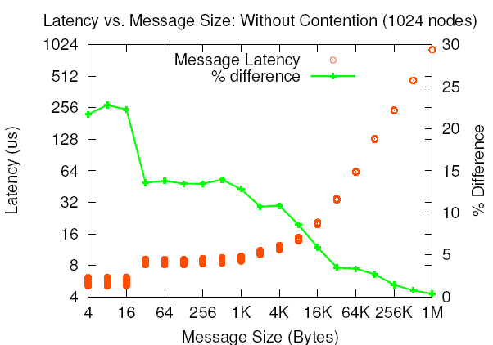
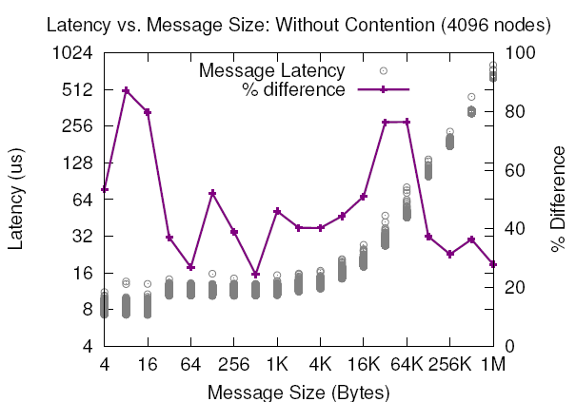
WOCON: Results
(L_{f}/B) x D + L/B
ANL Blue Gene/P
PSC XT3
ORNL XT4

Slide 9
WICON: With Contention
Divide all ranks into pairs and everyone sends to their respective partner simultaneously
Near Neighbor: NN
Random: RND

Slide 10
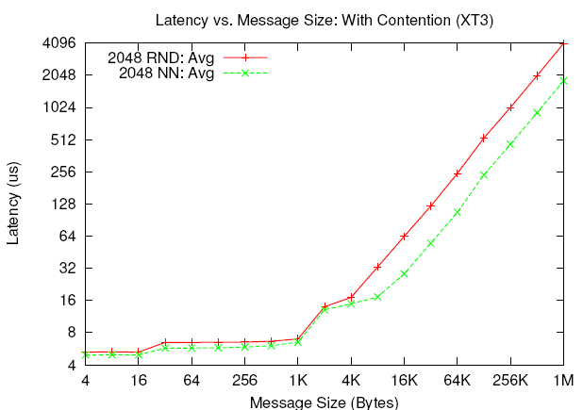
WICON: Results
ANL Blue Gene/P
PSC XT3
Notes:
BG/P = 1.737 times
XT3 = 2.24 times

Slide 11
Message Latencies and Hops
Pair each rank with a partner which is ‘n’ hops away

Slide 13
Results
8 times
Notes:
1 to 2 – 1.84
1 to 3 – 2.11
1 to 4 - 2.55
1 to 7 – 3.54
1 to 8 – 7.396

Slide 14
Notes:
Peak bandwidth of each link = 425 MB/s unidirectional

Slide 15
Difference from previous work
Then | Now
Mainly for theoretical object graphs on hypercubes, shuffle exchange and other theoretical networks | Object graphs from real applications on 3D torus/mesh topologies
Most techniques were used offline – slow | Fast, runtime solutions
Demonstrated on graphs with 10-100 nodes | Scalable techniques for large machines
No cardinality variation | Multiple objects per processor
Not tested with real applications on actual machines – theoretical work | Targeted at production codes – tested with real applications

Slide 16
Difference from recent work
[5] G. Bhanot, A. Gara, P. Heidelberger, E. Lawless, J. C. Sexton, and R. Walkup. Optimizing task layout on the Blue Gene/L supercomputer. IBM Journal of Research and Development, 49(2/3), 2005.
Use of simulated annealing – slow and solution is developed offline
[6] Hao Yu, I-Hsin Chung, and Jose Moreira. Topology mapping for Blue Gene/L supercomputer. In SC '06: Proceedings of the 2006 ACM/IEEE conference on Supercomputing, page 116, New York, NY, USA, 2006. ACM
Node mappings for simple scenarios (1D rings, 2D meshes, 3D)
Only useful in case of simple near-neighbor communication

Slide 17
Topology Manager API†
The application needs information such as
Dimensions of the partition
Rank to physical co-ordinates and vice-versa
TopoManager: a uniform API
On BG/L and BG/P: provides a wrapper for system calls
On XT3 and XT4, there are no such system calls
Help from PSC and ORNL staff to discovery topology at runtime
Provides a clean and uniform interface to the application
† http://charm.cs.uiuc.edu/~bhatele/phd/topomgr.htm
Notes:
This can be used by MPI Topology functions

Slide 18
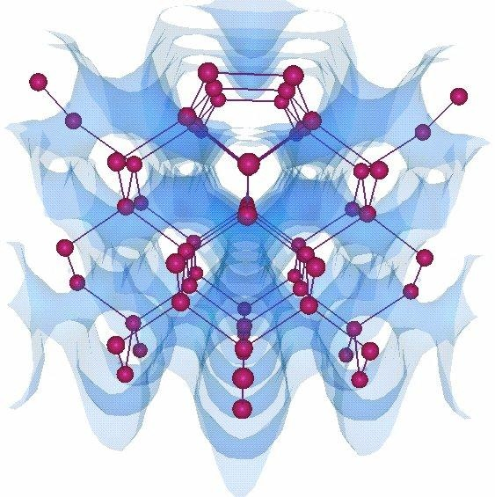
OpenAtom
Ab-Initio Molecular Dynamics code
Communication is static and structured
Challenge: Multiple groups of objects with conflicting communication patterns

Slide 19
Parallelization using Charm++
[10] Eric Bohm, Glenn J. Martyna, Abhinav Bhatele, Sameer Kumar, Laxmikant V. Kale, John A. Gunnels, and Mark E. Tuckerman. Fine Grained Parallelization of the Car-Parrinello ab initio MD Method on Blue Gene/L. IBM J. of R. and D.: Applications of Massively Parallel Systems, 52(1/2):159-174, 2008.

Slide 20
PairCalculator
GSpace
RealSpace
States
Planes
Planes
States
Planes

Slide 21
Topology Mapping of Chare Arrays
State-wise
communication
Plane-wise
communication
Joint work with Eric J. Bohm

Slide 22
Results on Blue Gene/P (ANL)

Slide 23
Results on XT3 (BigBen)

Slide 24
Summary
Topology is important again
Even on fast interconnects such as Cray
In presence of contention, bandwidth occupancy effects message latencies significantly
Increases with the number of hops each message travels
Topology Manager API: A uniform API for IBM and Cray machines
Case Studies: OpenAtom, NAMD, Stencil
Eventually, an automatic mapping framework

Slide 25
Acknowledgements: 1. Argonne National Lab: Pete Beckman, Tisha Stacey 2. Pittsburgh Supercomputing Center: Chad Vizino, Shawn Brown 3. Oak Ridge National Laboratory: Patrick Worley, Donald Frederick 4. IBM: Robert Walkup, Sameer Kumar 5. Cray: Larry Kaplan 6. SiCortex: Matt Reilly
References: 1. Abhinav Bhatele, Laxmikant V. Kale, Dynamic Topology Aware Load Balancing Algorithms for MD Applications, submitted to Philosophical Transactions of the Royal Society A, 2008
2. Abhinav Bhatele, Laxmikant V. Kale, Benefits of Topology-aware Mapping for Mesh Topologies, LSPP special issue of Parallel Processing Letters, 2008
3. Abhinav Bhatele, Laxmikant V. Kale, Application-specific Topology-aware Mapping for Three Dimensional Topologies, Proceedings of Workshop on Large-Scale Parallel Processing (held as part of IPDPS '08), 2008

